Slide 1


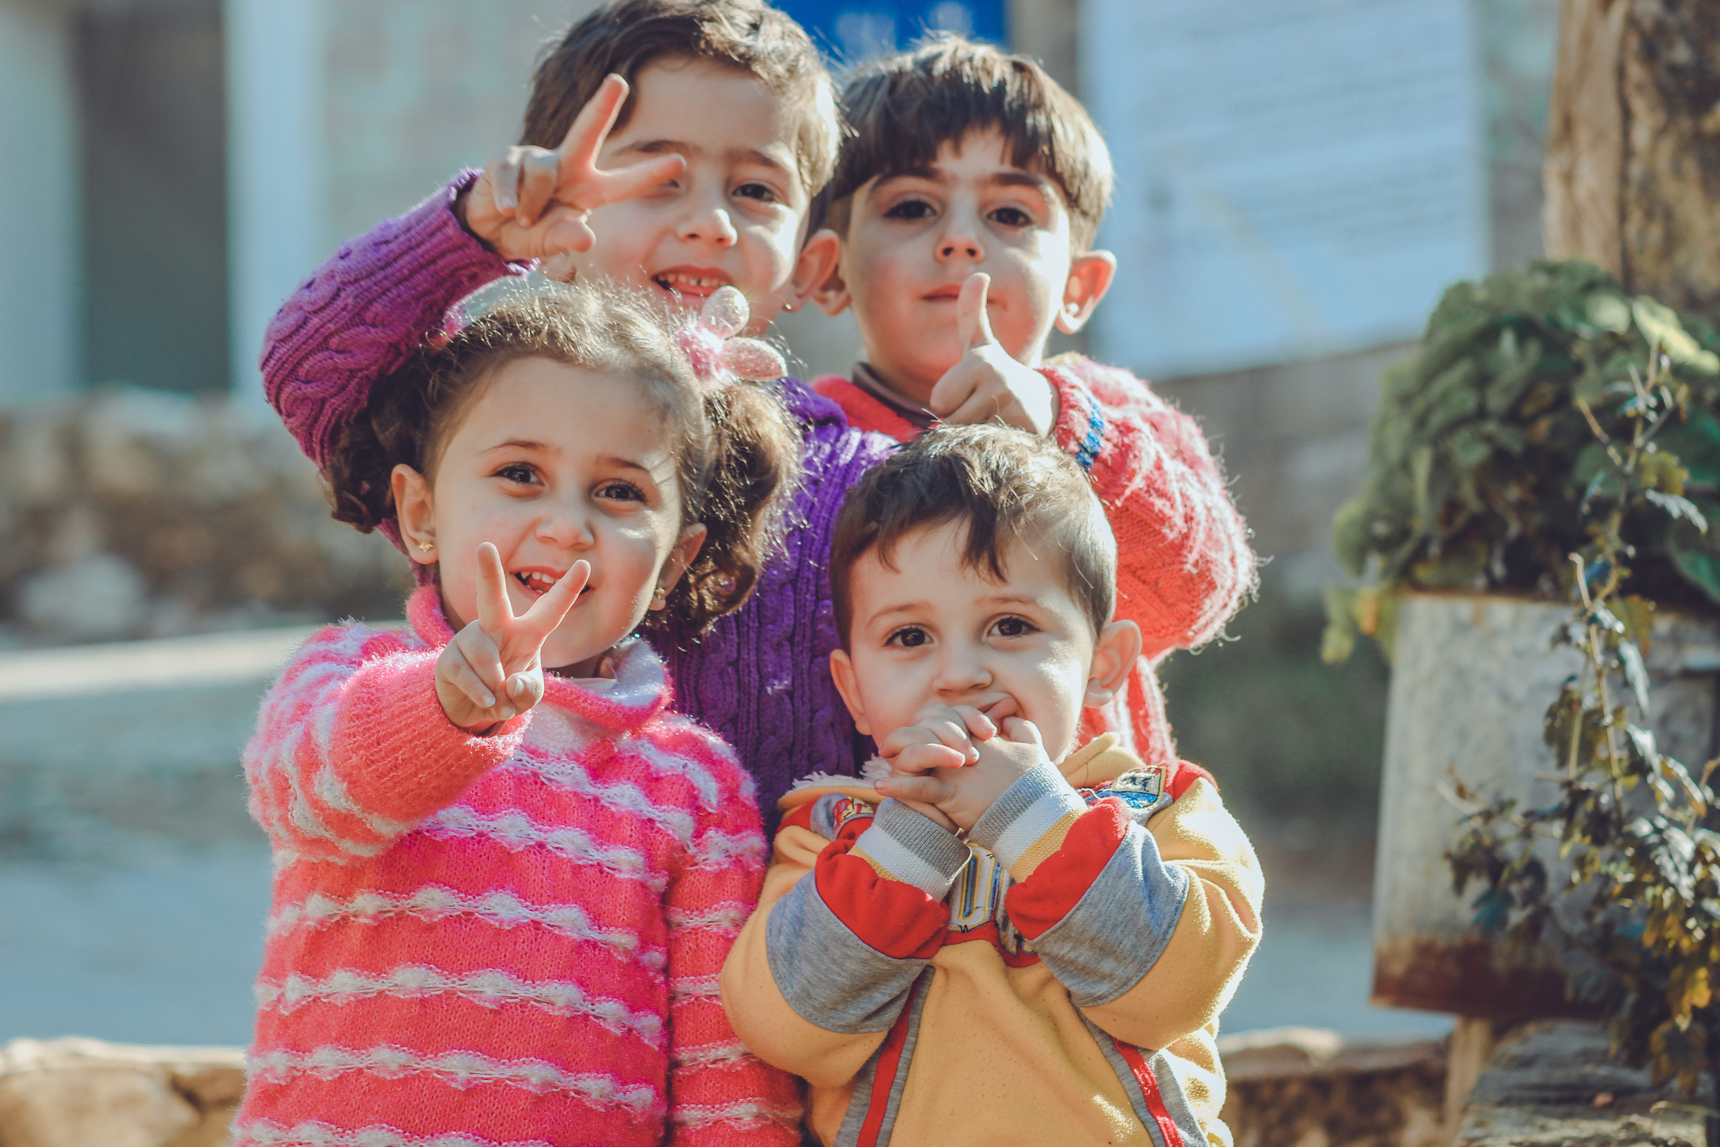

unifec
|
unifec
for every child
|
for every child
unifec
unifec
Idhlopnsdoö ljkhvgcnxn.
for every child

Slide 2


Slide 3




Slide 4
|
unifec
for every child

Slide 5
|
unifec
for every child

Slide 6
|
unifec
for every child
SUSTAINABLE
DEVELOPMENT
GOALS

