Slide 1




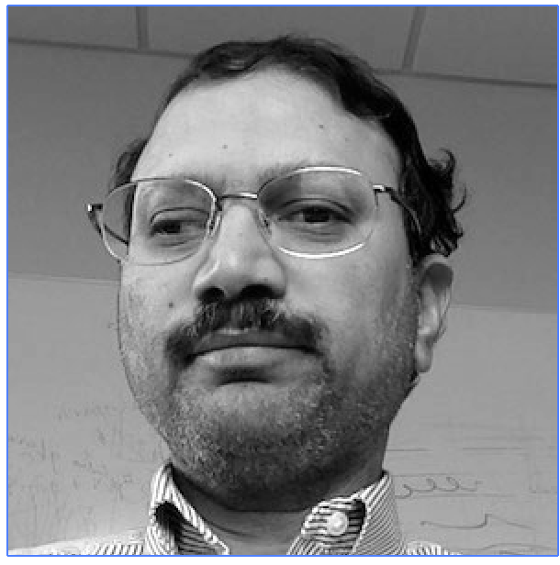
Team
Ronesha
Shaw
Steven
Galloway II
La’Andrea Gates
Mentor,
Sudhakar
Pamidighantam

Slide 2
Interactive Community Gateway
The Problem/Solution
This visualization is not interactive. Our goal for this project is to implement a interactive visualization so that it allows us to receive more information and closely observe this visualization as well
What is a VNC Server and a VNC client
A VNC Server is a program on machines that implements a screen and allows the user to take control of it passively.
A VNC Client allows the user to establish a connection with a desktop that has been shared on another computer.

Slide 3
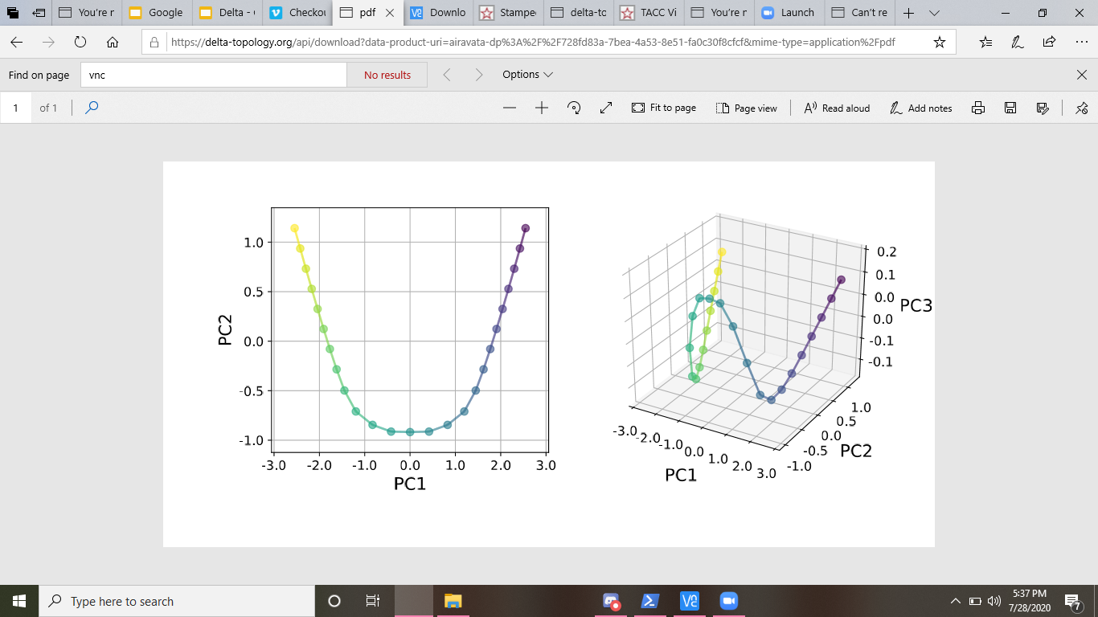
Interactive Community Gateway
Challenge
Community login based gateway requires additional implementation for interactive visualization
Steps
Connect to stampede to launch a vnc server part of a batch job to create a url.
Connect to the vnc server from a vnc client to be able to launch the vnc server.

Slide 4
Computer Problems (Windows):
We use git clone to go into directory and did a docker run but, we could not get the scripts to run again.
We opened port 8000 by adding the setting locals file, than we adjusted the setting py file to check the python version, if it had been adjusted we would not ran into the errors that we did yesterday.
We then realized that we were using python 2 instead of the correct python which is python 3.

Slide 5
Computer Problems (Windows):
We then ran into problems with the IP address which was easily fixed by adjusting allowed host within the terminal
The host was then allowed to access the gateway

Slide 6
Future work
Implement the visualization image to become interactive

Slide 7

THANK
YOU

