Slide 1


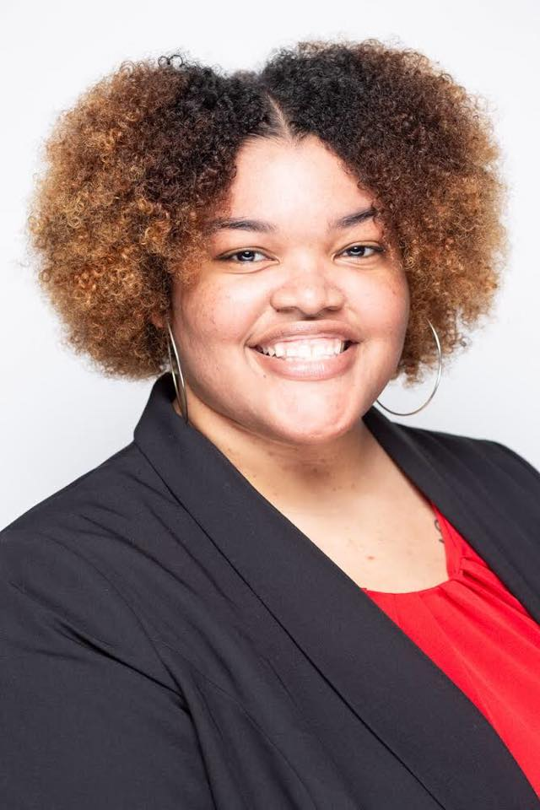
There are two goals. The first one is to create code for interactive visualization based on a URL from VNC server. The second goal is to develop visualization plugins for DELTA-Topology org under Django framework.
Group Members: Ronesha Shaw
La’Andrea Gates Steven Galloway II
Mentor: Sudhakar Pamidighantam

