Slide 1
Weather GPT
Conversational weather intelligence
Abstract submission draft
Interactive maps and forecasts in familiar language
01
Notes:
Weather GPT project proposal based on five user-supplied screen recordings. The recordings contain reference demos under the names WeatherGPT, Weather Globe, and WeatherEx.ai/Cumulus. They do not verify a single unified implementation. Add team details, institution and problem-statement ID before submitting. No official slide limit or template was available in the recordings.

Slide 2
Problem statement and objectives
How can users find local weather and understand a forecast in familiar language?
Location access
Select a place on a globe or search by name.
Forecast understanding
Explain current conditions and the coming week.
Everyday planning
Answer practical questions about rain, temperature, and travel.
02
Notes:
This is a proposed problem framing for the Weather GPT abstract, not a quotation from an official organizer brief. Reference inspiration: recording 2026-09-27 103319, country weather panels and forecasts, and recording 2026-09-28 082043, regional-language weather questions.

Slide 3
Project abstract
Weather GPT proposes a weather information platform that combines an interactive globe with a conversational assistant.
Users will select a location, inspect current conditions and a seven-day forecast, and ask questions in natural language. The assistant will use structured weather data to explain rain, temperature, and other conditions in familiar language, including supported regional languages.
Selectable weather overlays will provide geographic context. The project aims to make forecasts easier to understand for everyday planning. Explainable heatwave-risk analysis is a possible extension after the core weather workflow is complete.
03
Notes:
This abstract describes a proposed system. Source features: WeatherGPT map controls in recordings 2026-09-27 102457 and 102703, country readings and seven-day forecasts in 103319, and multilingual Cumulus conversations in 2026-09-28 082043. No measured accuracy, performance result or implementation completion is claimed.

Slide 4
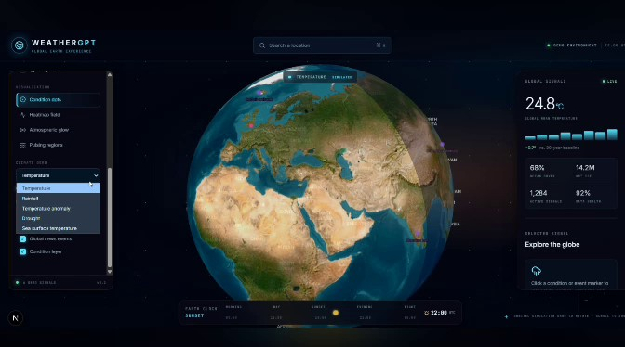
Interactive globe and weather layers
Globe navigation
Rotate and zoom to explore locations.
Weather overlays
Temperature and rainfall, with further layer options.
Map context
Base-map styles and geographic overlays.
Reference demo: WeatherGPT
04
Notes:
Reference image: user-supplied Screen Recording 2026-09-27 102457.mp4, frame near 21 seconds. Map-style and overlay controls are visible in this reference interface. The weather-layer menu includes temperature, rainfall, temperature anomaly, drought and sea-surface temperature. The recording does not validate live data sources or working results for every menu item.

Slide 5
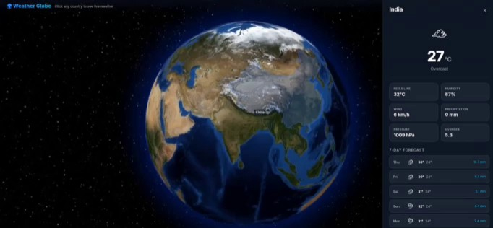
Location weather and seven-day forecasts
Current conditions
Temperature, condition, and feels-like temperature.
Detailed readings
Humidity, wind, rain, pressure, and UV index.
Seven-day outlook
Daily conditions and forecast values.
Reference demo: Weather Globe
05
Notes:
Reference image: user-supplied Screen Recording 2026-09-27 103319.mp4, near 30 seconds, India selection. Additional selections include Ukraine, United States of America, Mexico and China. The panel displays current temperature and condition, feels-like temperature, humidity, wind, precipitation, pressure and UV index. The interface attributes live data to Open-Meteo. The recording does not validate API freshness or how country locations map to coordinates. Values in the screenshot are demonstration values, not current forecasts.

Slide 6
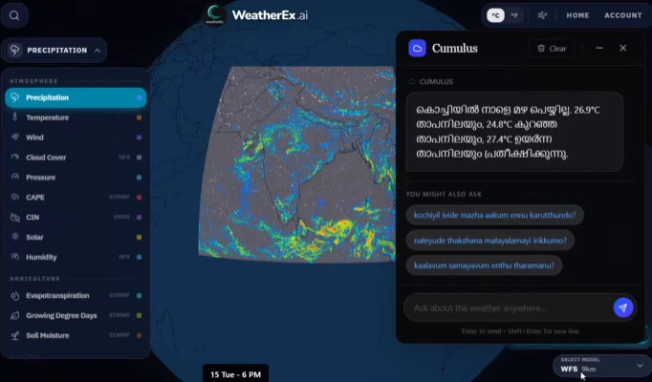
Weather conversations in regional languages
Natural-language questions
“Will it rain in Kochi tomorrow?”
Regional-language support
Romanized Malayalam input and a response in Malayalam script.
Reference demo: WeatherEx.ai / Cumulus
Suggested follow-up questions
06
Notes:
Reference image: user-supplied Screen Recording 2026-09-28 082043.mp4, near 24 seconds. WeatherEx.ai/Cumulus demonstrates a question typed in Malayalam using Latin characters: "kochiyil nale mazha peyyumo?", meaning approximately "Will it rain in Kochi tomorrow?" The assistant responds in Malayalam script and offers follow-up questions. Forecast, trip-planning, extended-forecast and comparison prompts are visible suggestions, not independently verified response capabilities. Sign-in is demonstrated, but its personal details are excluded from this deck.

Slide 7
Proposed system approach
1. Location input
Search text or a selected map position identifies the place.
2. Weather retrieval
A weather service returns current readings and forecast data.
3. Assistant response
The assistant uses the retrieved data to answer in the requested language.
4. User interface
The map, forecast panel, and chat present the same location and time context.
Responses should show the data source, timestamp, and units.
07
Notes:
Conceptual architecture proposed for Weather GPT, not an architecture verified from the screen recordings. The core data flow uses an external weather-data service and an assistant that retrieves location-specific readings before composing an answer. The reference Weather Globe attributes data to Open-Meteo, but the team must confirm its actual provider, application stack and model before claiming an implementation. Data timestamps and units are proposed requirements.

Slide 8
Expected outcomes and project scope
Core deliverable
Possible extension
A working location-to-forecast workflow with an interactive map and a weather assistant.
Heatwave-risk analysis using historical weather features, with explanations of the main contributing factors.
Evaluation goals
Scope boundary
Check data consistency, answer accuracy, language quality, and ease of use.
Core weather features come first. Risk-model development and evaluation form a later phase.
08
Notes:
Expected outcomes are project objectives, not measured results. The heatwave extension draws inspiration from Screen Recording 2026-09-28 082340.mp4, a concept montage that shows lagged features, a 90th-percentile threshold, Random Forest and SHAP-style explainability. The montage does not establish a trained model, evaluation results or working risk service. For a future heatwave extension, define location-specific criteria and evaluate historical data with separate training and testing periods.

