Slide 1
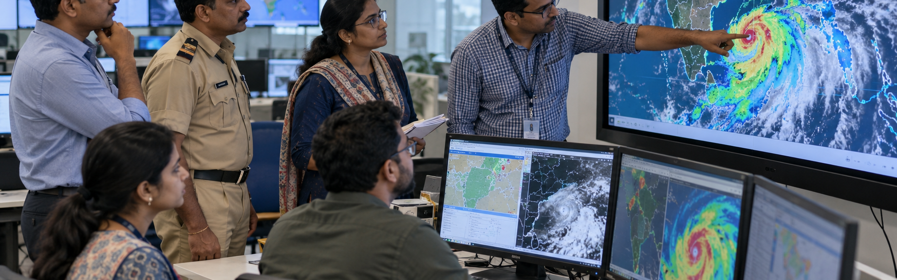

Domain and Problem Statement
DOMAIN
Agentic Artificial Intelligence, Conversational AI, Weather Analytics, Geospatial Visualisation, Speech Technology and Hazard-Awareness Systems
PROBLEM STATEMENT
PAIN POINTS
STAKEHOLDERS
Weather information is spread across forecast applications, technical dashboards, map services and separate emergency-alert platforms. Users often need to interpret numerical data without receiving a clear explanation of how the conditions affect their location, activity or travel plans. Most applications provide static results and require manual navigation between screens. Weather GPT addresses this gap through an agentic AI assistant that understands user intent, selects trusted weather and alert sources, analyses the retrieved information and presents relevant guidance through text, voice and interactive maps.
Fragmented information
Current conditions, forecasts, map layers and emergency alerts often appear in separate applications.
Difficult interpretation
Technical maps, measurements and scientific terms can be difficult for ordinary users to understand.
Static interaction
Weather agencies, emergency services and technical teams
Traditional applications show fixed results and provide limited support for follow-up questions.
TARGET USERS
Limited hands-free access
Manual navigation makes weather information less convenient while travelling, working or handling urgent situations.
Weak decision support
Generic forecasts do not explain how weather may affect travel, outdoor work, events or personal safety.
Farmers, coastal communities, commuters and older adults
KEY CHALLENGES
RELIABLE DATA
INTEGRATION
AGENT DECISION
RELIABILITY
LOCATION AND TIME
AMBIGUITY
VERIFIED HAZARD
INFORMATION
VOICE AND RESPONSE
QUALITY
Weather APIs, geospatial services and official alert feeds may use different formats, update intervals and levels of accuracy.
The agent must select the correct tools, interpret results accurately and avoid generating unsupported weather information.
Incomplete place names and phrases such as “tomorrow evening” must be resolved before retrieving data.
Heatwave assessments must follow defined thresholds, while tsunami warnings must come from authorised sources.
Speech recognition and spoken responses must remain understandable across accents, background noise and unstable connectivity.

