Slide 1


GrowMate
01
The plant market has a trust gap.
People buy plants online, but listings often lack identity, care, health, and safety context.
Hook
?Who here owns a plant, collects plants, or knows a plantito or plantita??
Plant identity
Care confidence
Selling safety
Is this the correct plant?
Can I keep it alive?
Is it safe and legal?

Slide 2
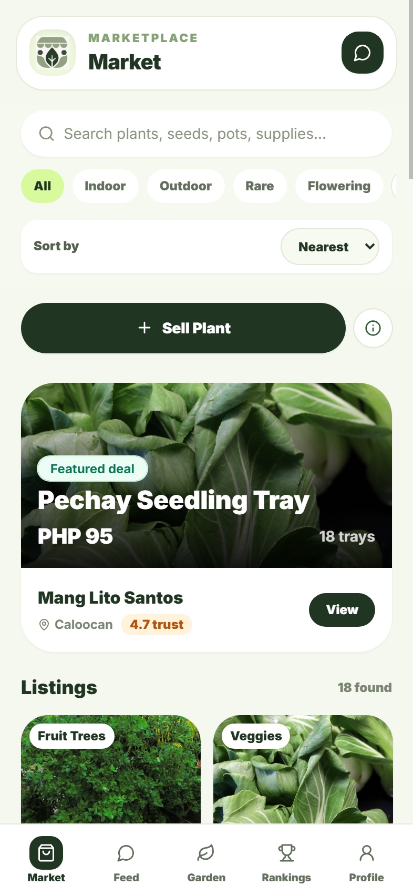
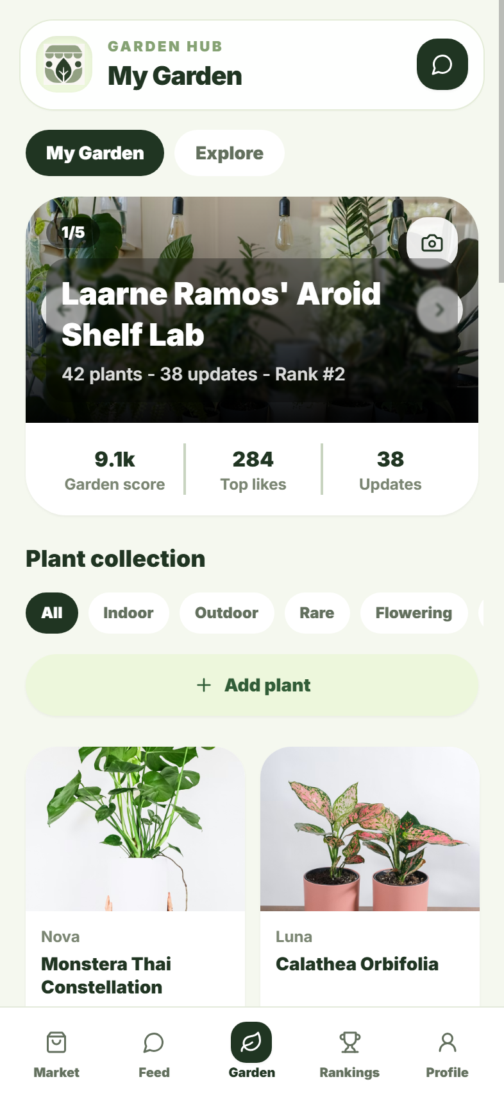
GrowMate
02
GrowMate makes plant selling safer.
A mobile marketplace and community app for buyers, sellers, beginners, and plantitos/plantitas.
Market
buy & sell
Leafy AI
verify & guide
Garden
showcase
Feed
ask & share
Rankings
motivate

Slide 3
GrowMate
03
Leafy AI
Identify. Verify. Guide.
1
Photo upload
?
2
Plant ID
?
3
Safety check
?
4
Listing help
AI supports safer posting by suggesting plant name, category, care notes, and risky-listing warnings.
Safe to sell

Slide 4
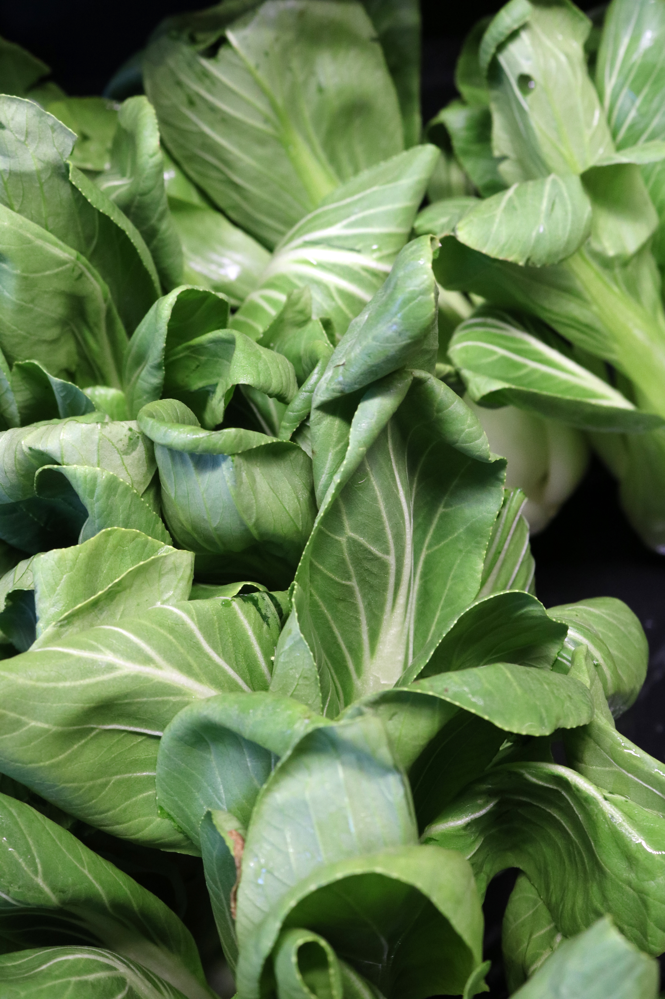
GrowMate
04
Who benefits?
Built for plant beginners, collectors, sellers, and home growers.
Buyers
Sellers
clearer listings
faster posting
Beginners
Communities
care guidance
local growth

Slide 5
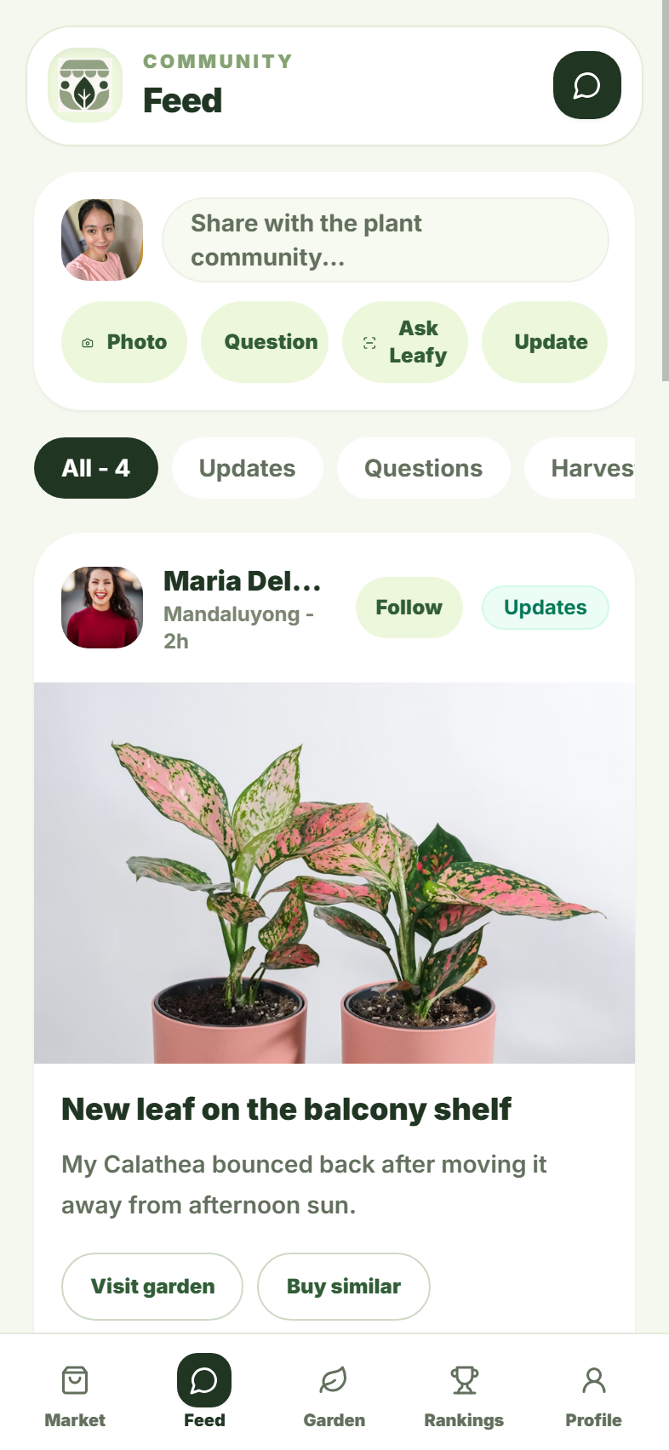
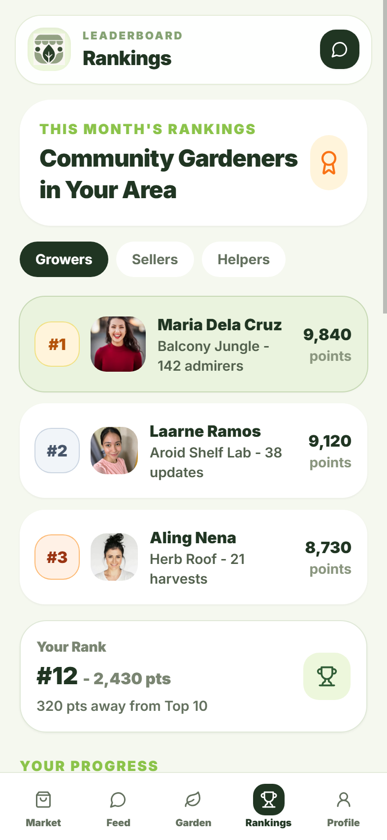
GrowMate
05
Prototype demonstration
Market ? Feed ? Garden ? Rankings ? Profile
Market
Feed
Garden
Rankings

Slide 6
GrowMate
06
Impact
GrowMate connects safer commerce with sustainable plant communities.
Safer buying
Better care
Local growth
clearer listings
beginner support
small sellers
SDG 11
SDG 12
SDG 15

Slide 7
GrowMate
07
Sustainable growth
GrowMate earns only when sellers succeed.
10%
marketplace fee when sold
Verified sellers
Premium tools
Promoted listings
Local partnerships
Grow smart, grow safe, grow great with GrowMate.

