Slide 1

Regression Analysis
Module 3

Slide 2
Regression
Dependent variable
Independent variable (x)
Regression is the attempt to explain the variation in a dependent variable using the variation in independent variables.
Regression is thus an explanation of causation.
If the independent variable(s) sufficiently explain the variation in the dependent variable, the model can be used for prediction.

Slide 3
Simple Linear Regression
y’ = b0 + b1X ± є
є
Dependent variable (y)
B1 = slope
= ∆y/ ∆x
b0 (y intercept)
Independent variable (x)
The output of a regression is a function that predicts the dependent variable based upon values of the independent variables.
Simple regression fits a straight line to the data.

Slide 4
Simple Linear Regression
Observation: y
^
Prediction: y
Dependent variable
Zero
Independent variable (x)
The function will make a prediction for each observed data point.
The observation is denoted by y and the prediction is denoted by y.
^

Slide 5
Simple Linear Regression
Prediction error: ε
Observation: y
^
Prediction: y
Zero
For each observation, the variation can be described as:
y = y + ε
Actual = Explained + Error
^

Slide 6
Regression
Dependent variable
Independent variable (x)
A least squares regression selects the line with the lowest total sum of squared prediction errors.
This value is called the Sum of Squares of Error, or SSE.

Slide 7
Calculating SSR
Population mean: y
Dependent variable
Independent variable (x)
The Sum of Squares Regression (SSR) is the sum of the squared differences between the prediction for each observation and the population mean.

Slide 8
Regression Formulas
The Total Sum of Squares (SST) is equal to SSR + SSE.
Mathematically,
SSR = ∑ ( y – y ) (measure of explained variation)
SSE = ∑ ( y – y ) (measure of unexplained variation)
SST = SSR + SSE = ∑ ( y – y ) (measure of total variation in y)
^
2
^
2

Slide 9
The Coefficient of Determination
The proportion of total variation (SST) that is explained by the regression (SSR) is known as the Coefficient of Determination, and is often referred to as R .
R = =
The value of R can range between 0 and 1, and the higher its value the more accurate the regression model is. It is often referred to as a percentage.
2
2
SSR SSR SST SSR + SSE
2

Slide 10
Standard Error of Regression
The Standard Error of a regression is a measure of its variability. It can be used in a similar manner to standard deviation, allowing for prediction intervals.
y ± 2 standard errors will provide approximately 95% accuracy, and 3 standard errors will provide a 99% confidence interval.
Standard Error is calculated by taking the square root of the average prediction error.
√
SSE
n-k
Standard Error =
Where n is the number of observations in the sample and
k is the total number of variables in the model

Slide 11
The output of a simple regression is the coefficient β and the constant A. The equation is then:
y = A + β * x + ε
where ε is the residual error.
β is the per unit change in the dependent variable for each unit change in the independent variable. Mathematically:
β =
∆ y
∆ x

Slide 12
Multiple Linear Regression
More than one independent variable can be used to explain variance in the dependent variable, as long as they are not linearly related.
A multiple regression takes the form:
y = A + β X + β X + … + β k Xk + ε
where k is the number of variables, or parameters.
1 1 2 2

Slide 13
Multicollinearity
Multicollinearity is a condition in which at least 2 independent variables are highly linearly correlated. It will often crash computers.
Example table of Correlations
 |  | Y | X1 | X2
 | Y | 1.000
 | X1 | 0.802 | 1.000
 | X2 | 0.848 | 0.578 | 1.000
A correlations table can suggest which independent variables may be significant. Generally, an ind. variable that has more than a .3 correlation with the dependent variable and less than .7 with any other ind. variable can be included as a possible predictor.

Slide 14
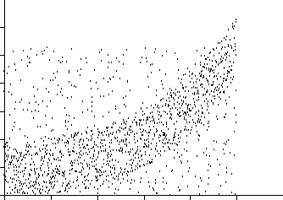
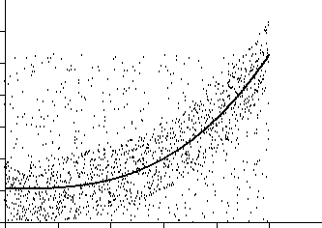
Nonlinear Regression
Nonlinear functions can also be fit as regressions. Common choices include Power, Logarithmic, Exponential, and Logistic, but any continuous function can be used.

Slide 15
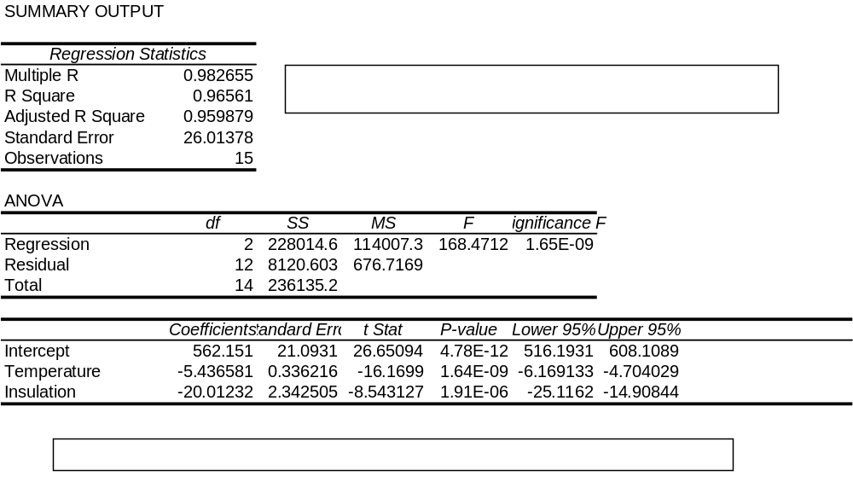
Regression Output in Excel

