Slide 1
AlzDx: AI-Based Early Detection of Alzheimer's Disease Using Speech and Machine Learning
Review III
Bhanu Prakash — 2420030209
Myneni Krishita — 2420030443
D.L.S. Laasya Priya — 2420030002

Slide 2
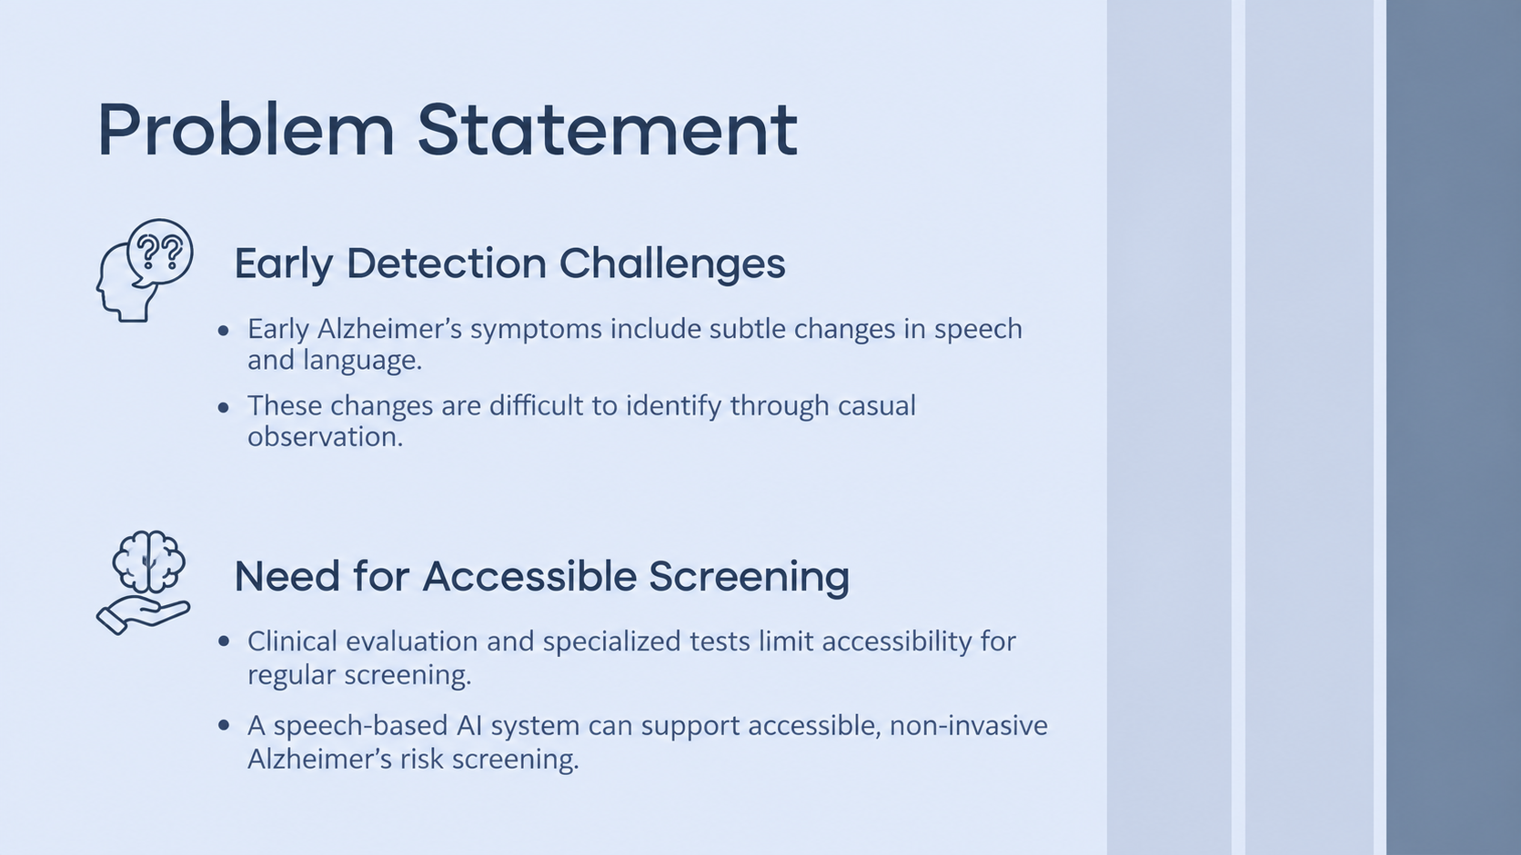
Introduction
Background
Provide a brief overview of the condition or disease being discussed in the case. Include pertinent information about its prevalence, clinical manifestations and any relevant previous studies or literature
Importance
Highlight the significance and educational value of the case. Emphasize the uniqueness, rarity, or complexity of the presented case, and explain how it contributes to the existing knowledge or clinical practice

Slide 3
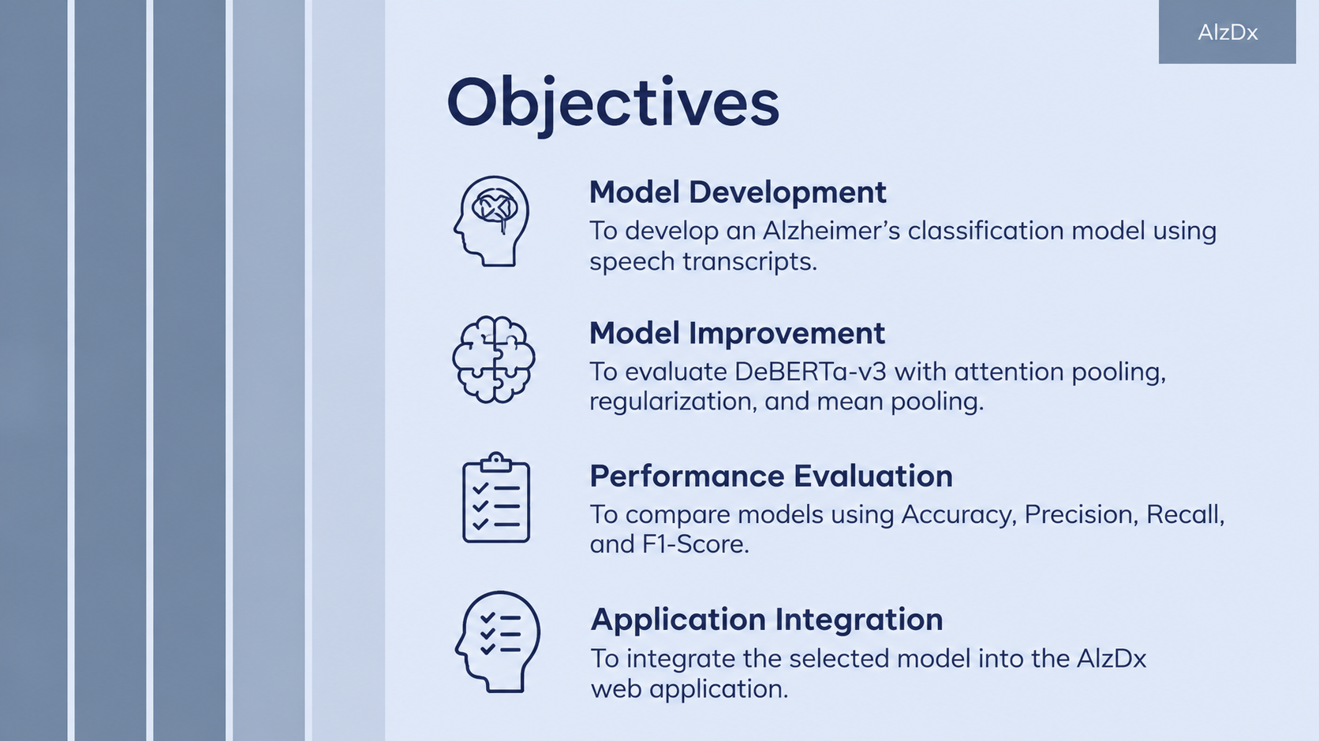
01
Abstract
Case report_0001

Slide 4
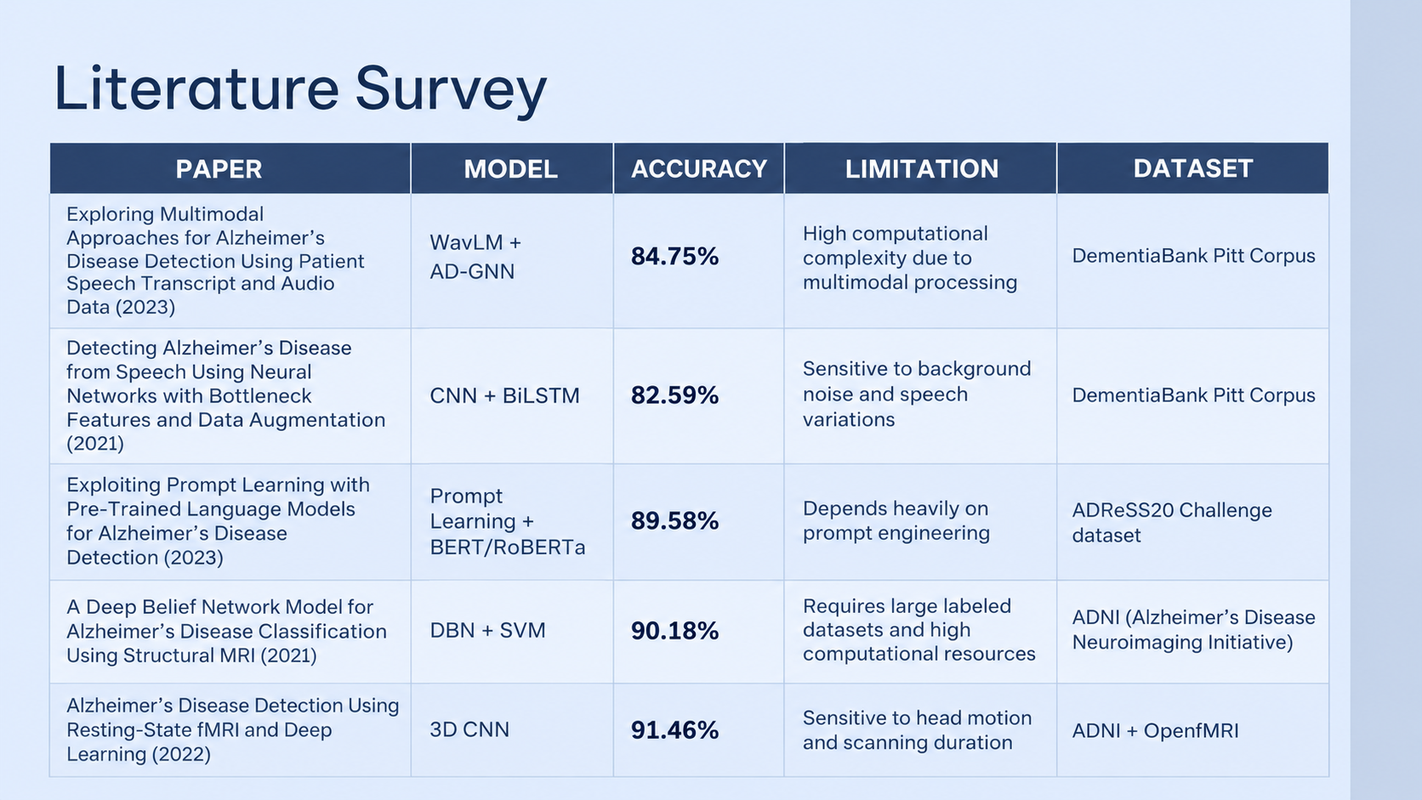
Table of contents
01
02
03
04
05
06
Abstract
Introduction
Case presentation
Discussion
Conclusion
Roadmap

Slide 5
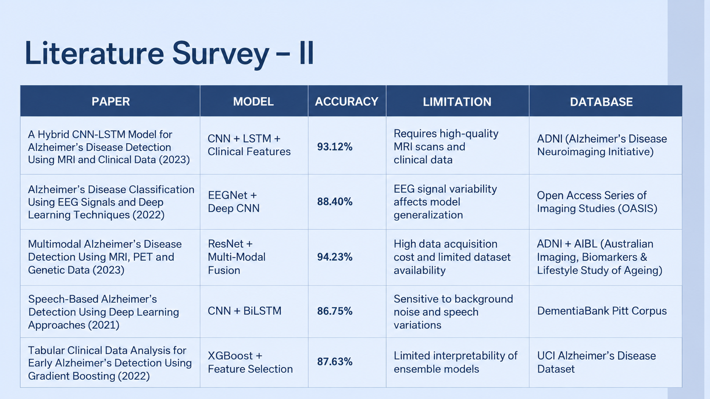
Table of contents
01
02
03
04
05
06
Abstract
Introduction
Case presentation
Discussion
Conclusion
Roadmap

Slide 6
Research Gap
Computational Cost: Multimodal models require significant processing power.
Transcription Errors: Speech recognition errors can reduce prediction accuracy.
Model Robustness: Dependence on prompt engineering limits consistency across datasets.
Practical Applications: Limited integration of prediction explanations, reports, and user-friendly interfaces.

Slide 7
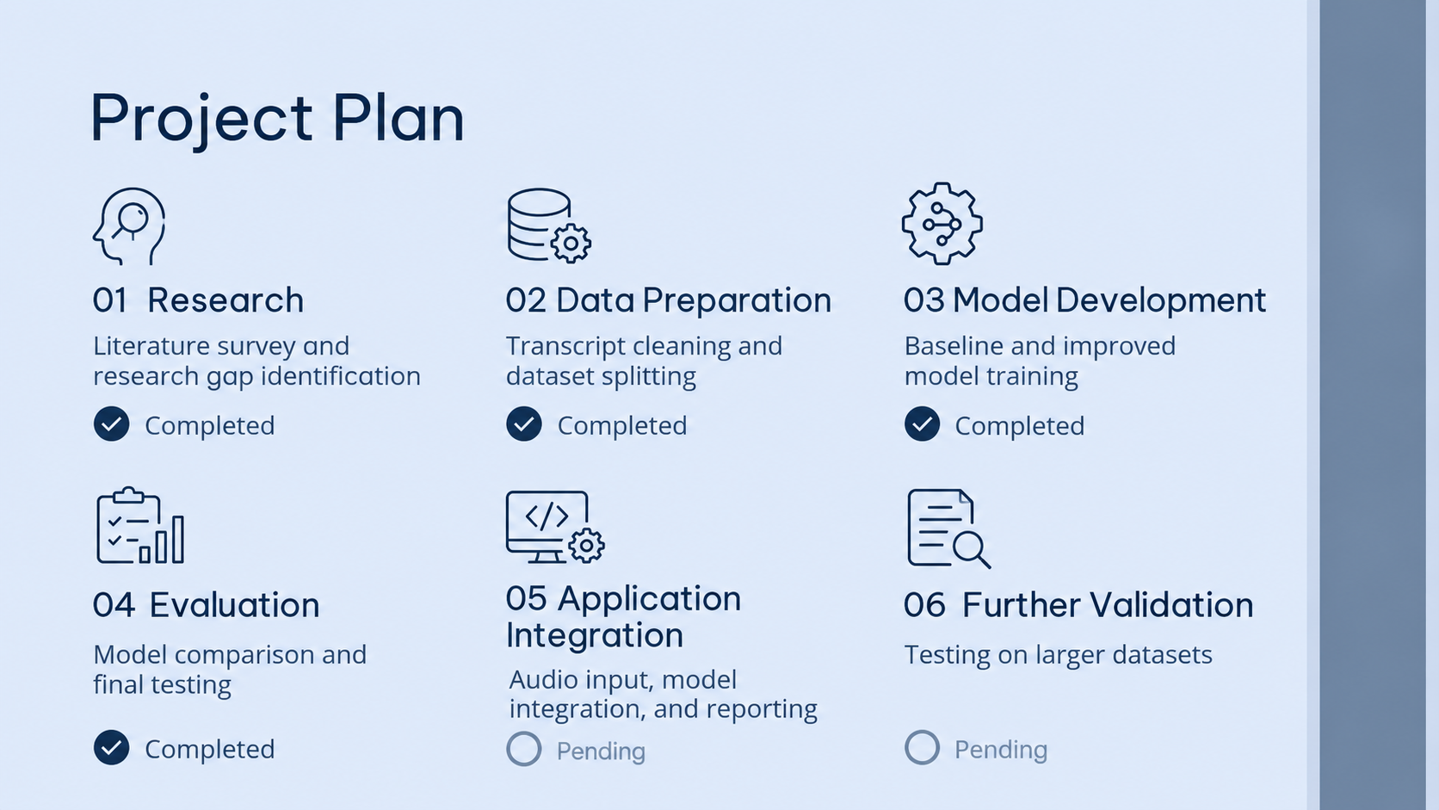
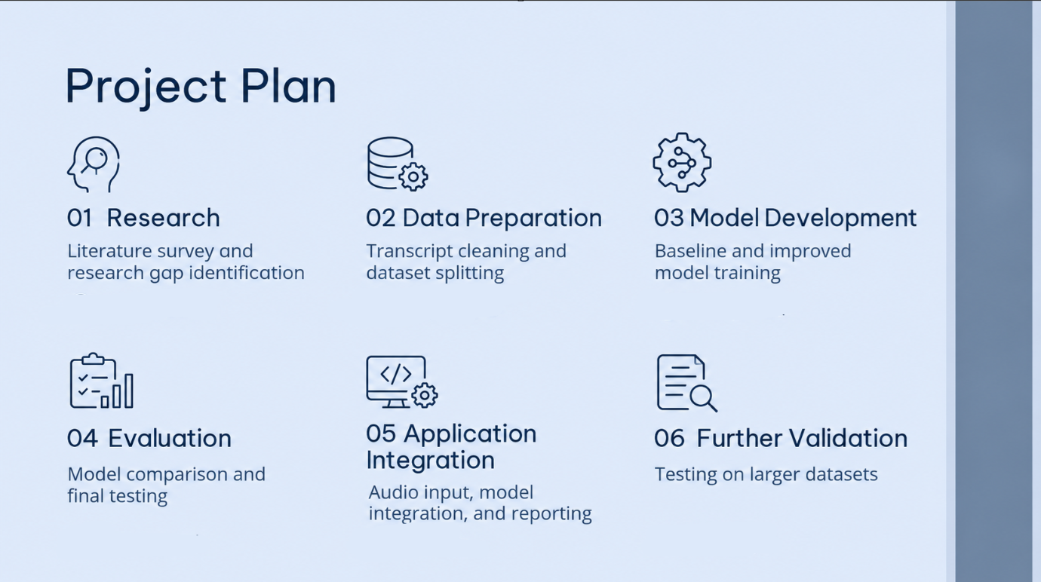
Conclusion
Challenge
Success
Lessons
Address any diagnostic challenges, emphasizing the importance of thorough investigation and clinical reasoning
Highlight successful outcomes achieved through the chosen treatment approach, showcasing effectiveness
Summarize valuable lessons learned, providing insights to guide future clinical decision-making and enhance care
Significance
Research
Summary
Emphasize the case's educational value, impact on medical knowledge, professional development, and learning
Identify areas for future investigation that have emerged from the case, stimulating advancements
End with a concise concluding statement, summarizing the overall significance of the case

Slide 8
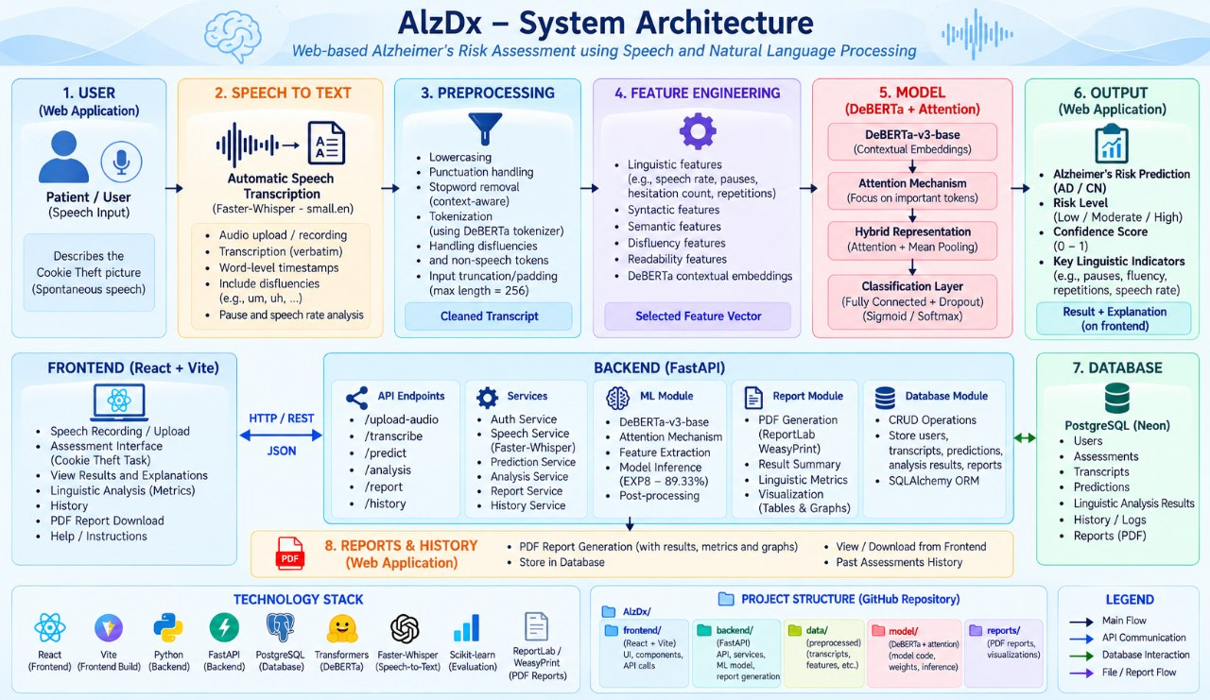
System architecture(the complicated fotu in mini hackathon)

Slide 9
Outcomes
Risk Screening: Classify speech transcripts as Healthy or Alzheimer’s with confidence scores.
Web Application: Enable users to upload audio recordings or enter text transcripts.
Analysis Reports: Provide prediction explanations and downloadable PDF reports.
AI Assistance: Help users understand their results through an integrated chatbot.
Analysis History: Save previous screening results for future reference.

Slide 10
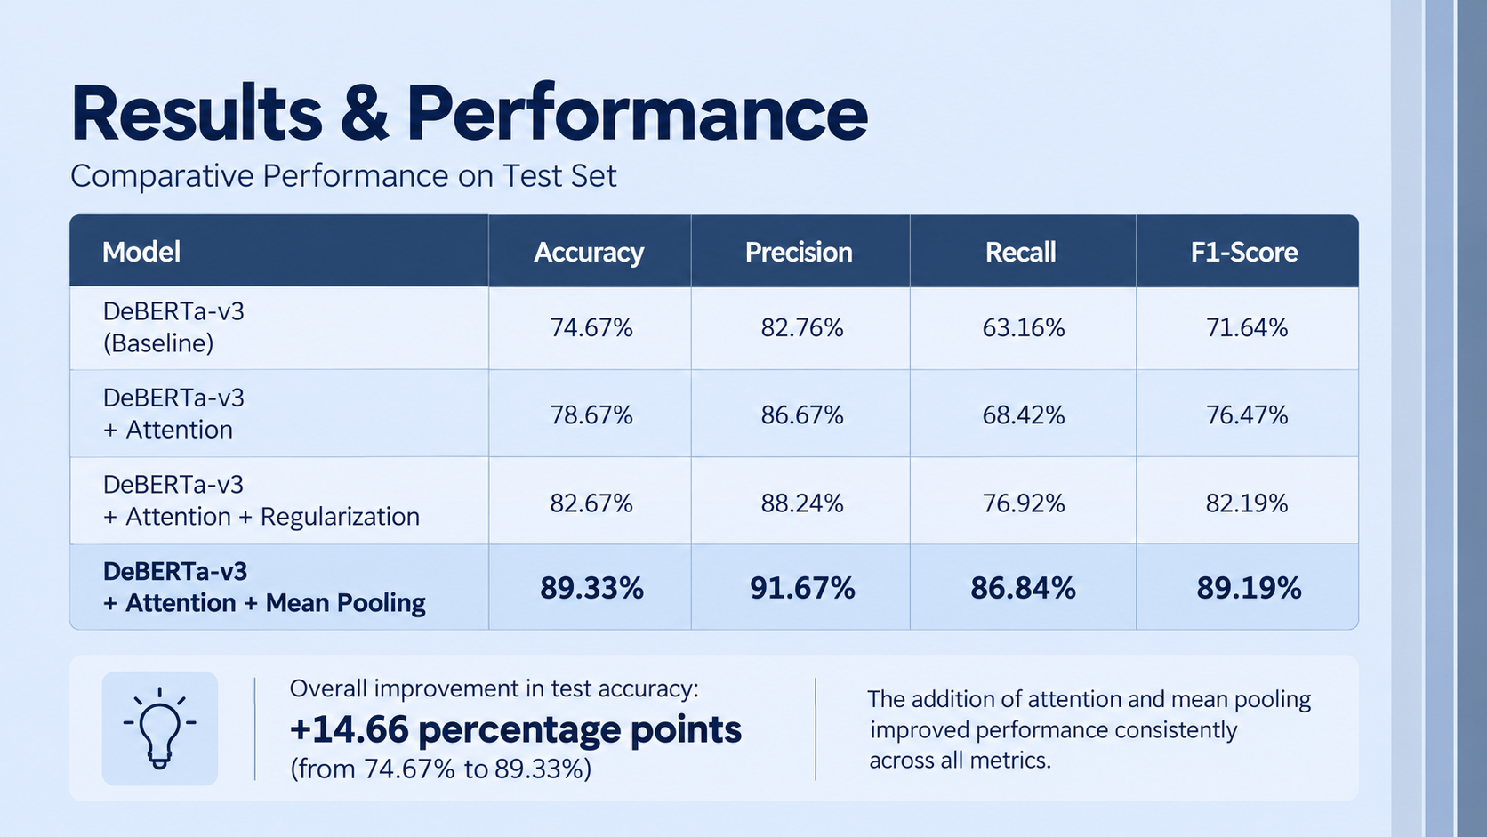

Slide 11
Frontend

Slide 12
Front end

Slide 13
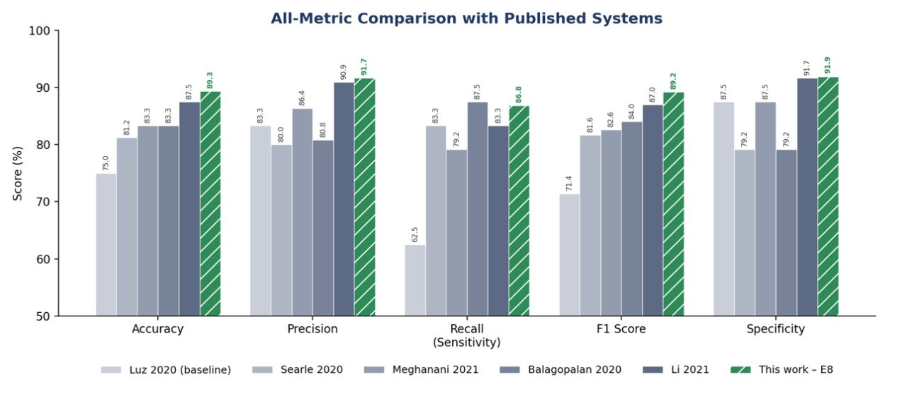
Comparative analysis

Slide 14
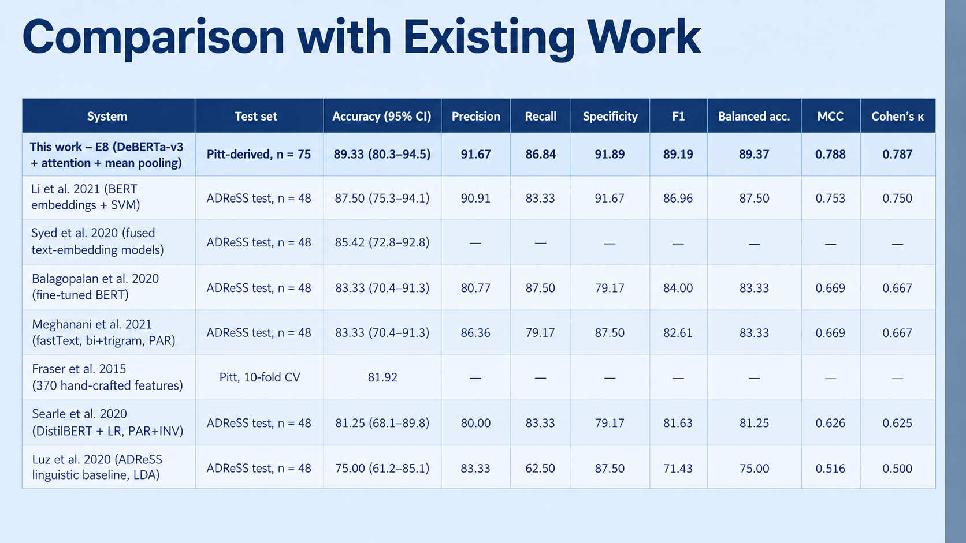
Comparison with exiting work

Slide 17
Discussion
Differential diagnosis
Treatment
Explore potential diagnoses based on the patient's presentation and relevant findings. Discuss distinguishing features for each and reasons for inclusion/exclusion
Present the confirmed diagnosis and explain diagnostic criteria. Outline the chosen treatment approach and rationale behind it
Clinical course
Lesson learned
Describe the patient's progression, treatment response and any significant events or complications. Summarize the final outcome
Discuss the case's educational value, highlighting unique aspects. Share insights gained, including diagnostic challenges, treatment considerations or disease mechanisms

Slide 18
Outcomes and recommendations
Start
1
2
3
Outcome
Outcome
Outcome
Write your recommendation
Write your recommendation
Write your recommendation
Write your recommendation
Write your recommendation
Write your recommendation
Write your recommendation
Write your recommendation
Write your recommendation
Write your recommendation
Write your recommendation
Write your recommendation

Slide 20

Thanks
Case report_0001
Do you have any questions?
youremail@freepik.com
+91 620 421 838
yourwebsite.com
Please keep this slide for attribution

Slide 21
Icon pack

Slide 22
Alternative resources
Here’s an assortment of alternative resources whose style fits the one of this template:
Photos
Person conducting online psychologist therapy
Top view on online psychologist concept
Medium shot senior woman sitting at table
Lonely woman confronting alzheimer disease
Old man in a nursing home reading a book
Old patient suffering from parkinson
Side view of old man in a nursing home
Elderly woman confronting alzheimer's disease I
Elderly woman confronting alzheimer's disease II
Old woman not feeling well at home
Tablet with medical app
Doctor getting patient ready for ct scan I
Doctor getting patient ready for ct scan II

Slide 23
Resources
Did you like the resources in this template? Get them for free at our other websites:
Photos
Doctor looking over ct scan
Doctor looking over ct scan II
Doctor looking over ct scan III
Side view woman at doctor's appointment
Medium shot doctor looking at radiography
Side view doctor holding radiography
Male social worker taking care of an old woman
Social worker taking care of a senior woman
African senior woman portrait
Senior woman confronting alzheimer disease
Icons
Alzheimer Icon Pack | Lineal

Slide 24
Instructions for use
If you have a free account, in order to use this template, you must credit Slidesgo by keeping the Thanks slide. Please refer to the next slide to read the instructions for premium users.
As a Free user, you are allowed to:
Modify this template.
Use it for both personal and commercial projects.
You are not allowed to:
Sublicense, sell or rent any of Slidesgo Content (or a modified version of Slidesgo Content).
Distribute Slidesgo Content unless it has been expressly authorized by Slidesgo.
Include Slidesgo Content in an online or offline database or file.
Offer Slidesgo templates (or modified versions of Slidesgo templates) for download.
Acquire the copyright of Slidesgo Content.
For more information about editing slides, please read our FAQs or visit our blog:
https://slidesgo.com/faqs and https://slidesgo.com/slidesgo-school

Slide 25
Instructions for use (premium users)
As a Premium user, you can use this template without attributing Slidesgo or keeping the "Thanks" slide.
You are allowed to:
Modify this template.
Use it for both personal and commercial purposes.
Hide or delete the “Thanks” slide and the mention to Slidesgo in the credits.
Share this template in an editable format with people who are not part of your team.
You are not allowed to:
Sublicense, sell or rent this Slidesgo Template (or a modified version of this Slidesgo Template).
Distribute this Slidesgo Template (or a modified version of this Slidesgo Template) or include it in a database or in any other product or service that offers downloadable images, icons or presentations that may be subject to distribution or resale.
Use any of the elements that are part of this Slidesgo Template in an isolated and separated way from this Template.
Register any of the elements that are part of this template as a trademark or logo, or register it as a work in an intellectual property registry or similar.
For more information about editing slides, please read our FAQs or visit our blog:
https://slidesgo.com/faqs and https://slidesgo.com/slidesgo-school

Slide 26
Fonts & colors used
This presentation has been made using the following fonts:
Be Vietnam Pro
(https://fonts.google.com/specimen/Be+Vietnam+Pro)
Open Sans
(https://fonts.google.com/specimen/Open+Sans)
#283d55
#dde6f7
#d8e2f7
#6d819a
#4a6482
#c6d0e3
#ffffff

Slide 27





Storyset
Create your Story with our illustrated concepts. Choose the style you like the most, edit its colors, pick the background and layers you want to show and bring them to life with the animator panel! It will boost your presentation. Check out how it works.
Pana
Amico
Bro
Rafiki
Cuate

Slide 28
Use our editable graphic resources...
You can easily resize these resources without losing quality. To change the color, just ungroup the resource and click on the object you want to change. Then, click on the paint bucket and select the color you want. Group the resource again when you’re done. You can also look for more infographics on Slidesgo.

Slide 31
JANUARY
FEBRUARY
MARCH
APRIL
MAY
JUNE
PHASE 1
Task 1
Task 2
PHASE 2
Task 1
Task 2
JANUARY
FEBRUARY
MARCH
APRIL
PHASE 1
Task 1
Task 2

Slide 34
...and our sets of editable icons
You can resize these icons without losing quality.
You can change the stroke and fill color; just select the icon and click on the paint bucket/pen.
In Google Slides, you can also use Flaticon’s extension, allowing you to customize and add even more icons.

Slide 35
Educational Icons
Medical Icons

Slide 36
Business Icons
Teamwork Icons

Slide 37
Help & Support Icons
Avatar Icons

Slide 38
Creative Process Icons
Performing Arts Icons

Slide 39
Nature Icons

Slide 40
SEO & Marketing Icons

Slide 41


