Slide 1
AlzDx
AI-Based Early Detection of Alzheimer's Disease Using Speech and Machine Learning
Review – II

Slide 2
INTRODUCTION & OBJECTIVE
Speech Analysis
AI-Based Analysis
AlzDx
Model Development
Performance Gain
NLP and transformer models can analyze speech transcripts for these patterns.
The proposed system provides AI-assisted Alzheimer's risk screening using speech.
Early Alzheimer's may cause subtle changes in speech and language patterns.
Application Development
Develop and evaluate transformer-based models for Alzheimer's classification.
Enhance the baseline model using an attention mechanism.
Integrate the trained model into the AlzDx web application.

Slide 3
Proposed Methodology
1
→
2
→
3
→
4
→
5
→
Input
Speech-to-Text
Text Preprocessing
Tokenization
Transformer Processing
User provides a speech recording or speech transcript.
Audio is converted into a text transcript for NLP analysis.
The transcript is cleaned while preserving meaningful speech patterns and disfluencies.
The transcript is converted into tokens using the DeBERTa-v3 tokenizer.
DeBERTa-v3 processes the tokens and captures contextual linguistic information.
6
→
7
→
8
→
9
→
10
Attention Pooling
Classification
Alzheimer's Prediction
Analysis Report
AlzDx Application
The attention mechanism assigns different weights to token representations to focus on informative parts of the transcript.
The resulting representation is passed to a classifier.
The system classifies the input as Healthy or Alzheimer's.
The prediction can be presented with confidence information and linguistic analysis.
The results are displayed through the proposed AlzDx web application.

Slide 4
Dataset & Preprocessing
Dataset
Pitt DementiaBank-derived Cookie Theft transcripts
498 source rows → 497 final samples
Healthy: 241
Alzheimer’s: 256
Preprocessing
Removed 1 normalized duplicate transcript
Preserved meaningful speech patterns and disfluencies
Stratified split: 347 Train | 75 Validation | 75 Test

Slide 5
System Design
User Speech / Transcript
Text Preprocessing
Attention Pooling
Alzheimer’s Prediction
Classification Layer
Analysis Report
Speech-to-Text
DeBERTa-v3

Slide 6
Model Training & Implementation
Pre-trained DeBERTa-v3-base used for text classification
Binary classification:
  Class 0 → Healthy
  Class 1 → Alzheimer's
Maximum sequence length: 256
Train / Validation / Test: 347 / 75 / 75
Training performed using CUDA
GPU: NVIDIA RTX 4070 Laptop GPU

Slide 7
Experimental Phases & Model Evolution
Phase 1 — Baseline
DeBERTa-v3-base
Test Accuracy: 74.67%
Phase 2 — Attention
DeBERTa-v3 + Attention Pooling
Test Accuracy: 78.67%
Improvement: +4.00 percentage points
Phase 3 — Regularization
DeBERTa-v3 + Attention + Regularization
Test Accuracy: 82.67%
Improvement over baseline: +8.00 percentage points

Slide 8
Model Architecture
Input Transcript
DeBERTa-v3 Encoder
Attention Pooling
Linear Classifier
Healthy / Alzheimer's
Dropout
For attention:
Linear: hidden_size → 128
Tanh
Linear: 128 → 1
Attention mask ignores padding tokens
Dropout: 0.2

Slide 9
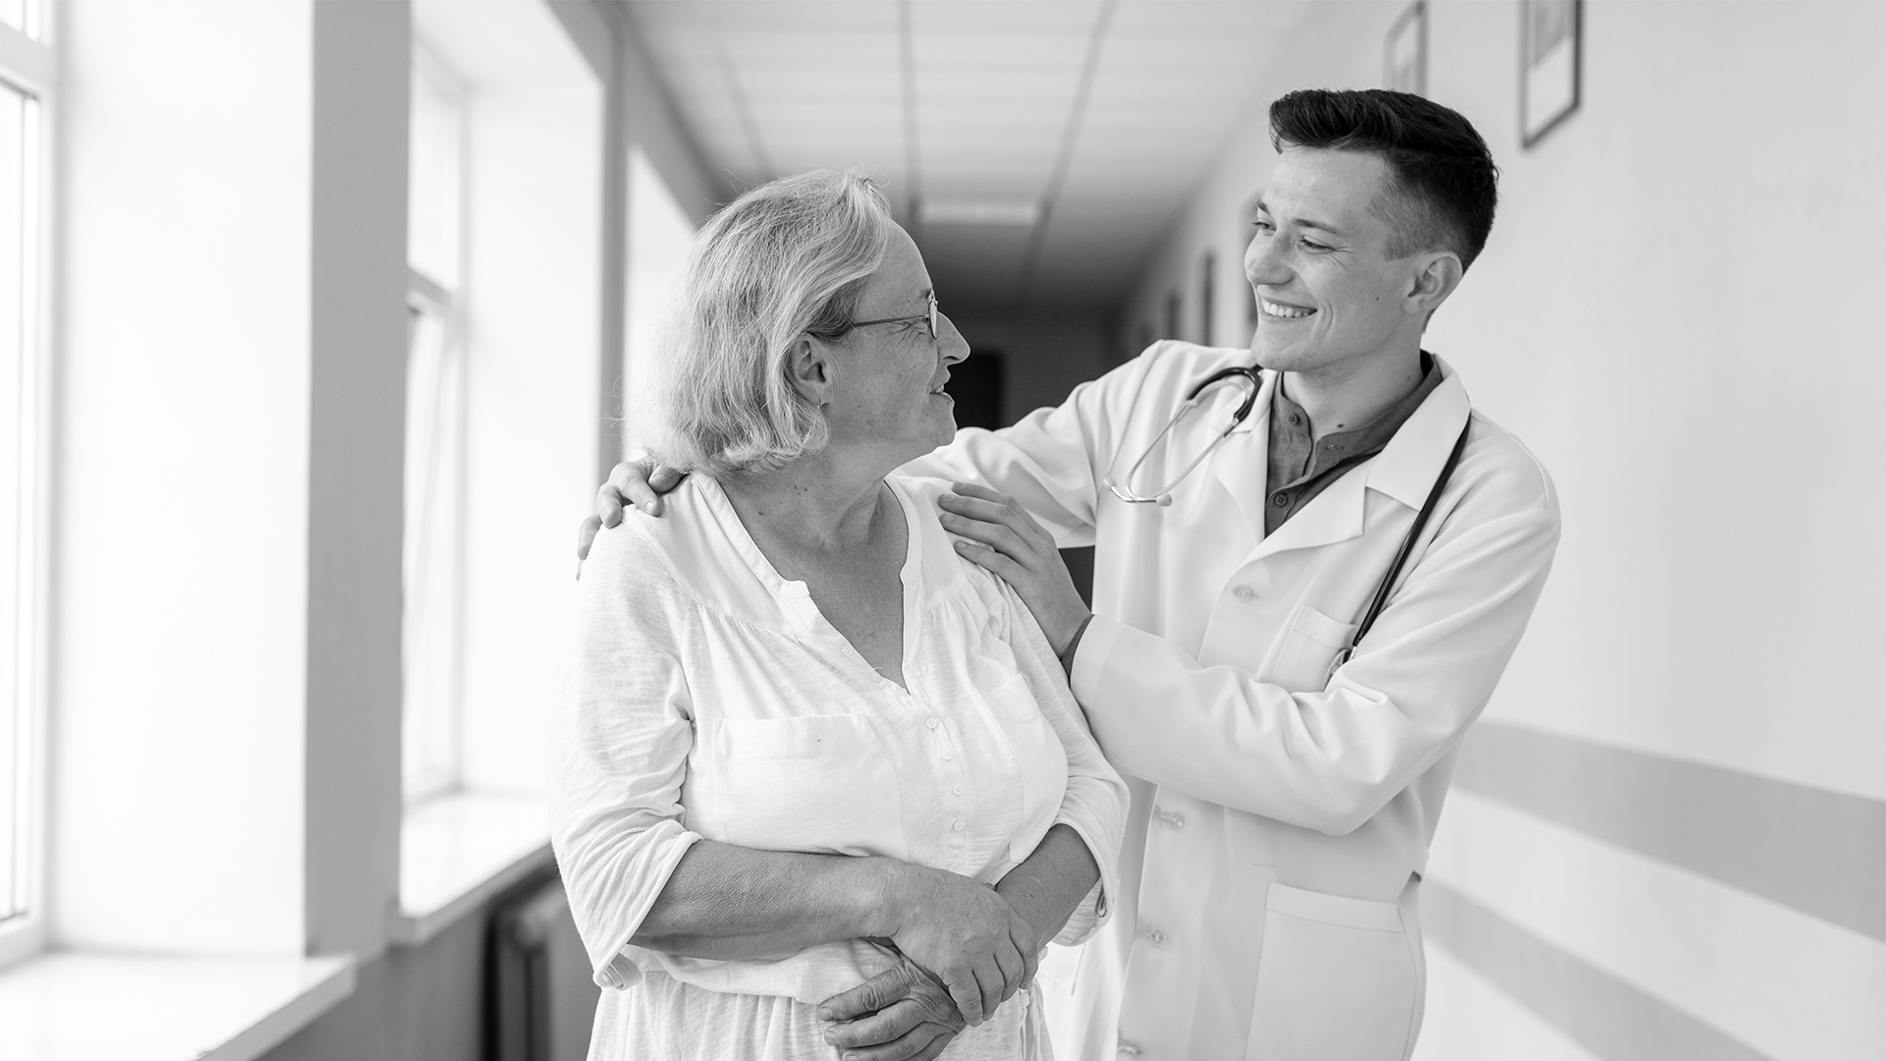
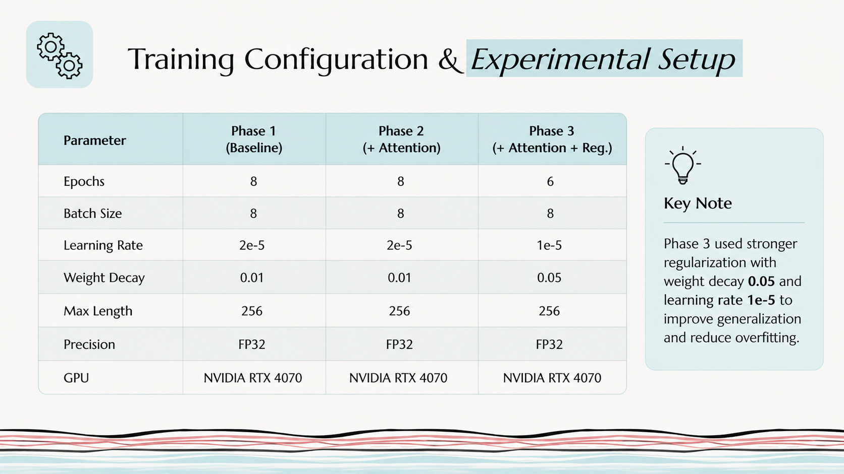
A picture is worth a thousand words

Slide 10
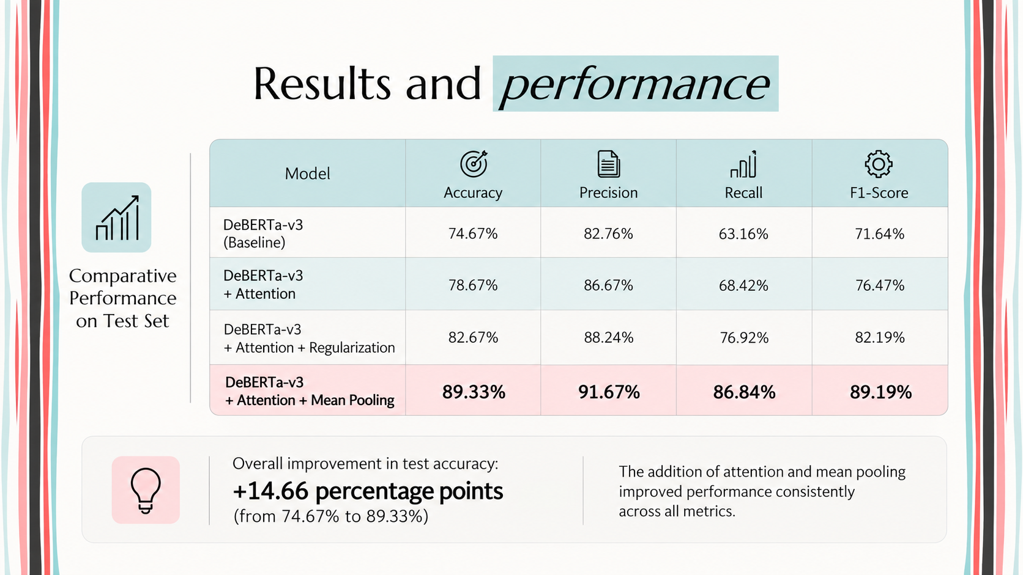

Slide 11
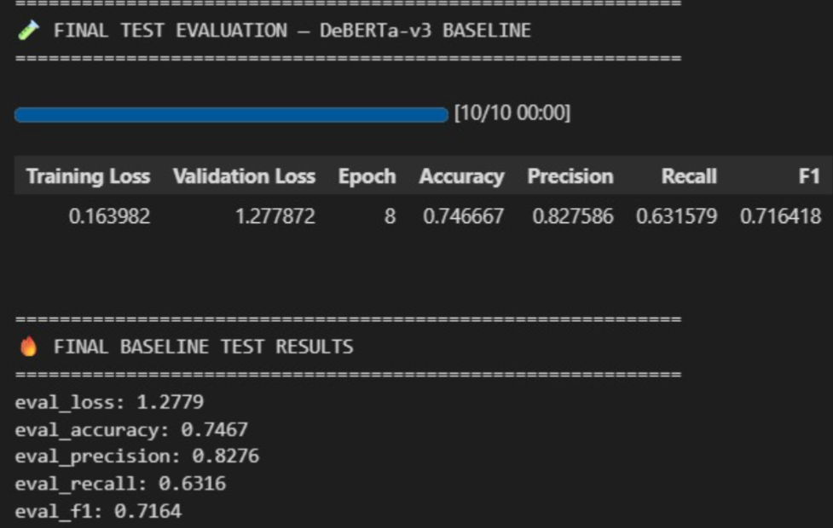
DeBERTa-v3 Baseline
Baseline Performance
DeBERTa-v3 used as the baseline classifier.
Evaluated on the final test set after 8 epochs.
Accuracy: 74.67%
Precision: 82.76%
Recall: 63.16%
F1-Score: 71.64%

Slide 12
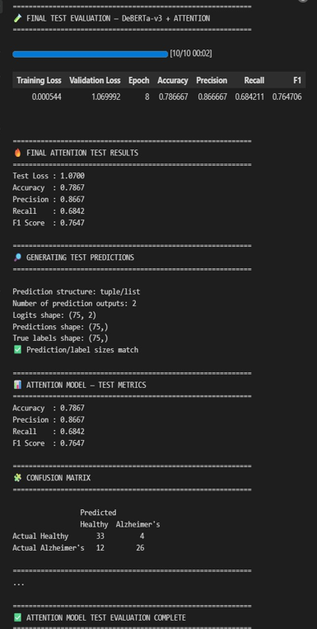
DeBERTa-v3 + Attention
Attention Model Performance
Attention mechanism added to the DeBERTa-v3 model.
Evaluated on 75 test samples.
Accuracy: 78.67%
Precision: 86.67%
Recall: 68.42%
F1-Score: 76.47%
Confusion Matrix:
Correct Healthy predictions: 33
Correct Alzheimer’s predictions: 26
Total correct: 59 / 75

Slide 13
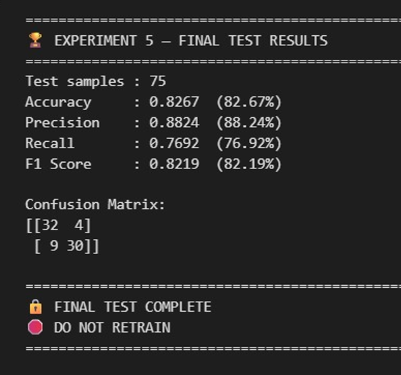
Final Test Results
Final Model Performance
Test Samples: 75
Accuracy: 82.67%
Precision: 88.24%
Recall: 76.92%
F1-Score: 82.19%
Confusion Matrix
Correct Healthy: 32
Correct Alzheimer’s: 30
Misclassified samples: 13

Slide 14
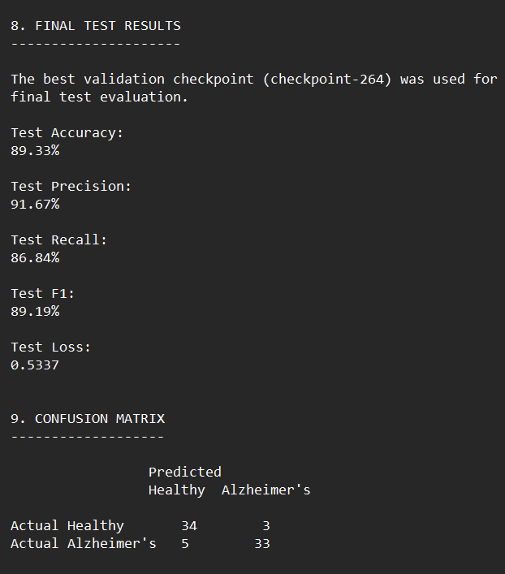
DeBERTa-v3 + Attention + Mean Pooling
Improved Model Performance
Test Samples: 75
Test Accuracy: 89.33%
Test Precision: 91.67%
Test Recall: 86.84%
Test F1-Score: 89.19%
Confusion Matrix
Correct Healthy: 34
Correct Alzheimer’s: 33
Misclassified samples: 8

Slide 15
Conclusion & Future Work
Completed:
Future Work:
Dataset preprocessing
DeBERTa-v3 baseline training
Attention mechanism implementation
Regularization experiment
Comparative evaluation
Final model evaluation
Research paper draft preparation
Integrate final model into AlzDx application
Speech/audio input pipeline
Explainable prediction/report generation
AI assistant integration
Further validation on larger datasets

Slide 16
THANK YOU
By-
Bhanu Prakash(2420030209)
Myneni Krishita (2420030443)
D.L.S. Laasya Priya(2420030002)

