Slide 1




Giri Venkata Laasya
Vanyashree JS
Mohana Mounica Rowtu
Jaladi Nimmi
SMARTBANK

Slide 2
Project Overview
User-friendly banking interface
Perform credit, debit, and transfer functions
View transaction history
Built with Angular and JSON Server

Slide 3
Core Functionalities
Account Management: Register users, manage accounts (db.json)
Credit: Add funds, log transactions
Debit: Validate balance, update and show new balance
Transfer: Update both sender and receiver, full transaction logging
History: Display all user actions, sorted by date

Slide 4
Technology Stack
LAYER | TOOLS USED
FrontEnd | Angular
Backend | JSON Server
HTTP Requests | Angular HttpClient
Testing | Jasmine
Storage | LocalStorage

Slide 5
Application Modules
Landing Component – The landing page of the application
Login Component – Processes user login
Register Component – Helps user create an account
BankingserviceService – Handles data & logic
Credit Component – Processes deposits
Debit Component – Handles withdrawals
Transfer Component – Transfer funds
Home Component – Dashboard & User Information

Slide 6
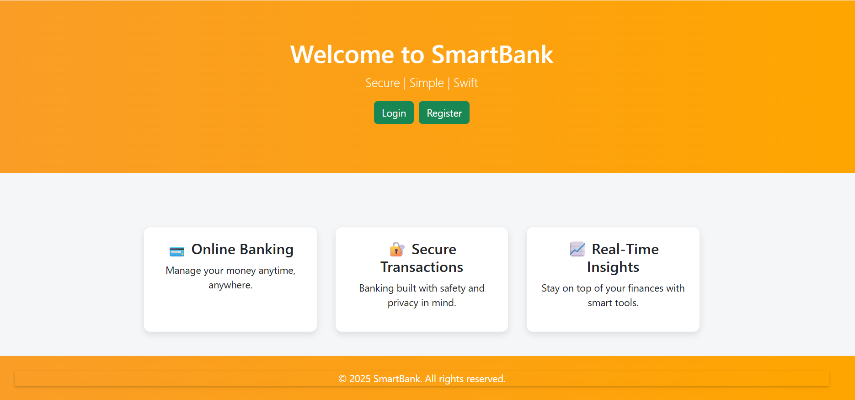
Landing page of application

Slide 7
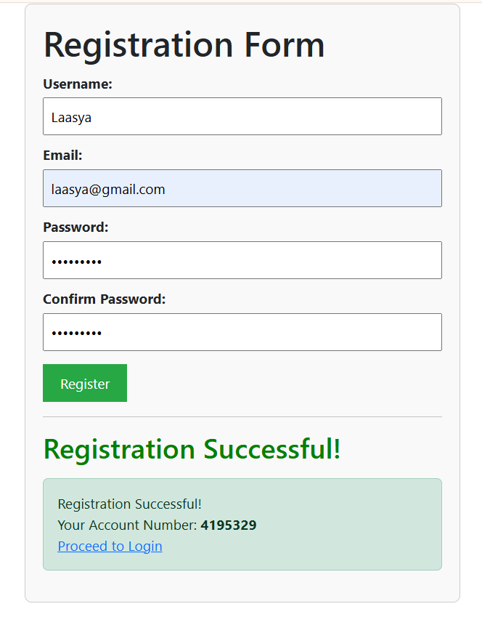
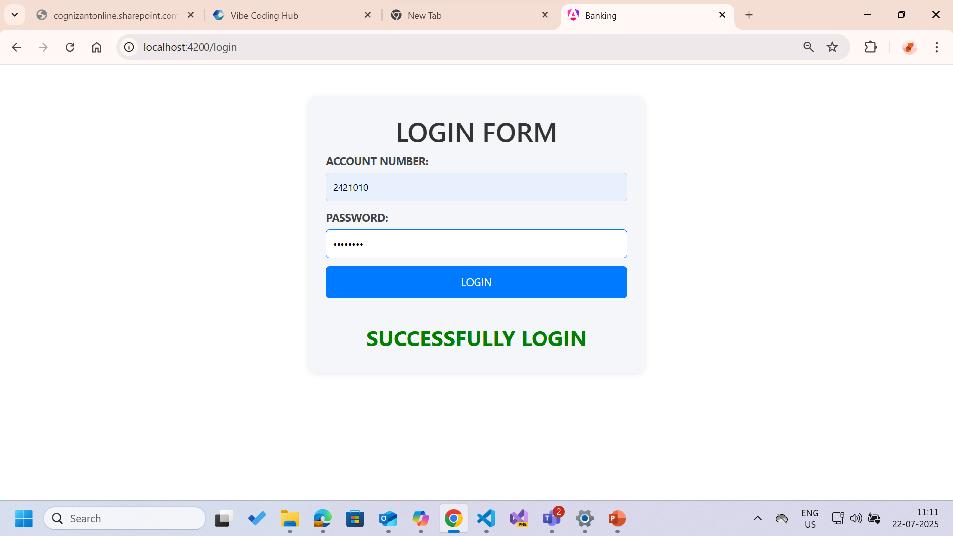
Registration Form
Login Form

Slide 8
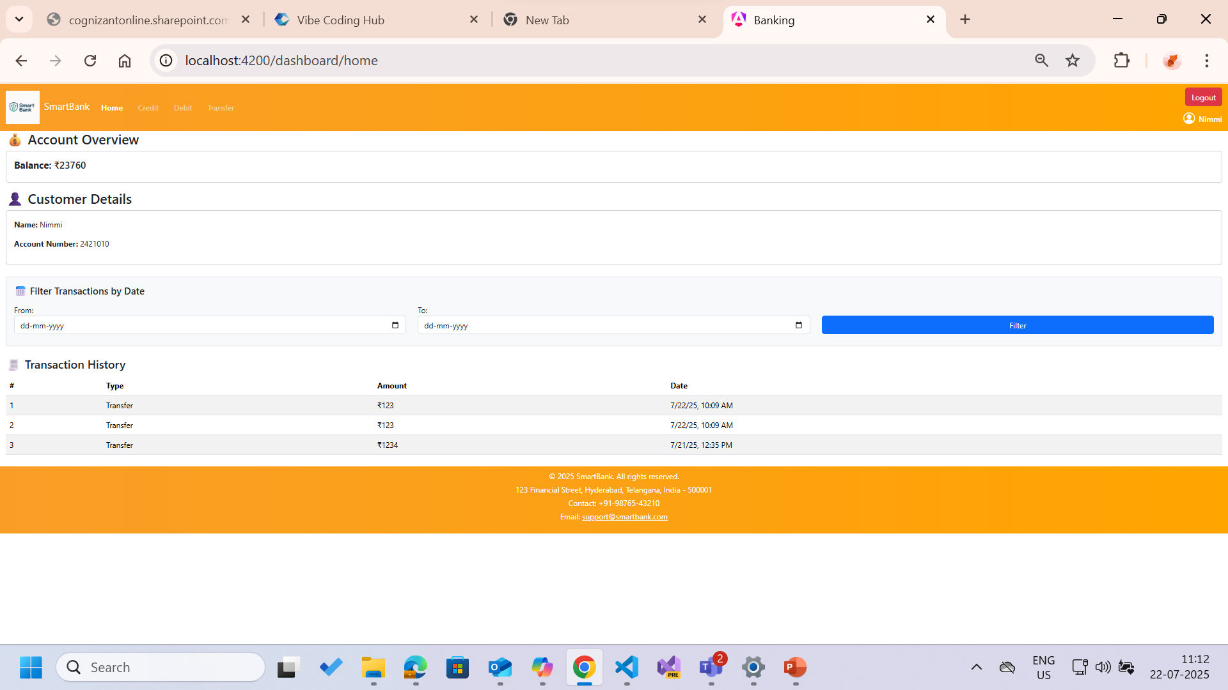
Dashboard Home Page

Slide 9
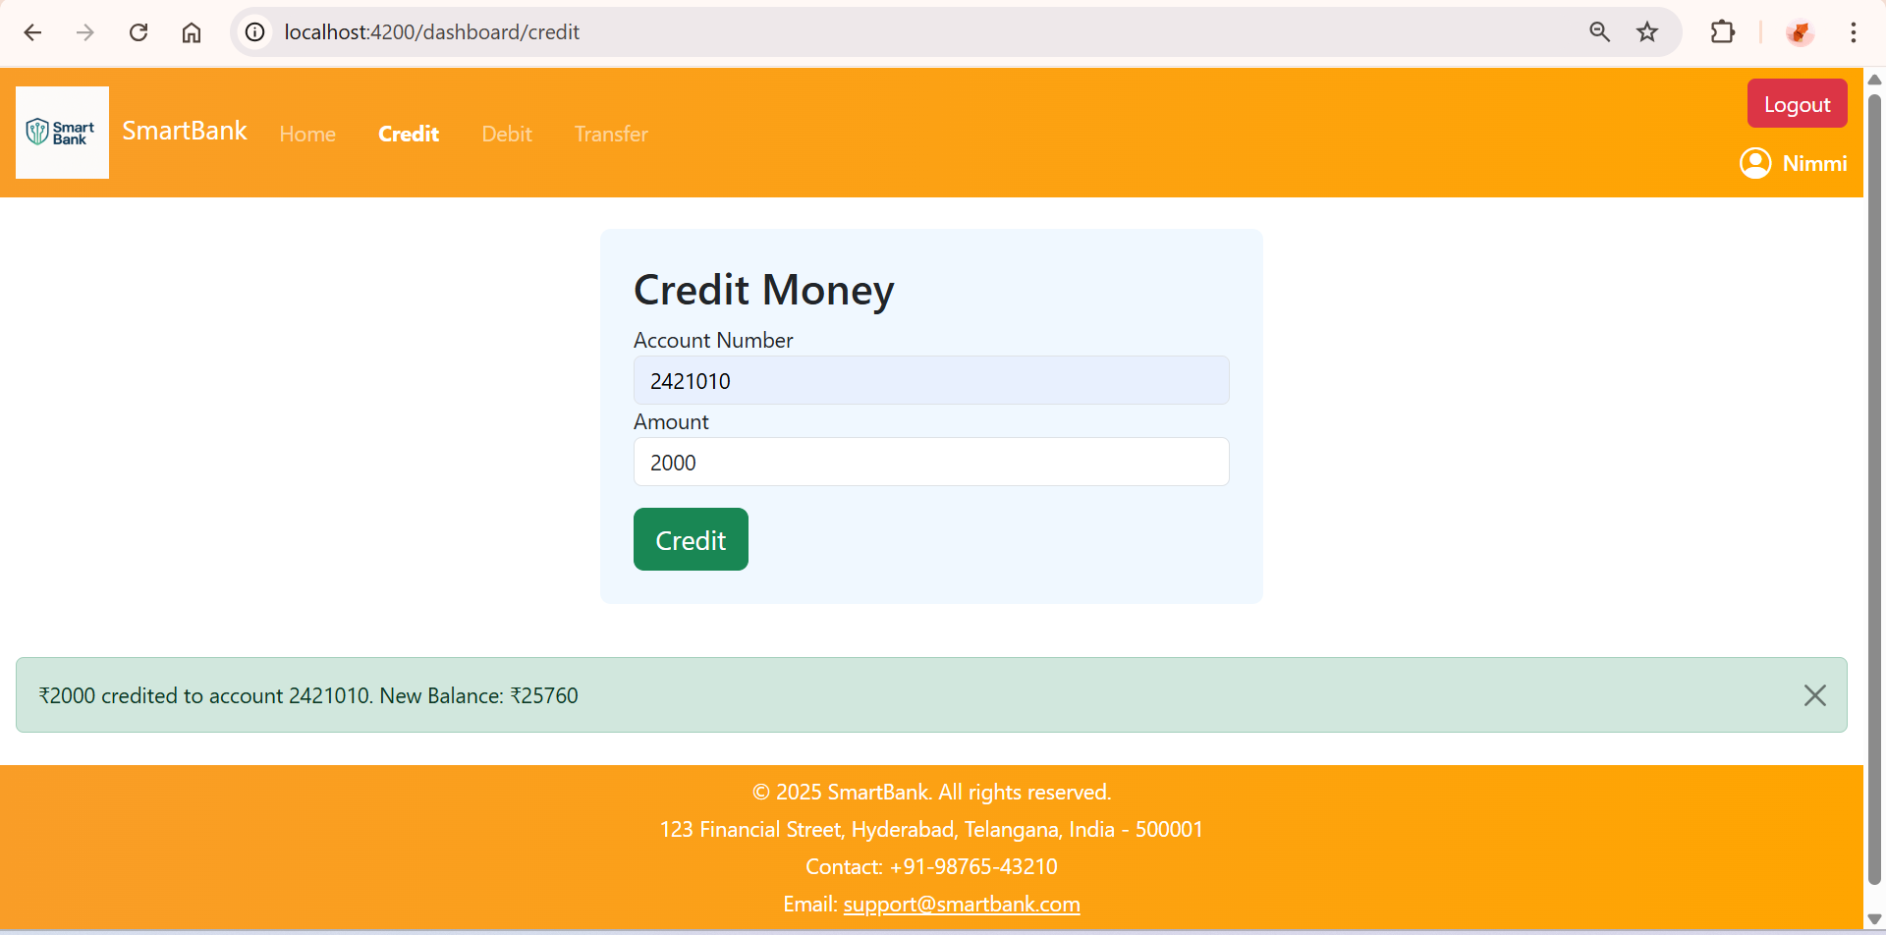
Credit Page

Slide 10
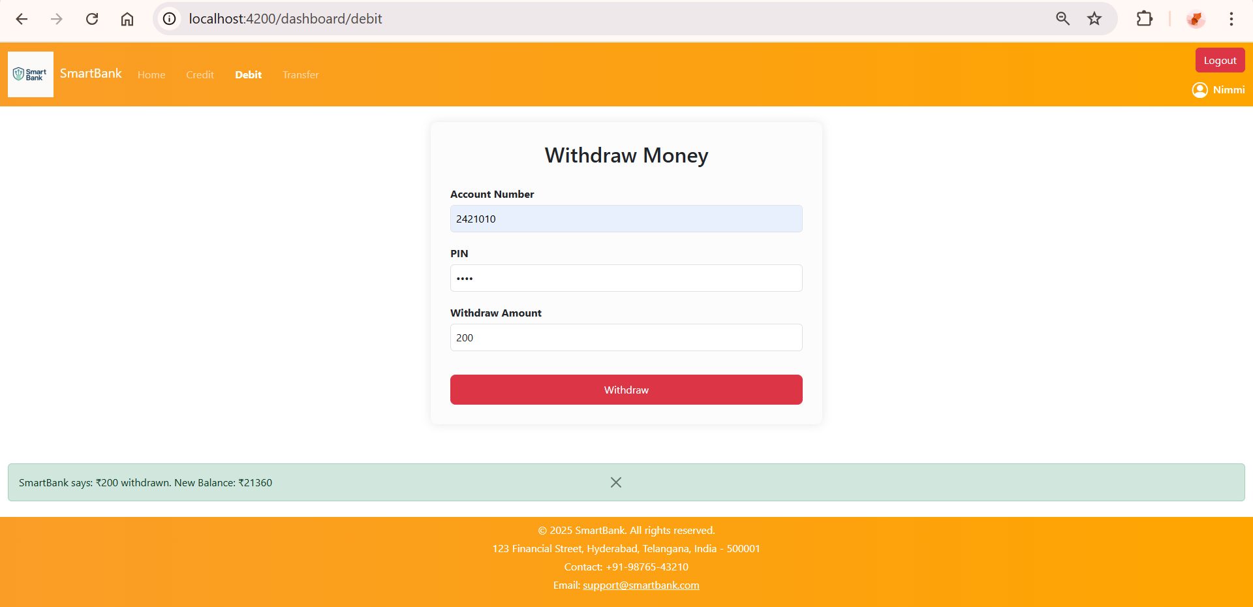
Debit Page

Slide 11
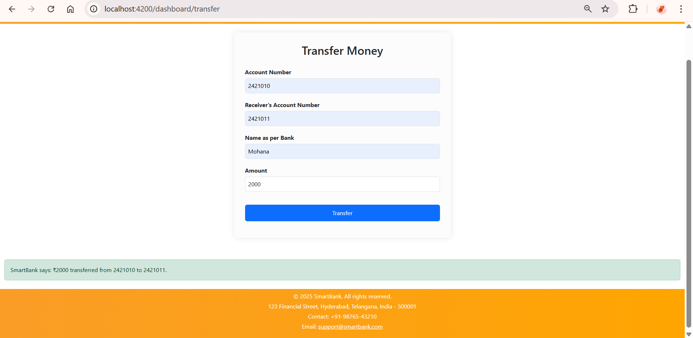
Transfer Page

Slide 12
Unit Testing
Test methods: creditAmount
Using Jasmine.
Validate forms and component logic
Use spyOn() to track internals

Slide 13
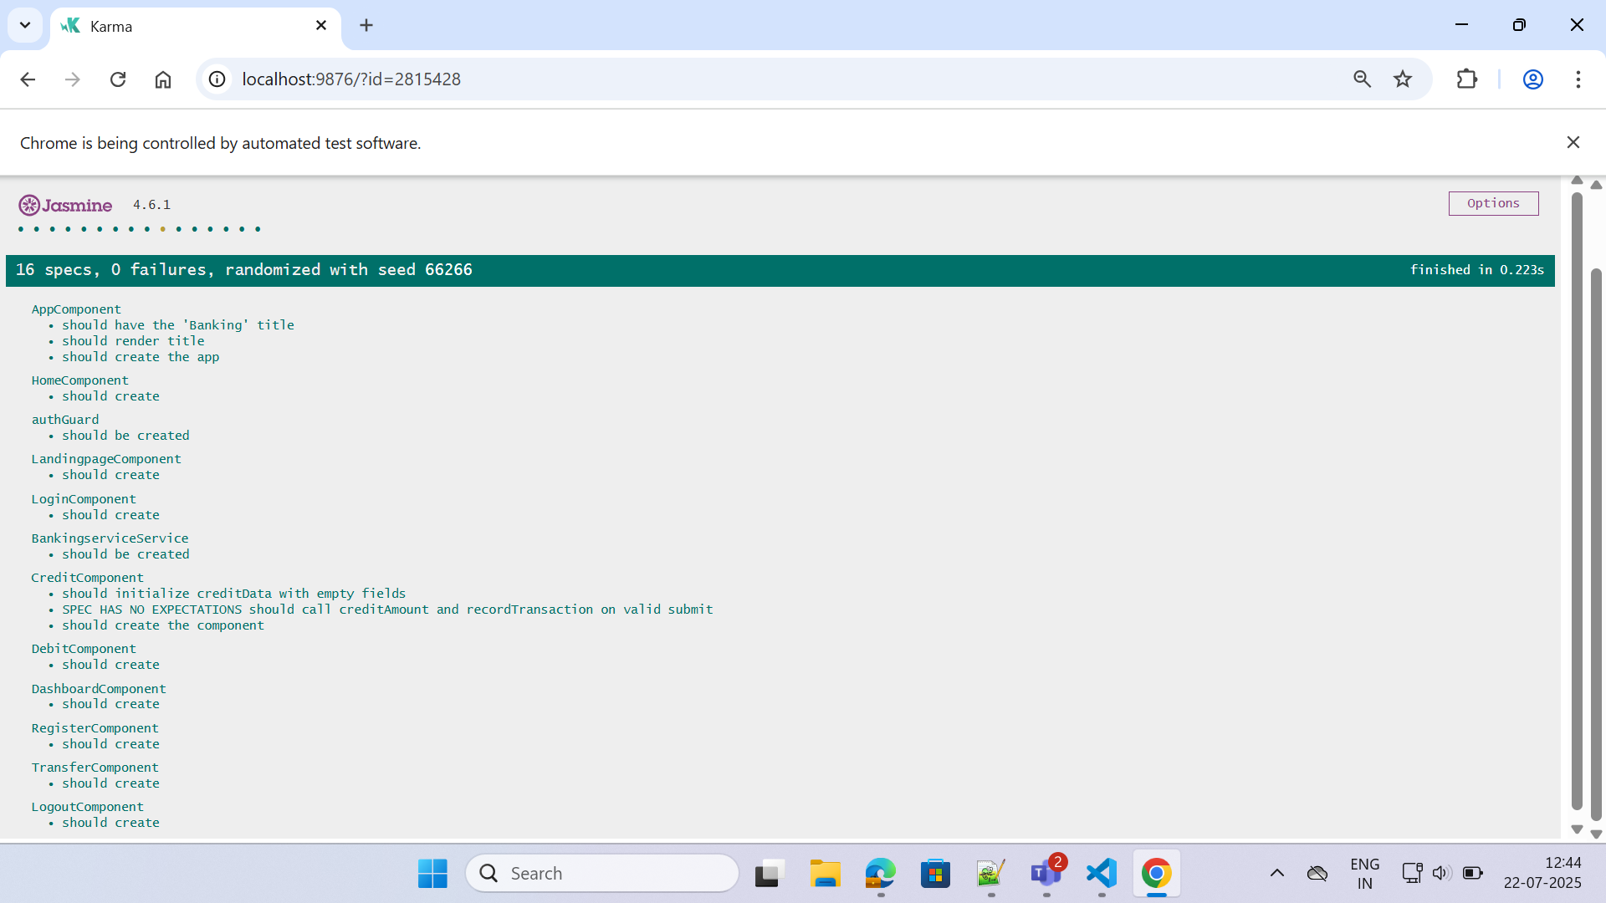
Unit Testing using Jasmine

Slide 14

Achievements
Achievements
Account Management: Register users, manage accounts (db.json)
Credit: Add funds, log transactions
Debit: Validate balance, update and show new balance
Transfer: Update both sender and receiver, full transaction logging
History: Display all user actions, sorted by date
Real-time, dynamic data updates
User-visible transaction history
Unit-tested and reliable
Scalable, modern web architecture
Real-time, dynamic data updates
User-visible transaction history
Unit-tested and reliable
Scalable modern web architecture

Slide 15
Thank you

