Slide 1


Mohan Babu University
Sree Sainath Nagar, Tirupati – 517102
Department Of Computer Applications
AI-Based Detection of Mango Leaf Diseases and Nutrient Deficiencies
Project Review-1
SIH ID: SIH1638
PRESENTED BY
K. Teena Reddy - 23102C010012
G. Laasyapriya - 23102C010036
K. Srivalli - 23102C010097
Project Guide:
Mr. S. Girinath
Department of CA

Slide 2

Abstract
Mango farming often suffers yield losses due to leaf diseases and nutrient deficiencies, usually detected only after serious damage. Early and automated detection can help farmers act promptly, reduce losses, and improve crop quality. This project proposes a machine learning-based system using image processing to detect and classify diseases and nutrient deficiencies in mango leaves. Leaf images are pre-processed through resizing, normalization, noise reduction, and colour space conversion to manage variations in lighting and field conditions. Segmentation separates leaves from the background, and key features including colour histograms, texture features (GLCM and LBP), and shape descriptors are extracted. These features are analysed with machine learning algorithms such as Random Forest, SVM, and KNN for accurate classification. Later, deep learning models like DenseNet-121 with transfer learning will be explored. Unlike manual diagnosis, this approach is faster, reliable, and requires no expert knowledge, offering farmers a cost-effective and efficient tool for early detection.

Slide 3
Contents
Abstract
Introduction
Review of Literature
Proposed Methodology
Proposed System
Results(UML diagrams)
Conclusion
References

Slide 4
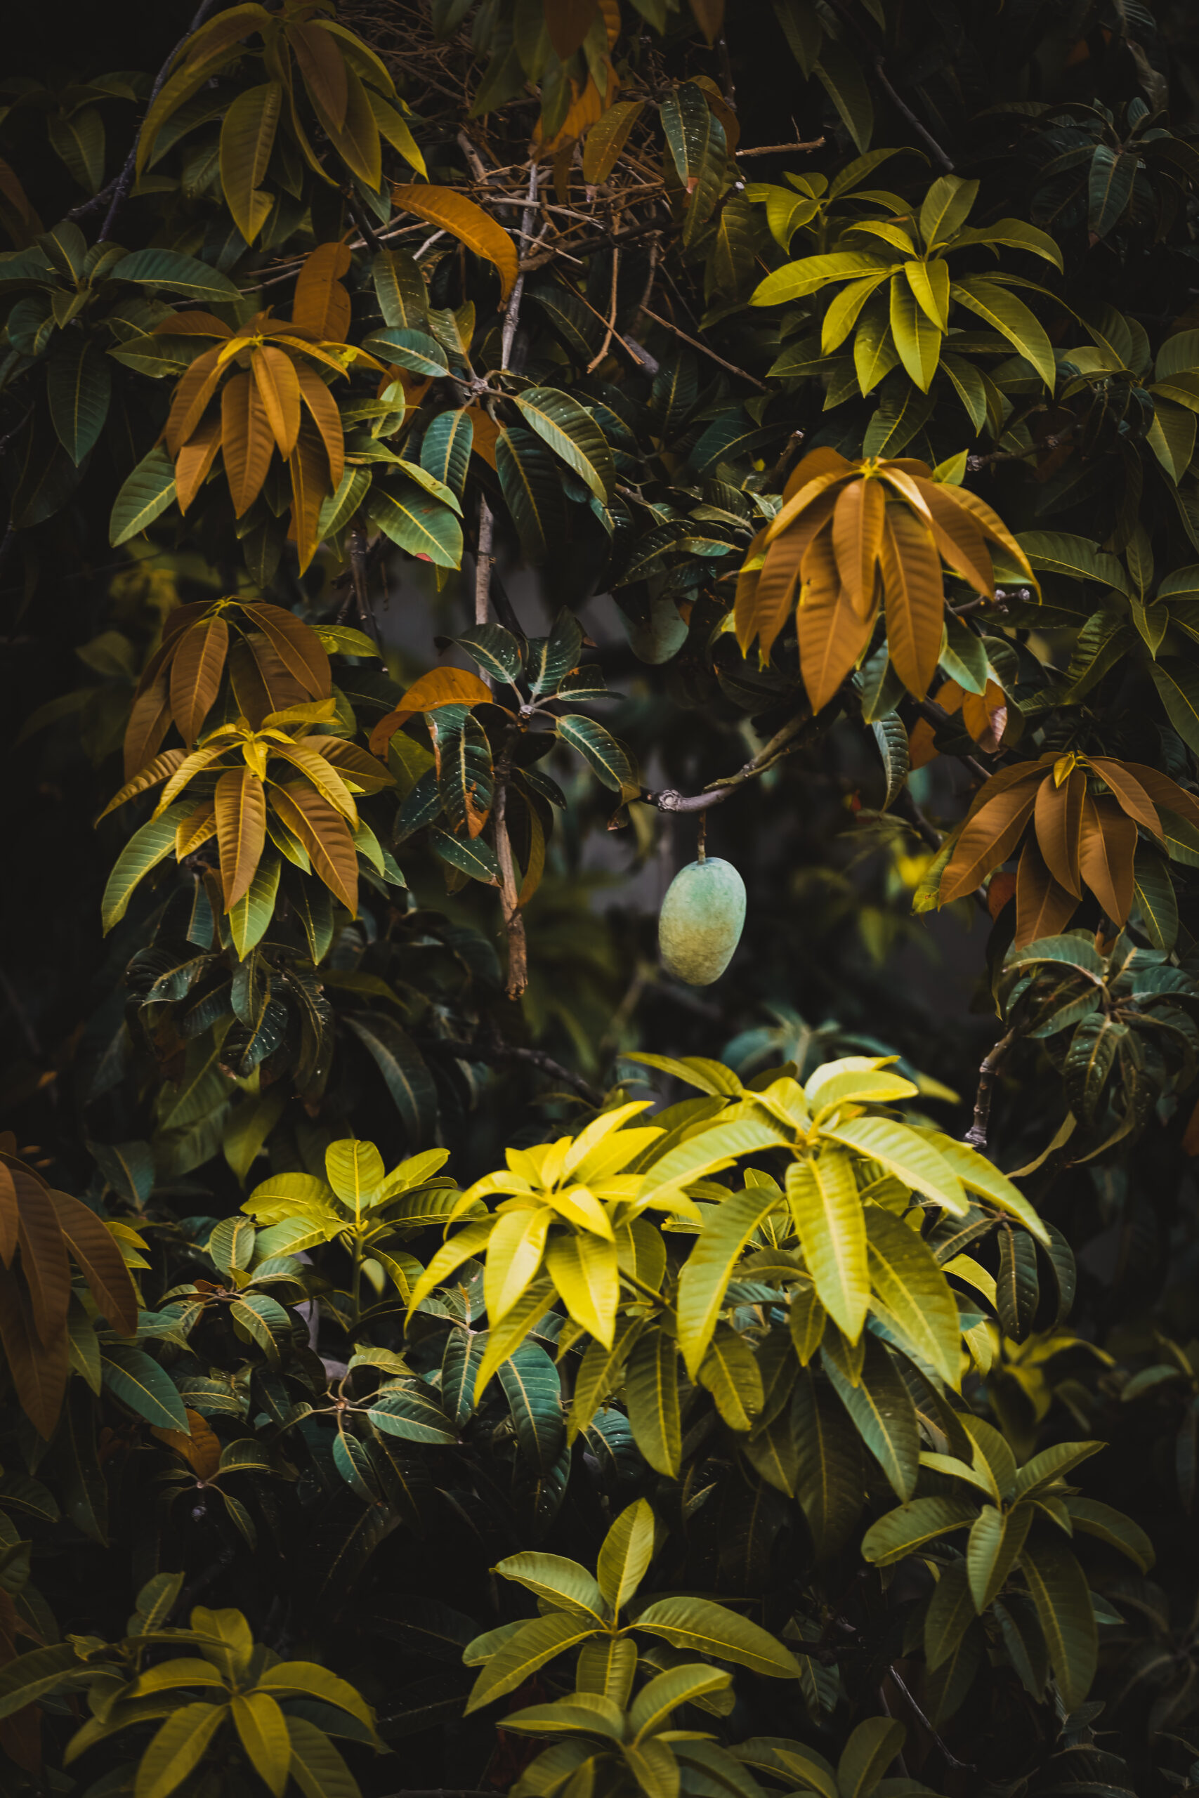
Introduction
Mango is one of the most important fruit crops with high economic value
Mango leaves are commonly affected by diseases and nutrient deficiencies
Early identification is crucial to prevent yield loss and quality reduction
Manual diagnosis is time-consuming and requires expert knowledge
Artificial Intelligence can assist in fast and accurate leaf health analysis

Slide 5
Review of Literature
We analyzed 41 research papers spanning a decade (2016-2025) on mango leaf health detection. link(literature survey excel sheet)
Key Findings
Scope Gap: Over 90% of studies focus exclusively on disease detection, largely ignoring nutrient deficiencies.
Tech Evolution: Clear shift from Classical ML (SVM, KNN) to Deep Learning (CNN, DenseNet) and now Lightweight/Explainable AI models.
Validation Gap: Nearly all high-accuracy models (>95%) are validated in controlled lab conditions, not real field environments.
Practicality Gap: Minimal focus on mobile deployment; only 2 papers discuss optimization for low-resource devices.
Our Synthesis: This analysis identifies a critical need for an integrated, field-robust, and farmer-accessible diagnostic system.

Slide 6
Proposed methodology
Two Parallel Approaches: Implementation of both classical machine learning and deep learning pipelines
Classical ML Pipeline: Image preprocessing → handcrafted feature extraction → classification using SVM, Random Forest, and KNN link
Deep Learning Pipeline: Image preprocessing → transfer learning using DenseNet-121 → multi-class classification link
Comparative Analysis: Performance evaluation based on accuracy, inference speed, and computational efficiency
Generalization Focus: Data augmentation and diverse dataset collection to improve robustness under field conditions

Slide 7
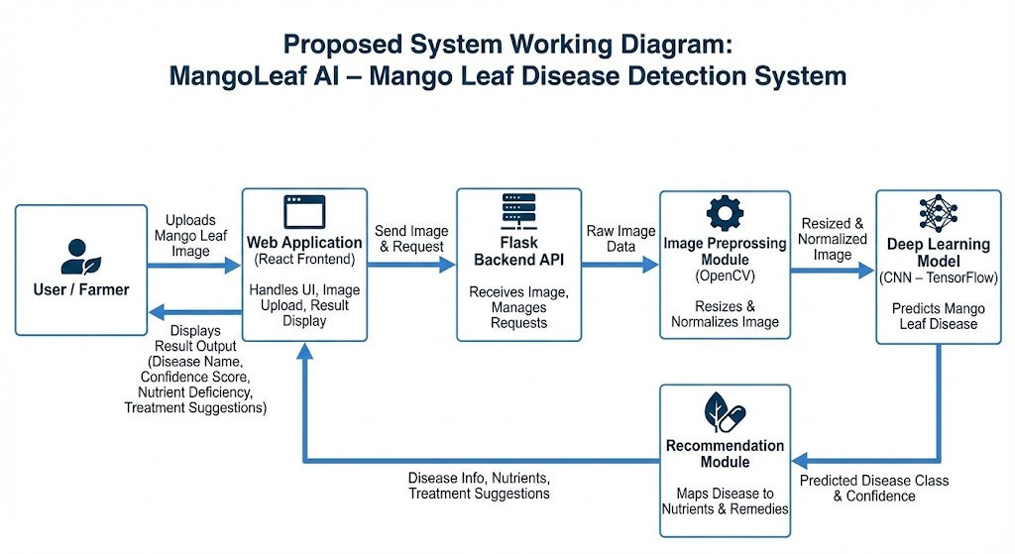
Proposed System

Slide 8
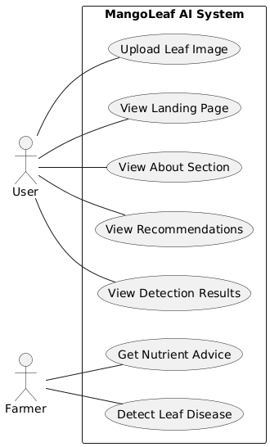
UML Diagrams
Use Case diagram

Slide 9
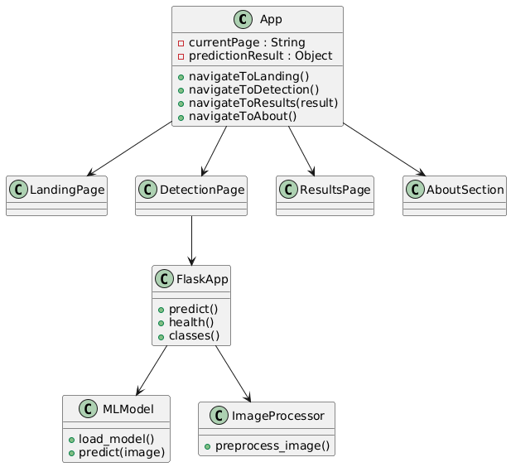
Class diagram

Slide 10
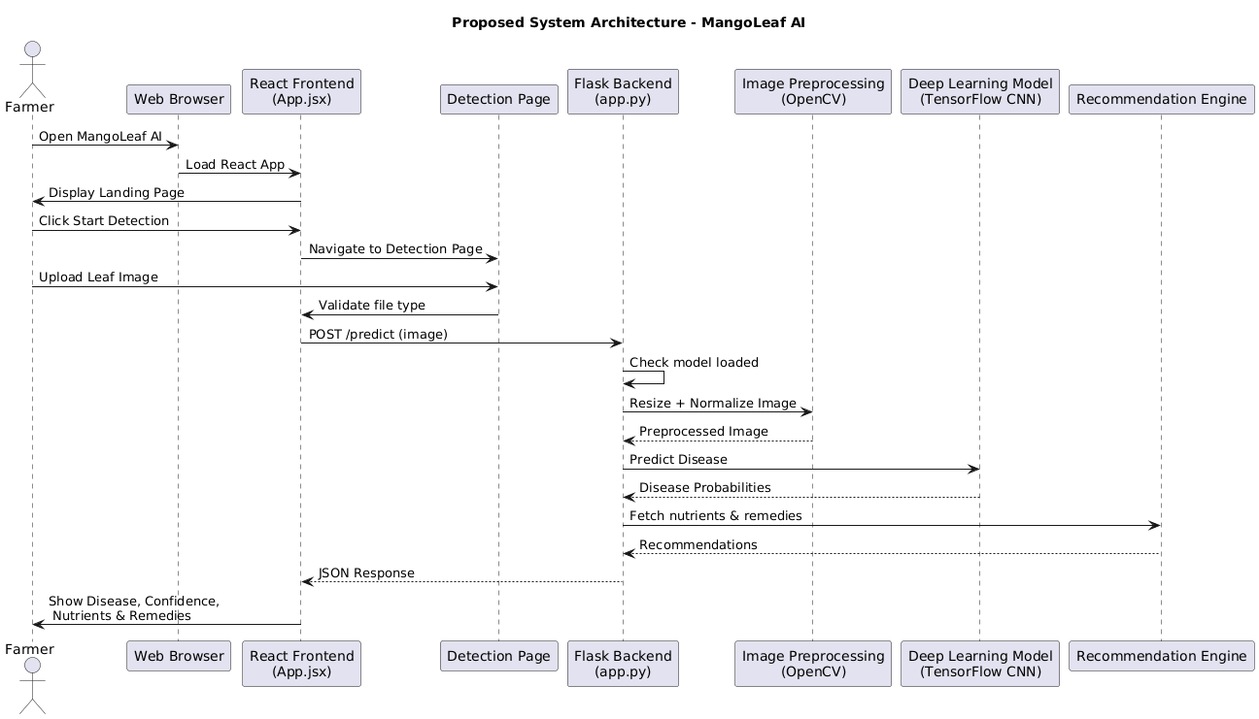
Sequence diagram

Slide 11
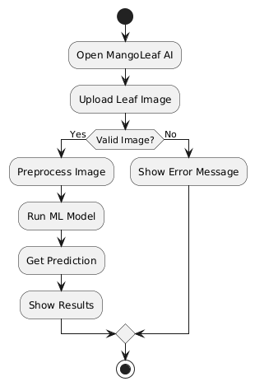
Activity diagram

Slide 12
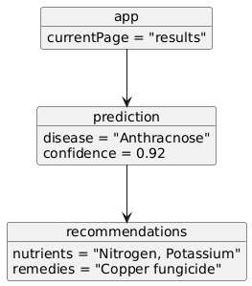
Object diagram

Slide 13
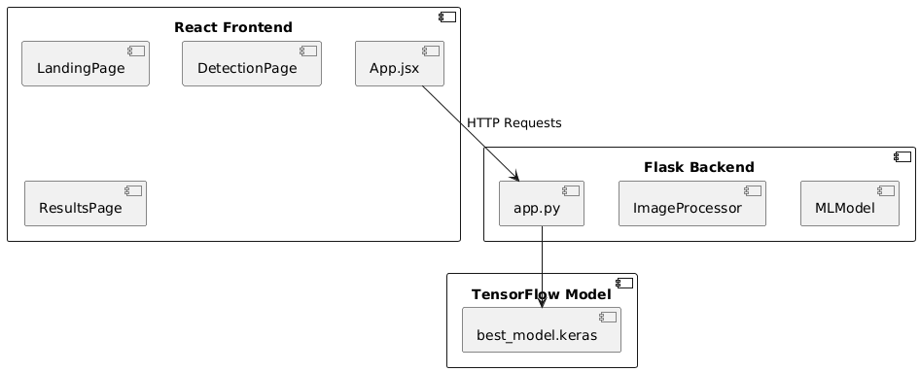
Component diagram

Slide 14
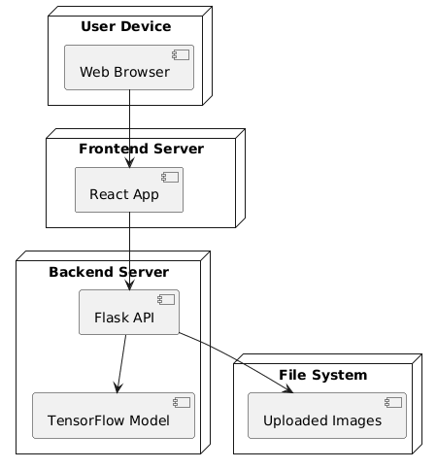
Deployment diagram

Slide 15
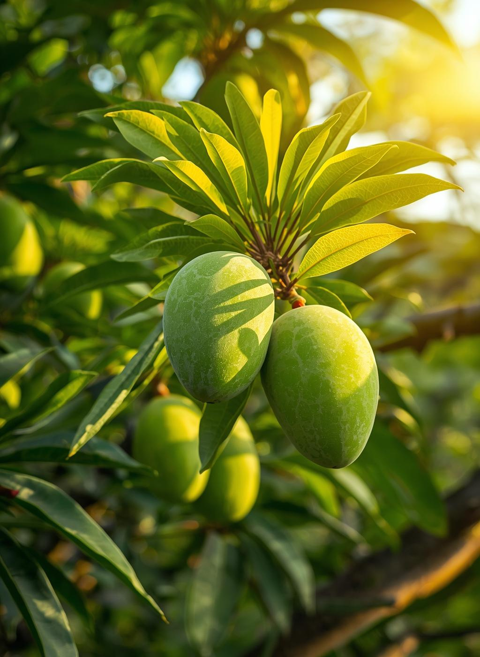
Conclusion
Mango leaf diseases and nutrient deficiencies significantly impact crop yield
Early and accurate detection is essential for effective crop management
AI-based image analysis provides a promising solution for automated diagnosis
The proposed system aims to identify multiple diseases and deficiencies from leaf images
Mobile-friendly deployment can support farmers with timely decision-making
This approach has the potential to improve productivity and promote sustainable agriculture

Slide 16
References
[1] M. Merchant et al., Mango leaf deficiency detection using image processing and ML, I2CT, Pune, India, 2018.
DOI: https://doi.org/10.1109/I2CT.2018.8529755
[2] S. Arivazhagan and S. V. Ligi, Mango leaf disease identification using CNN, Int. J. Pure Appl. Math., 2018.
Link: https://www.academia.edu/download/76332505/731.pdf
[3] M. R. Mia et al., Mango leaf disease recognition using NN and SVM, Iran J. Comput. Sci., 2020.
DOI: https://doi.org/10.1007/s42044-020-00057-z
[4] S. Govindarajan et al., Plant leaf disease classification using DenseNet-121, ICACCS, 2020. Link:https://www.academia.edu/49045897/MULTIPLE_PLANT_LEAF_DISEASE_CLASSIFICATION_USING_DENSENET_121_ARCHITECTURE
[5] M. T. Islam et al., MangoLeafDB: Dataset for mango leaf disease classification, Mendeley Data, 2024.
DOI: https://doi.org/10.17632/7ghdbftp54.1

Slide 17
Thank You

