Slide 1
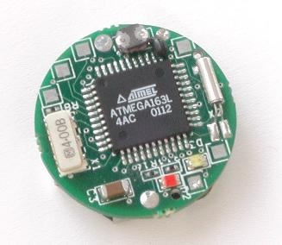
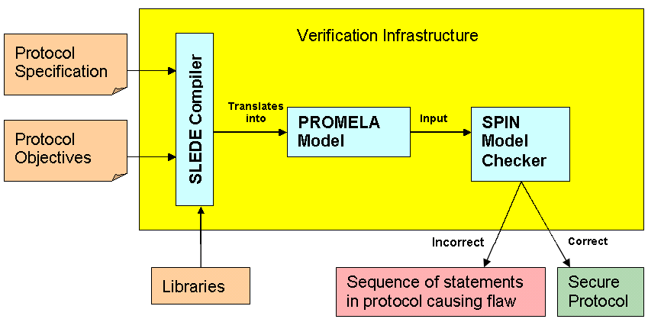
SLEDE: Event-Based Specification of Sensor Network Security Protocols*
http://www.cs.iastate.edu/~slede
Problem
Solution
Sensor networks often used in hostile settings
New protocols emerging to secure these networks
Specifying and verifying these protocols is harder
Issues: group-oriented, resource constraint
SLEDE: An event-based specification language
Based on nesC syntax, a dominant programming language for networked systems
A model-based verification technique
Event (Light, sound,
motion, etc)
Action taken (Event Handler)
node Sender {
command result_t StdControl.init() {
...
}
event result_t Timer.fired() {
...
call Transmission.broadcastMsg(msg);
}
}
Nodes in sensor networks use event-based paradigm
Implementation follows
event-based paradigm
Specification follows
message-driven paradigm
node Receiver {
event result_t Receiving.receiveMsg(msg_t msg){
%if unable to decrypt, signal error
signal Error.error();
% deliver message if decrypted
call Transmission.deliver(msg);
}
}
Impedance mismatch leads to verification issues
  e.g. missing assumptions
Results in proliferation of informal specifications
Contributions
Easier to understand and write
Extensible w.r.t. intruder and channel models
More expressive objectives in terms of user-defined events
  In existing specification languages, goals are fixed
  (e.g. SECRET, PRECEDES in CAPSL [1])
  Example objective: ensure that the data received
  from a certain node is not sent by an impersonator
objective
{
Sender.Transmission.broadcastMsg(msg) =>
(Receiver.ReceiveMsg(msg) &&
Receiver.Transmision.deliver(msg)) ||
(Receiver.ReceiveMsg(msg) &&
Receiver.Error.error())
}
lib securityLib{
command int hash(Key inputKey, msg_t theMsg) {
...
}
in SLEDE:
Sender.Transmission.broadcastMsg(msg)=> Receiver.Receiving.ReceiveMsg(msg) &&
! Receiver.Error.msgFromImpersonator()
Objectives described in terms of commands and events
Event-based communication is emulated using global channels in PROMELA model
in CAPSL: can’t be represented
[1] J. K. Millen. CAPSL:Common authentication protocol specification language .In NSPW’96
Proceedings of the 1996 workshop on New security paradigms, 1996.
*This research is supported in part by the National Science Foundation under grant CT-ISG 0627354
Department of Computer Science
Youssef Hanna and Hridesh Rajan

