Slide 1

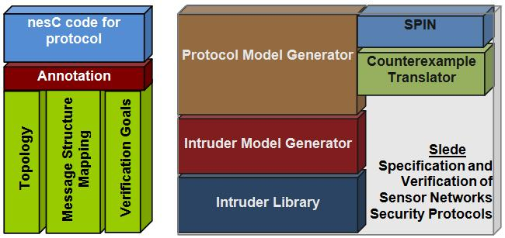
CT-ISG: Specification and Verification Challenges for Security Protocols in Sensor Networks
Hridesh Rajan and Wensheng Zhang
Broad Problem
Sensor networks often used in hostile settings, need to secure these networks
Specifying and verifying new protocols is harder
Issues: unboundedness, topological issues, intruder behavior
Specific Problem #1: Verification from Specification is not enough
Specialized knowledge in specification language required
No guarantee that the implementation is implementing the verified specification of the protocol
Approach: Extract verifiable models from protocol implementations
Specific Problem #2: Undecidability of the Problem
State explosion in model checking:
  Unbounded number of sensors in
  a network
  Dynamic topology
  Unbounded Intruder behavior
Formal proofs are expensive
Approach:
  Put a bound on number of sensors
  Verify against all possible topologies for bounded number of sensors, one at a time
  Provide intruder with information about protocol to bind behavior
Program analysis based optimizations to enhance scalability
Overview
Automatically extracts models from source code
Given a bounded number of sensors, all possible topologies are generated for thorough verification
Translated the generated counterexample written in PROMELA to the corresponding statements sequence int nesC
Information about messages exchanged in the protocol that is required for the intruder to make smart attacks
Goals written in terms of commands/events (functions) of the implementation for easier specification of goals
Provides extensibility by verifying against different intruders (node compromise, Dolev-Yao, etc..)
Generated intruder model is merged into the protocol model
NSF Cyber Trust Principal Investigators Meeting
March 16-18, 2008
New Haven, Connecticut

