Slide 1
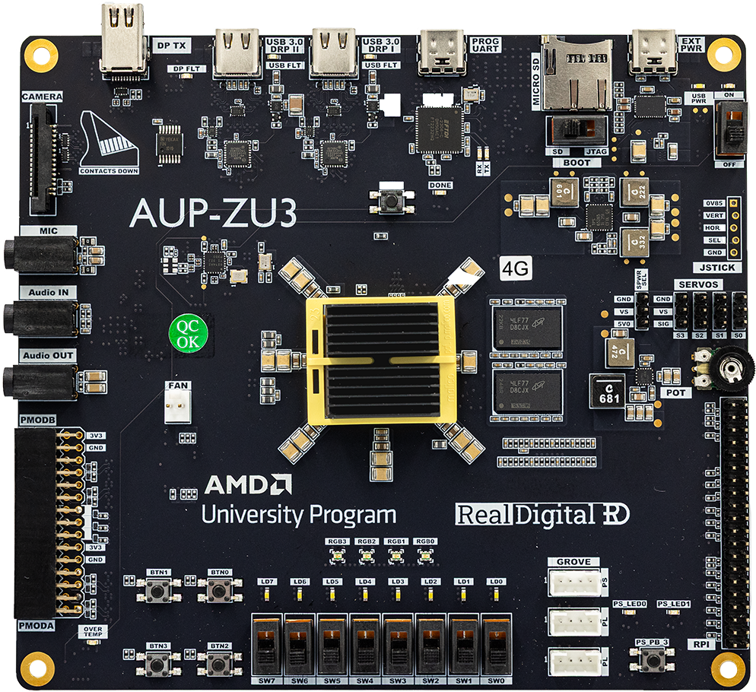
① Connect to PC
② Connect to Power
④ Push up to Power On
③ Push Right to use JTAG
LEDs
RGB LEDs

Slide 2
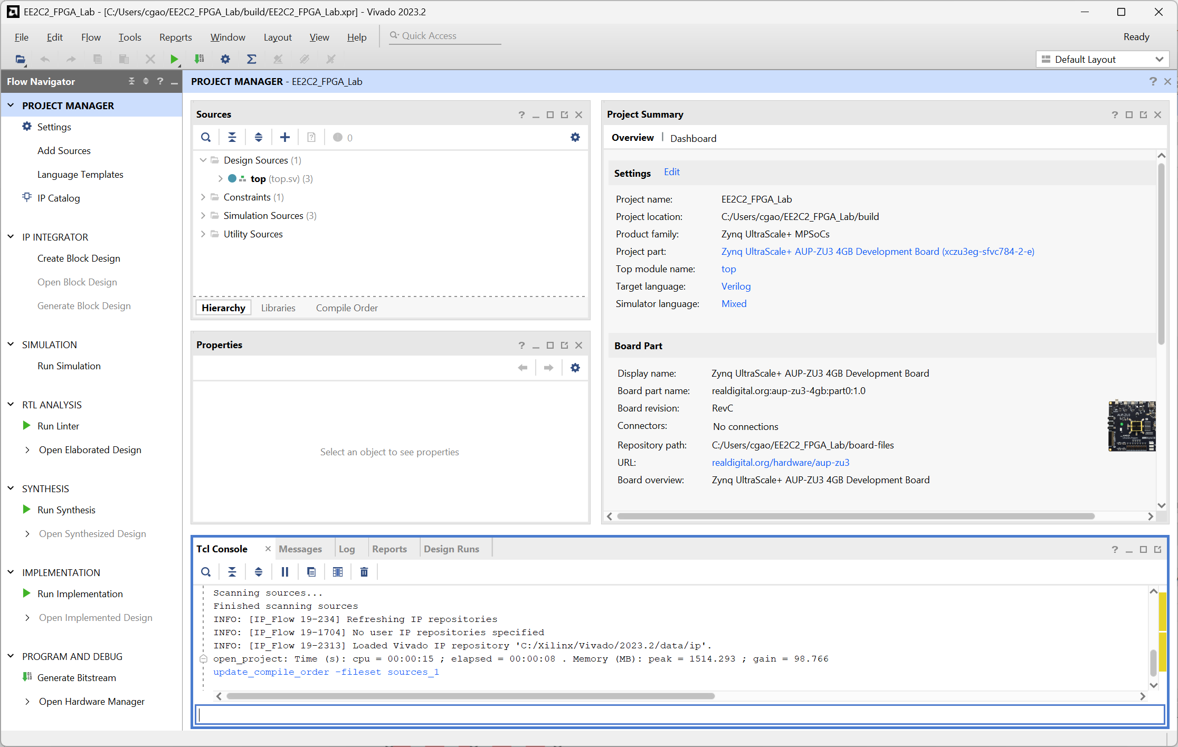
Find your source files here
Where errors are reported
Flow Status & Progress
Design Flow
Run your Tcl commands here

