Slide 1
Lab::Measurement
Instrumentation control with Perl –
The Next Generation

Slide 2
Lab::Measurement is written in Perl
Written in Perl (and some low-level stuff in C)
To be used from programs written in Perl
Perl: interpreted scripting language
Runs on almost every OS
Extremely good in reading data files, manipulating data, etc.
Allows to write quick and dirty scripts that get the job done
Also allows to write clean fullsize programs
=> ideal for experimental physics

Slide 3
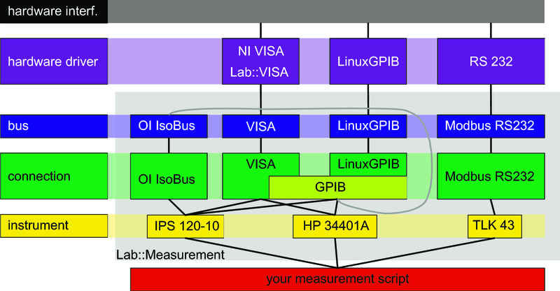
Modular architecture of the core stack
measurement
… looks complicated, but:

Slide 4
Using Lab::Measurement
#!/usr/bin/perl
use strict;
use Lab::Instrument::HP34401A;
my $hp_gpib=$ARGV[0];
print "Reading HP34401A at GPIB address $hp_gpib\n";
my $hp=new Lab::Instrument::HP34401A(
connection_type=>'LinuxGPIB',
gpib_address => $hp_gpib,
gpib_board=>0,
);
my $volt=$hp->$get_voltage_dc(10,0.00001);
print "Result: $volt V\n";

Slide 5
A real measurement!
How about doing a gate sweep, 100 steps from 0V to 1V?
#!/usr/bin/perl
use Lab::Instrument::HP34401A;
use Lab::Instrument::Yokogawa7651;
# Connect to gate voltage source
my $yoko=new Lab::Instrument::Yokogawa7651({
connection_type => 'LinuxGPIB',
gpib_address => 14,
gate_protect => 0,
});
# Connect to multimeter
my $hp=new Lab::Instrument::HP34401A(0, 21);
for (my $volt=0; $volt<=1; $volt=$volt+0.01) {
# set Yokogawa
$yoko->set_voltage($volt);
# wait a second
sleep(1);
# read multimeter
my $vmeas=$hp->read_voltage_dc();
# print values
print $volt,"\t",$vmeas,"\n";
}

Slide 6
Complex measurements possible
Not just one input, multi-dimensional measurements
Read out as many instruments as you like, as often as you like
Combine with monitoring of setup (pressures, temperatures, …)
Low-level aspects (bus, connection, interface)
  Want to access as many devices as possible
  Linux / Windows
  Different device drivers, different hardware interfaces
  Thread-safe
High-level aspects (your script, measurement)
  Want to make measuring as comfortable as possible
  Access different hardware with same / similar commands
  Keep track of metadata
  Plotting during measurement, easy re-plotting afterwards

Slide 7
High-level classes: Lab::Measurement & friends
Provide additional tools to write better measurement scripts
Store metadata alongside data
  date and time
  settings of additional instruments
  ratio of voltage divider
  color of the shirt you are wearing
  everything that might be important for a later interpretation of the data
Don‘t repeat yourself
  Use above collected information automatically
  Automatically plot data with correct axes, scaling, labels etc.

Slide 8
High-level classes: metadata philosophy
Voltage source (Yoko)
Constants
R = 1000 Ω
V_{bias}
Columns
C1: V_{bias}
C2: V_{resistor}
unit
description…
1.5 | +8.19300500E-01
1.4 | +7.23413000E-01
1.3 | +6.28083900E-01
1.5 | +8.19300500E-01
R
V
Multimeter (HP)
V_{resistor}
Axes
Axis “bias voltage” (C1)
Axis “diode current”(C2 / R)
Axis “diode resistance”
(R * (C1 / C2 – 1))
unit
expression
description…
Plots
Plot “diode current”
axis “diode current” over
axis “bias voltage”
Plot “diode resistance”
axis “diode resistance” over
axis “bias voltage”
logscale
grid
ranges…

Slide 9
Using Lab::Measurement
my $measurement=new Lab::Measurement(
sample => $sample,
title => $title,
filename_base => 'zener_kennlinie',
description => $comment,
live_plot => 'diode current',
constants => [
{
'name' => 'R',
'value' => '1000',
},
],
columns => [
{
'unit' => 'V',
'label' => 'V_{bias}',
'description' => 'Bias Voltage',
},
{
'unit' => 'V',
'label' => 'Amplifier output',
'description' => 'Voltage drop on serial resistor',
}
],
axes => [
{
'unit' => 'V',
'expression' => '$C0',
'label' => 'V_{bias}',
'description' => 'Bias voltage',
'min' => ($start_voltage < $end_voltage)
? $start_voltage
: $end_voltage,
'max' => ($start_voltage < $end_voltage)
$measurement->start_block();
for (
my $volt = $start_voltage;
($volt-$end_voltage)/$step < 0.5;
$volt += $step
) {
$knick->set_voltage($volt);
sleep(1);
my $meas = $hp->get_voltage_dc(10,0.0001);
$measurement->log_line($volt,$meas);
}
my $meta = $measurement->finish_measurement();
Run measurement!
Describe measurement!

Slide 10
Result: two files per measurement
„.dat“: your measurement data, in simple text format
# comment
# comment
x1 x2 x3 y1 y2 y3
x1 x2 x3 y1 y2 y3
...
„.meta“: all the additional metadata in computer-readable xml
can be read out and evaluated again
can be used to automatically replot the data for example

Slide 11
Other high-level features
“Gate protect” safety mechanism
  Makes sure that no voltage is changed to fast
  Big voltage steps are automatically split into small, slow steps
Date/time handling
  Date/time column can contain timestamp for every data point
  Plot data as function of time
Measurements with higher dimensionality
  Each trace/sweep/line is a “block”
  Two-dimensional plots, selections of traces, etc.

Slide 12
Utilities: plotter.pl, make_overview.pl
plotter.pl:
  Reads measurement file, list avaible plots (axes etc)
  Creates postscript or pdf output
make_overview.pl:
  Reads all measurements e.g. in a directory
  Generates a postscript or pdf file with plots for each measurement, including the metadata (i.e. constants, parameters, color of your shirt) (via LaTeX)
  Great for completing your lab book

Slide 13
Modular architecture of the core stack
measurement

Slide 14
Internal architecture
Divided into several layers
Lab::Measurement is the highest abstraction layer. Provides support for writing good measurement scripts. Offers means of saving data and meta information to disk, plotting data, etc.
Lab::Instrument package makes communication with instruments easier by silently handling the protocol involved
Lab::Connection and Lab::Bus handle communication with the hardware and encapsulate the actual device drivers.
The lowermost layer is given by the hardware driver and its Perl binding. Several backends are supported, e.g. NI-VISA via Lab::VISA or LinuxGPIB.

Slide 15
VISA, GPIB, etc.
Instruments can be connected in various ways:
Serial port, GPIB, VXI, TCP/IP, USBtm, ...
GPIB (hardware and software)
  GPIB (IEEE488): Standard by Hewlett-Packard
  Physical layer IEEE488.1
  Command layer IEEE488.2
  SCPI (Standard Commands for Programmable Instruments)
VISA (software)
  Virtual Instrument Software Architecture
  VXI, GPIB, serial, or computer-based instruments
  NI-VISA library is one implementation of the VISA standard
Notes:
most important for us: GPIB

Slide 16
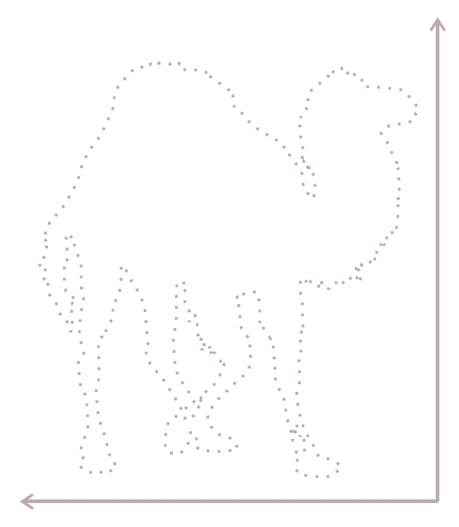
Open source, free software
Open source, free software
License: same as Perl (Artistic / GPL-2)
Homepage: http://www.labmeasurement.de/
Releases available from CPAN
Development code and history on Gitorious
https://www.gitorious.org/lab-measurement/lab
Contributors welcome!

