Slide 1
Lab::VISA

Slide 2
Introduction
Lab::VISA is software to control instruments in the laboratory
(e.g. voltage sources, multimeters etc.)
Alternative to LabView, GPPlus etc.
Very different: no GUI, just API
Design goals of Lab::VISA
Flexible
  Allow any kind of measurement procedure
  Control anything that has GPIB or serial connection
Safe
  Make sure you never drive voltage sources to fast and destroy your gates
Helpful
  Automatically collect additional information about the data (“Metadata”), that he can easily forget to write down in the lab book
  User should have to type in additional information only once and then never again

Slide 3
Perl
Lab::VISA is written in Perl and C
To be used from programs written in Perl
Perl is an interpreted scripting language
Released first in 1987
Based on C and shell scripting languages
Very easy to read data files, manipulate lists of datapoint etc. => Ideal for experimental physicists

Slide 4
VISA, GPIB, etc.
Instruments can be connected in various ways: Serial port, GPIB, VXI, TCP/IP, etc.
GPIB
GPIB (IEEE488) standard invented by Hewlett-Packard
Physical layer IEEE488.1 that defines cables and signals
Command layer IEEE488.2 that describes a syntax for messages between communicating instruments
SCPI (Standard Commands for Programmable Instruments) is an extension of IEEE488.2 and refines the available commands further
VISA
Virtual Instrument Software Architecture
VXI, GPIB, serial, or computer-based instruments
National Instruments NI-VISA library is one implementation of the VISA standard
Notes:
most important for us: GPIB

Slide 5
Architecture of Lab::VISA
Lab::... software is divided into three parts
Build on top of each other; provide increasing comfort
Measurement scripts can be based on any of these stages
Lab::VISA is the lowest layer. It makes the NI-VISA library accessible from perl and therefor allows to make any standard VISA call
Lab::Instrument package makes communication with instruments easier by silently handling the protocol involved
Lab::Tools is the highest abstraction layer. These modules provide support for writing good measurement scripts. They offer means of saving data and related meta information to disk, plotting data etc

Slide 6
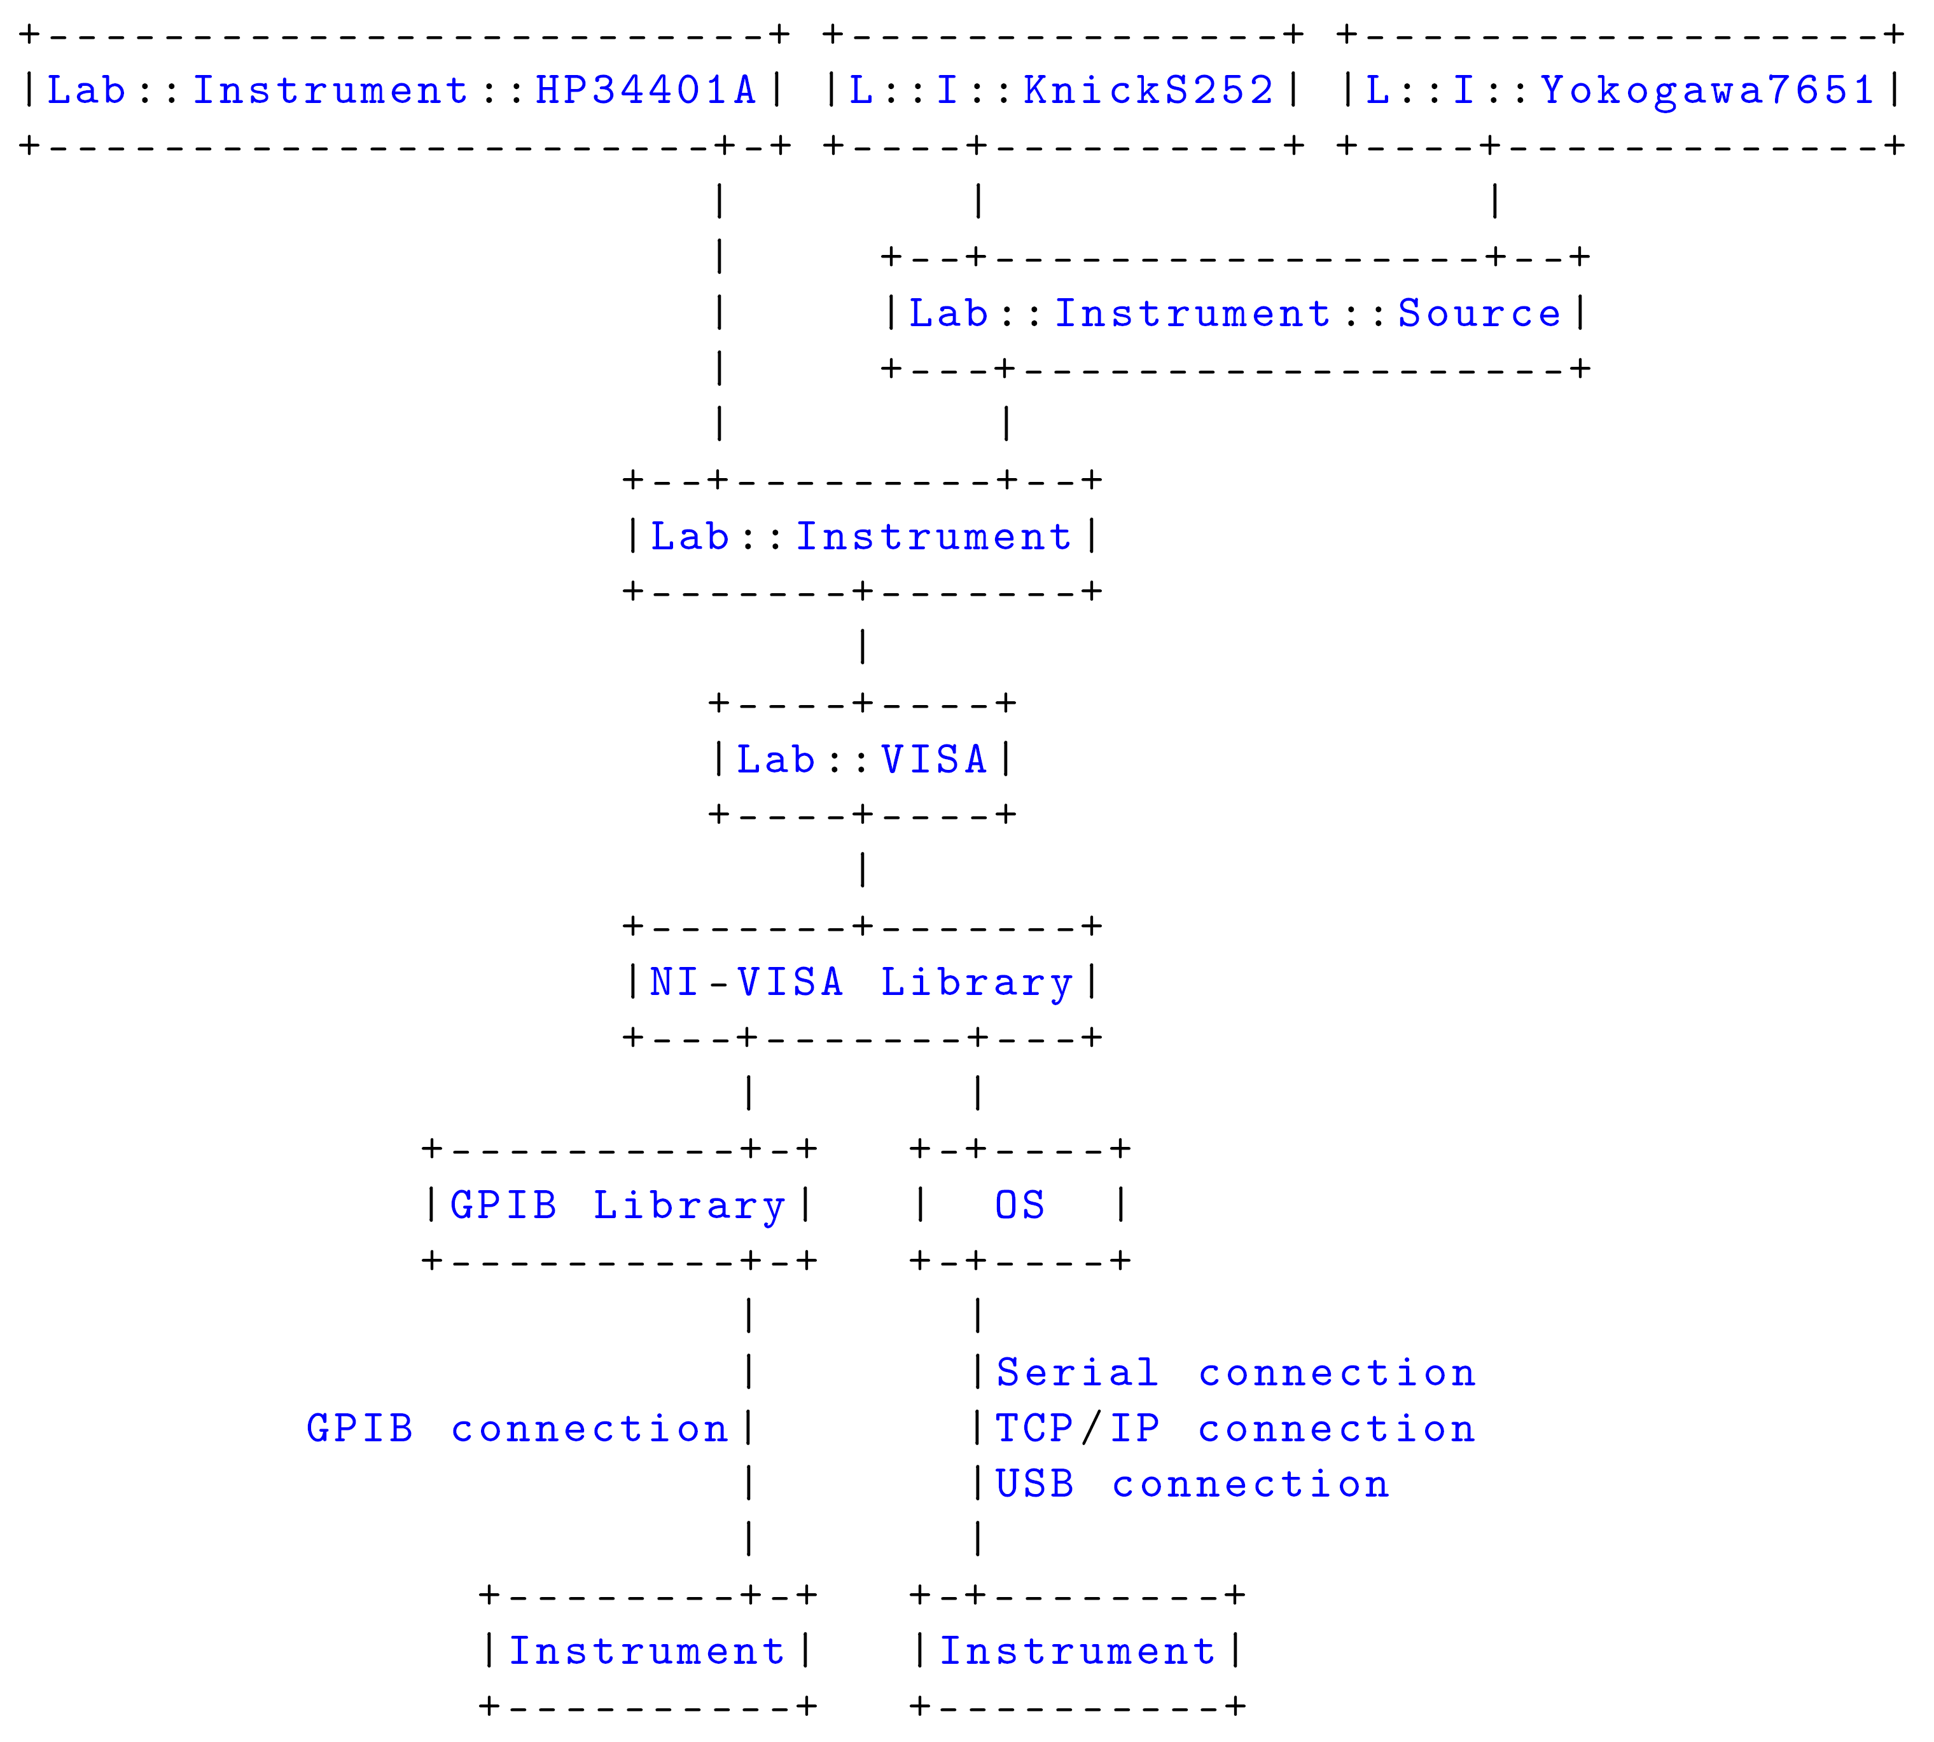
Architecture of Lab::VISA

Slide 7
Lab::Tools
Provides additional tools to write better measurement scripts
Provide means to keep additional information stored along with the raw measured data. Additional information means all the notes that you would usually write down in your laboratory book, like date and time, settings of additional instruments, the environment temperature, the color of the shirt you were wearing while recording the data and everything else that might be of importance for a later interpretation of the data. In my experience, having to write these things in a book by hand is tedious and error-prone. It's the kind of job that computers were made for.
Another goal is to free the laborant from having to repeat himself all the time when the data is used for analysis or presentation. Let us assume that, for example, you are measuring a very small current with the help of a current amplier. This current amplier will output a voltage that is proportional to the original current, so in fact you will be measuring a voltage that can be converted to the original current by multiplying it with a certain factor. The last paragraph has shown that the Lab::Tools modules will help you to keep track of this additional information current amplier constant of proportionality. But as long as the precise formula for this transformation is not stored together with the data, you will still find yourself repeatedly typing in the same expressions, whenever you work with the data. This is where the axis concept comes into play. Already at the time you are preparing your measurement script, you define an axis named current that stores the expression to calculate the current from the voltage. From there you work with the current-axis and will never have to care about the conversion again. And of course you can define many different axes.

Slide 8
Online resources
Source Code
http://www.nano.physik.uni-muenchen.de/
svn/lab/trunk/
Tutorial
http://www.nano.physik.uni-muenchen.de/
svn/lab/trunk/documentation.pdf

