Slide 1
Lab::VISA

Slide 2
VISA, GPIB, etc.
Instruments can be connected in various ways:
Serial port, GPIB, VXI, TCP/IP, etc.
GPIB (hardware and software)
  GPIB (IEEE488): Standard by Hewlett-Packard
  Physical layer IEEE488.1
  Command layer IEEE488.2
  SCPI (Standard Commands for Programmable Instruments)
VISA (software)
  Virtual Instrument Software Architecture
  VXI, GPIB, serial, or computer-based instruments
  NI-VISA library is one implementation of the VISA standard
Notes:
most important for us: GPIB

Slide 3
Lab::VISA
Lab::VISA is software to control instruments in the lab via VISA
(e.g. voltage sources, multimeters, etc.)
Alternative to LabView, Gpplus, etc.
But very different: no GUI, just API

Slide 4
Lab::VISA design goals
Flexible
  Allow any kind of measurement procedure
  Control anything that has GPIB or serial connection
Safe
  Make sure you never drive voltage sources to fast and destroy your gates
Helpful
  Automatically collect additional information about the data (“metadata”)
  User should have to type in additional information only once and then never again

Slide 5
Lab::VISA is in Perl
Lab::VISA is written in Perl and C
To be used from programs written in Perl
Perl: interpreted scripting language
Runs on almost every OS
Extremely good in reading data files, manipulating data, etc.
Allows to write quick and dirty scripts that get the job done
Also allows to write clean fullsize programs
=> ideal for experimental physics

Slide 6
Lab::VISA architecture
Divided into three parts
Build on top of each other
Provide increasing comfort
Measurement scripts can be based on any of these stages
Lab::VISA is the lowest layer. It makes the NI-VISA library accessible from perl and therefor allows to make any standard VISA call
Lab::Instrument package makes communication with instruments easier by silently handling the protocol involved
Lab::Tools is the highest abstraction layer. Provides support for writing good measurement scripts. Offers means of saving data and related meta information to disk, plotting data, etc.

Slide 7
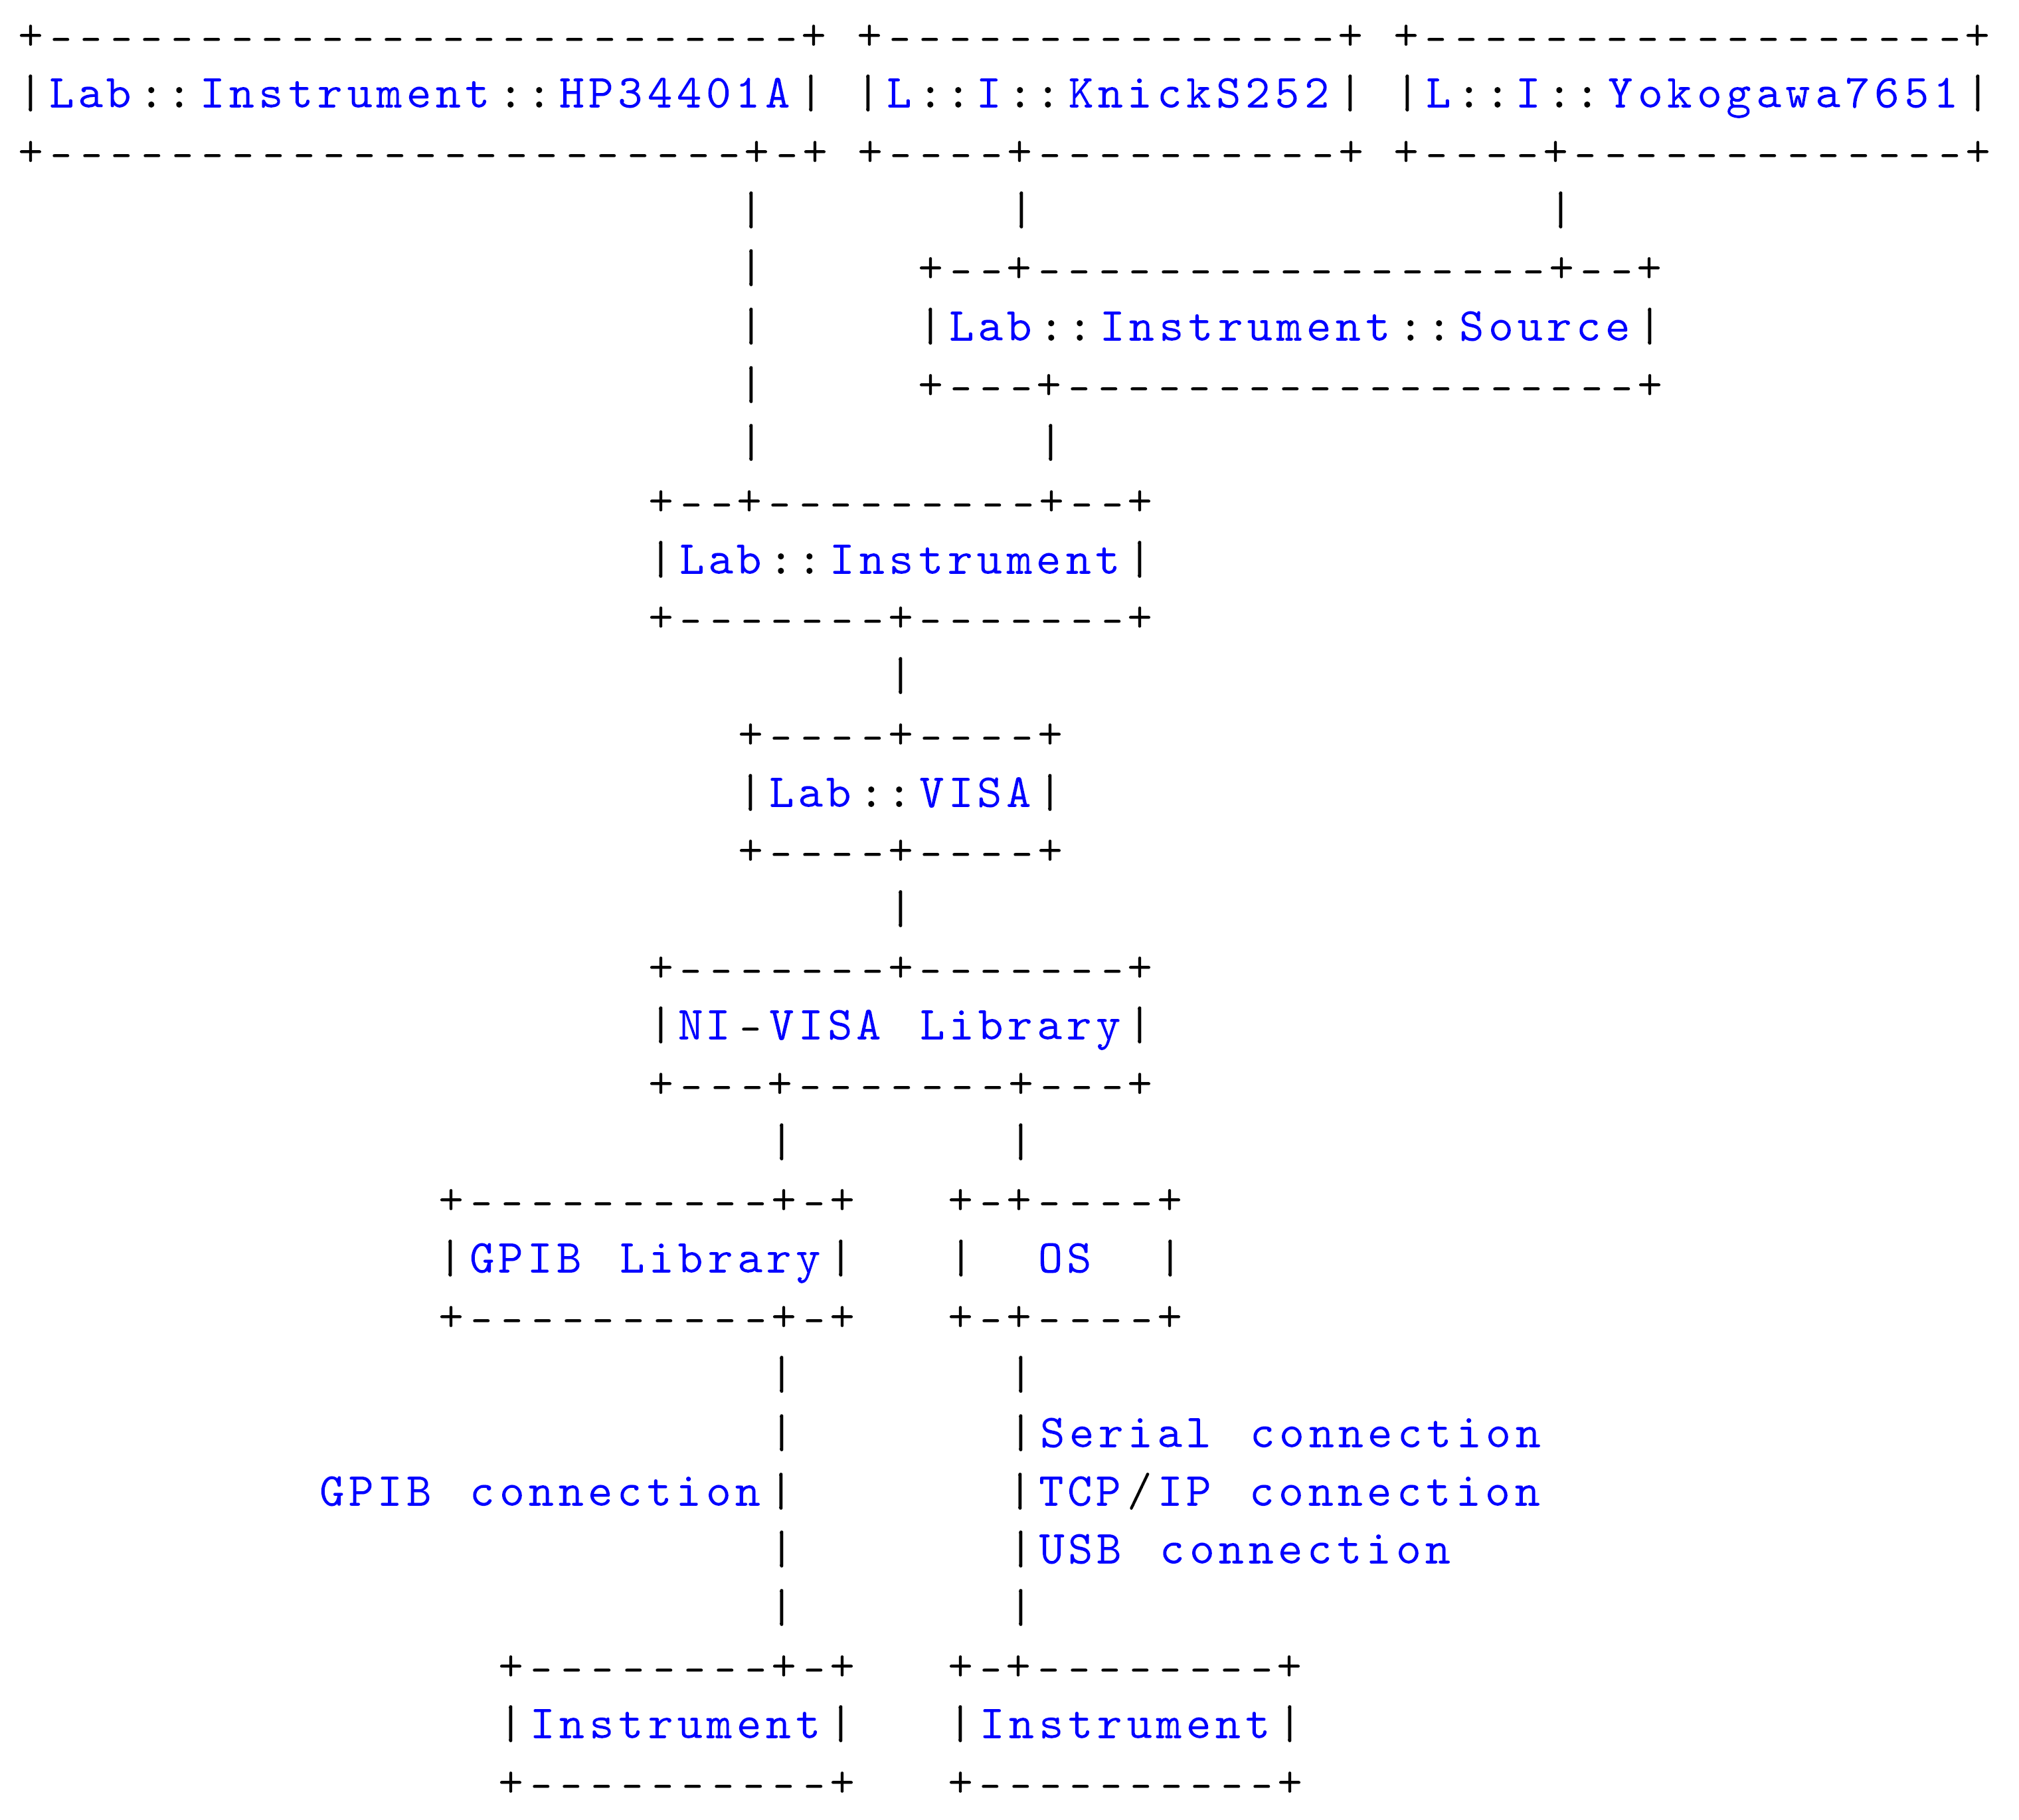
Lab::VISA architecture

Slide 8
Example 1
lab-visa/raw_visa.pl
  looks like example programs from manual
  protocol overhead is pain in the neck

Slide 9
Example 2
lab-instrument/query_id.pl
  much nicer!

Slide 10
Example 3
lab-instrument/make_sweep.pl
  already at the level of GPplus

Slide 11
Lab::Tools
Provides additional tools to write better measurement scripts
Store metadata alongside data
  date and time
  settings of additional instruments
  ratio of voltage divider
  color of the shirt you are wearing
  everything that might be important for a later interpretation of the data
Don‘t repeat yourself
  Use above collected information automatically
  Automatically plot data with correct axes, scaling, labels etc.

Slide 12
Metadata philosophy
Voltage source (Knick)
Constants
R = 1000 Ohm
V_{bias}
Columns
C₁: V_{bias}
C₂: V_{resistor}
unit
description…
1.5 | +8.19300500E-01
1.4 | +7.23413000E-01
1.3 | +6.28083900E-01
… | …
R
V
Multimeter (HP)
V_{resistor}
Axes
Axis “bias voltage”
(C₁)
Axis “diode current”
(C₂ / R)
Axis “diode resistance”
(R * (C₁ / C₂ – 1))
unit
expression
description…
Plots
Plot “diode current”
axis “diode current” over
axis “bias voltage”
Plot “diode resistance”
axis “diode resistance” over
axis “bias voltage”
logscale
grid
ranges…

Slide 13
Example 4
lab-measurement/lab-measurement.pl
  metadata
  plotter.pl
    live plot
    list avaible plots
    create postscript

Slide 14
Example 5
real-world/ladediagramm_qpc.pl
  there is room for further improvements
  standard measurements should be factored out to dedicated classes like Lab::Measurement::Ladediagramm
  collection of metadata could be automated further

Slide 15
Other Lab::VISA features
“Gate protect” safety mechanism
  Makes sure that no voltage is changed to fast
  Big voltage steps are automatically split into small, slow steps
Date/time handling
  Date/time column can contain timestamp for every data point
  Plot data as function of time
Measurements with higher dimensionality
  Each trace/sweep/line is a “block”
  Two-dimensional plots, selections of traces, etc.

Slide 16
Online resources
It‘s far from being complete...
Source Code
http://www.nano.physik.uni-muenchen.de/svn/lab/trunk/
Tutorial
http://www.nano.physik.uni-muenchen.de/svn/lab/trunk/documentation.pdf

Slide 17
Example 6
goodbye/goodbye.pl

