Slide 1
Lab::VISA original set of slides © Daniel Schröer

Slide 2
VISA, GPIB, etc.
Instruments can be connected in various ways:
Serial port, GPIB, VXI, TCP/IP, etc.
GPIB (hardware and software)
  GPIB (IEEE488): Standard by Hewlett-Packard
  Physical layer IEEE488.1
  Command layer IEEE488.2
  SCPI (Standard Commands for Programmable Instruments)
VISA (software)
  Virtual Instrument Software Architecture
  VXI, GPIB, serial, or computer-based instruments
  NI-VISA library is one implementation of the VISA standard
Notes:
most important for us: GPIB

Slide 3
Lab::VISA
Lab::VISA is software to control instruments in the lab via VISA
(e.g. voltage sources, multimeters, etc.)
Alternative to LabView, Gpplus, etc.
But very different: no GUI, just API

Slide 4
Lab::VISA design goals
Flexible
  Allow any kind of measurement procedure
  Control anything that has GPIB or serial connection
Safe
  Make sure you never drive voltage sources to fast and destroy your gates
Helpful
  Automatically collect additional information about the data (“metadata”)
  User should have to type in additional information only once and then never again

Slide 5
Lab::VISA is in Perl
Lab::VISA is written in Perl and C
To be used from programs written in Perl
Perl: interpreted scripting language
Runs on almost every OS
Extremely good in reading data files, manipulating data, etc.
Allows to write quick and dirty scripts that get the job done
Also allows to write clean fullsize programs
=> ideal for experimental physics

Slide 6
Lab::VISA architecture
Divided into three parts
Build on top of each other
Provide increasing comfort
Measurement scripts can be based on any of these stages
Lab::VISA is the lowest layer. It makes the NI-VISA library accessible from perl and therefor allows to make any standard VISA call
Lab::Instrument package makes communication with instruments easier by silently handling the protocol involved
Lab::Tools is the highest abstraction layer. Provides support for writing good measurement scripts. Offers means of saving data and related meta information to disk, plotting data, etc.

Slide 7
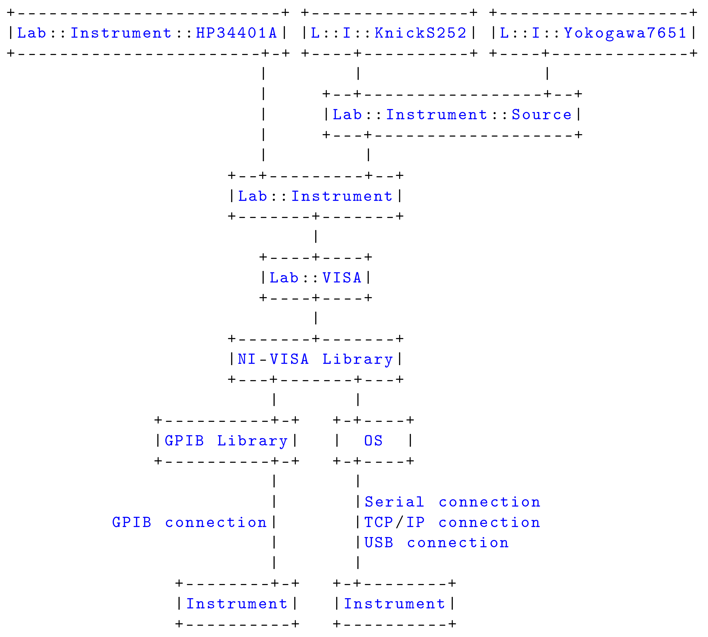
Lab::VISA architecture
your (tiny) measurement program / script

Slide 8
Example 1: Use only Lab::VISA
looks like example programs from the NI VISA manual
  protocol overhead is pain in the neck. NOT GOOD.
#!/usr/bin/perl
use strict;
use Lab::VISA;
# Initialize VISA system and
# Open default resource manager
my ($status,$default_rm)=Lab::VISA::viOpenDefaultRM();
if ($status != $Lab::VISA::VI_SUCCESS) {
die "Cannot open resource manager: $status";
}
# Open one resource (an instrument)
my $gpib=21; # we want to open the instrument
my $board=0; # with GPIB address 21
# connected to GPIB board 0 in our computer
my $resource_name=sprintf("GPIB%u::%u::INSTR",$board,$gpib);
($status, my $instr)=Lab::VISA::viOpen(
$default_rm, # the resource manager session
$resource_name, # a string describing the
$Lab::VISA::VI_NULL,# access mode (no special mode)
$Lab::VISA::VI_NULL # time out for open (no time out)
);
if ($status != $Lab::VISA::VI_SUCCESS) {
die "Cannot open instrument $resource_name. status: $status";
}
(...)
(...)
# Now we are going to send one command and read the result.
# We send the simple SCPI command "*IDN?" which asks the instrument
# to identify itself. Of course the instrument must support this
# command, in order to make this example work.
my $cmd="*IDN?";
($status, my $write_cnt)=Lab::VISA::viWrite(
$instr, # the session identifier
$cmd, # the command to send
length($cmd) # the length of the command in bytes
);
if ($status != $Lab::VISA::VI_SUCCESS) {
die "Error while writing: $status";
}
# Now we will read the instruments reply
($status, # indicates if the operation was successful
my $result, # the answer string
my $read_cnt)= # the length of the answer in bytes
Lab::VISA::viRead(
$instr, # the session identifier
300 # read 300 bytes
);
if ($status != $Lab::VISA::VI_SUCCESS) {
die "Error while reading: $status";
}
# The result string will be 300 bytes long, but only $read_cnt
# bytes are part of the answer. We cut away the rest.
$result=substr($result,0,$read_cnt);
print $result;

Slide 9
Example 2: Use Lab::Instrument
Much nicer!
#!/usr/bin/perl
use strict;
use Lab::Instrument::HP34401A;
my $gpib=21; # we want to open the instrument
my $board=0; # with GPIB address 21
# connected to GPIB board 0 in our computer
# Create an instrument object
my $hp=new Lab::Instrument::HP34401A($board,$gpib);
# Use the id method to query the instruments ID string
my $result=$hp->id();
print $result;

Slide 10
Example 3: My first real measurement!
How about doing a gate sweep?
That's easy!
#!/usr/bin/perl
use strict;
use Lab::Instrument::HP34401A;
use Lab::Instrument::Yokogawa7651;
# Connect to voltage source
my $yoko=new Lab::Instrument::Yokogawa7651({
GPIB_address => 14,
gate_protect => 0,
});
# Connect to multimeter
my $hp=new Lab::Instrument::HP34401A(0,21);
# Sweep Yokogawa from 0 to 1 volt (10 steps)
for (my $volt=0; $volt<=1; $volt=$volt+0.1) {
# set Yokogawa
$yoko->set_voltage($volt);
# wait a second
sleep(1);
# read multimeter
my $vmeas=$hp->read_voltage_dc();
# print values
print $volt,"\t",$vmeas,"\n";
}

Slide 11
Lab::Tools
Provides additional tools to write better measurement scripts
Store metadata alongside data
  date and time
  settings of additional instruments
  ratio of voltage divider
  color of the shirt you are wearing
  everything that might be important for a later interpretation of the data
Don‘t repeat yourself
  Use above collected information automatically
  Automatically plot data with correct axes, scaling, labels etc.

Slide 12
Metadata philosophy
Voltage source (Knick)
Constants
R = 1000 Ohm
V_{bias}
Columns
C1: V_{bias}
C2: V_{resistor}
unit
description…
1.5 | +8.19300500E-01
1.4 | +7.23413000E-01
1.3 | +6.28083900E-01
1.5 | +8.19300500E-01
R
V
Multimeter (HP)
V_{resistor}
Axes
Axis “bias voltage”
(C1)
Axis “diode current”
(C2 / R)
Axis “diode resistance”
(R * (C1 / C2 – 1))
unit
expression
description…
Plots
Plot “diode current”
axis “diode current” over
axis “bias voltage”
Plot “diode resistance”
axis “diode resistance” over
axis “bias voltage”
logscale
grid
ranges…

Slide 13
Example 4: Using Lab::Measurement
metadata, live plot
#!/usr/bin/perl
use strict;
use Lab::Instrument::KnickS252;
use Lab::Instrument::HP34401A;
use Lab::Measurement;
use Time::HiRes qw/usleep/;
################################
my $start_voltage = 1.5;
my $end_voltage = -3.5;
my $step = -0.05;
my $knick_gpib = 14;
my $hp_gpib = 21;
my $sample = "Zenerdiode";
my $title = "Messung mit Lab::Measurement";
my $comment = <<COMMENT;
Reihenschaltung aus Widerstand 1kOhm und Zenerdiode.
COMMENT
################################
my $knick=new Lab::Instrument::KnickS252({
'GPIB_board' => 0,
'GPIB_address' => $knick_gpib,
'gate_protect' => 0,
});
my $hp=new Lab::Instrument::HP34401A(0,$hp_gpib);
my $measurement=new Lab::Measurement(
sample => $sample,
title => $title,
filename_base => 'zener_kennlinie',
description => $comment,
live_plot => 'diode current',
constants => [
{
'name' => 'R',
'value' => '1000',
},
],
columns => [
{
'unit' => 'V',
'label' => 'V_{bias}',
'description' => 'Bias Voltage',
},
{
'unit' => 'V',
'label' => 'Amplifier output',
'description' => 'Voltage drop on serial resistor',
}
],
axes => [
{
'unit' => 'V',
'expression' => '$C0',
'label' => 'V_{bias}',
'description' => 'Bias voltage',
'min' => ($start_voltage < $end_voltage)
? $start_voltage
: $end_voltage,
'max' => ($start_voltage < $end_voltage)
? $end_voltage
: $start_voltage,
},
{
'unit' => 'mA',
'expression' => '1000*($C1/R)',
'label' => 'I_{diode}',
'description' => 'Current through diode',
'min' => '-1.2',
'max' => '1.2',
},
{
'unit' => 'Ohm',
'expression' => 'R * ($C0/$C1 - 1)',
'label' => 'R_{diode}',
'description' => 'Diode resistance',
},
],
plots => {
'diode current' => {
'type' => 'line',
'xaxis' => 0,
'yaxis' => 1,
'grid' => 'xtics ytics',
},
'diode resistance' => {
'type' => 'line',
'xaxis' => 0,
'yaxis' => 2,
'grid' => 'xtics ytics',
'logscale' => 'y',
},
},
);
$measurement->start_block();
for (
my $volt = $start_voltage;
($volt - $end_voltage) / $step < 0.5;
$volt += $step
) {
$knick->set_voltage($volt);
usleep(500000);
my $meas = $hp->read_voltage_dc(10,0.0001);
$measurement->log_line($volt,$meas);
}
my $meta = $measurement->finish_measurement();
constants => [
{
'name' => 'R',
'value' => '1000',
},
],
columns => [
{
'unit' => 'V',
'label' => 'V_{bias}',
'description' => 'Bias Voltage',
},
{
'unit' => 'V',
'label' => 'Amplifier output',
'description' => 'Voltage drop on serial resistor',
}
],
axes => [
{
'unit' => 'V',
'expression' => '$C0',
'label' => 'V_{bias}',
'description' => 'Bias voltage',
'min' => ($start_voltage < $end_voltage)
? $start_voltage
: $end_voltage,
'max' => ($start_voltage < $end_voltage)
? $end_voltage
: $start_voltage,
},
{
'unit' => 'mA',
'expression' => '1000*($C1/R)',
'label' => 'I_{diode}',
'description' => 'Current through diode',
'min' => '-1.2',
'max' => '1.2',
},
{
'unit' => 'Ohm',
'expression' => 'R * ($C0/$C1 - 1)',
'label' => 'R_{diode}',
'description' => 'Diode resistance',
},
],
plots => {
'diode current' => {
'type' => 'line',
'xaxis' => 0,
'yaxis' => 1,
'grid' => 'xtics ytics',
},
'diode resistance' => {
'type' => 'line',
'xaxis' => 0,
'yaxis' => 2,
'grid' => 'xtics ytics',
'logscale' => 'y',
},
},
);
$measurement->start_block();
for (
my $volt = $start_voltage;
($volt - $end_voltage) / $step < 0.5;
$volt += $step
) {
$knick->set_voltage($volt);
usleep(500000);
my $meas = $hp->read_voltage_dc(10,0.0001);
$measurement->log_line($volt,$meas);
}
my $meta = $measurement->finish_measurement();
{
'unit' => 'Ohm',
'expression' => 'R * ($C0/$C1 - 1)',
'label' => 'R_{diode}',
'description' => 'Diode resistance',
},
],
plots => {
'diode current' => {
'type' => 'line',
'xaxis' => 0,
'yaxis' => 1,
'grid' => 'xtics ytics',
},
'diode resistance' => {
'type' => 'line',
'xaxis' => 0,
'yaxis' => 2,
'grid' => 'xtics ytics',
'logscale' => 'y',
},
},
);
$measurement->start_block();
for (
my $volt = $start_voltage;
($volt - $end_voltage) / $step < 0.5;
$volt += $step
) {
$knick->set_voltage($volt);
usleep(500000);
my $meas = $hp->read_voltage_dc(10,0.0001);
$measurement->log_line($volt,$meas);
}
my $meta = $measurement->finish_measurement();

Slide 14
More utilities: plotter.pl, make_overview.pl
plotter.pl:
  Reads measurement file, list avaible plots (axes etc)
  Creates postscript or pdf output
make_overview.pl:
  Reads all measurements in a directory
  Generates a postscript or pdf file with plots for each measurement, including the metadata (i.e. constants, parameters, color of your shirt) (via LaTeX)
  Great for completing your lab book

Slide 15
Other Lab::VISA features
“Gate protect” safety mechanism
  Makes sure that no voltage is changed to fast
  Big voltage steps are automatically split into small, slow steps
Date/time handling
  Date/time column can contain timestamp for every data point
  Plot data as function of time
Measurements with higher dimensionality
  Each trace/sweep/line is a “block”
  Two-dimensional plots, selections of traces, etc.

