Slide 1
Wearabouts Semantic Localization through Wearable Devices
Branden Ghena
EECS589 Advanced Computer Networks – October 16, 2014

Slide 2
The Key Question
Who’s in Lab?
Notes:
Why is this question so hard to answer?

Slide 3
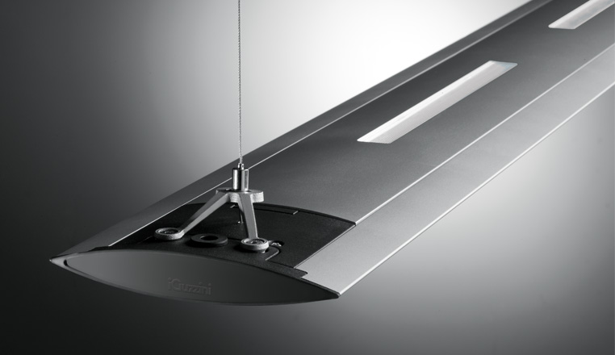
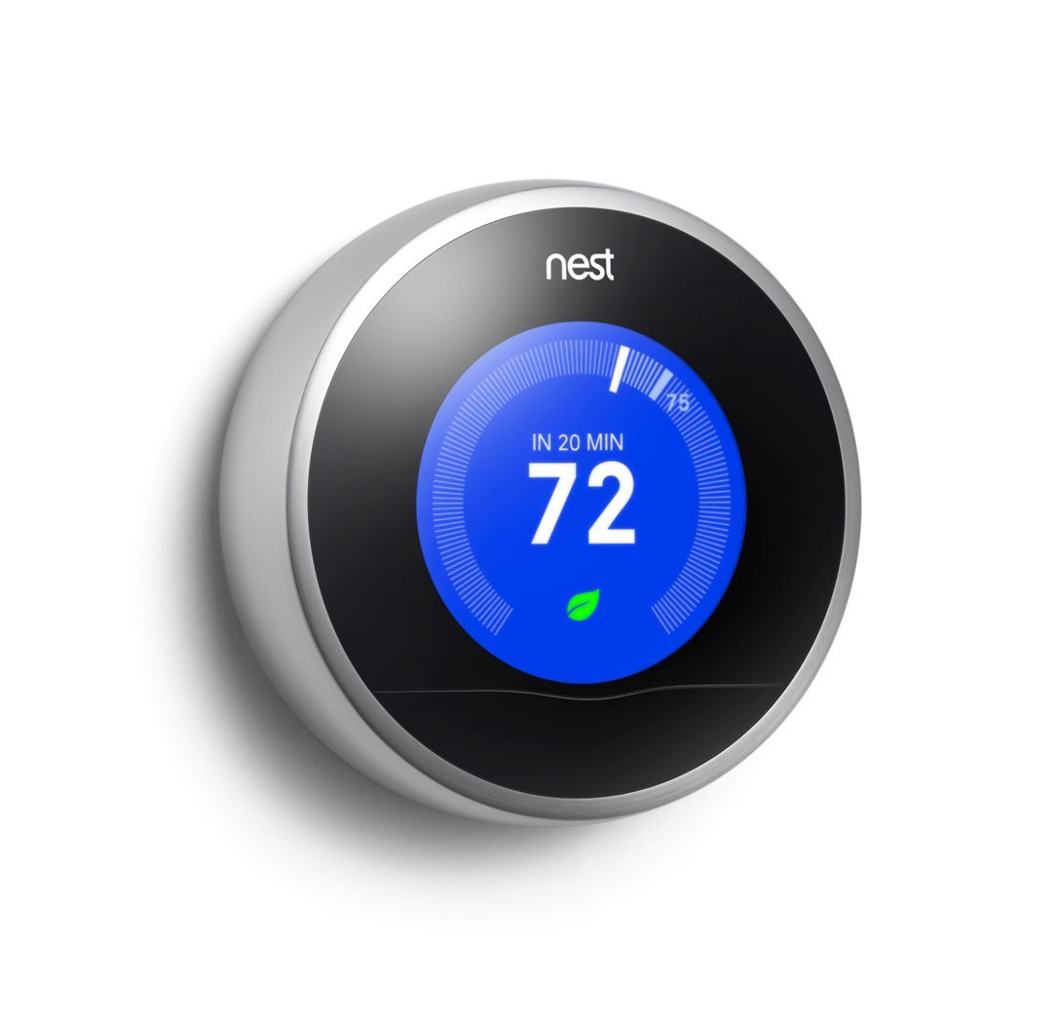
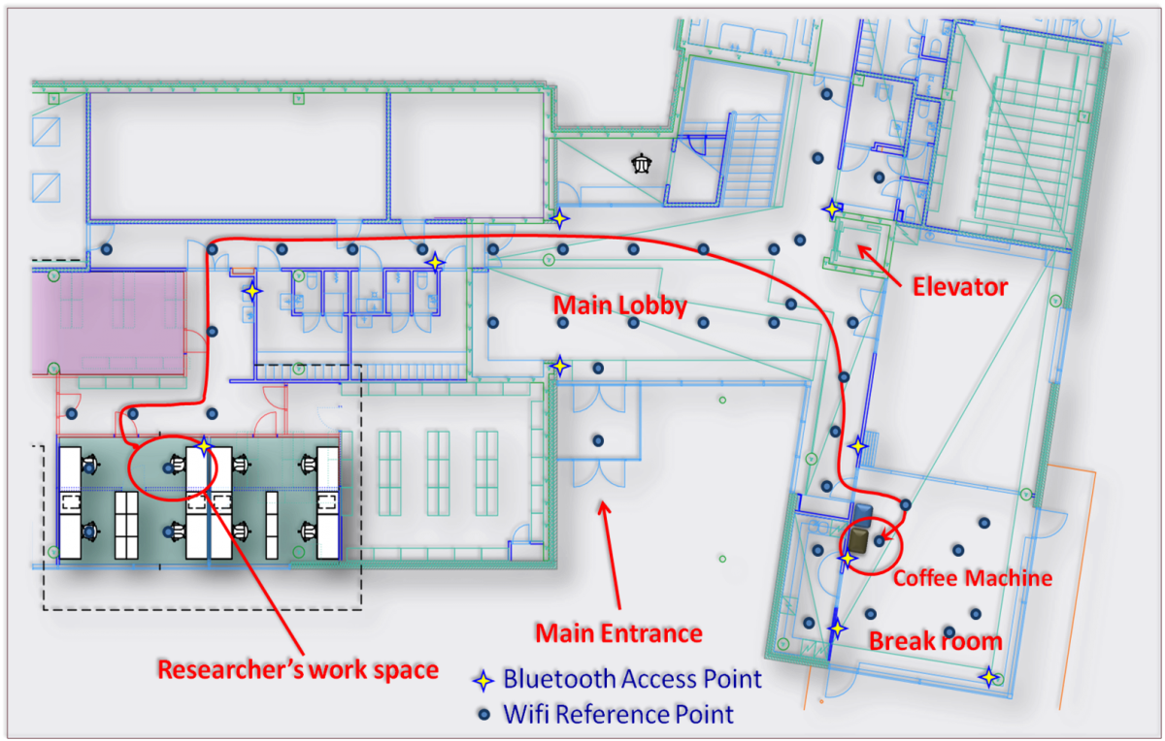
Why do we want localization?
Building Control Systems
HVAC, Lights, Power Usage
Indoor Navigation
People Finding
Notes:
Imagine a world where you could always find your advisor…

Slide 4
Levels of Localization
But what degree of localization do we need?
Fine-Grained Systems
GPS, Ultra-Wideband RF, Visible Light Positioning
Coarse-Grained System
Semantic Localization

Slide 5
The New Question
How do we provide semantic localization?
Notes:
Why is this question so hard to answer?

Slide 6
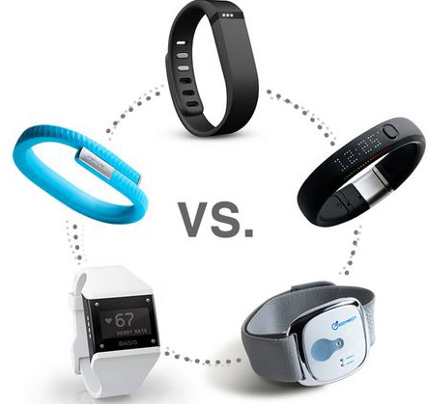
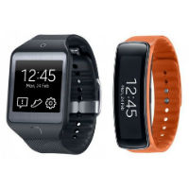
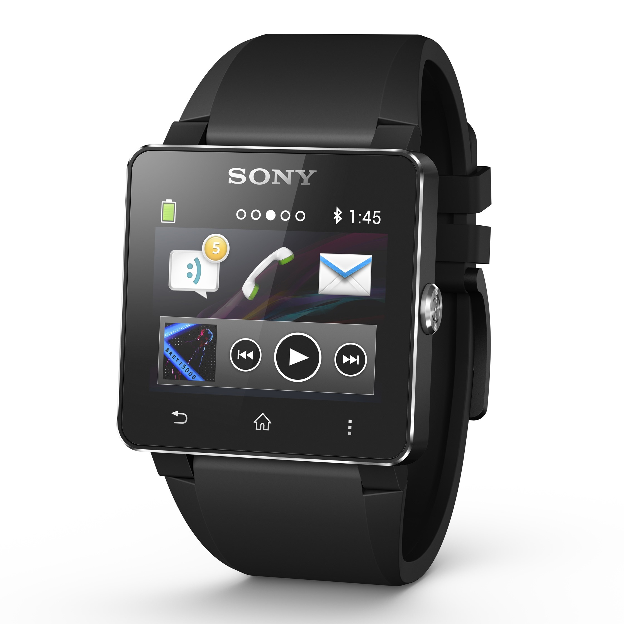
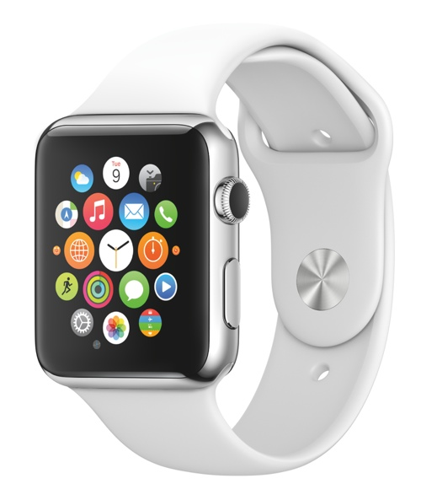
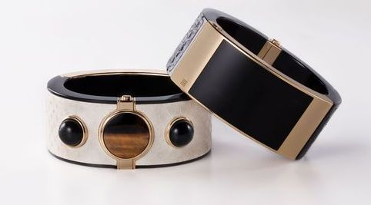
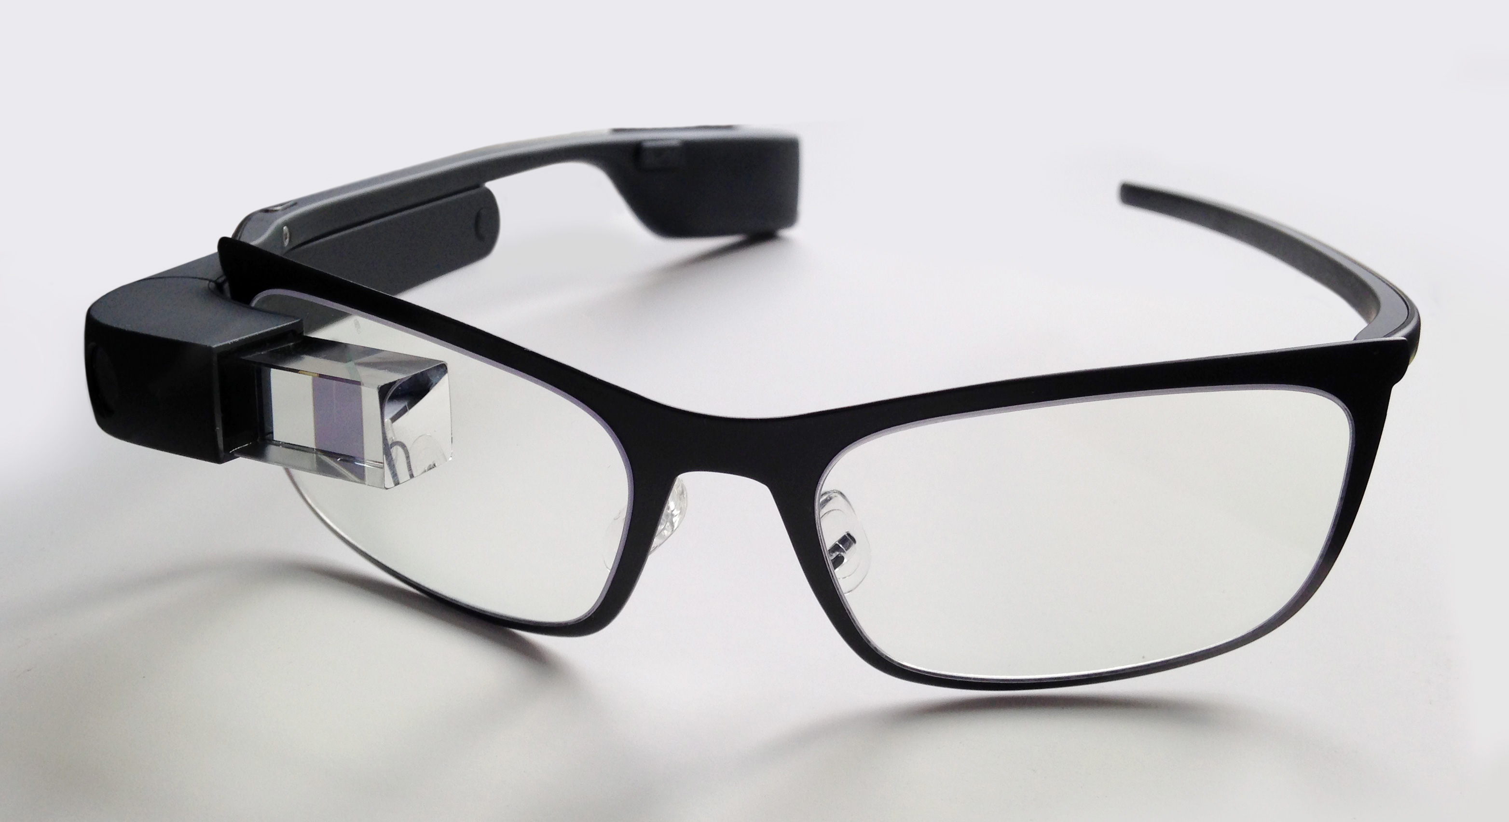
The Wearables Revolution
Answer: Wearable Devices
Notes:
Why is this question so hard to answer?

Slide 7

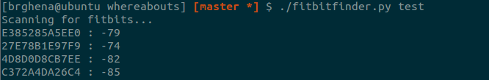
Detectable Communications
Wearable devices need communication
Bluetooth Low-Energy has become the leader in this area
BLE advertises device MAC address periodically

Slide 8
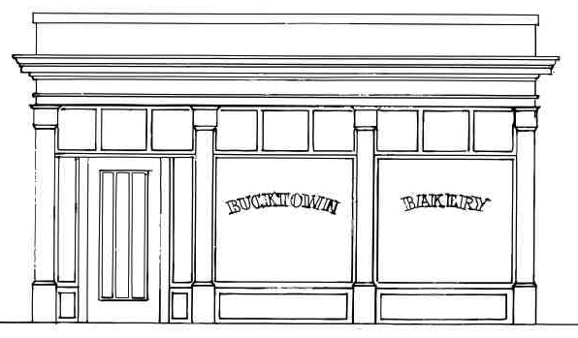



The Barrier Problem
1 Dozen
Goldfish Special
$8.95

Slide 9
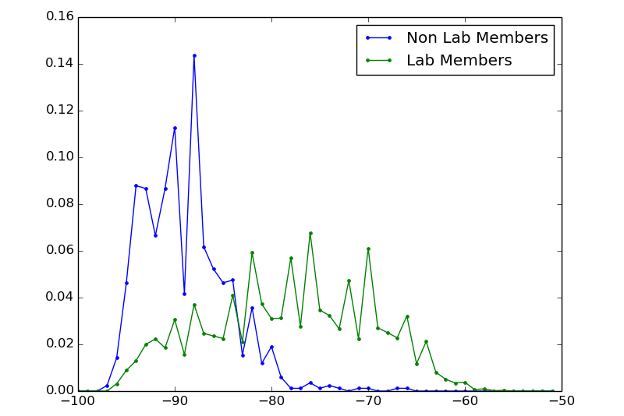
The Approach
Scanning for BLE associates addresses, location, and signal strength
Use RSSI to make a location decision
Probability of Occurrence
RSSI

Slide 10
Open Problems
How does device registration work?
Can registration be done automatically?
How to determine the in-room vs not distributions automatically?
Will take time and sampling data
Needs a certain amount of truth provided to the system
Can this type of system provide a useful semantic localization service?

Slide 11
Questions or Ideas?
Wearabouts: Semantic Localization through Wearable Devices
Branden Ghena | brghena@umich.edu
Notes:
Thank you very much

