Slide 1
Semantic Heuristic Localization
Branden Ghena
University of Michigan
TerraSwarm Localization Workshop. Ann Arbor, MI. May 16, 2014

Slide 2
Background
Who’s in Lab?
Notes:
A simple question, but not so easy to answer.

Slide 3
Background
What People Carry
Phones
Laptops
RFID Cards
Fitbits
What People Are
Voice
Faces
Height
Weight
What People Use
Desk Chair
Computer

Slide 4
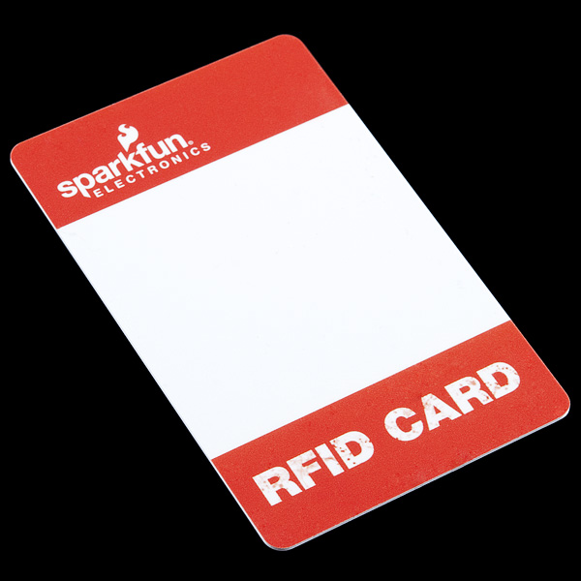
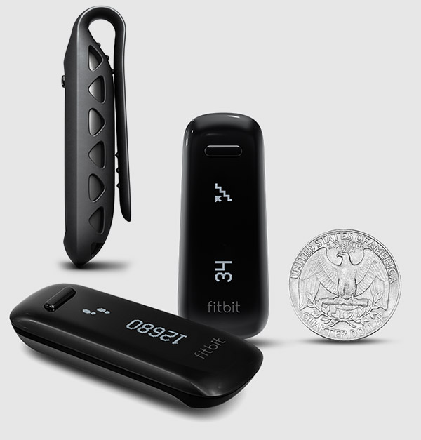
Background
What People Carry
Phones
Laptops
RFID Cards
Fitbits

Slide 5
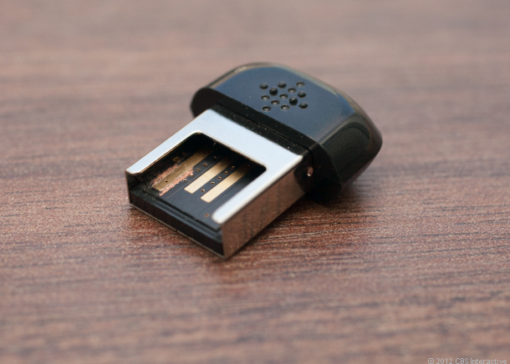
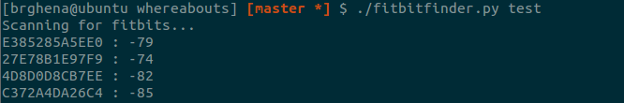
Fitbit Scanning
Fitbits communicate over BLE
Actively scan using base station
Can run from a Raspberry PI
Notes:
Initially it was all or nothing. Then we started to take a look at the RSSI data

Slide 6
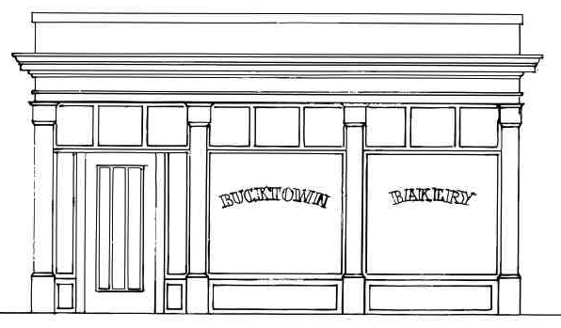



Challenges
The Barrier Problem
1 Dozen
Goldfish Special
$8.95

Slide 7
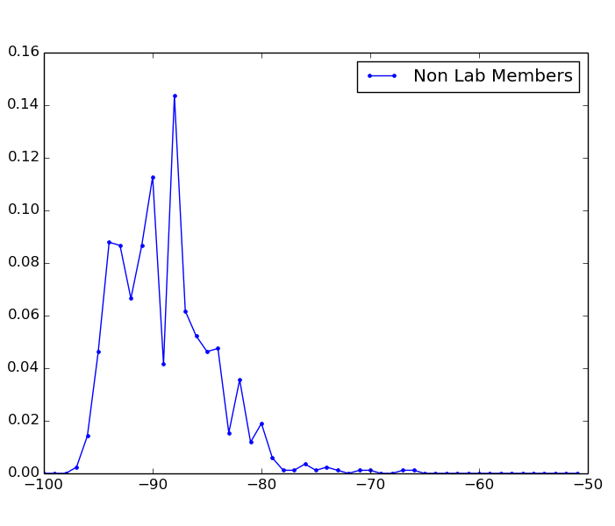
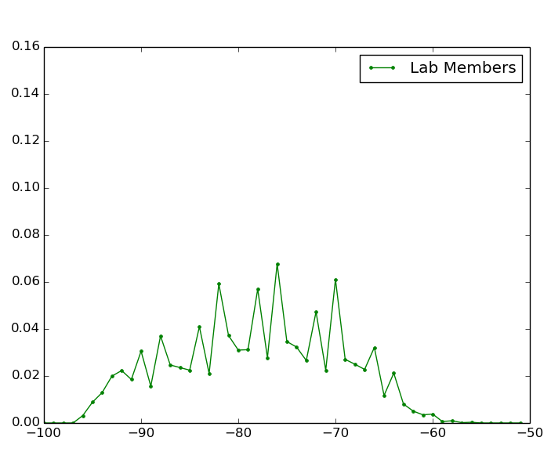
Challenges
How bad is RSSI in practice?
Probability of Occurrence
RSSI
RSSI
Notes:
Let’s say you’re given a list of room occupants and their fitbit ids.

Slide 8
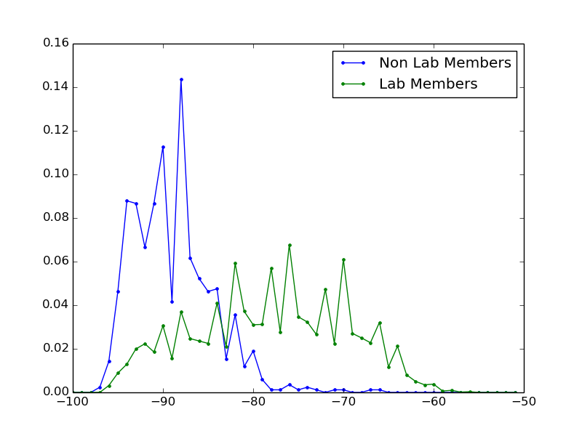
Challenges
How bad is RSSI in practice?
Probability of Occurrence
RSSI
Notes:
Over time, you can generate two clearly separate distributions and use these to decide on a cutoff point.

Slide 9
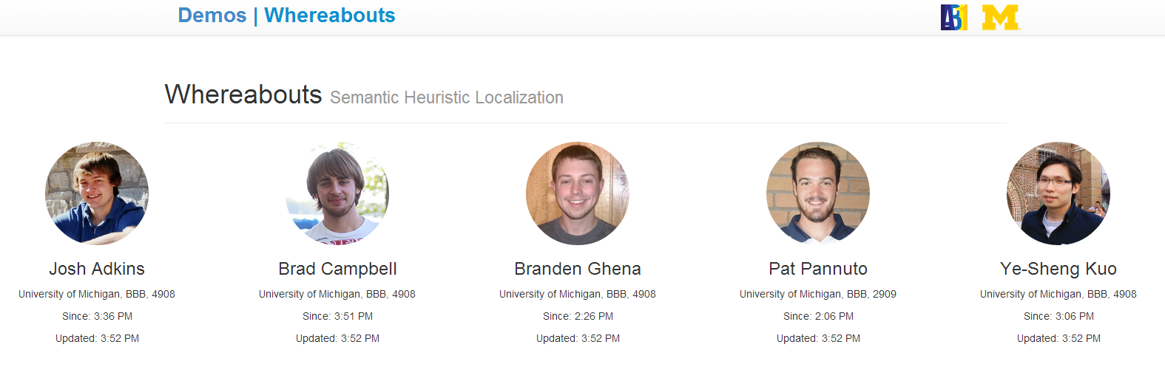
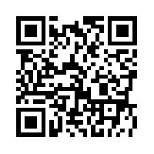
Whereabouts
http://inductor.eecs.umich.edu/whereabouts.html
https://github.com/lab11/whereabouts
Notes:
We’ve got a live demo running right now. Next up is build some applications on top of it. Then go back and try to aggregate more sources of information.

