Slide 1
RIP BLOCKBUSTER
Lauren Blatchford
Justin Saunders
Hayley Stueber
Kelly Kolb
David Johnson

Slide 2
About the program
Rip blockbuster is an in-store application that allows the user to browse over 500 movies before renting.
Features:
search movies by title, actor or genre
edit movie information
add/remove movies
add/remove customers
view customer rentals and details
check movies in/out to customers

Slide 3
implementation
Sql and java
https://github.com/lab2139/RIPBlockbuster/tree/master/complete_v3/src/projPack

Slide 4
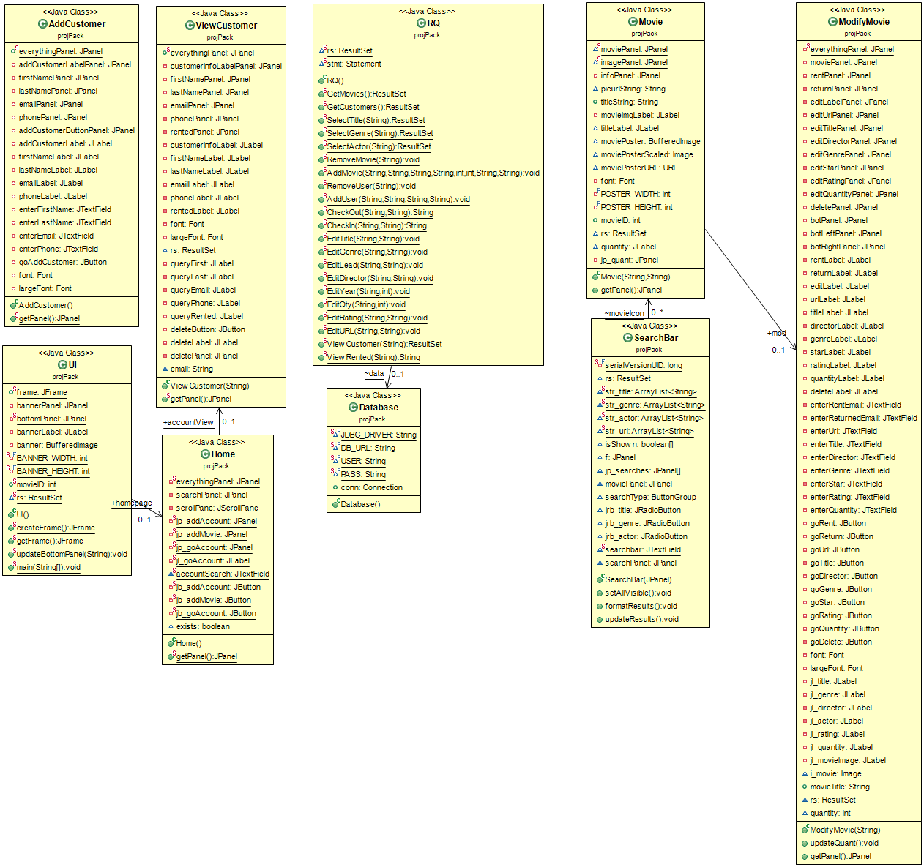

Slide 5
demo

Slide 6
Challenges
Establish connection between sql server and java
Organization of ui
Making changes/additions to the database tables due to the size
Search layout

