Slide 1

Electrical Services Design of a 10 Storied, 2 Unit Residential Building
EEE 414: Electrical Services Design
January 2024 Level-4 Term-2 Section-A
Final Project Presentation
Submitted by – Group 1
S. M. TAHMEED REZA
1906149
ROKON UDDIN MAHMUD 1906140
SADAD HASAN
1906163
SHOURAV JOARDER
1906156
AL NAYEM
1906158

Slide 2
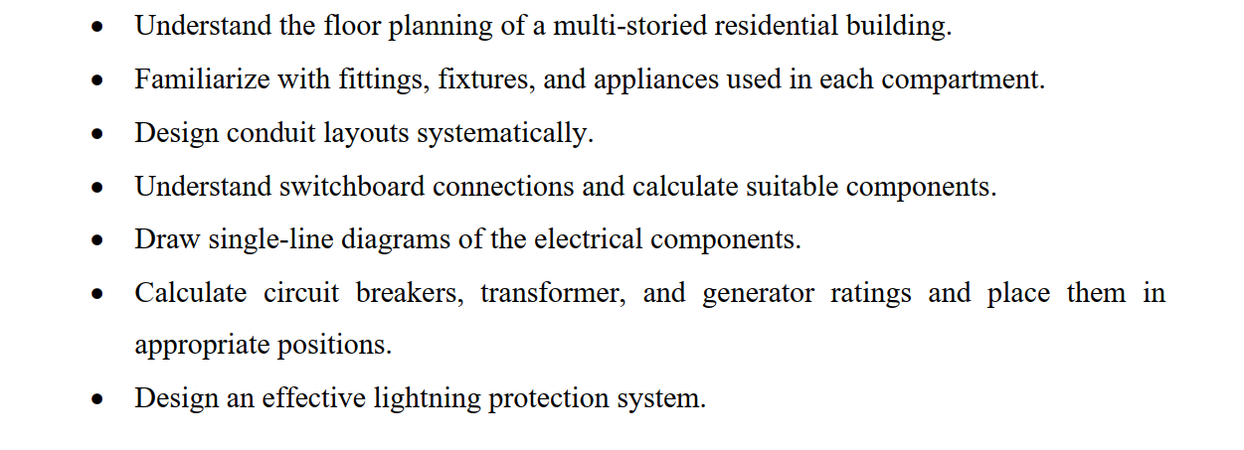
Project Objectives:

Slide 3
Building Specification:
Type | High-rise Residential Building
Length | 51'-0" (15.55 m)
Width | 50'-0" (15.24 m)
Area | 2550 sq.ft (236.982 sq.m)
No. of floors | 11(9 common dwelling floors, 1 ground, 1 underground)
Units per floor | 2
Area of a unit | 1275 sq.ft (118.491 sq.m)

Slide 4
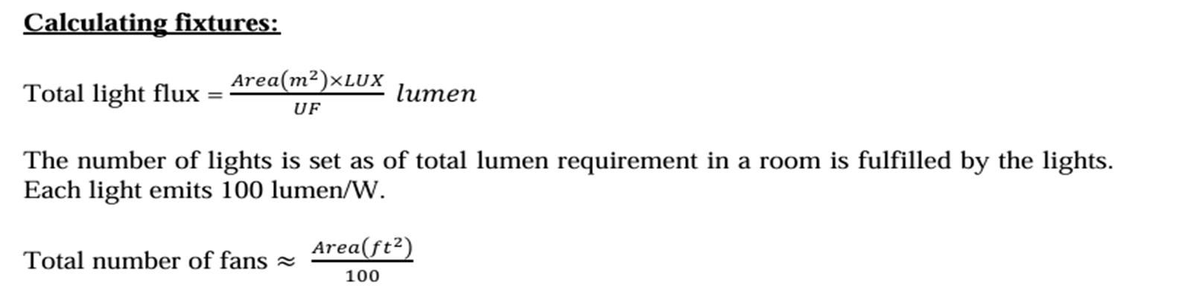

Slide 5
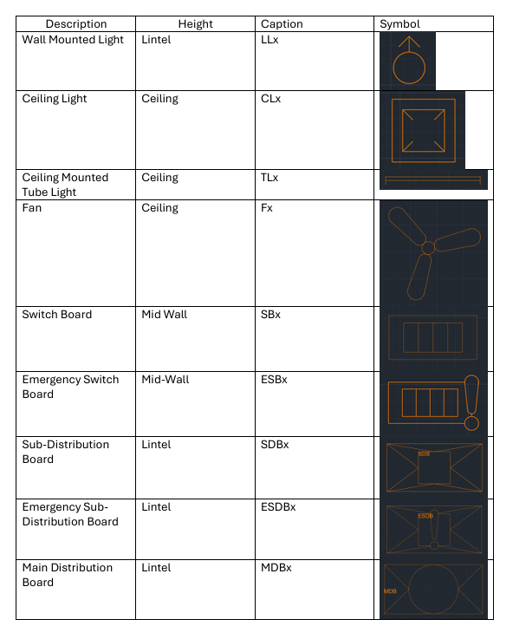
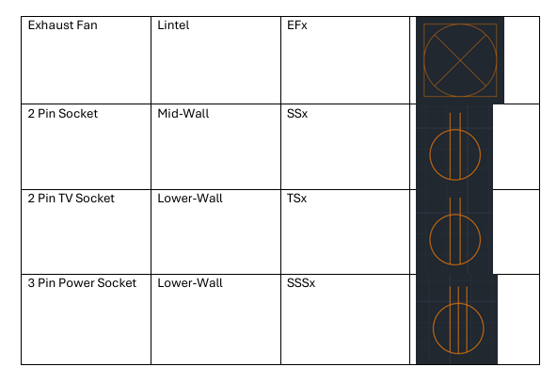
Fixture Legend

Slide 6
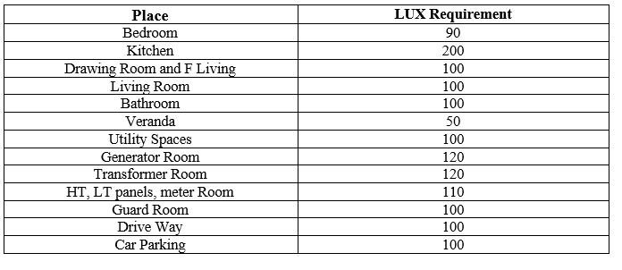
Required Lux Ratings:

Slide 7
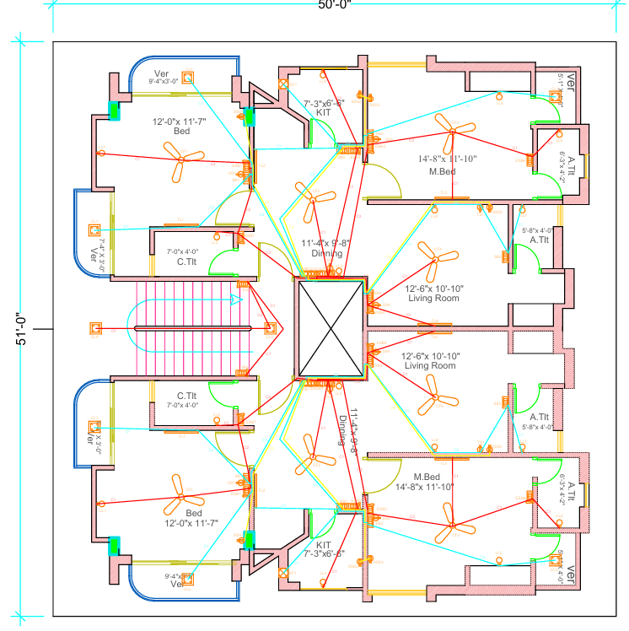
TYPICAL FLOOR

Slide 8
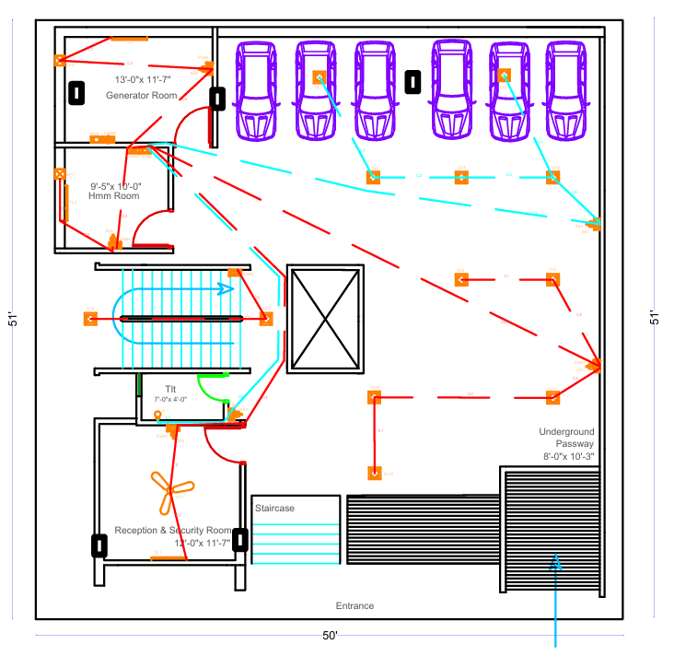
GARAGE

Slide 9
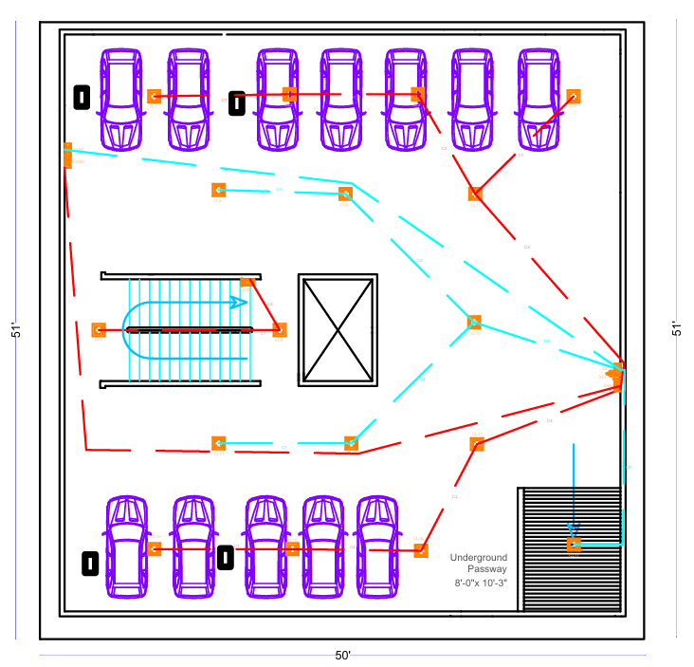
UNDER-
GROUND

Slide 10
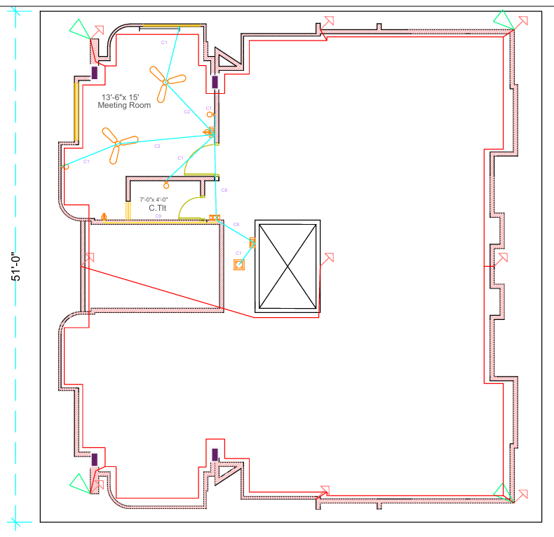
ROOF

Slide 11
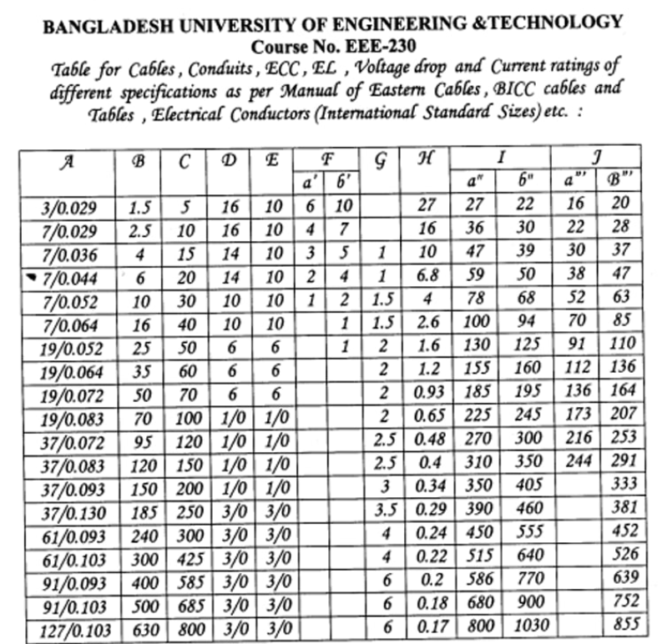
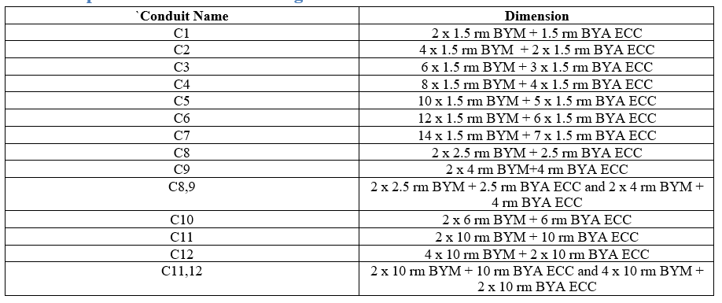
Conduit legend:
* Using ECC is not necessary for normal appliances. Only to be used in SB/ESB to SB/ESB or SB/ESB to SDB/ESDB.

Slide 12
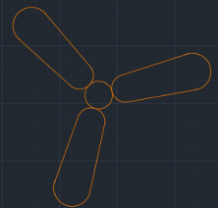

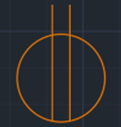

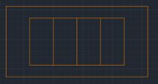

Conduit Calculation:
Rule of thumb: The minimum current rating of a conduit is 5A. So, if we consider the pf=0.8, total power will be P=V_{L}I_{L}cosΘ = 220 × 5 × 0.8 =880W.
Practically, the total power rating of all appliances does not exceed 880 W. So, we can follow the process:
C2
C1
C3
For these cases, ECC must be used.
C1
C1

Slide 13
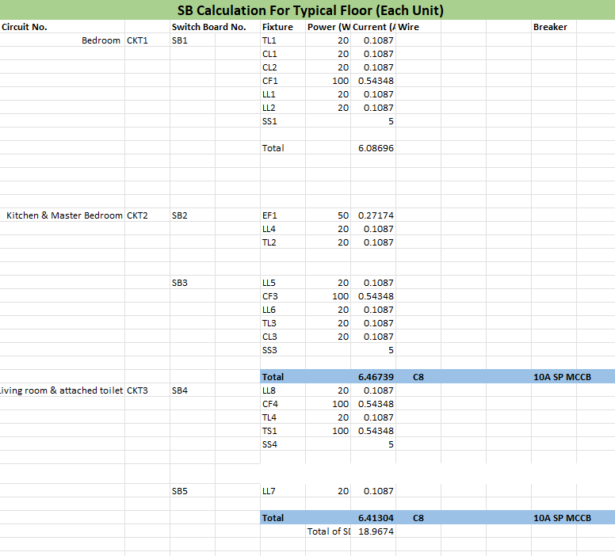
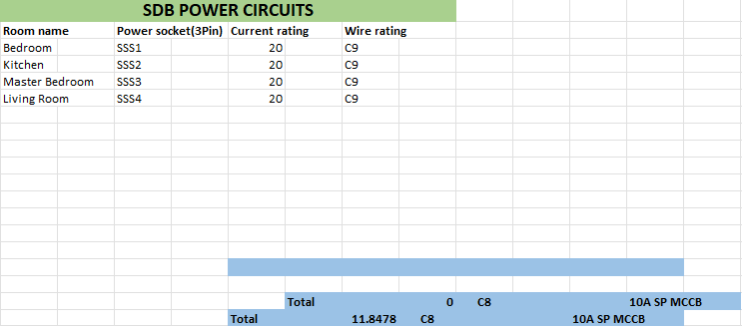
Power Calculation:

Slide 14
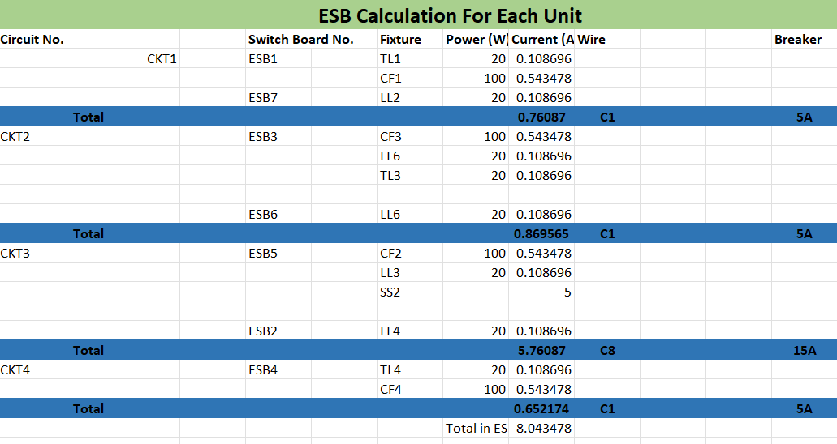
Power Calculation:

Slide 15
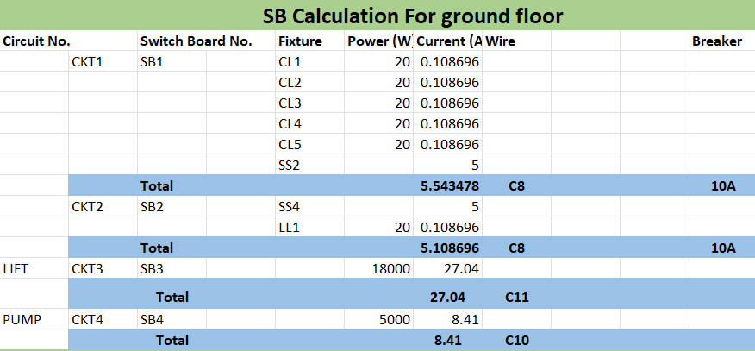
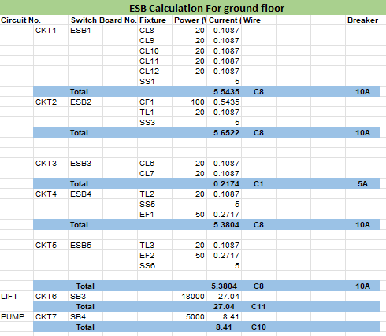
Power Calculation:

Slide 16
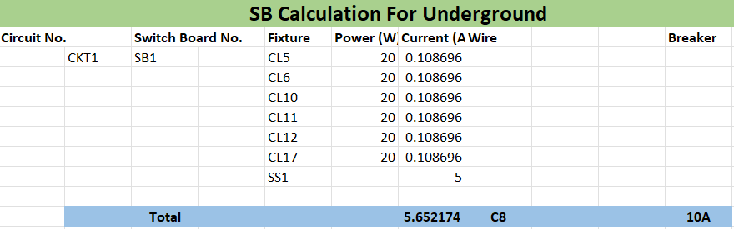
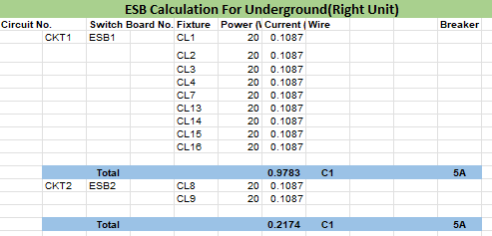
Power Calculation:

Slide 17
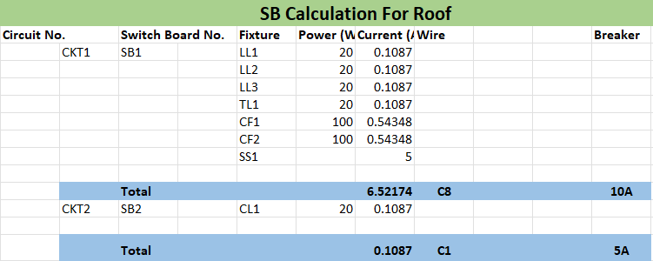
Power Calculation:

Slide 18
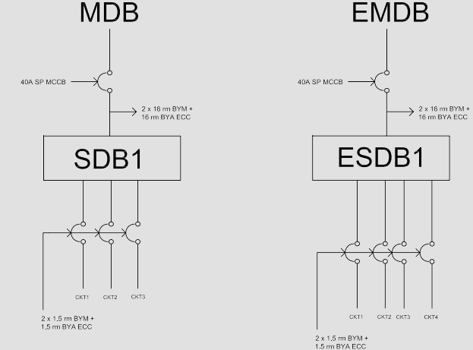
Single Line Diagram of Typical Floor (MDB & EMDB):

Slide 19
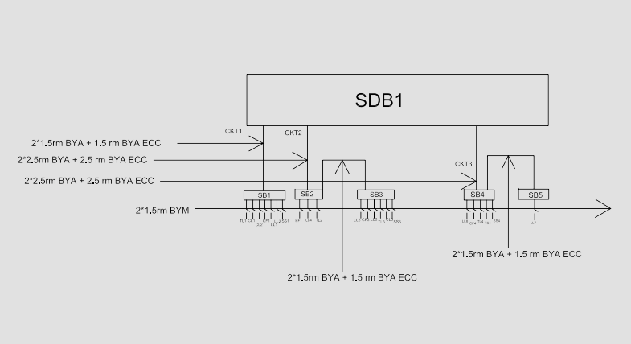
Single Line Diagram of Typical Floor (SDB):

Slide 20
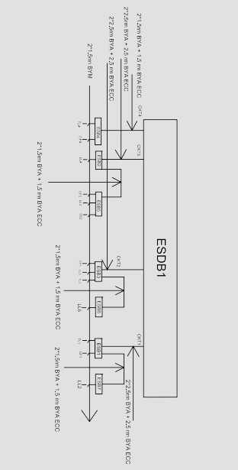
Single Line Diagram of Typical Floor (ESDB):

Slide 21
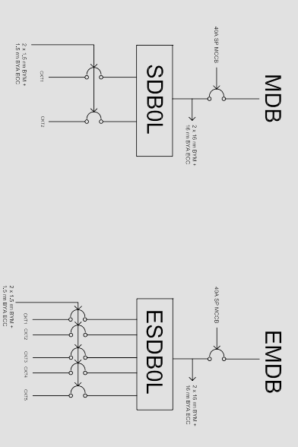
Single Line Diagram of Ground Floor (MDB & EMDB):

Slide 22
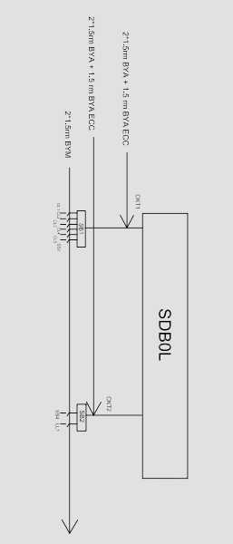
Single Line Diagram of Ground Floor (SDB):

Slide 23
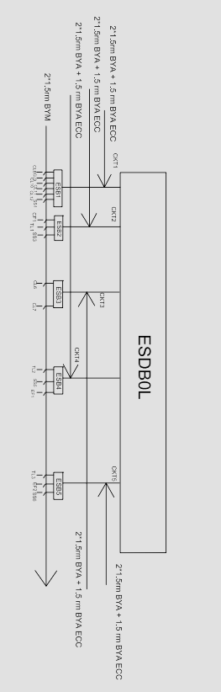
Single Line Diagram of Ground Floor (ESDB):

Slide 24
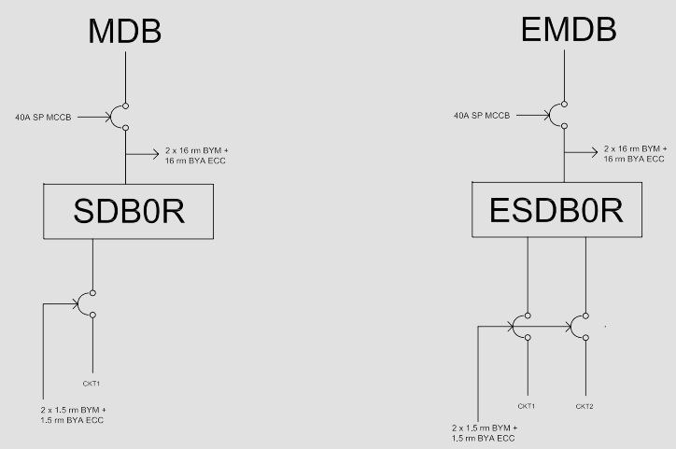
Single Line Diagram of Underground Floor (MDB & EMDB):

Slide 25
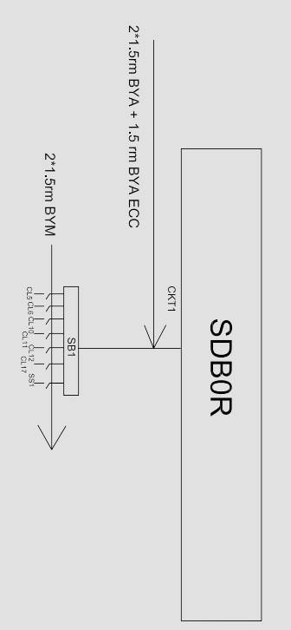
Single Line Diagram of Underground Floor (SDB):

Slide 26
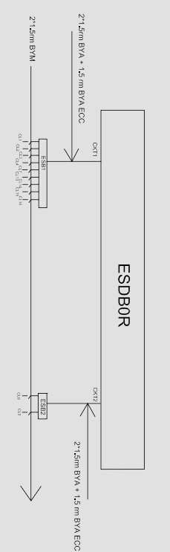
Single Line Diagram of Underground Floor (ESDB):

Slide 27
Single Line Diagram of Roof (SDB):

Slide 28
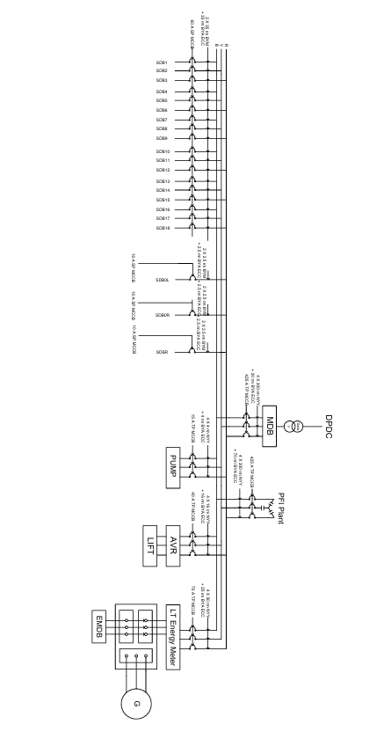
Full Building Diagram (MDB):

Slide 29
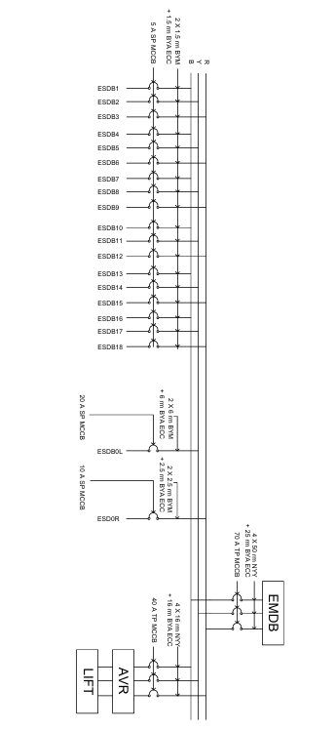
Full Building Diagram (EMDB):

Slide 30
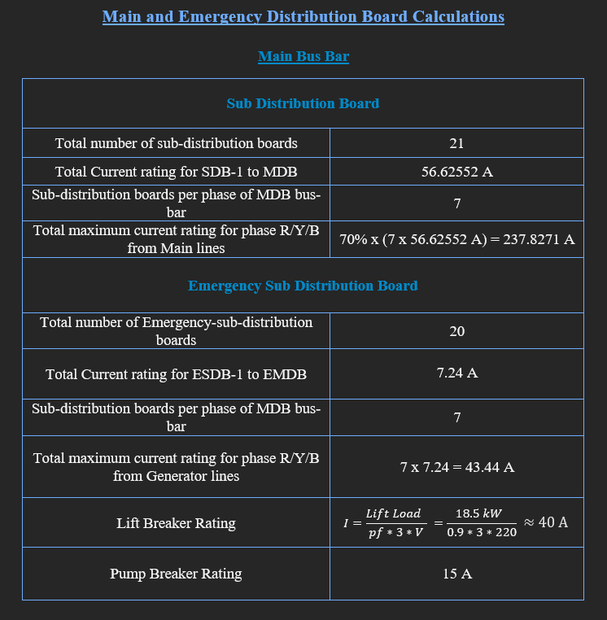
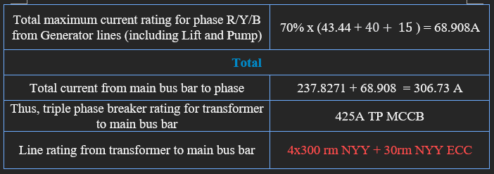

Slide 31
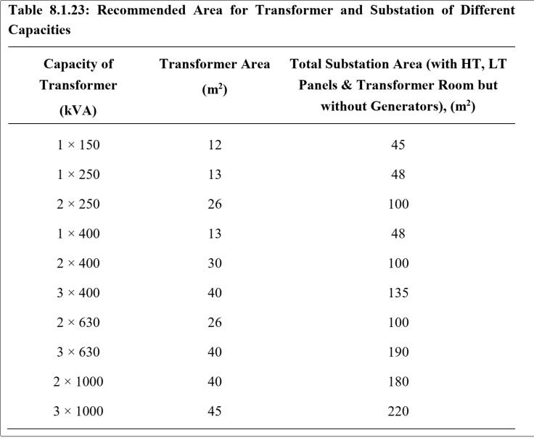
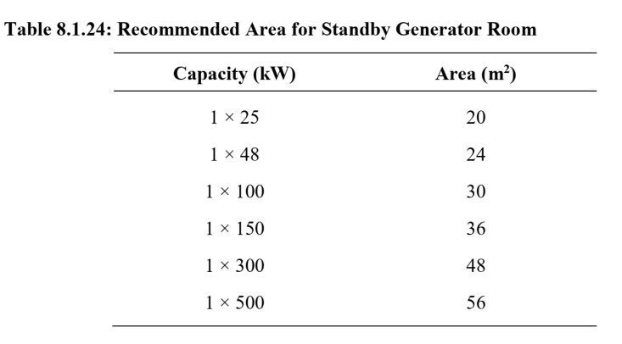
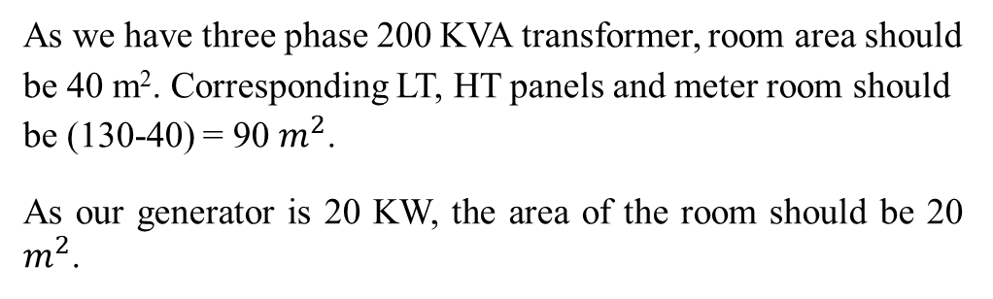
As we have three phase 200 KVA transformer, room area should be 40 m². Corresponding LT, HT panels and meter room should be (130-40) = 90 $m^{2}$.
As our generator is 20 KW, the area of the room should be 20 $m^{2}$.

Slide 32
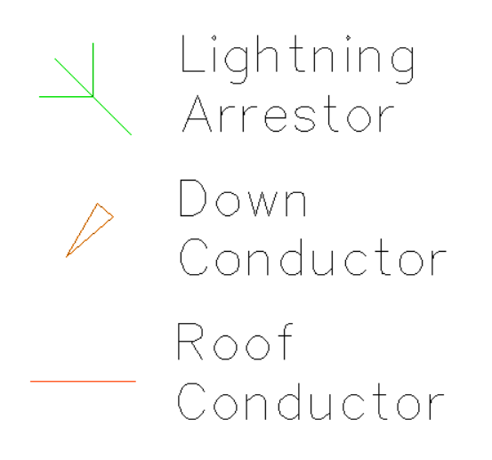
Lightning Protection System
A lightning protection system (LPS) in a building is a system designed to safeguard the structure and its occupants from the destructive effects of lightning strikes. It works by providing a low-resistance path for the lightning current to travel safely to the ground, thereby minimizing the risk of fire, structural damage, and harm to people or equipment inside the building.
Components:
1. Lightning Arrestor: A lightning arrester (or lightning arrestor) is a protective device used to shield electrical systems and equipment from the damaging effects of lightning strikes or power surges.
2. Down Conductor: These are metal cables or conductors that provide a path for the lightning current to flow from the air terminals to the ground. They are installed along the exterior walls of the building.
3. Roof Conductor: It is a metal conductor installed on the roof of a building to direct the electrical energy from a lightning strike safely toward the ground.

Slide 33
Calculation for Lightning Protection System:
1 arrestor is needed per 25 ft of the perimeter of the roof.
This leads us to 9 arrestors.
1 down conductor is needed for the first 80 sq-m and 1 down conductor per 100 sq-m for the rest.
This leads us to 3 down conductors.

Slide 34
Credits
Co-ordinator
EVERYONE
Layout Design
S. M. TAHMEED REZA
Power Calculation
SHOURAV JOARDER
AL NAYEM
Circuit Diagram
ROKON UDDIN AHMED
Presentation
SADAD HASAN
Report
EVERYONE

Slide 35
Thank You.
Any Questions?

