Slide 1






Electrical Services Design of a 10 Storied, 2 Unit Residential Building
EEE 414: Electrical Services Design
January 2024 Level-4 Term-2 Section-A
Final Project Presentation
Submitted by – Group 1
Rokon Uddin Mahmud
19060140
S.M. Tahmeed Reza
1906149
Shourov Joarder
1906156
Al Nayem
1906158
Sadad Hasan
19060163

Slide 2
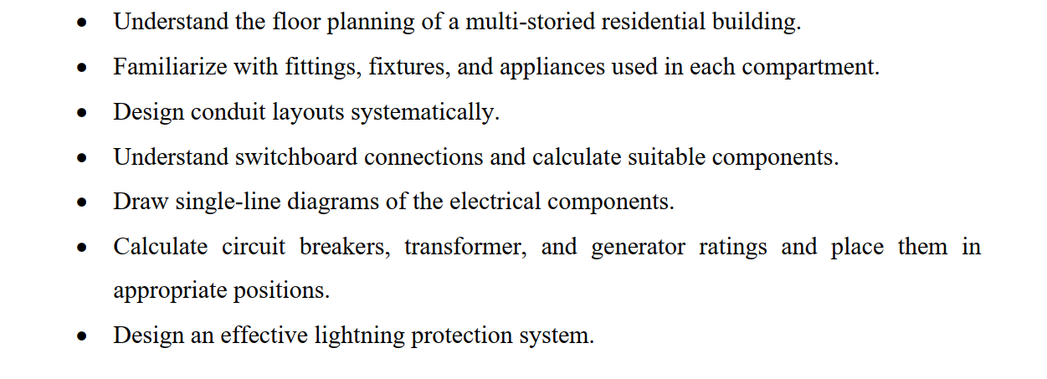
Project Objectives:

Slide 3
Building Specification:
Type | High-rise Residential Building
Length | 73’-6’’ (22.4028 m)
Width | 57’ (17.3736 m)
Area | 4189.5 sq.ft (389.21 sq.m)
No. of floors | 12(10 common dwelling floors, 1 ground, 1 underground)
Units per floor | 2
Area of a unit | 2094.75 sq.ft (194.605 sq.m)

Slide 4
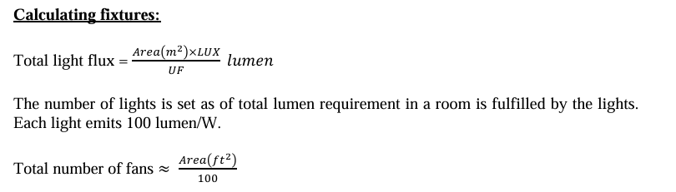

Slide 5
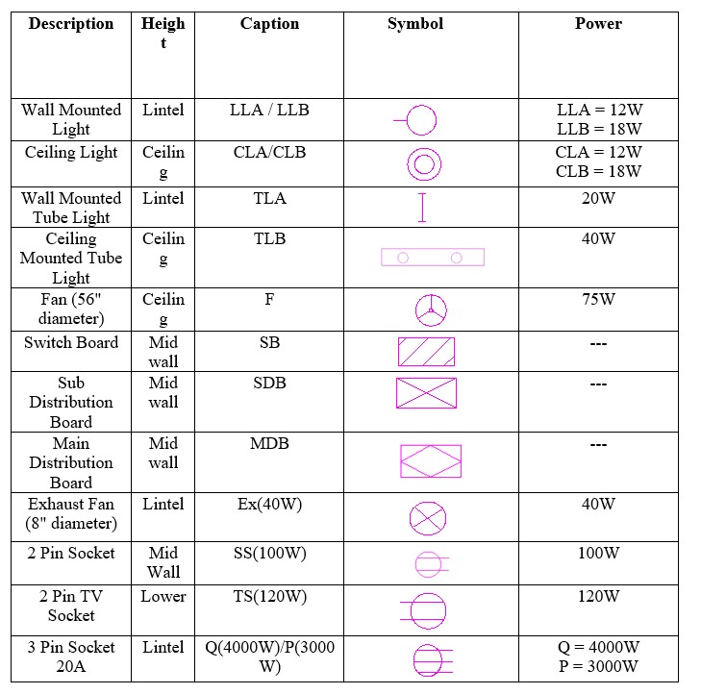
Component Ratings:

Slide 6
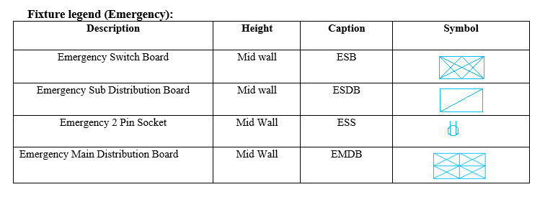
Component Ratings:

Slide 7
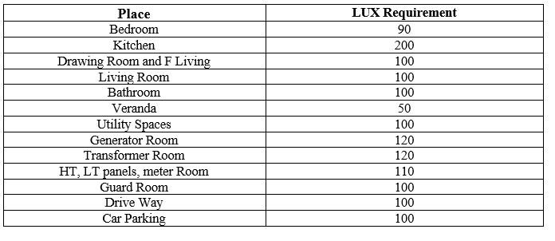
Required Lux Ratings:

Slide 8
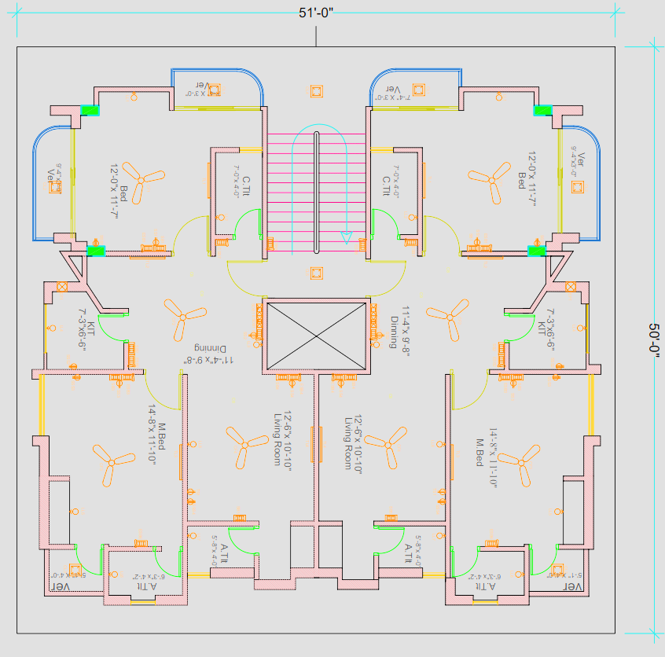
Typical Floor Plan

Slide 9
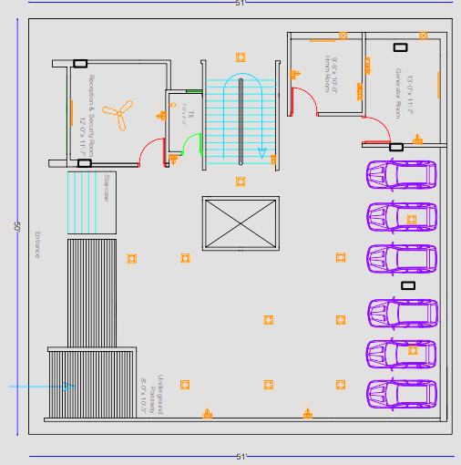
Ground Floor Plan

Slide 10
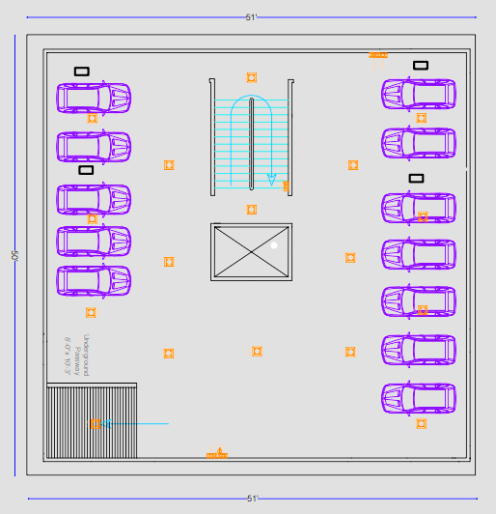
Underground Floor Plan

Slide 11
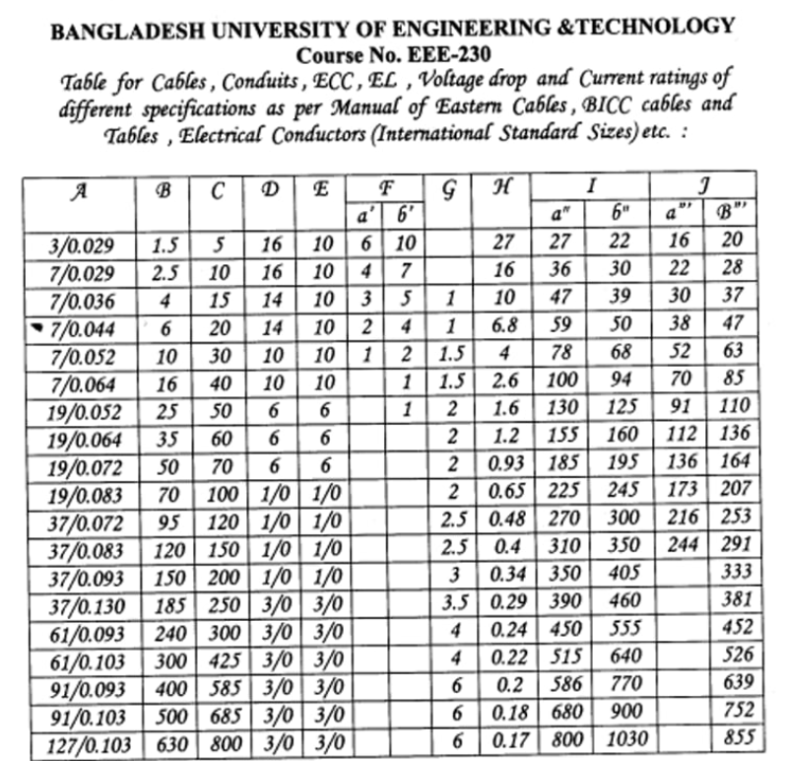
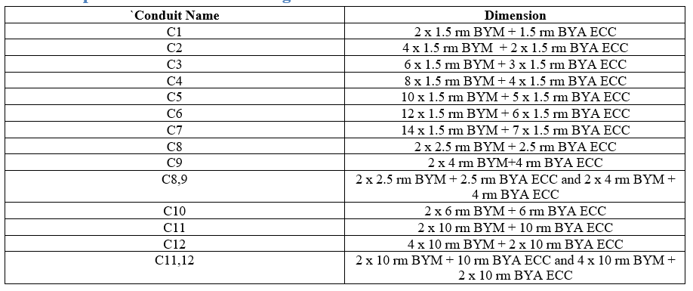
Conduit Legend:
* Using ECC is not necessary for normal appliances. Only to be used in SB/ESB to SB/ESB or SB/ESB to SDB/ESDB.

Slide 12






Conduit Calculation:
Rule of thumb: The minimum current rating of a conduit is 5A. So, if we consider the pf=0.8, total power will be P=V_{L}I_{L}cosΘ = 220 × 5 × 0.8 =880W.
Practically, the total power rating of all appliances does not exceed 880 W. So, we can follow the process:
C2
C1
C3
For these cases, ECC must be used.
C1
C1

Slide 13
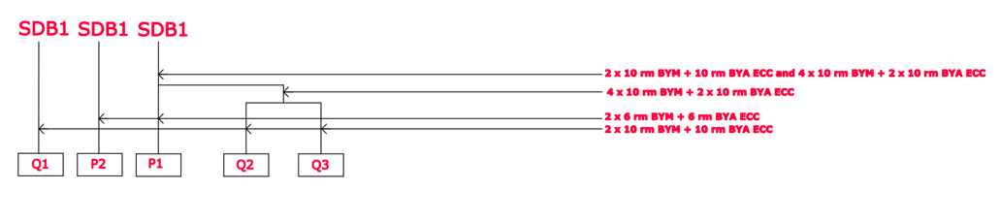
Conduit Calculation:
For P load (3000W), we get current around 17 A. In the current rating and conduit area is 6 mm^2. So, a new conduit label C10 is defined.
For Q load (4000W), we get current around 22.73 A. In the current rating and conduit area is 10 mm^2. So, a new conduit label C11 is defined.
C11,12
C12
C10
C11

Slide 14
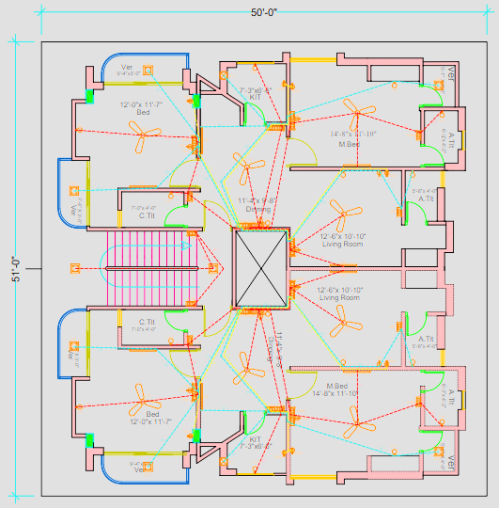
Typical Floor Plan
With Conduit

Slide 15
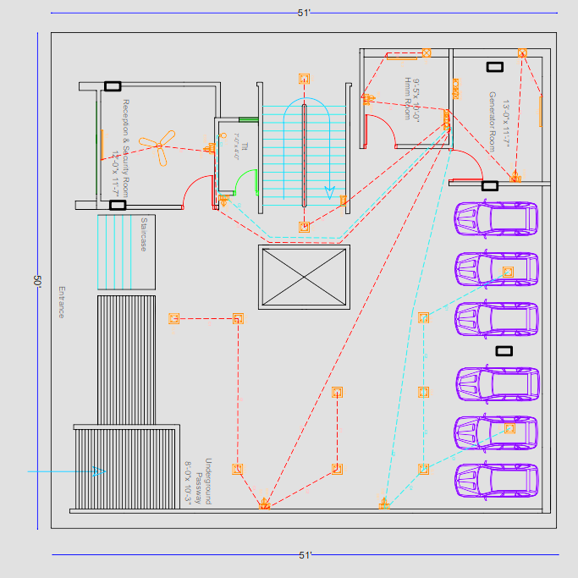
Ground Floor Plan
With Conduit

Slide 16

Underground Floor Plan
With Conduit

Slide 17
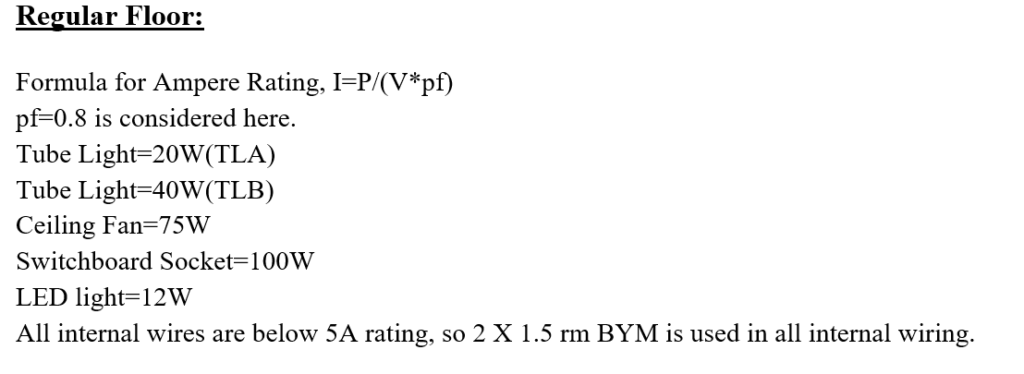
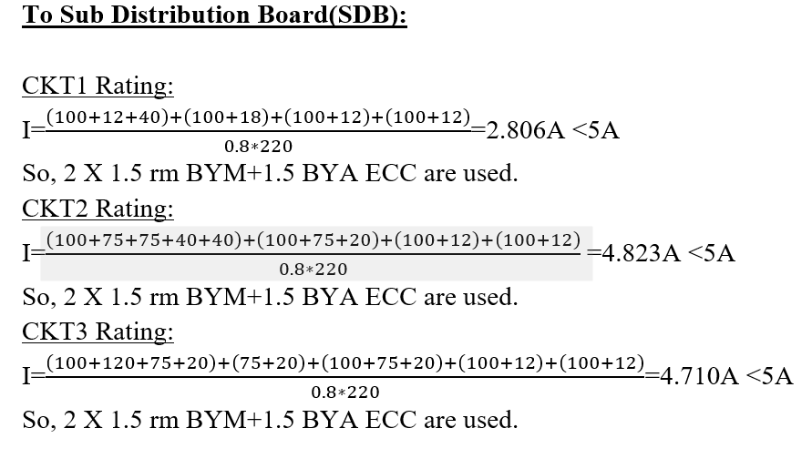
Circuit-wise Calculation:

Slide 18
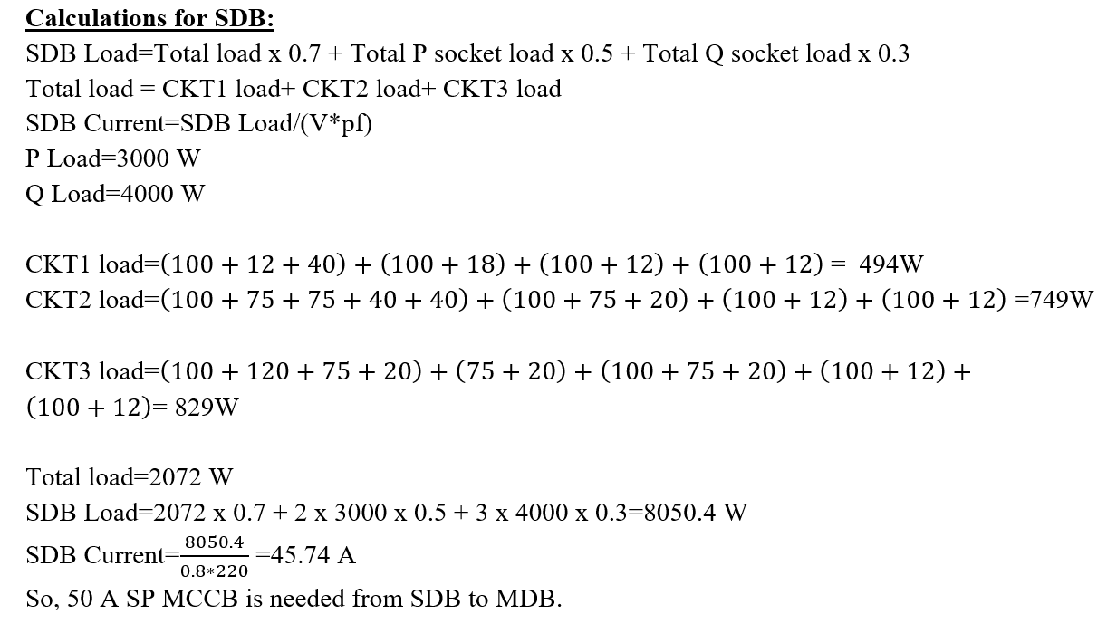
Circuit-wise Calculation:

Slide 19
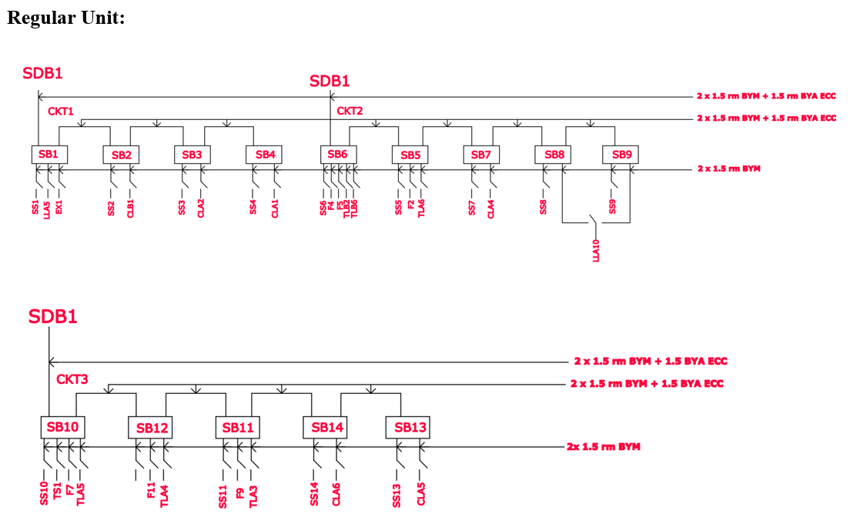
Single Line Diagram:

Slide 20
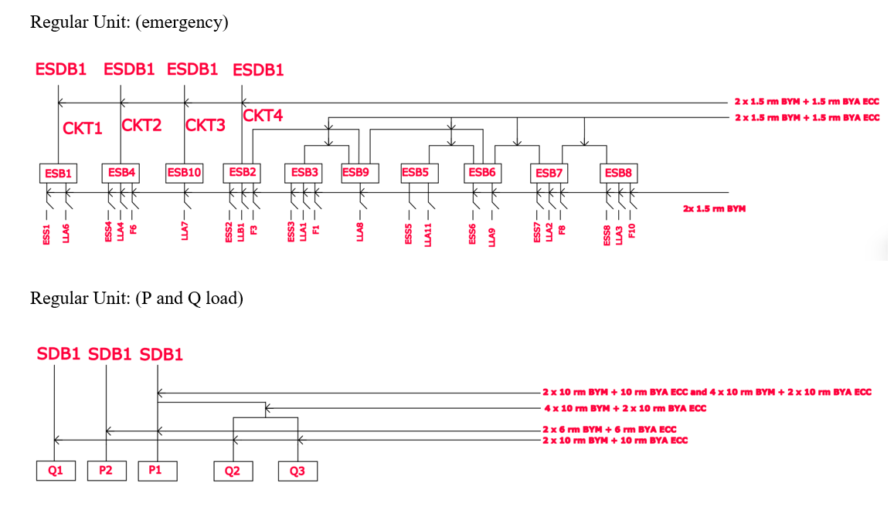
Single Line Diagram:

Slide 21
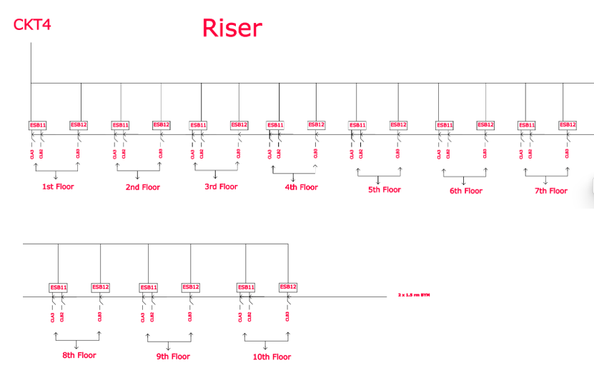
Single Line Diagram:

Slide 22
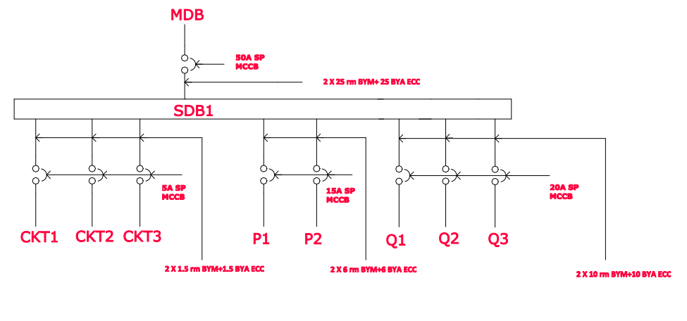
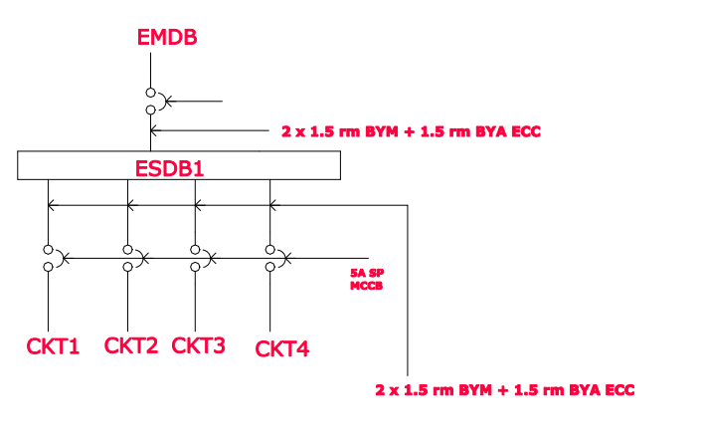
MDB and EMDB Connection Diagram:
Regular Unit:
Regular Unit(emergency):

Slide 23
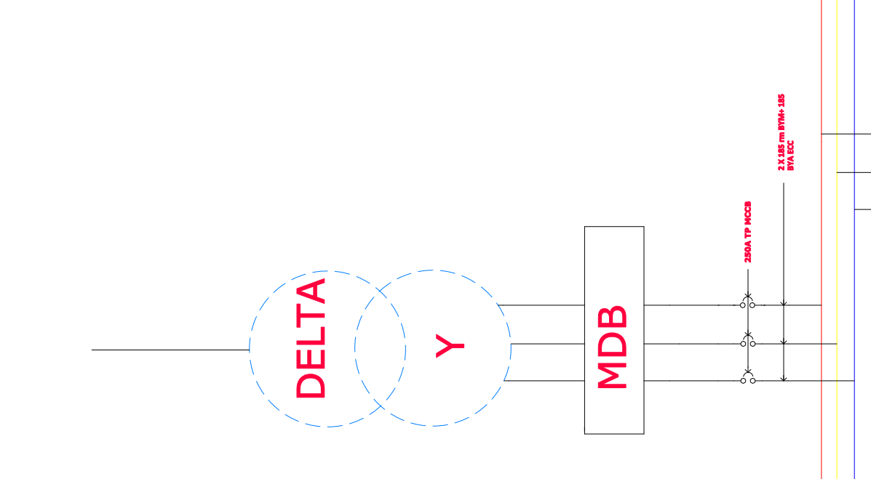
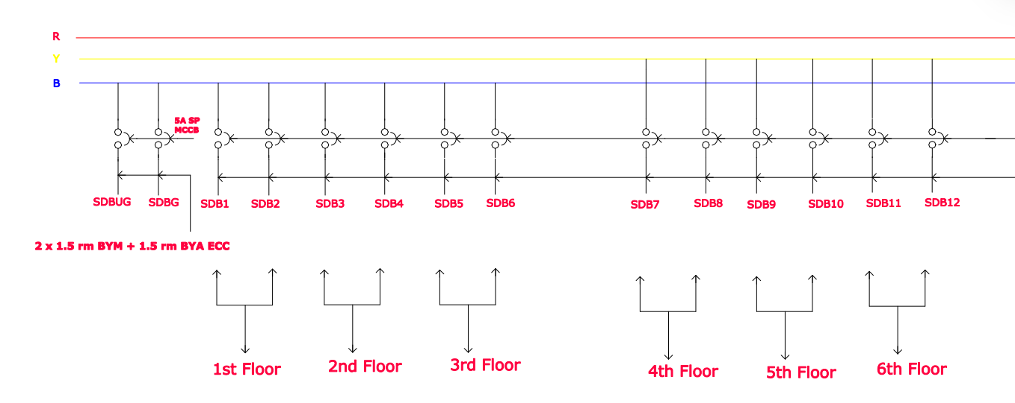
MDB and EMDB Connection Diagram:

Slide 24
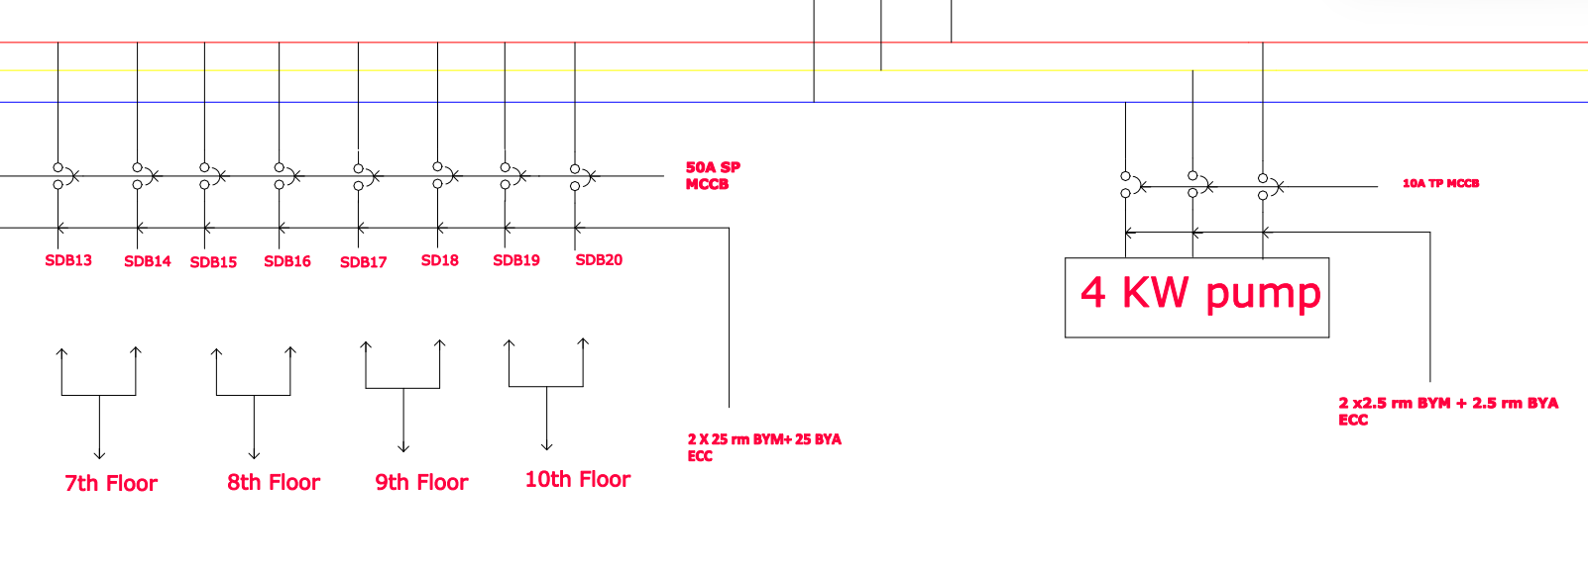
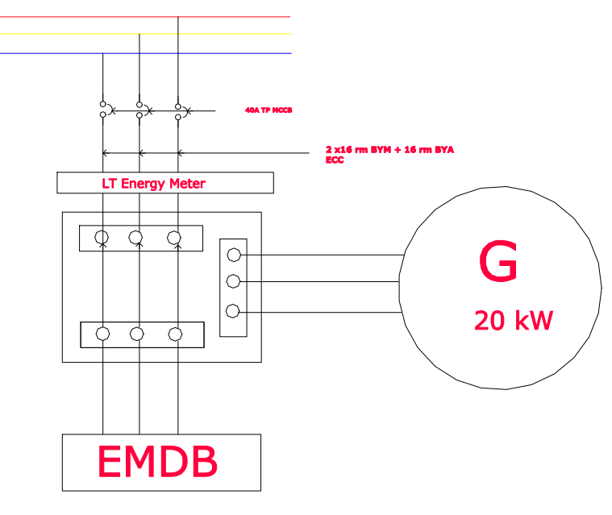
MDB and EMDB Connection Diagram:

Slide 25
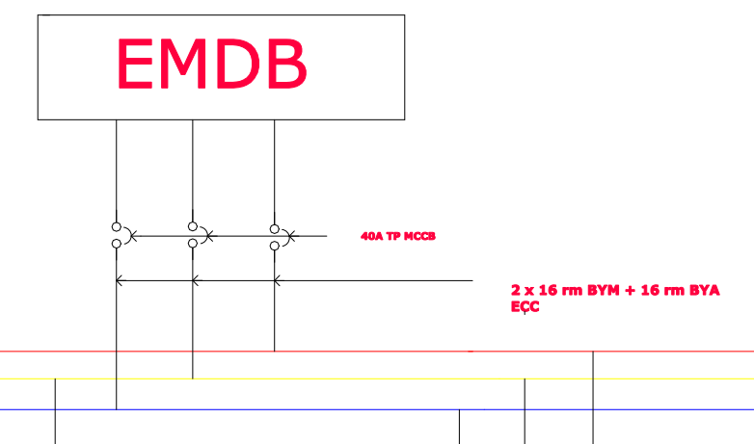
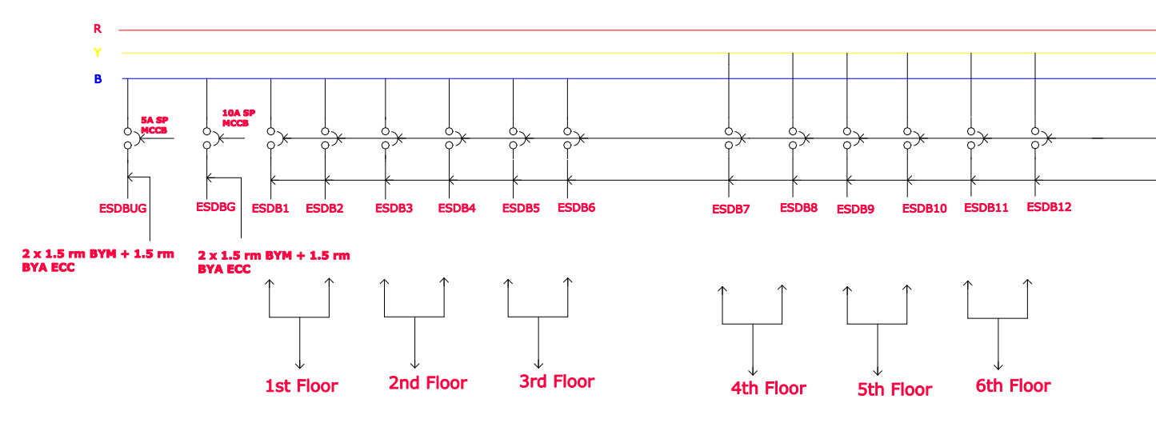
MDB and EMDB Connection Diagram:

Slide 26
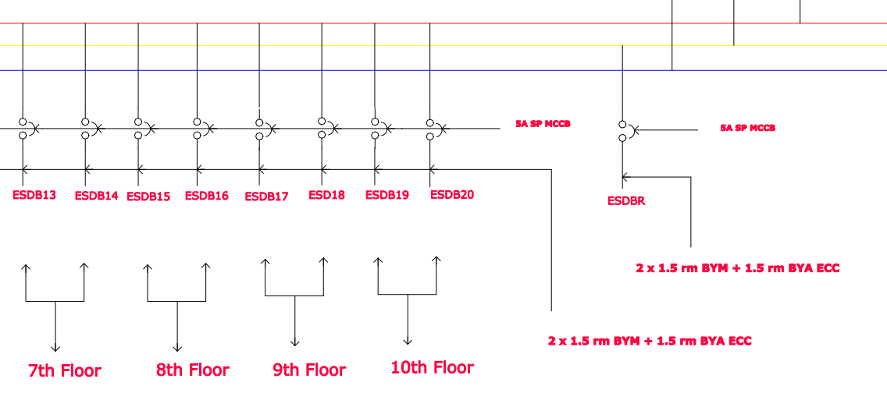
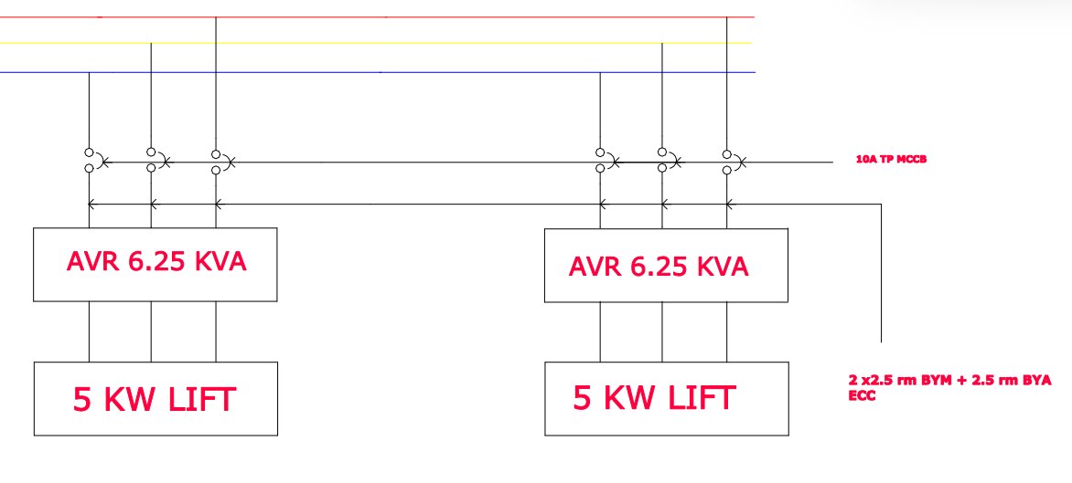
MDB and EMDB Connection Diagram:

Slide 27
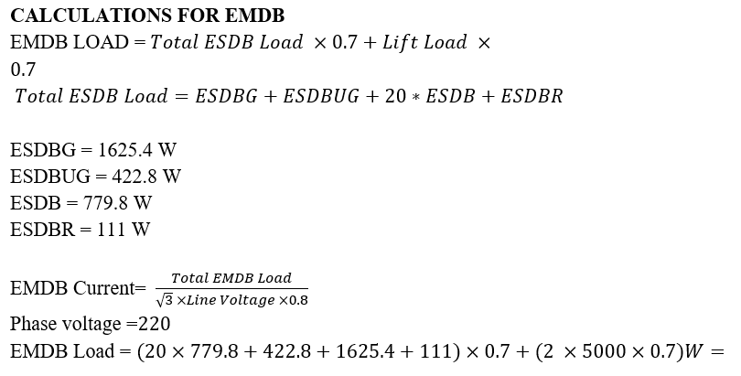
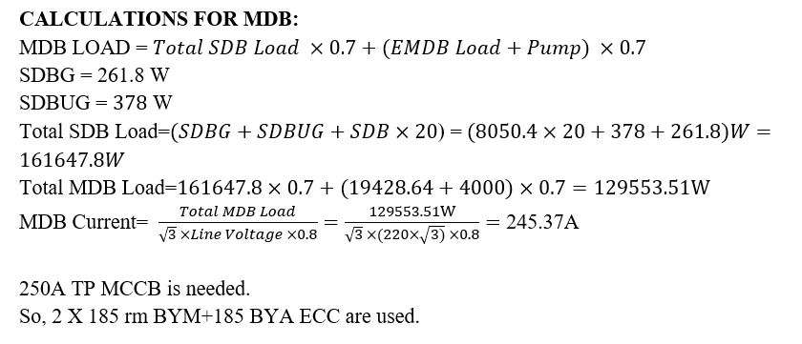
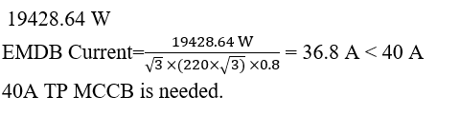

Slide 28
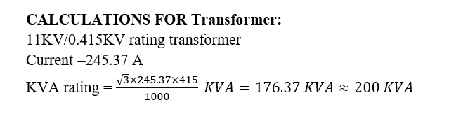
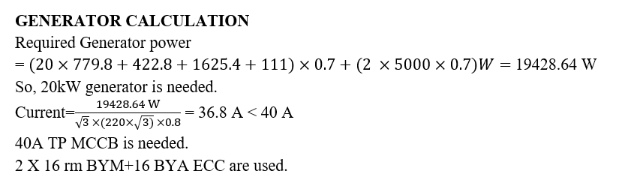
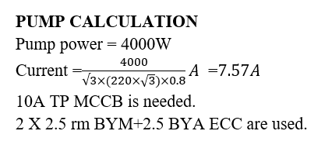
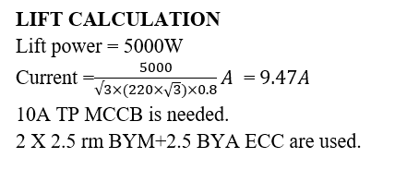
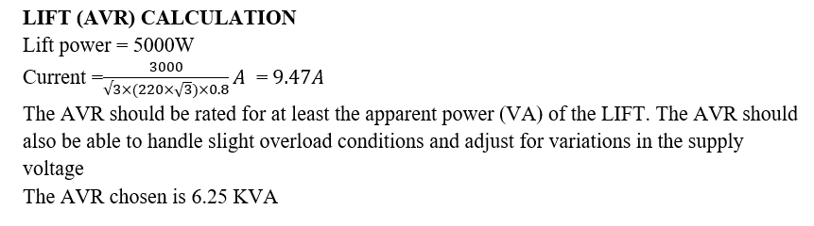

Slide 29
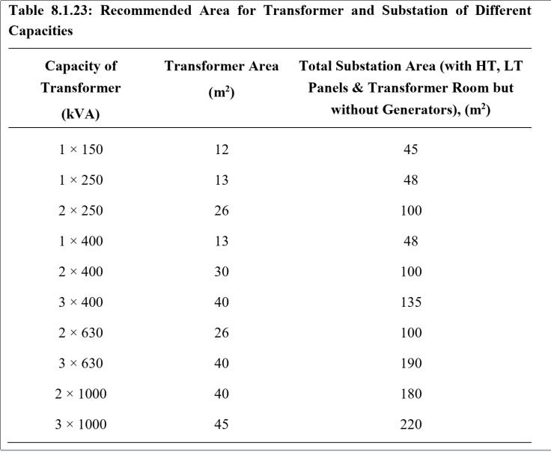
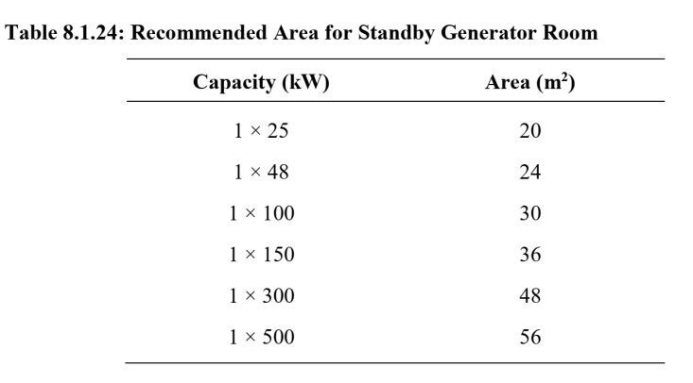
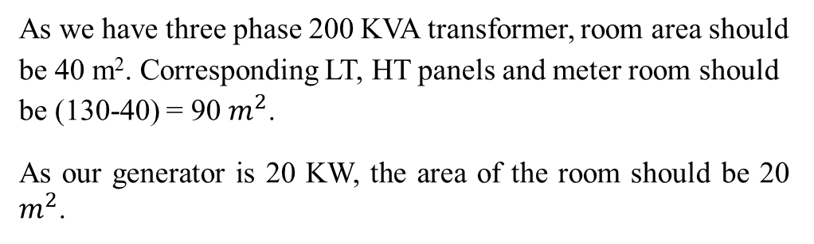
As we have three phase 200 KVA transformer, room area should be 40 m². Corresponding LT, HT panels and meter room should be (130-40) = 90 $m^{2}$.
As our generator is 20 KW, the area of the room should be 20 $m^{2}$.

Slide 30
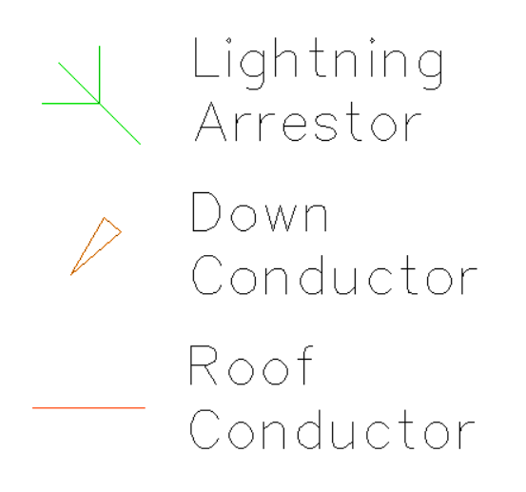
Lightning Protection System
A lightning protection system (LPS) in a building is a system designed to safeguard the structure and its occupants from the destructive effects of lightning strikes. It works by providing a low-resistance path for the lightning current to travel safely to the ground, thereby minimizing the risk of fire, structural damage, and harm to people or equipment inside the building.
Components:
1. Lightning Arrestor: A lightning arrester (or lightning arrestor) is a protective device used to shield electrical systems and equipment from the damaging effects of lightning strikes or power surges.
2. Down Conductor: These are metal cables or conductors that provide a path for the lightning current to flow from the air terminals to the ground. They are installed along the exterior walls of the building.
3. Roof Conductor: It is a metal conductor installed on the roof of a building to direct the electrical energy from a lightning strike safely toward the ground.

Slide 31
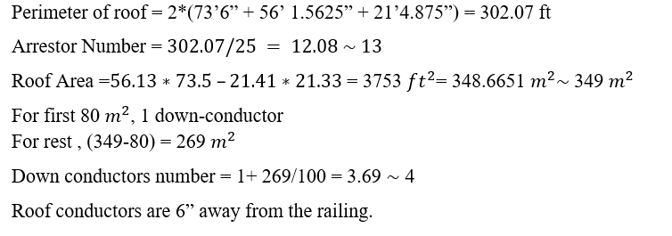
Calculation for Lightning Protection System:
1 arrestor is needed per 25 ft of the perimeter of the roof.
1 down conductor is needed for the first 80 sq-m and 1 down conductor per 100 sq-m for the rest

Slide 32
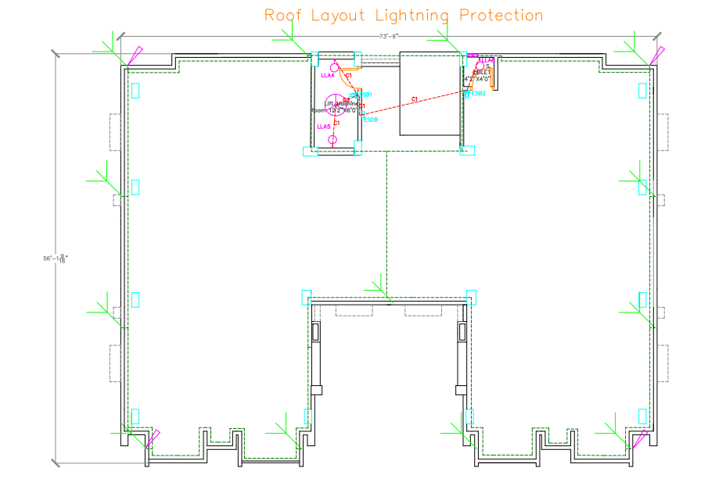

Slide 33
References
https://ssgeshop.com/shop/super-star-led-lux-eye-safe/
https://ssgeshop.com/shop/ac-led-20-watt-4ft-daylight-t-8-compact/
https://www.displayspecifications.com/en/model-power-consumption/78e8d13
https://vision.com.bd/fan/exhaust-fan/vision-exhaust-fan-8-en-2/
বাংলাদেশ-জাতীয়-বিল্ডিং-কোড-(BNBC) (hbri.gov.bd)

Slide 34
Thank You.
Any Questions?

