Slide 1

Modern React Frontend Architecture
Building Scalable, Type-Safe, and Efficient Web Applications

Slide 2
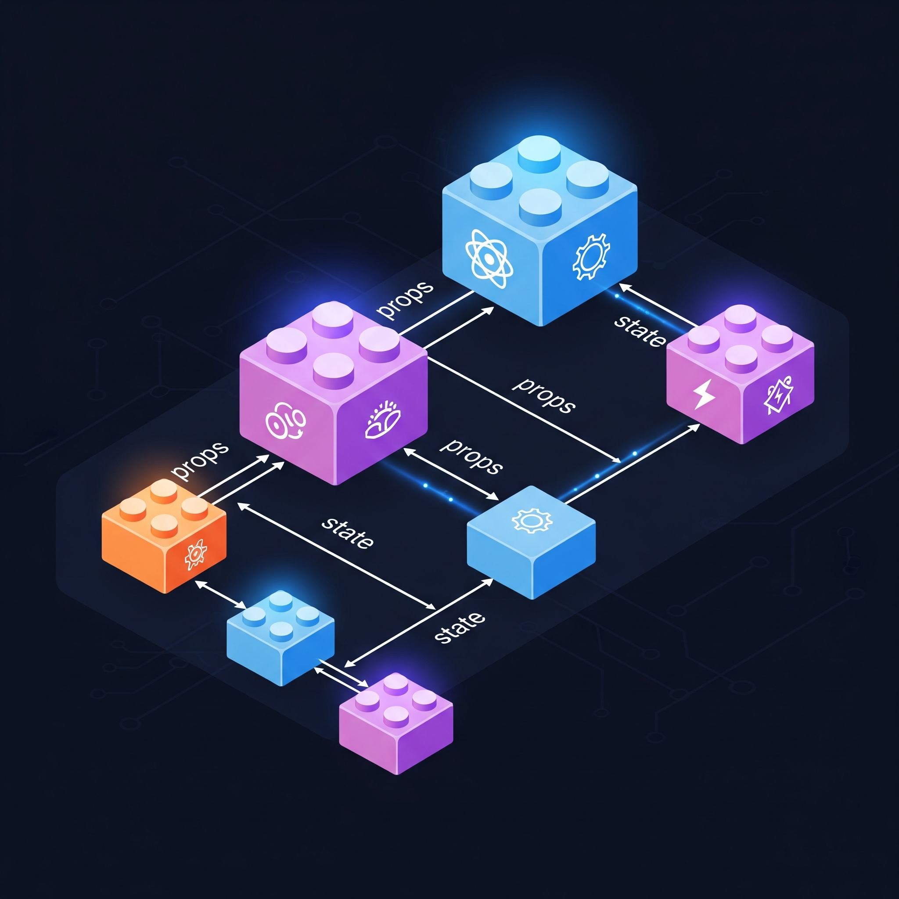
React Core Concepts
React is a JavaScript library for building user interfaces
Component-Based: components that manage their own state, composed together to make complex UIs
Virtual DOM: DOM stored in memory, making updates incredibly fast by only changing what's necessary
State describes what your UI should look like while props tell React with what content

Slide 3
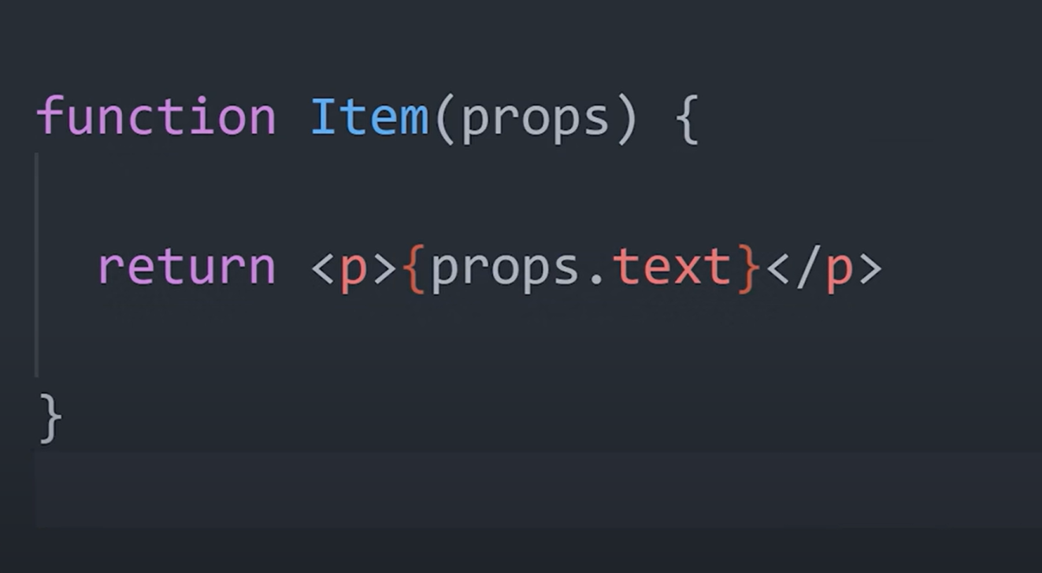
React Core Concepts
Functions: components simply javascript functions
JSX: The unique html return type of the function that can reference code and variables via brackets
Props: arguments passed and referenced in functions

Slide 4
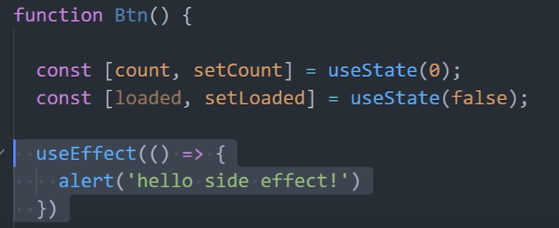
React Core Concepts
Components become dynamic because of hooks
useState: variables that keep track of state so rerenders on change
useEffect: allow a function to run when specific state is changed (specified via dependency array)

Slide 5
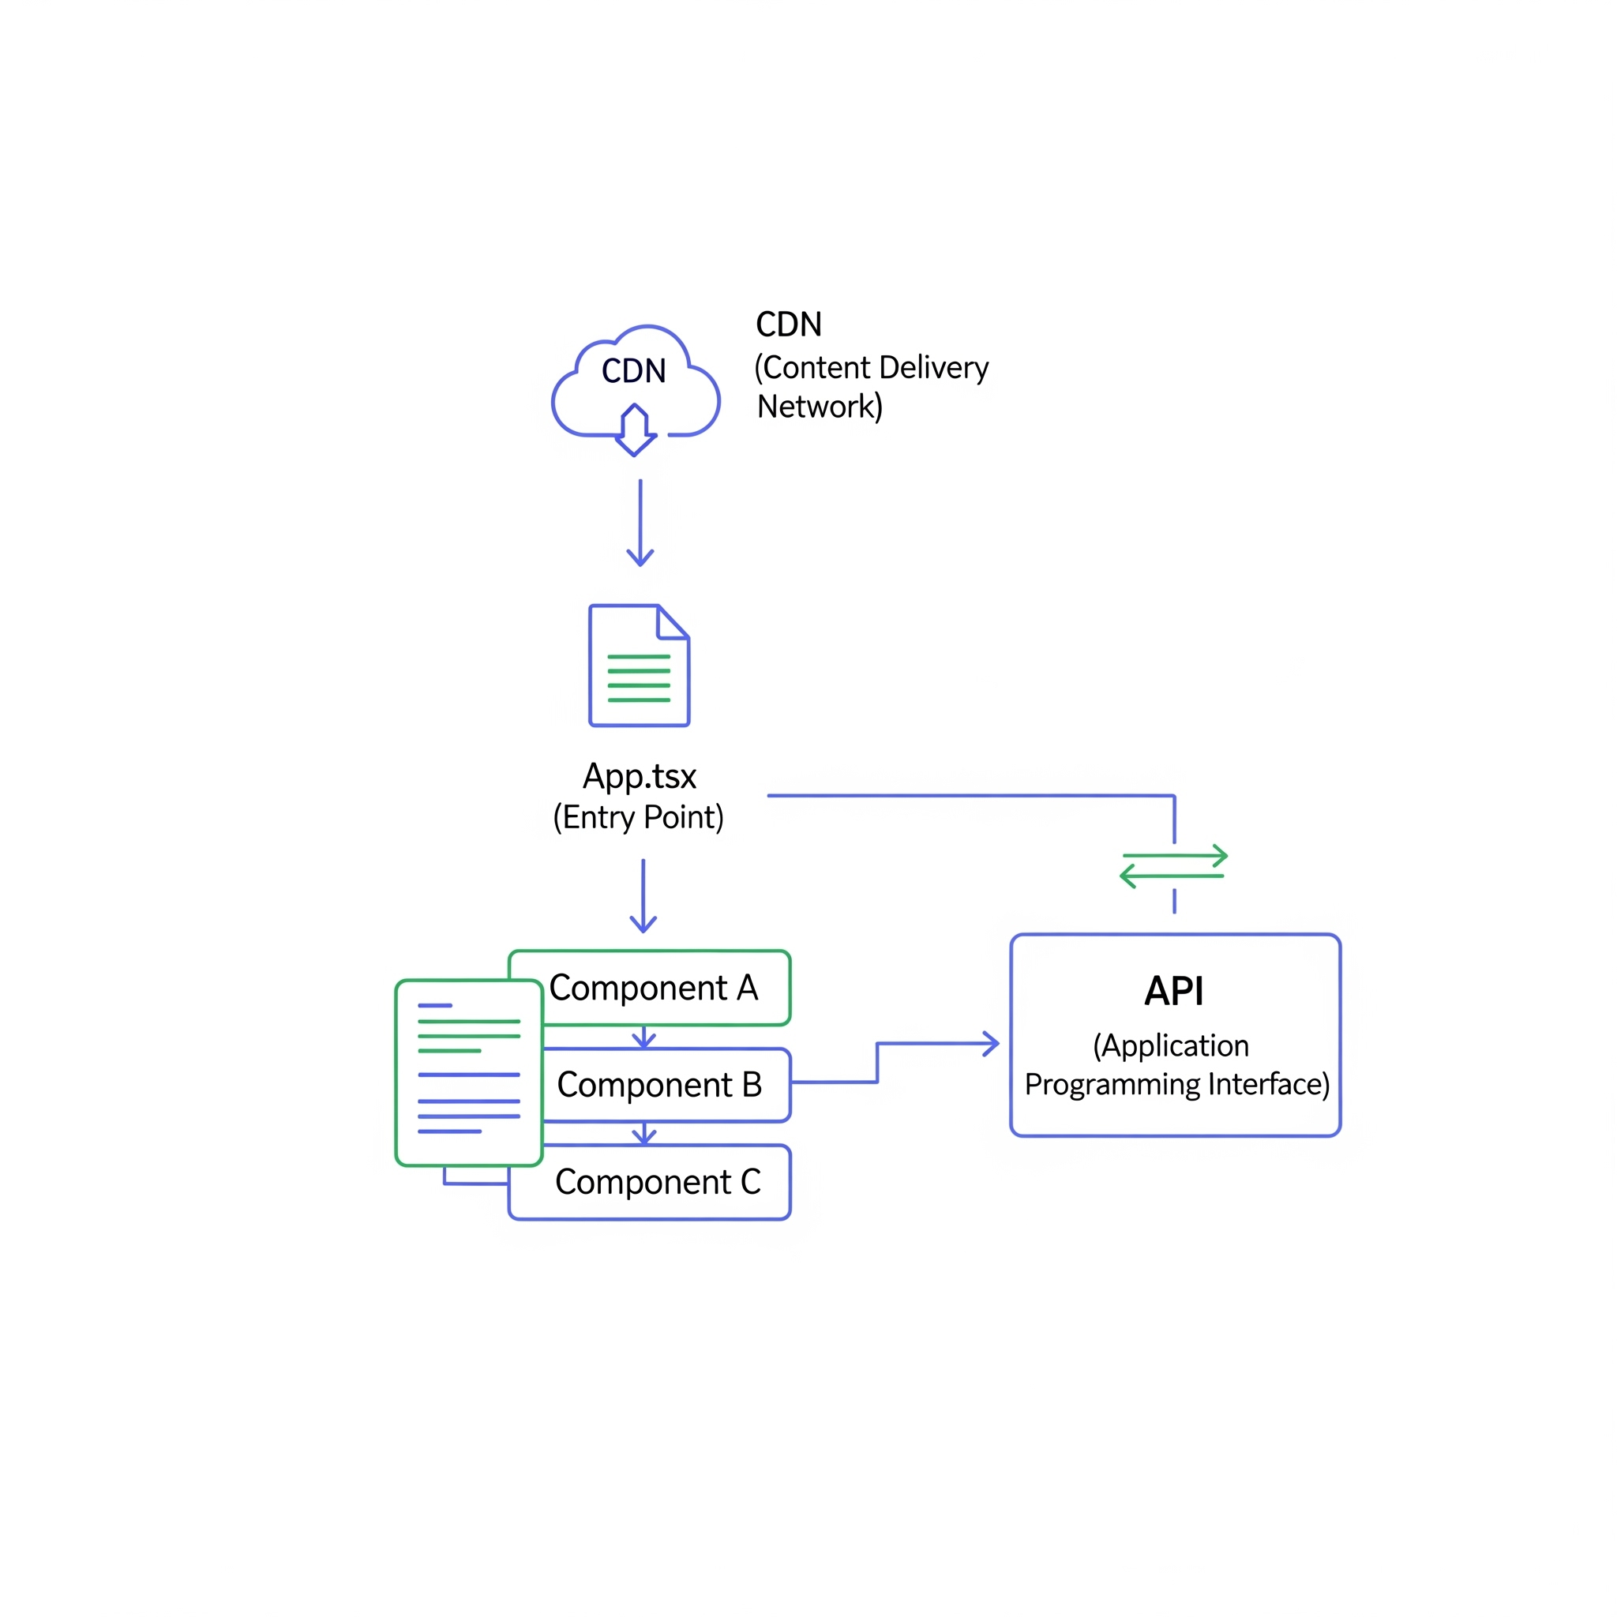
React Architecture
Built for CSR with static serving of SPA
Individual Components support dynamic UI within browser
Blazing Fast Delivery: Using a CDN, static files in a storage bucket are delivered to users (no web server needed)
API Communication: React communicates directly to API using client architecture
App.tsx is the entry point and routing hub

Slide 6

Integrated Components - Zustand
React supports a vast library of pre-made open source components
import { create } from 'zustand';
// Define the store
const useCounterStore = create((set) => ({
count: 0, // Initial state
// Actions to modify the state
increment: () => set((state) => ({ count: state.count + 1 })),
decrement: () => set((state) => ({ count: state.count - 1 })),
reset: () => set({ count: 0 }),
}));
export default useCounterStore;
As your app grows, managing shared state gets complicated. Passing props down multiple levels ("prop drilling") is messy.
Zustand is a small, fast, and scalable state-management solution
Use hooks to access and modify states
Performance: components only re-render when specific state changes

Slide 7

Integrated Components - Zod
Typescript validation with static type inference
import { z } from 'zod';
const UserSchema = z.object({
id: z.string().uuid(),
name: z.string().min(3, "Name must be at least 3 characters long"),
email: z.string().email("Invalid email address"),
age: z.number().int().positive("Age must be a positive integer").optional(),
});
// Infer the TypeScript type from the schema
type User = z.infer<typeof UserSchema>;
Zod is used to validate API response types using a Typescript Client
Where should API calls happen in React? - In stores of course!
API (defined in client) -> called in store -> validated in Typescript Client -> used in components

Slide 8


Integrated Components - UI
Pre-made UI components for UX
Utilize premade components in a UI material guide
These components have already been optimized, and pre-built perfect for React plug and use experience

