Slide 1


Lucas Batista
Plant Breeding/Department of Agronomy
Menard Soni
Carl and Melinda Helwig Department of Biological and Agricultural Engineering
GitHub: https://shorturl.at/9GejU

Slide 2
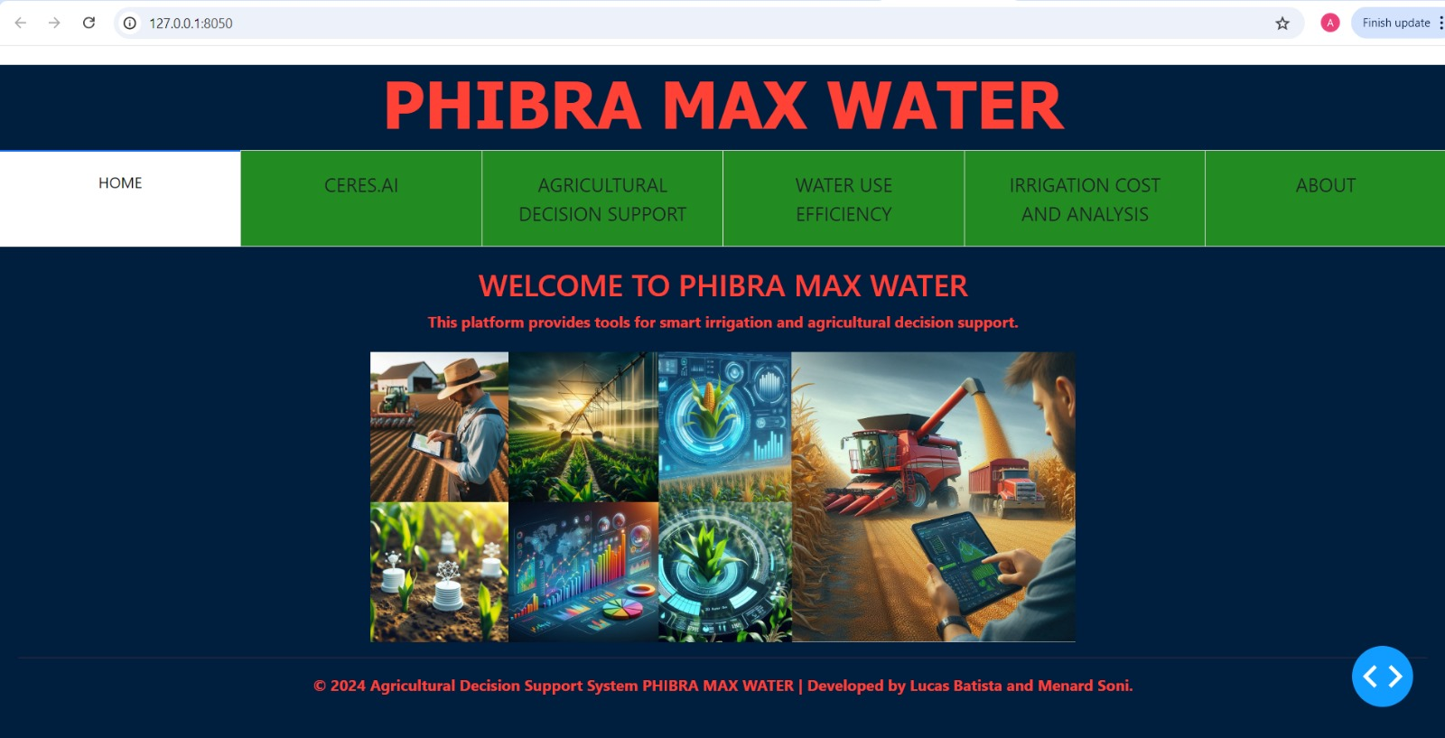
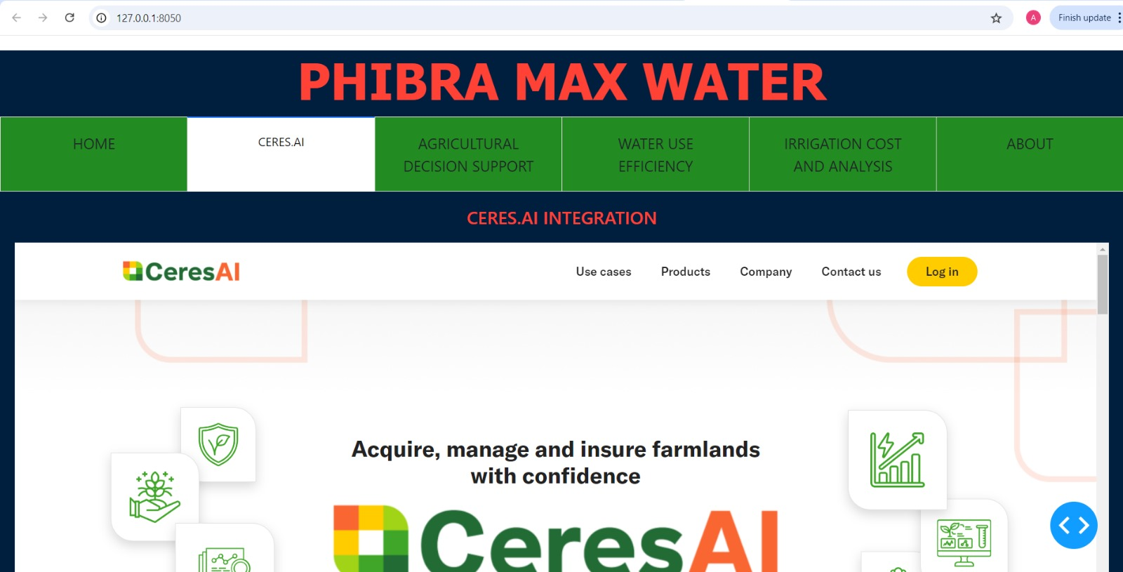
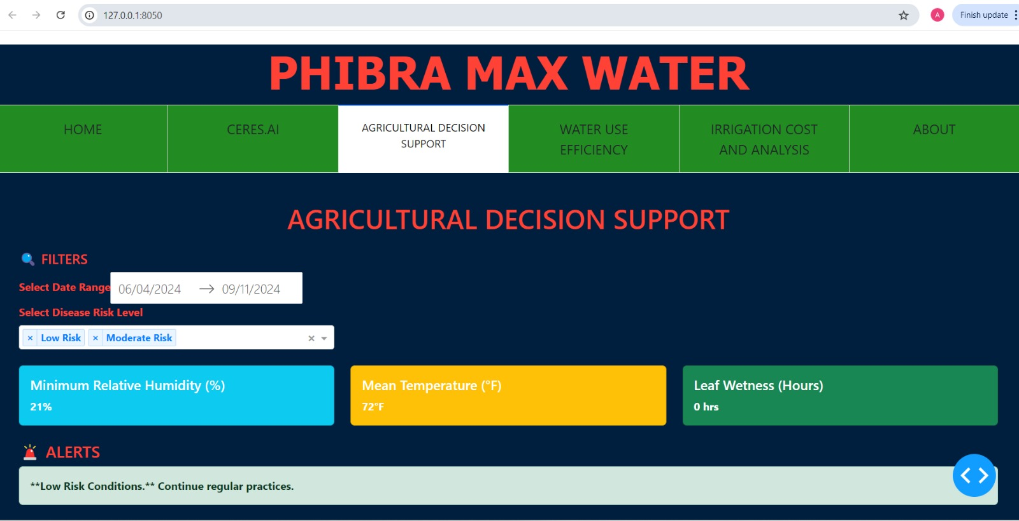
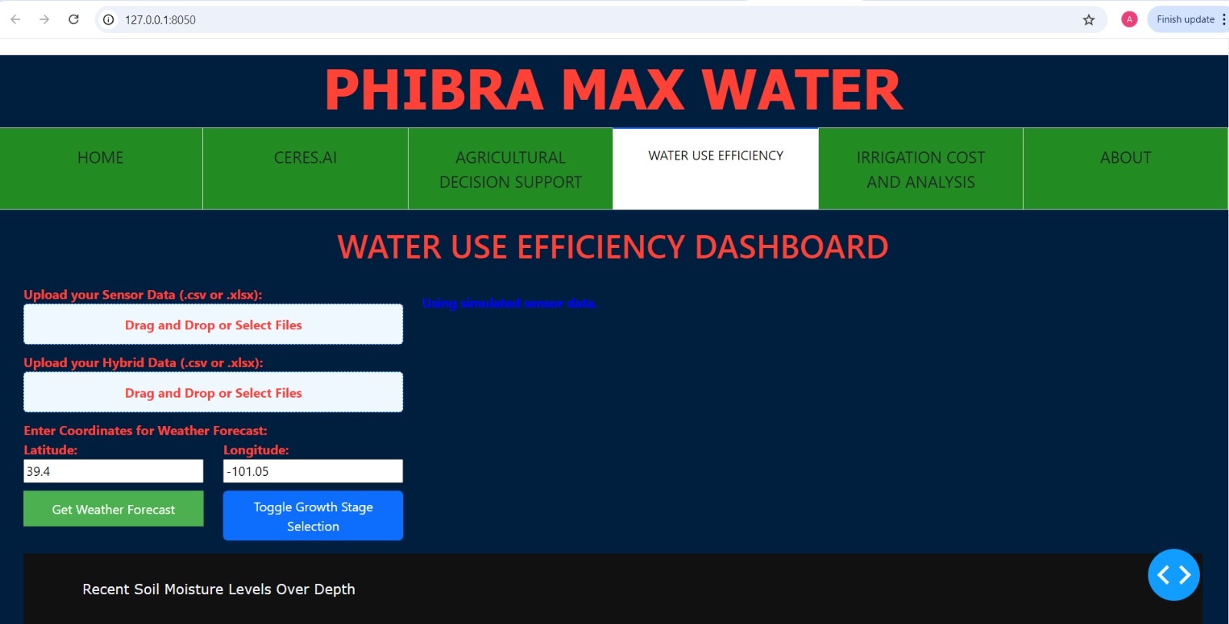
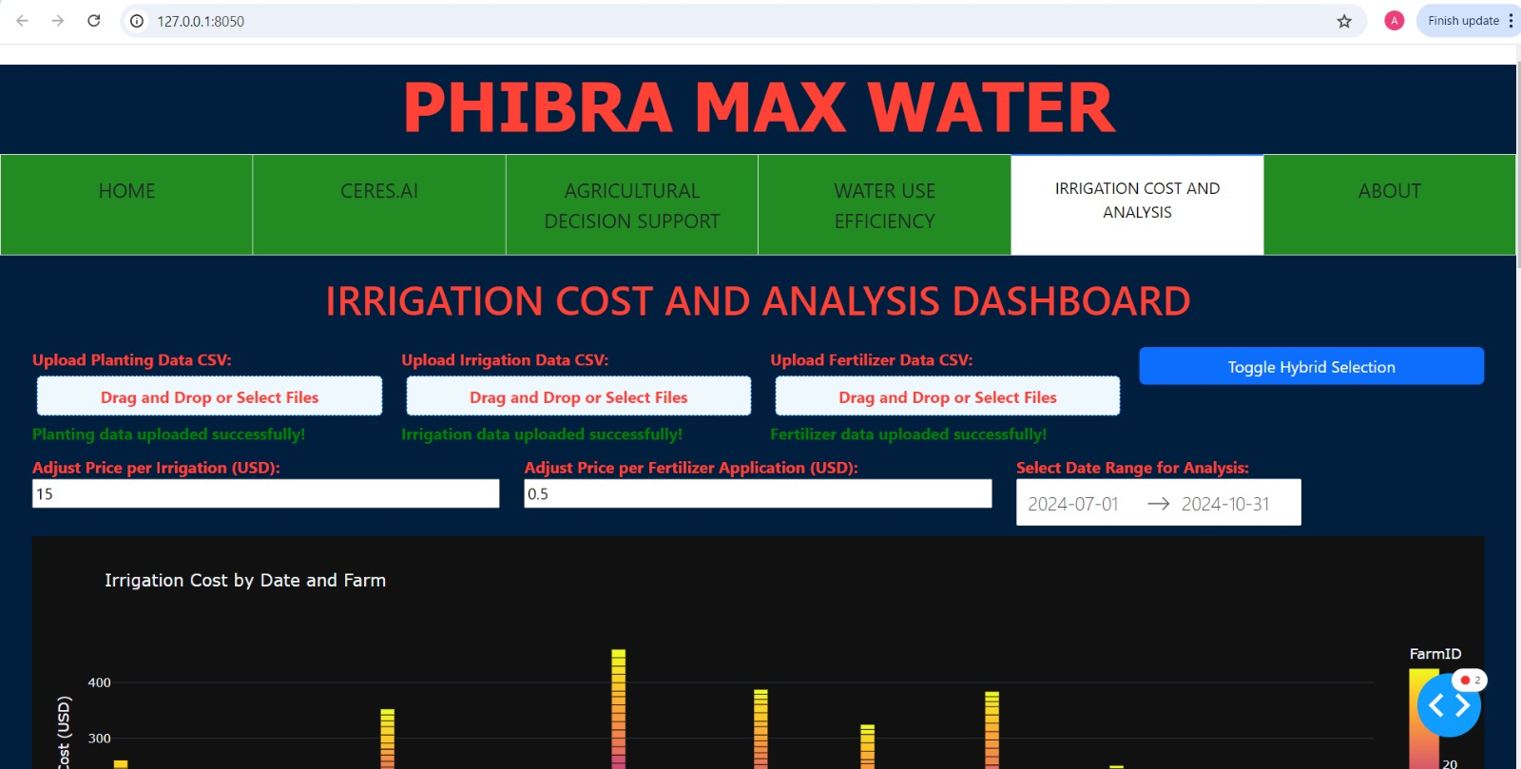
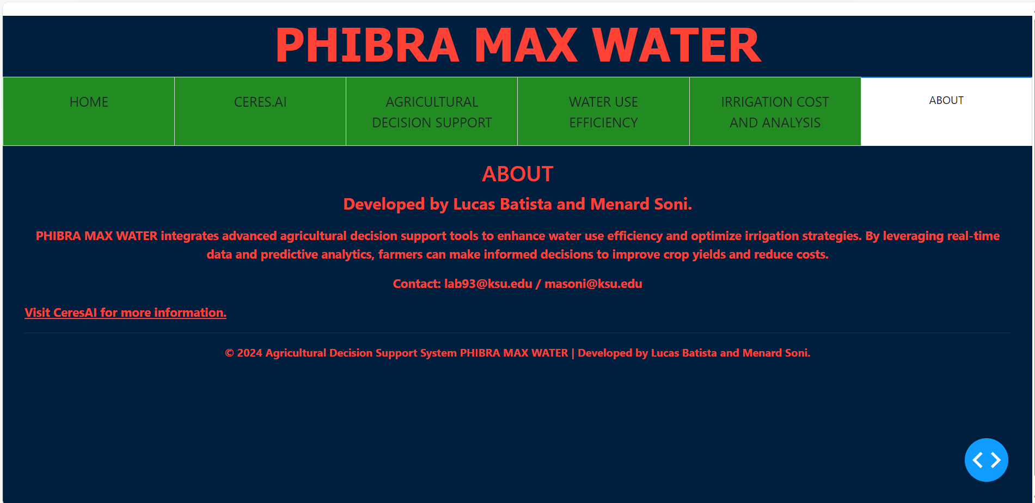
Data Processing Pipeline
Data Loading & Validation
Data Cleaning
Calculations & Analytics
Visualization Generation
Input Data Sources
Sensor Data
Field Properties
Plant Properties
Irrigation
Fertilizer Application
Technology Stack
Python 3.12.4
Dash framework
Plotly
Pandas

