Slide 1
Explanable model for time-series via ChatGPT
Xue Zhechang

Slide 2
Outlines
Explanable model for time-series via ChatGPT
Motivation
Reason of using ChatGPT
A preliminary experiment
Methodology
Evaluation

Slide 3
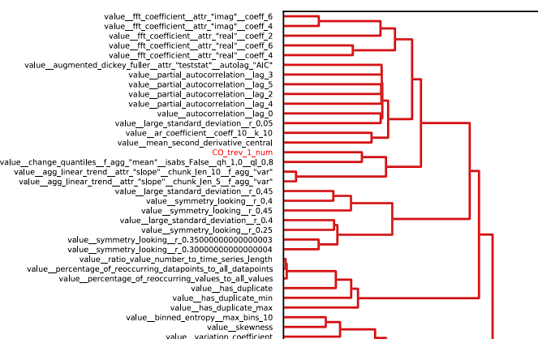
Motivation
Explanable model for time-series via ChatGPT
Problem: Current methods to explain time series are not user-friendly for non-researchers.
Idea: Use ChatGPT to explain why the feature can contribute to the classification
Benefit:
User-friendly and easy-accessible.
Link features to knowledge in other fields.
Why?

Slide 4
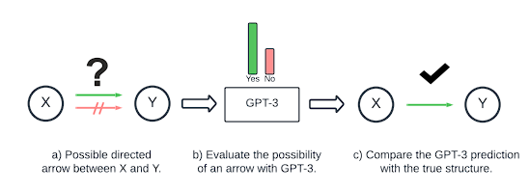
Reason of using ChatGPT
Explanable model for time-series via ChatGPT
Related Works
Forecasting via Prompt
Prompt-based method > numerical-based in forecasting time-series data
Big advantage in zero-shot (RMSE: 70 vs 7)
Casual inference
GPT can generate causal graphs in a high accuracy (about 70%)
Helpful in combining domain knowlegde to classification.
PROMPTCAST: A NEW PROMPT-BASED LEARNING PARADIGM FOR TIME SERIES FORECASTING, Hao Xue, Flora D. Salim, https://arxiv.org/abs/2210.08964
Can Large Language Models Build Causal Graphs?, Stephanie Long, Tibor Schuster, Alexandre Piché, https://arxiv.org/abs/2303.05279

Slide 5
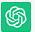
A preliminary experiment
Explanable model for time-series via ChatGPT
Accelerometer in x-axis with different gestures
Prompt
Context
Query
Background
Feature
Feature importance
Classify given gesture
The given features are about Accelerometer in x-axis with different gestures
Trend,
Directional change, Periodic fluctuation…
Which of these features is the most important
Pick up; B. shake hand;
C. Move to left; D. move to right.
Trend influences slightly.
Directional change relatively strong.
Periodic fluctuation significantly.
Answer: Shake hand
Periodic fluctuation means periodic move
Directional change means the move has 2 directions.

Slide 6
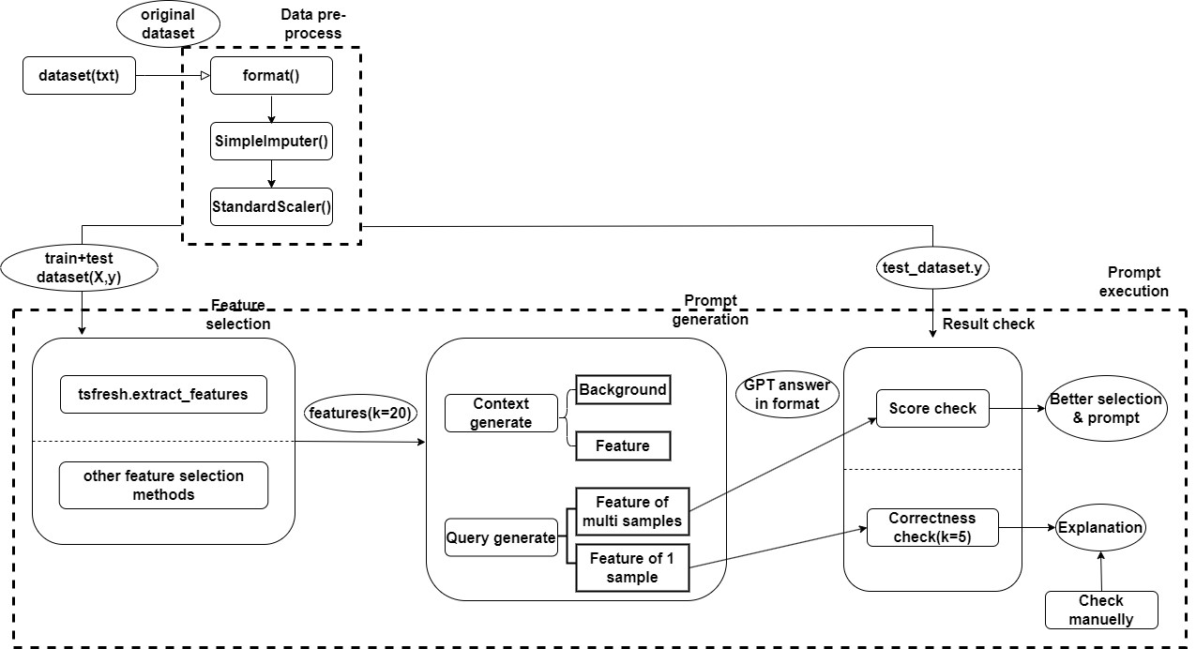
Methodology
Explanable model for time-series via ChatGPT
General pipeline

Slide 7
Evaluation
Explanable model for time-series via ChatGPT
Research object: Time-series datasets about human activity recognition
1 basic movement (pick up, shake...) & 2 advanced (basketball, brush teeth...)
Intuitively understandable explanation
Target:
Stable desired answer
Better prompt, avoiding incorrect answer or unwished format
Prove to be reliable
Correct casual inference
Good consistency
Modify original data to strongly affect feature

