Slide 1
Prompt engineering
Generate explanations for time-series classification by ChatGPT
Write clear and specific instructions
使用分隔符
获得指定输出 如JSON
让LLM检查文本是否满足条件
为模型提供几个问答的例子，让 LLM 熟悉这种风格
Give the model time to think
明确完成任务所需的步骤：Step1, Step2
获取结构化的输出:
LLM的具体功能：
总结, 推理（态度，情感，主题）, 转换，扩展
迭代优化:
更明确地聚焦于某个方面:
Bsp:The description is intended for furniture retailers, so should be technical in nature and focus on the materials the product is constructed from.
Use the following format:
Text: <text to summarize>
Summary: <summary>
Translation: <summary translation>
Names: <list of names in French summary>
Output JSON: <json with summary and num_names>

Slide 2
Dataset
Generate explanations for time-series classifier by ChatGPT
Acuteinflammation & acutenephritis
Method: 15 times, 25 tests, decision tree vs ChatGPT
Decision tree: 100% correct on both datasets
ChatGPT: big range, not stable
Old_Prompt: There are A acuteinflammation, and each has B columns. Each column C is …
Try to classify following… to Label 0.0 or 1.0, with the help of dataset given above.
Don’t show me the code. Give me the label in format: [label 1, label 2, ..., label D].
New_Prompt: You are a data analyst, your job is to classify the given time series dataset.
There are 93 acutenephritis, and each has 6 columns.
The dataset will be given in format: [column 1, column 2, ..., column 6, label].
False rate：
Acuteinflammation：20.0%, 16.0%, 20.0%, 20.0%, 20.0%, 36.0%, 20.0%, 28.0%, 16.0%, 20.0%, 16.0%, 16.0%, 20.0%, 28.0%, 20.0%
Acutenephritis：40.0%, 40.0%, 12.0%, 40.0%, 8.0%, 36.0%, 36.0%, 28.0%, 44.0%, 40.0%, 32.0%, 36.0%, 8.0%, 24.0%, 0.0%
Average: 21.06%(35.2%), 28.26%(40.8%)

Slide 3
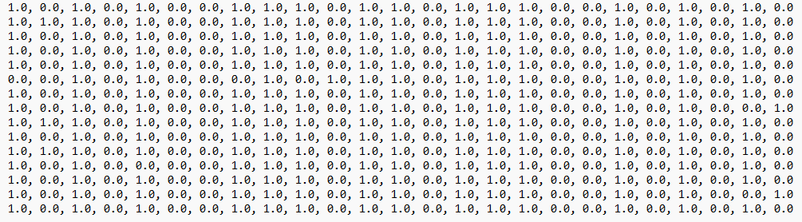
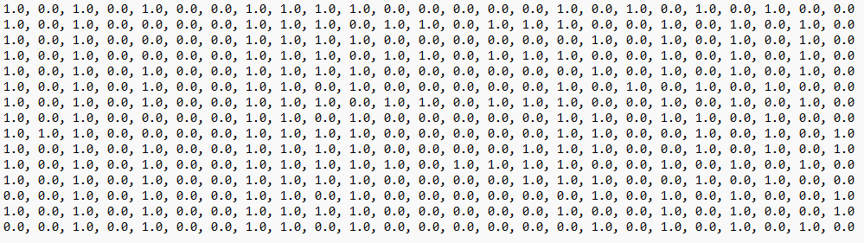
Dataset
Generate explanations for time-series classifier by ChatGPT
Acuteinflammation & acutenephritis

Slide 4
GPT test
Trend, cyclicity, autocorrelation
Trend = 0.0064, cyclicity-Lag1 = 0.349374, autocorrelation-Lag1 = 0.8551
A: Given the information provided, the autocorrelation feature seems to provide more meaningful insights about the data compared to the trend and cyclicity features.
Q：Why trend is the most important feature?
A: I apologize for any confusion caused. Based on the information provided, the trend alone may not necessarily be the most important feature.
Q: Why cyclicity is the most important feature?
A: I apologize for the confusion in my previous response. Let's reevaluate the importance of the features based on the provided information.

Slide 5
GPT test
Trend, cyclicity, autocorrelation
Q：Why cyclicity is more important than autocorrelation
A: Apologies for any confusion caused. Upon further consideration, it is important to note that the importance of features like cyclicity and autocorrelation can vary depending on the specific analysis goals and context of the dataset. Let's reassess the importance of cyclicity and autocorrelation
意外情况：GPT分析cyclicity的时候用了autocorrelation的数据，导致后面的信息全部错位

Slide 6
Repr2Seq
Generate explanations for time-series classifier by ChatGPT
使用14.01.2019-12.01.2022的股票TS
使用了Encoder-decoder模型，来描述TS结构和关键信息
Encoder分为Sequence Processor+TS2Vec
SP: q_i = {x_i_1 - x_i_1, …, x_i_j - x_i_1, …, x_i_T - x_i_1}
TS2Vec：计算Loss
Decoder：
用argmax operation收集了生成词的目录
Repr2Seq相比Transformer和Seq2seq有着更高的得分（BLEU）

Slide 7
Generative Agent
Generate explanations for time-series classifier by ChatGPT
Memory and retrieval
takes the agent’s current situation as input and returns a subset of the memory stream
𝑠𝑐𝑜𝑟𝑒 = 𝛼𝑟𝑒𝑐𝑒𝑛𝑐𝑦 · 𝑟𝑒𝑐𝑒𝑛𝑐𝑦 + 𝛼𝑖𝑚𝑝𝑜𝑟𝑡𝑎𝑛𝑐𝑒 ·𝑖𝑚𝑝𝑜𝑟𝑡𝑎𝑛𝑐𝑒 +𝛼𝑟𝑒𝑙𝑒𝑣𝑎𝑛𝑐𝑒 ·𝑟𝑒𝑙𝑒𝑣𝑎𝑛𝑐𝑒.
Reflection
when the sum of the importance scores for the latest events exceeds a certain threshold
Agents generate trees of reflections
Planning and Reacting
Reacting and Updating Plans + Dialogue

Slide 8
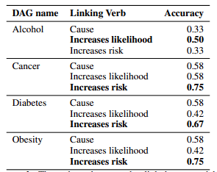
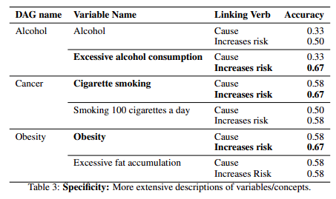
Causal inference
Generate explanations for time-series classifier by ChatGPT
Can Large Language Models Build Causal Graphs
Using medical context
Determining whether GPT-3 can signal the presence or absence of an edge between two variables in a directed acyclic graph from the medical context.
Evaluating whether the use of certain language in prompts or linking verbs improves the classification accuracy of GPT-3.
Normally, a better prompt after iteration performs better
Verb: specific statements did not increase the accuracy and often resulted in worse accuracy
Cause, Increases likelihood, Increases risk

Slide 9
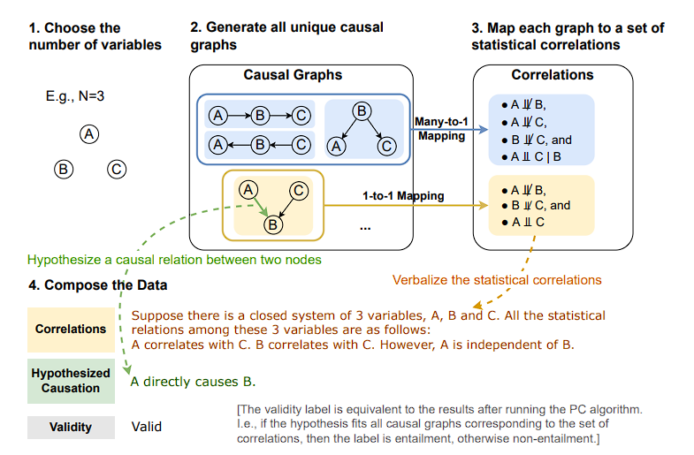
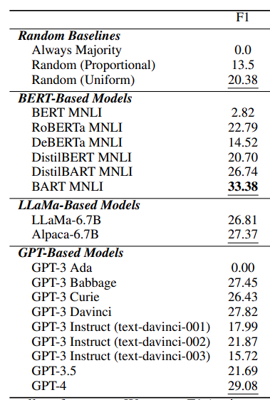
Causal inference
Generate explanations for time-series classifier by ChatGPT
Can Large Language Models Infer Causation from Correlation Using medical context
17 LLMs (BERT, GPT-3, GPT-3.5, GPT-4 …)
2-6 Nodes
Some results are even worse than random
Better performance if fine-tuned
Only use phrase like “cause”

