Slide 1
Generate explanations for time-series classifier by ChatGPT
Xue Zhechang

Slide 2
Outlines
Generate explanations for time-series classifier by ChatGPT
Motivation
Ground knowledge
Related Works
Example of my solution
Realization of my solution
Planned Evaluation

Slide 3
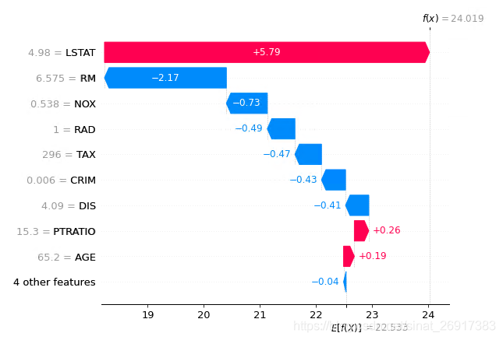
Motivation
Generate explanations for time-series classifier by ChatGPT
Problem: Current method to explain AI is not user-friendly for non-researchers.
Idea: Use ChatGPT to explain why the feature can contribute to the classification
Benefit:
User-friendly and easy-accessible.
Link features to knowledge in other fields.
Actions: Design a prompt to guide GPT give the answer.
Why?

Slide 4

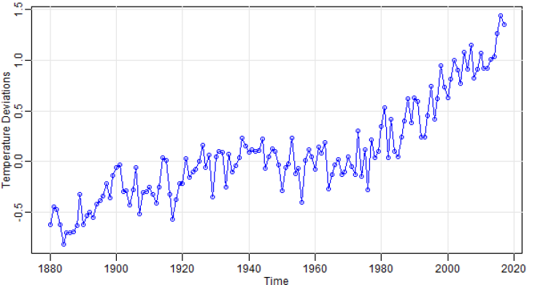


Ground knowledge
Generate explanations for time-series classifier by ChatGPT
ChatGPT
Time series
Explanability

Slide 5
Related Works
Generate explanations for time-series classifier by ChatGPT
Feature selection(tsfresh)
Gašper et al. provided a new method to understand the importance of time series feature generated by tsfresh
Forecasting via Prompt
Xue et al. used prompt-based method to forecast time-series data
Set a benchmark to evaluate different methods and LLM
Causal Inference
Stephanie et al. Proved that GPT can generate causal graphs in a high accuracy.

Slide 6
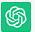
Example of my solution
Generate explanations for time-series classifier by ChatGPT
Daily total female births in California
Prompt
Context
Query
Dataset
Feature
Feature importance
Related Knowledge
From {t0} to {t1}, the number of births was [A] on each day
Trend is X,
cyclicity is [Y], autocorrelation is [Z]
Which of these features is the most important
Why this features is the most important
Trend influences slightly.
Cyclicity relatively strong.
Autocorrelation significantly
Behavioral patterns
Social contagion
Medical scheduling
Reporting and registration processes

Slide 7
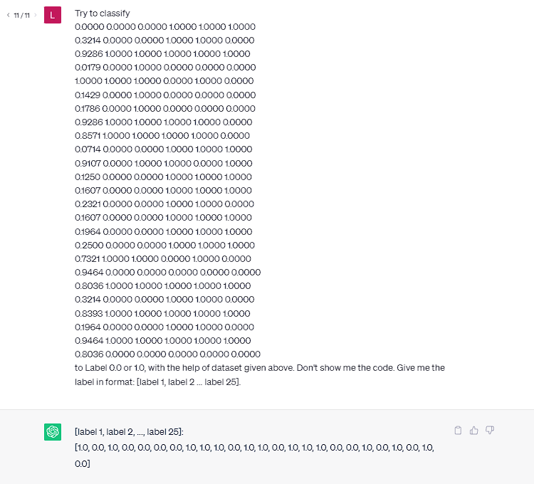
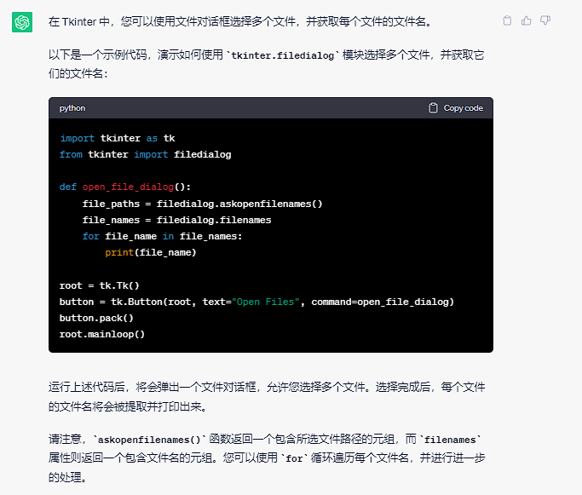


Realization of my solution
Generate explanations for time-series classifier by ChatGPT
Feature selection(tsfresh)
Prompt design
Context
Dataset description
Features
Query
Study which key words improve answer stability
Combine feature importance to domain knowledge
Get key words from answer and ask automatically.
Prove the reliability

Slide 8
Planned Evaluation
Generate explanations for time-series classifier by ChatGPT
Research object: A time-series dataset (From UCR)
With explanation generated by other methods
Target:
Stable desired answer
Better prompt, avoiding incorrect answer or unwished format
Prove to be reliable
Compare GPT-selected importance and pre-set importance
Modify original data to strongly affect feature
Test consistency

Slide 9
Prompt engineering
Generate explanations for time-series classifier by ChatGPT
Write clear and specific instructions
使用分隔符
获得指定输出 如JSON
让LLM检查文本是否满足条件
为模型提供几个问答的例子，让 LLM 熟悉这种风格
Give the model time to think
明确完成任务所需的步骤：Step1, Step2
获取结构化的输出:
LLM的具体功能：
总结, 推理（态度，情感，主题）, 转换，扩展
迭代优化:
更明确地聚焦于某个方面:
Bsp:The description is intended for furniture retailers, so should be technical in nature and focus on the materials the product is constructed from.
Use the following format:
Text: <text to summarize>
Summary: <summary>
Translation: <summary translation>
Names: <list of names in French summary>
Output JSON: <json with summary and num_names>

Slide 10
Dataset
Generate explanations for time-series classifier by ChatGPT
Acuteinflammation & acutenephritis
Method: 15 times, 25 tests, decision tree vs ChatGPT
Decision tree: 100% correct on both datasets
ChatGPT: big range, not stable
Old_Prompt: There are A acuteinflammation, and each has B columns. Each column C is …
Try to classify following… to Label 0.0 or 1.0, with the help of dataset given above.
Don’t show me the code. Give me the label in format: [label 1, label 2, ..., label D].
New_Prompt: You are a data analyst, your job is to classify the given time series dataset.
There are 93 acutenephritis, and each has 6 columns.
The dataset will be given in format: [column 1, column 2, ..., column 6, label].
False rate：
Acuteinflammation：20.0%, 16.0%, 20.0%, 20.0%, 20.0%, 36.0%, 20.0%, 28.0%, 16.0%, 20.0%, 16.0%, 16.0%, 20.0%, 28.0%, 20.0%
Acutenephritis：40.0%, 40.0%, 12.0%, 40.0%, 8.0%, 36.0%, 36.0%, 28.0%, 44.0%, 40.0%, 32.0%, 36.0%, 8.0%, 24.0%, 0.0%
Average: 21.06%(35.2%), 28.26%(40.8%)

Slide 11
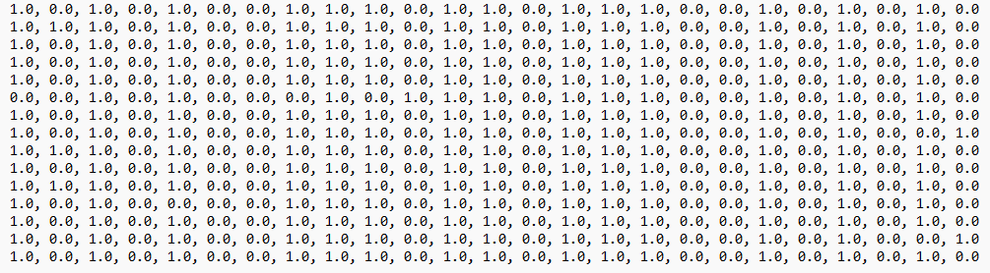
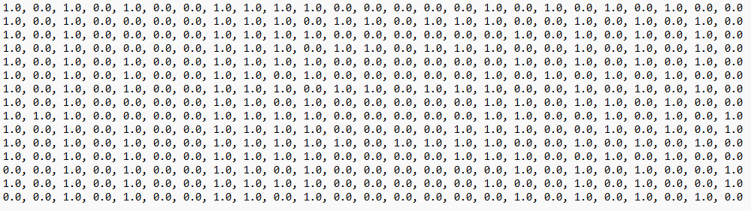
Dataset
Generate explanations for time-series classifier by ChatGPT
Acuteinflammation & acutenephritis

Slide 12
Repr2Seq
Generate explanations for time-series classifier by ChatGPT
使用14.01.2019-12.01.2022的股票TS
使用了Encoder-decoder模型，来描述TS结构和关键信息
Encoder分为Sequence Processor+TS2Vec
SP: q_i = {x_i_1 - x_i_1, …, x_i_j - x_i_1, …, x_i_T - x_i_1}
TS2Vec：计算Loss
Decoder：
用argmax operation收集了生成词的目录
Repr2Seq相比Transformer和Seq2seq有着更高的得分（BLEU）

Slide 13
Generative Agent
Generate explanations for time-series classifier by ChatGPT
Memory and retrieval
takes the agent’s current situation as input and returns a subset of the memory stream
𝑠𝑐𝑜𝑟𝑒 = 𝛼𝑟𝑒𝑐𝑒𝑛𝑐𝑦 · 𝑟𝑒𝑐𝑒𝑛𝑐𝑦 + 𝛼𝑖𝑚𝑝𝑜𝑟𝑡𝑎𝑛𝑐𝑒 ·𝑖𝑚𝑝𝑜𝑟𝑡𝑎𝑛𝑐𝑒 +𝛼𝑟𝑒𝑙𝑒𝑣𝑎𝑛𝑐𝑒 ·𝑟𝑒𝑙𝑒𝑣𝑎𝑛𝑐𝑒.
Reflection
when the sum of the importance scores for the latest events exceeds a certain threshold
Agents generate trees of reflections
Planning and Reacting
Reacting and Updating Plans + Dialogue

Slide 14
Causal inference
Generate explanations for time-series classifier by ChatGPT
Can Large Language Models Build Causal Graphs
Using medical context
Determining whether GPT-3 can signal the presence or absence of an edge between two variables in a directed acyclic graph from the medical context.
Evaluating whether the use of certain language in prompts or linking verbs improves the classification accuracy of GPT-3.
Normally, a better prompt after iteration performs better
Both verb and noun
Specificity lowers accuracy

