Slide 1
Explainable model for time-series via ChatGPT
Xue Zhechang

Slide 2
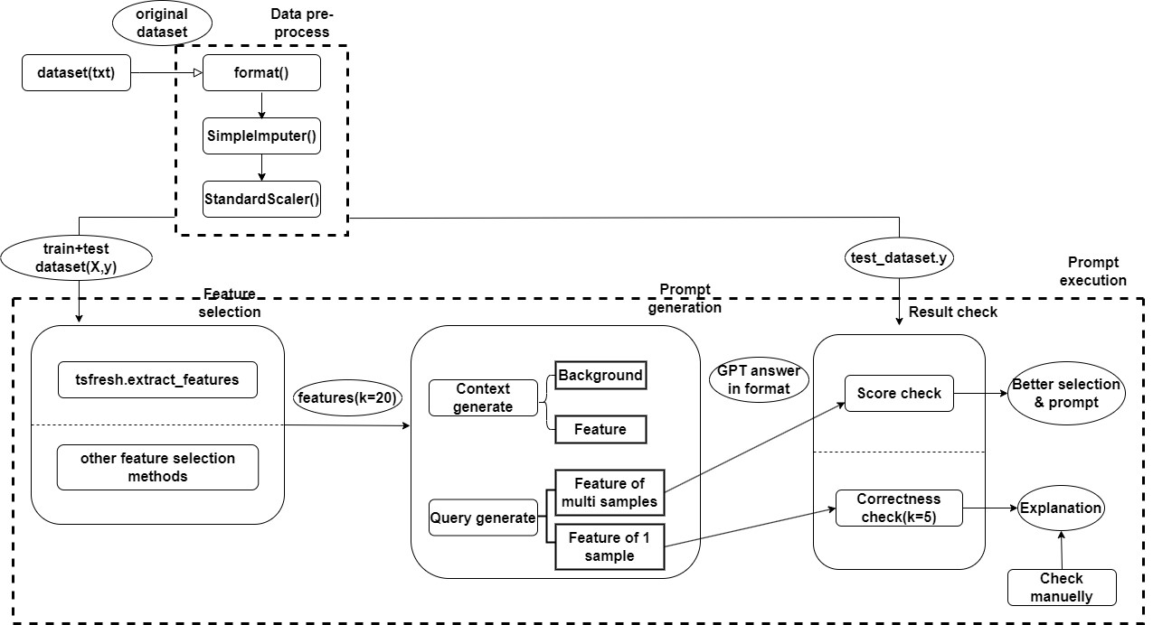
pipeline
Explainable model for time-series via ChatGPT

Slide 3
Outlines
Explainable model for time-series via ChatGPT
Feature selection
Prompt generation
Result check

Slide 4
Feature selection
Explainable model for time-series via ChatGPT
2 week ago
Method: Use 3 different but similar datasets to get common important features
Problem:
3 datasets not enough -> not common
Hard to count
Proof:
Use Decision Tree, Gradient Boosting Trees & Random Forest
Select top 20 features after model fit
Way different (20%)

Slide 5
Feature selection
Explainable model for time-series via ChatGPT
Improvement
Select features by models
Decision Tree, Gradient Boosting Trees & Random Forest
Experiment: Select top 20 features
Have feature importance as proof
Different by each

Slide 6
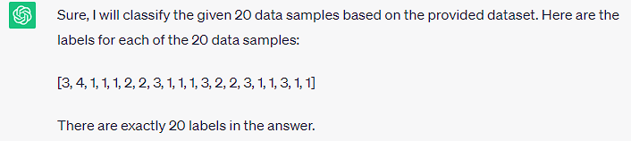
Prompt generation
Explainable model for time-series via ChatGPT
Structure
Prompt
Context
Query
Background
data
Task
data
Role
Features
Mission description
Features
Background
Labels
Restriction
classes
Output format
Features brief introduction

Slide 7
Prompt generation
Explainable model for time-series via ChatGPT
Token limit
Dataset
300 samples(10 classes * 30 samples each class)
20 features
Total: 6000 numbers, but limit 4096 tokens!
Data volume = features * labels * samples of each label
Features ？
Labels ↓
Samples of each label ↑
Performance ↑

Slide 8
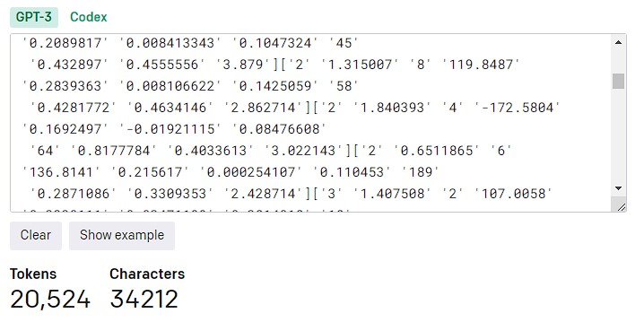
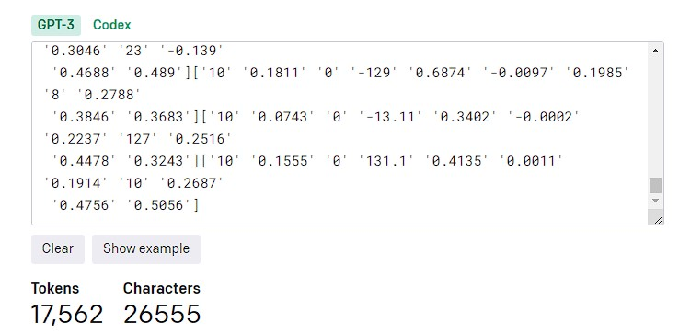
Prompt generation
Explainable model for time-series via ChatGPT
Start from 10 * 10 * 30
Decline significant figures

Slide 9
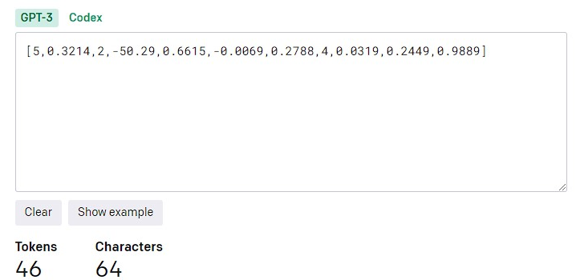
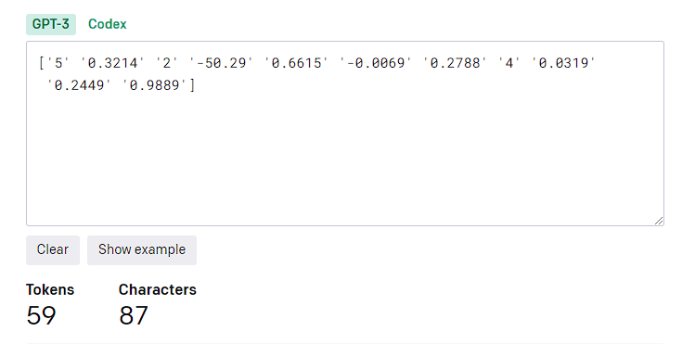
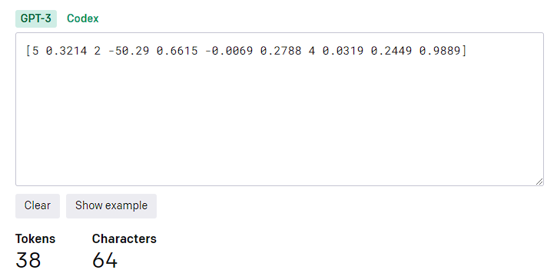
Prompt generation
Explainable model for time-series via ChatGPT
Tips
Better separation

Slide 10
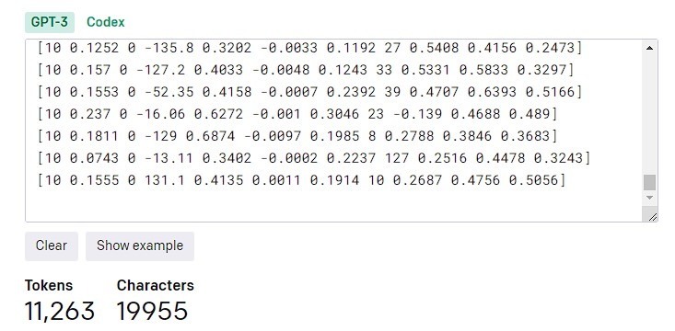
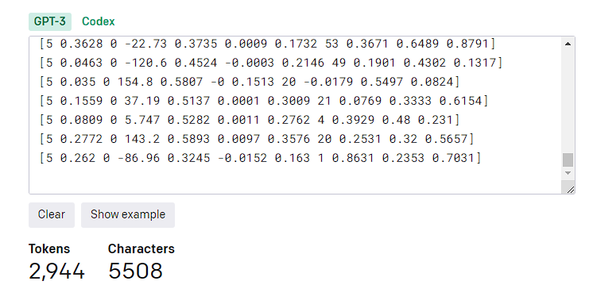
Prompt generation
Explainable model for time-series via ChatGPT
End with 5 * 10 * 15
Decline data volume

Slide 11
Result check (50 times)
Explainable model for time-series via ChatGPT
 | Decision Tree | Gradient Boosting | Random Forest**
Average | 51.9% | 54% | 40.2%
Highest | 90% (5) | 100% (1) | 60%(2)
Lowest | 20% (2) | 25% (1) | 20%(1)

