Slide 1
Generate explanations for time-series classifier by ChatGPT
Xue Zhechang

Slide 2
Outlines
Generate explanations for time-series classifier by ChatGPT
Motivation (PIBA)
Ground knowledge (not finished)
Related Works (not finished)
Example of my solution
Realization of my solution
Planned Evaluation
Time plan (not finished)

Slide 3
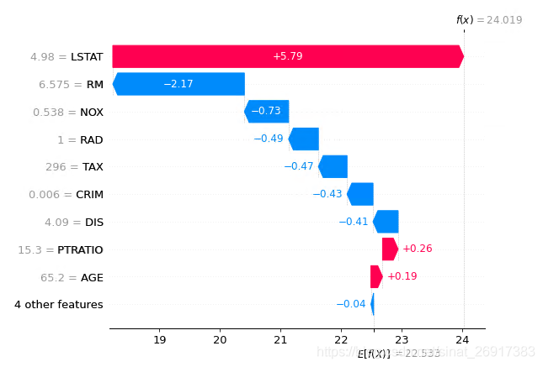
Motivation
PIBA(Problem, Idea, Benefit, Actions)
Generate explanations for time-series classifier by ChatGPT
Problem: Current method to explain AI is not user-friendly for non-researchers.
Idea: Use ChatGPT to explain why the feature can contribute to the classification
Benefit:
User-friendly and easy-accessible.
Link features to knowledge in other fields.
Actions: Design a prompt to guide GPT give the answer.
Why?

Slide 4
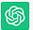
Example of my solution
Generate explanations for time-series classifier by ChatGPT
Daily total female births in California
Prompt
Context
Query
Dataset
Feature
Feature importance
Related Knowledge
From {t0} to {t1}, the number of births was [A] on each day
Trend is X,
cyclicity is [Y], autocorrelation is [Z]
Which of these features is the most important
Why this features is the most important
Trend influences slightly.
Cyclicity relatively strong.
Autocorrelation significantly
Behavioral patterns
Social contagion
Medical scheduling
Reporting and registration processes

Slide 5
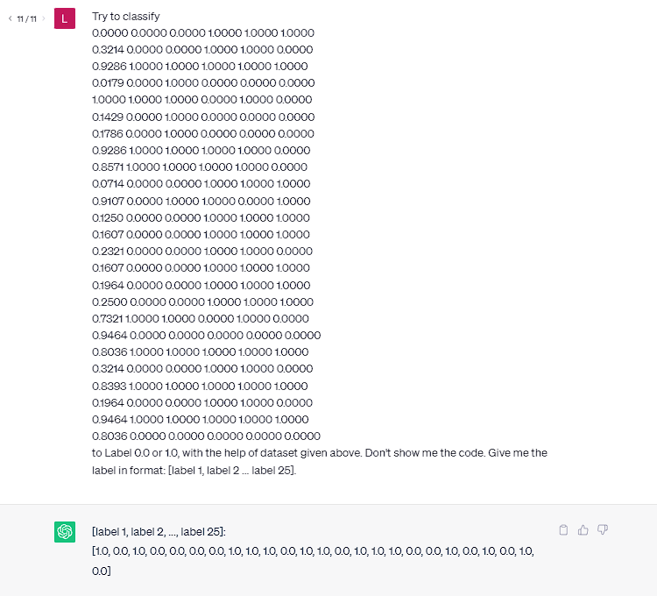
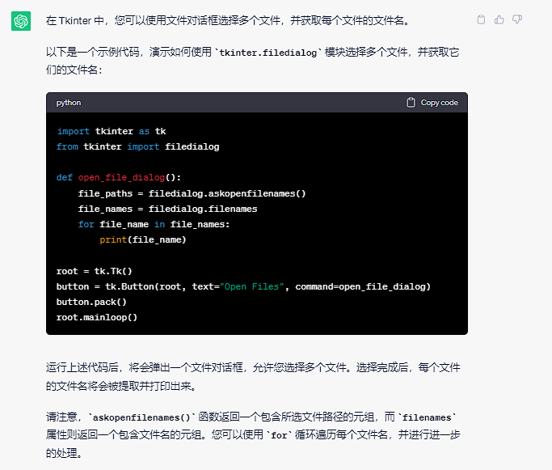


Realization of my solution
Generate explanations for time-series classifier by ChatGPT
Feature selection(tsfresh)
Prompt design
Context
Dataset description
Features
Query
Study which key words improve answer stability
Combine feature importance to domain knowledge
Get key words from answer and ask automatically.
Prove the reliability

Slide 6
Planned Evaluation
Generate explanations for time-series classifier by ChatGPT
Research object: A time-series dataset (From UCR)
Target:
User-friendly method
A prompt design with stable desired answer
Prove to be reliable

Slide 7
Dataset
Generate explanations for time-series classifier by ChatGPT
Acuteinflammation & acutenephritis
Method: 15 times, 25 tests, decision tree vs ChatGPT
Decision tree: 100% correct on both datasets
ChatGPT: big range, not stable
Prompt: There are A acuteinflammation, and each has B columns. Each column C is …
Try to classify following… to Label 0.0 or 1.0, with the help of dataset given above.
Don’t show me the code. Give me the label in format: [label 1, label 2, ..., label D].
False rate：
Acuteinflammation：44.0%，48.0%，16.0%，44.0%，16.0%，28.0%，
12.0%，32.0%，48.0%，16.0%，40.0%，48.0%，48.0%，40.0%，48.0%
Acutenephritis：40.0%，16.0%，44.0%，48.0%，44.0%，48.0%，44.0%，
52.0%，48.0%，44.0%，44.0%，16.0%，28.0%，48.0%，48.0%
Average: 35.2%, 40.8%

Slide 8
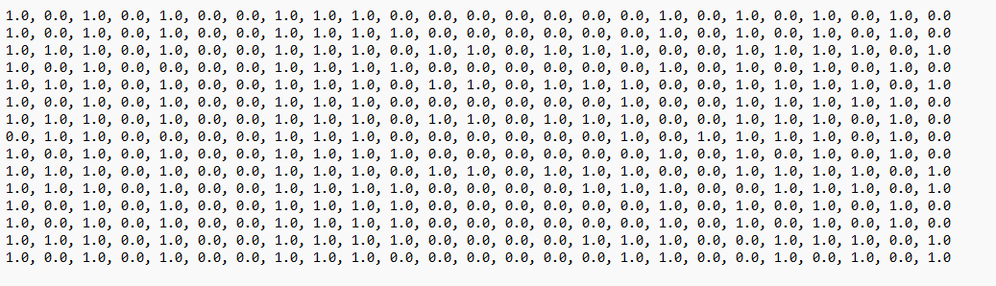
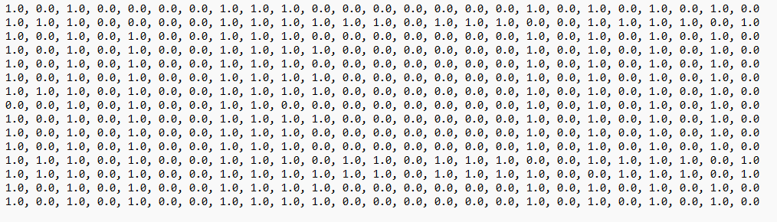
Dataset
Generate explanations for time-series classifier by ChatGPT
Acuteinflammation & acutenephritis

