Slide 1
Generate explanations for time-series classification by ChatGPT
Xue Zhechang

Slide 2
Outlines
Generate explanations for time-series classification by ChatGPT
Motivation
Ground knowledge
Related Works
Methodology
A preliminary experiment
Evaluation

Slide 3
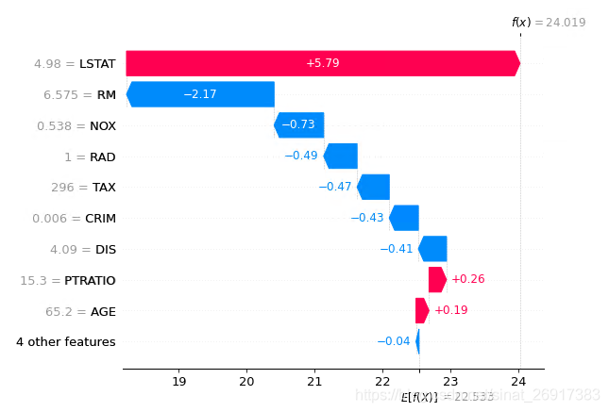
Motivation
Generate explanations for time-series classification by ChatGPT
Problem: Current method to explain AI is not user-friendly for non-researchers.
Idea: Use ChatGPT to explain why the feature can contribute to the classification
Benefit:
User-friendly and easy-accessible.
Link features to knowledge in other fields.
Actions: Design a prompt to guide GPT give the answer.
Why?

Slide 4

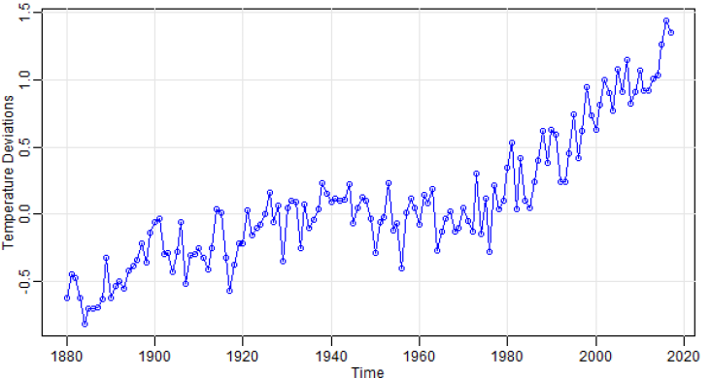


Ground knowledge
Generate explanations for time-series classification by ChatGPT
ChatGPT
Time series
Explanability

Slide 5
Related Works
Generate explanations for time-series classification by ChatGPT
Feature selection
tsfresh features offer better predictive performance
Forecasting via Prompt
Prompt-based method > numerical-based in forecasting time-series data
Big advantage in zero-shot
Causal Inference
GPT can generate causal graphs in a high accuracy
Helpful in combining domain knowlegde to classification.
Towards understanding the importance of time-series features in automated algorithm performance prediction, Gašper Petelin, Gjorgjina Cenikj, Tome Eftimov, https://www.sciencedirect.com/science/article/pii/S0957417422020413
PROMPTCAST: A NEW PROMPT-BASED LEARNING PARADIGM FOR TIME SERIES FORECASTING, Hao Xue, Flora D. Salim, https://arxiv.org/abs/2210.08964
Can Large Language Models Build Causal Graphs?, Stephanie Long, Tibor Schuster, Alexandre Piché, https://arxiv.org/abs/2303.05279

Slide 6
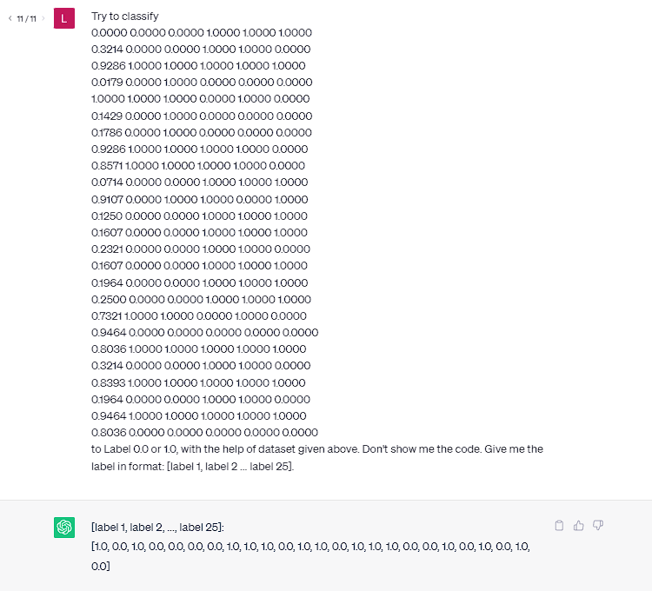
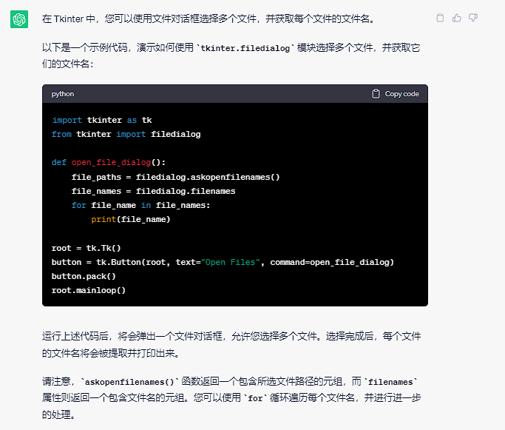


Methodology
Generate explanations for time-series classification by ChatGPT
General pipeline
Feature selection(tsfresh)
Prompt design
Context
Dataset description
Features
Query
Study which key words improve answer stability
Combine feature importance to domain knowledge
Get key words from answer and ask automatically.

Slide 7
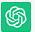
A preliminary experiment
Generate explanations for time-series classification by ChatGPT
Daily total female births in California in 1959
Prompt
Context
Query
Dataset
Feature
Feature importance
Related Knowledge
From {t0} to {t1}, the number of births was [A] on each day
Trend is X,
cyclicity is [Y], autocorrelation is [Z]
Which of these features is the most important
Why this features is the most important
Trend influences slightly.
Cyclicity relatively strong.
Autocorrelation significantly
Behavioral patterns
Social contagion
Medical scheduling
Reporting and registration processes

Slide 8
Evaluation
Generate explanations for time-series classification by ChatGPT
Research object: A time-series dataset (From UCR)
With explanation generated by other methods
Target:
Stable desired answer
Better prompt, avoiding incorrect answer or unwished format
Prove to be reliable
Compare GPT-selected importance and pre-set importance
Modify original data to strongly affect feature
Test consistency

