Slide 1
Generate explanations for time-series classification by ChatGPT
Xue Zhechang

Slide 2
Outlines
Generate explanations for time-series classification by ChatGPT
Motivation
Reason of using ChatGPT
A preliminary experiment
Methodology
Evaluation

Slide 3
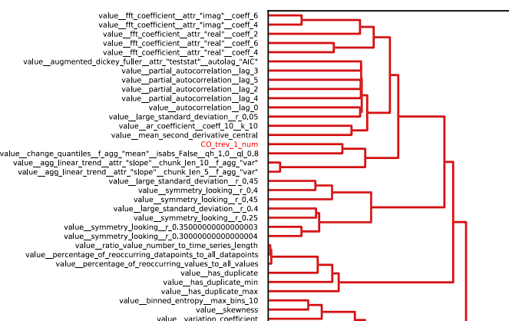
Motivation
Generate explanations for time-series classification by ChatGPT
Problem: Current methods to explain time series are not user-friendly for non-researchers.
Idea: Use ChatGPT to explain why the feature can contribute to the classification
Benefit:
User-friendly and easy-accessible.
Link features to knowledge in other fields.
Why?

Slide 4

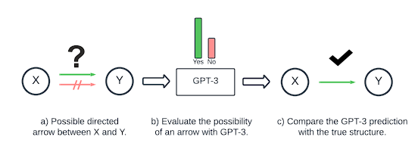
Reason of using ChatGPT
Generate explanations for time-series classification by ChatGPT
Related Works
Forecasting via Prompt
Prompt-based method > numerical-based in forecasting time-series data
Big advantage in zero-shot (RMSE: 70 vs 7)
Casual inference
GPT can generate causal graphs in a high accuracy (about 70%)
Helpful in combining domain knowlegde to classification.
PROMPTCAST: A NEW PROMPT-BASED LEARNING PARADIGM FOR TIME SERIES FORECASTING, Hao Xue, Flora D. Salim, https://arxiv.org/abs/2210.08964
Can Large Language Models Build Causal Graphs?, Stephanie Long, Tibor Schuster, Alexandre Piché, https://arxiv.org/abs/2303.05279

Slide 5
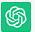
A preliminary experiment
Generate explanations for time-series classification by ChatGPT
Daily total female births in California in 1959
Prompt
Context
Query
Dataset
Feature
Feature importance
Related Knowledge
From {t0} to {t1}, the number of births was [A] on each day
Trend is X,
cyclicity is [Y], autocorrelation is [Z]
Which of these features is the most important
Why this features is the most important
Trend influences slightly.
Cyclicity relatively strong.
Autocorrelation significantly
Behavioral patterns
Social contagion
Medical scheduling
Reporting and registration processes

Slide 6
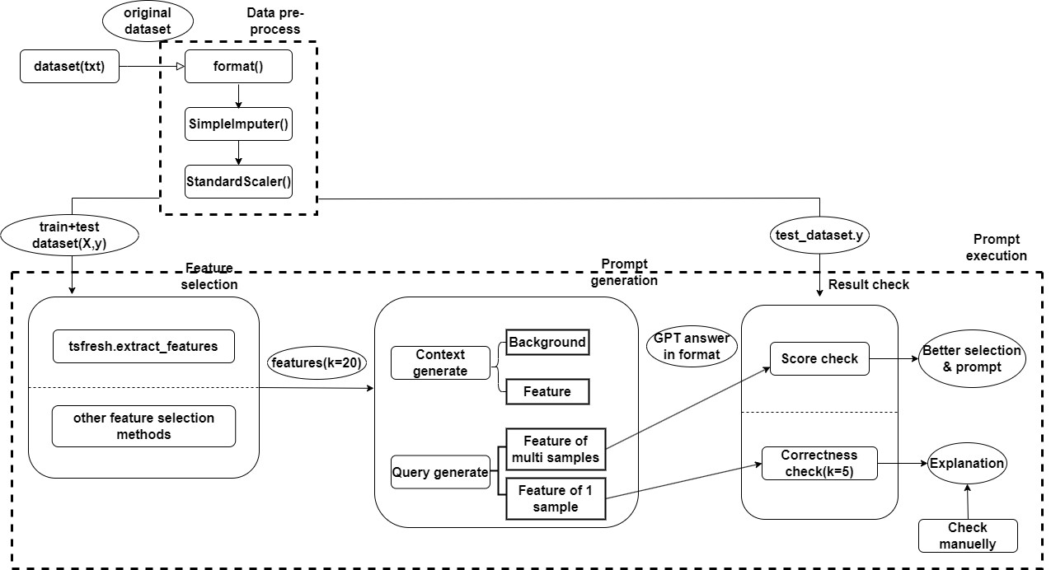
Methodology
Generate explanations for time-series classification by ChatGPT
General pipeline

Slide 7
Evaluation
Generate explanations for time-series classification by ChatGPT
Research object: Time-series datasets about human activity recognition
1 basic movement (pick up, shake...) & 2 advanced (basketball, brush teeth...)
Intuitively understandable explanation
Target:
Stable desired answer
Better prompt, avoiding incorrect answer or unwished format
Prove to be reliable
Correct casual inference
Good consistency
Modify original data to strongly affect feature

