Slide 1
Explainable model for time-series via ChatGPT
Xue Zhechang

Slide 2
Outlines
Explainable model for time-series via ChatGPT
Paper review
Baseline
2-Class classification
Generate data trend by ChatGPT
Time Table

Slide 3
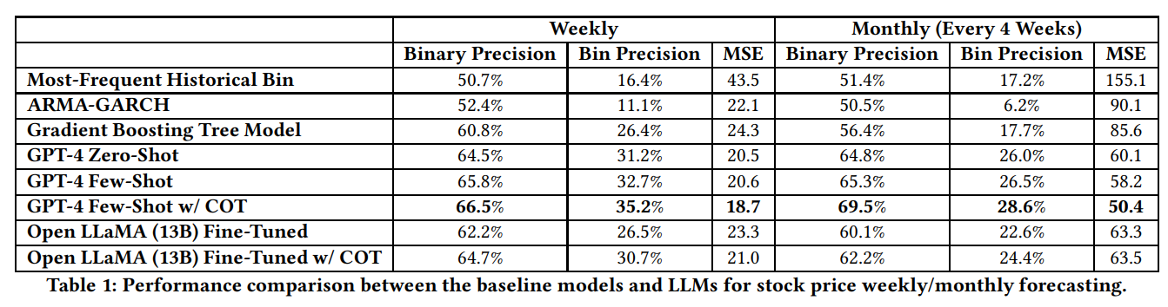
Paper Review
Explainable model for time-series via ChatGPT
Temporal Data Meets LLM
实验模型：few-shot/zero-shot GPT-4
Insturction-based fine-tuning LLaMa
实验对象：NASDAQ-100
实验结果：效果比ARMA-GARCH， gradient-boosting tree model好，GPT-4 > LLaMa
评价标准：Binary precision：看是Up还是Down
Bin precision：看是不是在这个bin里
MSE: 测量与实际值误差
实验方法：周预测：把数据集根据周切成12份，（D5+，U5+）
月预测：（D10+， U10+）
让GPT-4自己总结公司profile， 输入相关的新闻（google），让他自己写meta-summary

Slide 4
Baseline
Explainable model for time-series via ChatGPT
300 train, 700 test，10 classes
Imputed with 0
XGBoost*：46.57% （XGBoost doesn’t really need to impute）
RandomForest: 54.29%
DecisionTree: 32.86%

Slide 5
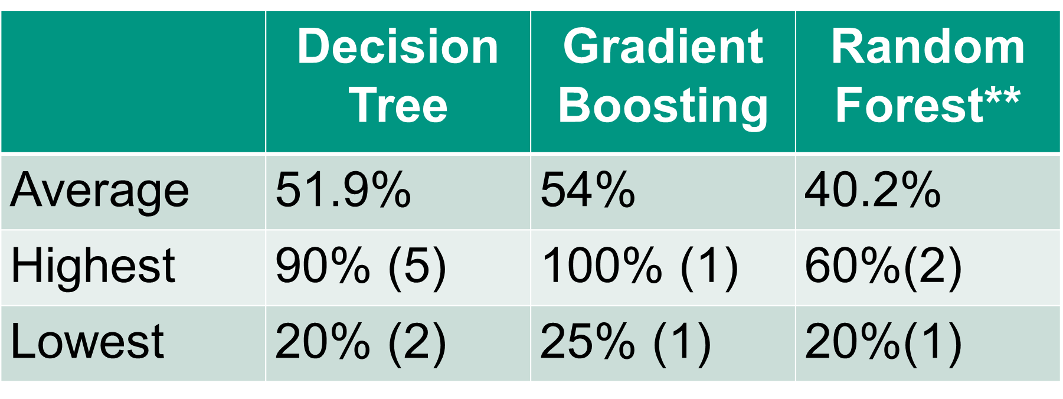
Baseline
Explainable model for time-series via ChatGPT
120 train, 280 test，4 classes
Imputed with 0
XGBoost*：68.93% （XGBoost doesn’t really need to impute）
RandomForest: 79.29%
DecisionTree: 57.50%

Slide 6
Baseline
Explainable model for time-series via ChatGPT
60 train, 140 test，2 classes (1&2)
Imputed with 0
XGBoost*：75.71% （XGBoost doesn’t really need to impute）
RandomForest: 92.86%
DecisionTree: 77.86%

Slide 7
2-class classification
Explainable model for time-series via ChatGPT
Based on 10 features extracted from Gradient boosting tree
2 classes & each 20 train samples & 10 test samples
 | 3 & 6 | 3 & 4 | 6 & 8 | 2 & 9 | 4 & 5 | 2 & 4
Average 72.93% | 63.8 % | 67.7% | 81.0% | 96.7% | 71.9% | 56.5%
Highest | 100% (10) | 100% (7) | 100% (4) | 100% (39) | 100% (10) | 100% (1)
Lowest | 35% (2) | 35% (1) | 50% (4) | 15% (1) | 40% (3) | 35% (2)

Slide 8
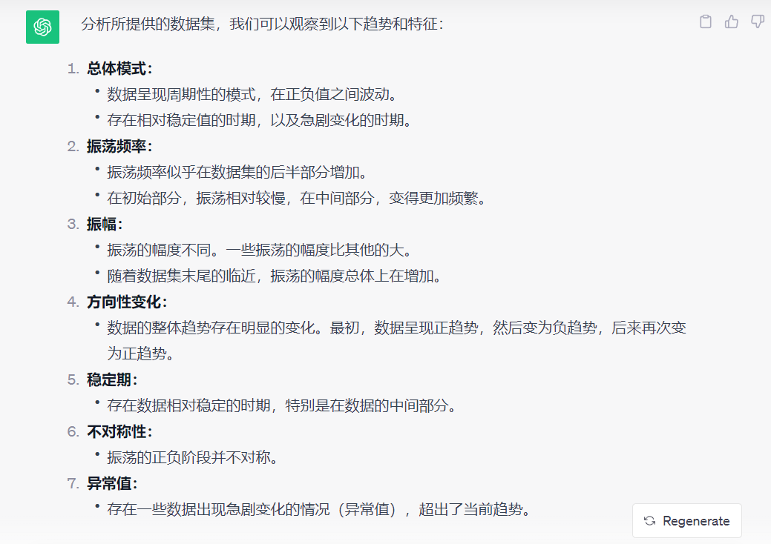
Generate data trend by ChatGPT
Explainable model for time-series via ChatGPT
Based on 10 features extracted from Gradient boosting tree
输入源数据，让GPT先想象数据的曲线图，然后分析曲线图得到对趋势的描述和特征。

Slide 9
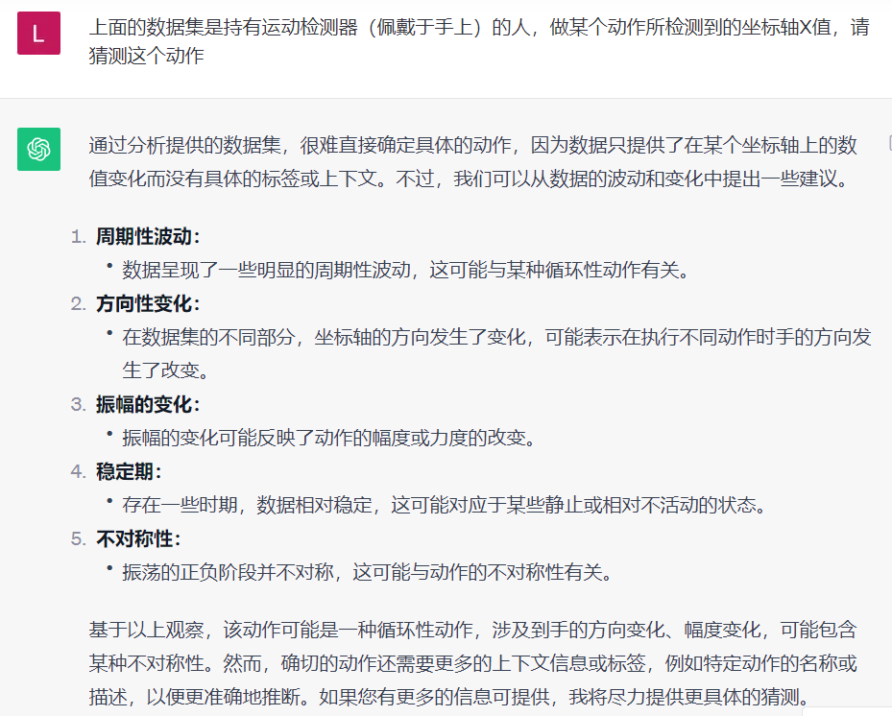
Generate data trend by ChatGPT
Explainable model for time-series via ChatGPT
Based on 10 features extracted from Gradient boosting tree
告诉GPT背景，让他猜测是什么动作

Slide 10
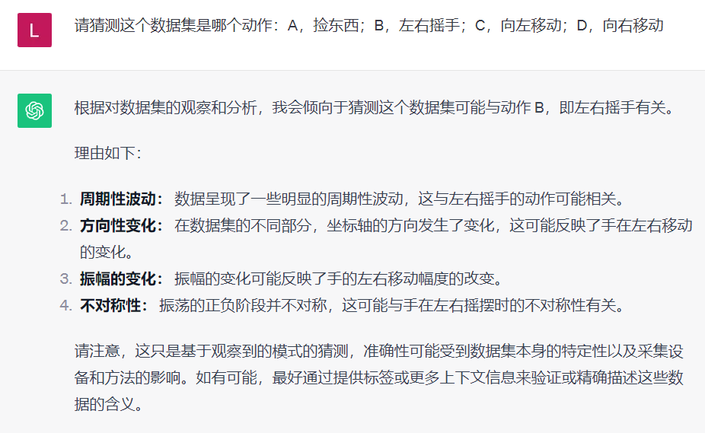
Generate data trend by ChatGPT
Explainable model for time-series via ChatGPT
Based on 10 features extracted from Gradient boosting tree
给GPT限定范围，让他猜测

Slide 11
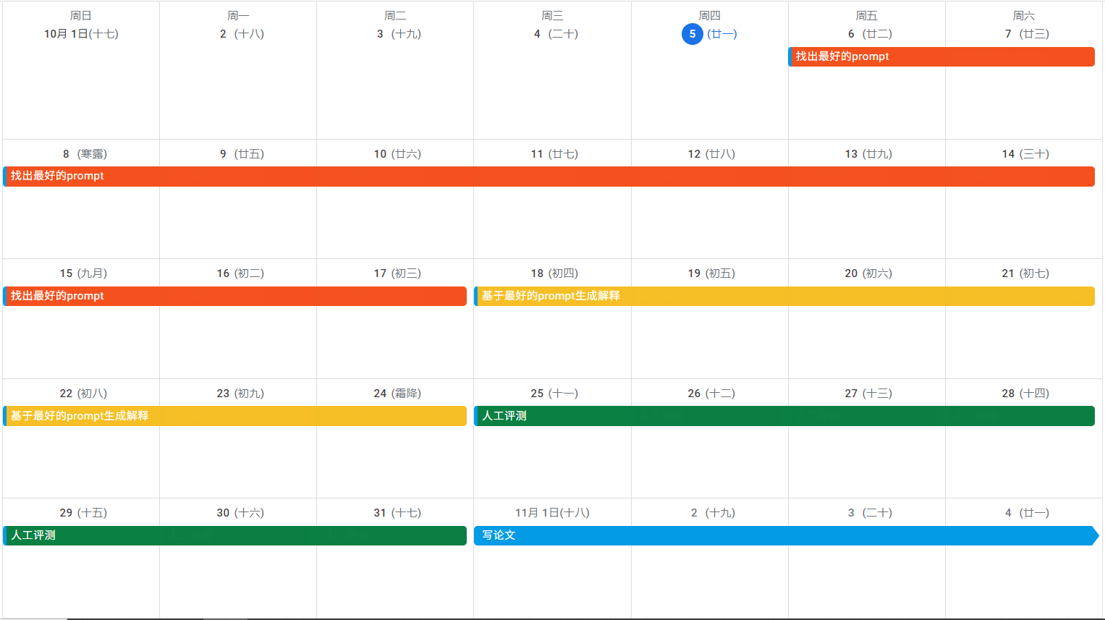
Time Table
Explainable model for time-series via ChatGPT
10/6-10/17: 找出最好的prompt
10/18-10/24: 基于最好的prompt生成解释
10/25-10/31: 人工评测
11/1 - 11/15: 写论文

