Slide 1
Explainable model for time-series via ChatGPT
Xue Zhechang

Slide 2
Outlines
Explainable model for time-series via ChatGPT
Summary of previous works
Improvement
Baseline
New method
Future works

Slide 3
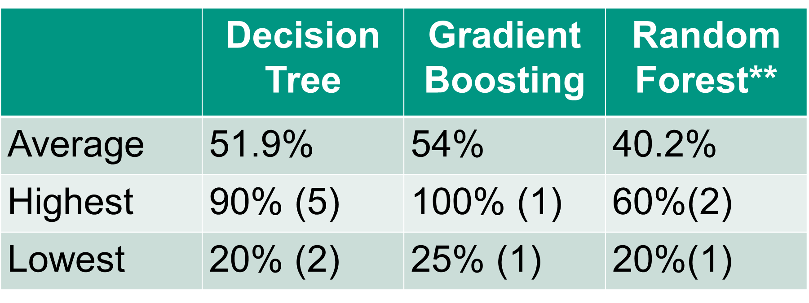
Summary of previous works
Explainable model for time-series via ChatGPT
Temporal Data Meets LLM
Feature-based GPT classification
GPT model: GPT-API(gpt-3.5-turbo)
5 classes, 15 samples, 10 features
Highest accuracy: Gradient Boosting Tree: 54%

Slide 4
Disadvantages of previous study
Explainable model for time-series via ChatGPT
Low accuracy
5 classes -> less accuracy
Lack baseline
Not few-shot

Slide 5
Improvement
Explainable model for time-series via ChatGPT
Set baseline
Decline class: Now 3 classes, let them do 2-class classification with each other
A new method：GPT-generated Feature-based classification

Slide 6
Baseline
Explainable model for time-series via ChatGPT
3 classes, 2 each other, train: 10, test: 40
Feature-based GPT classification: 59.43%
DummyClassifier from sklearn: 50%
XGBoost*：64.17%
RandomForest: 74.17%
DecisionTree: 63.33%
Average: 62.22%

Slide 7
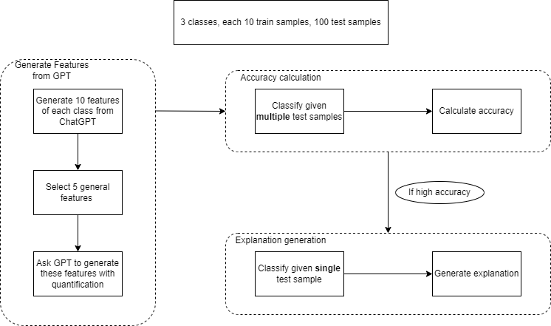
New method
Explainable model for time-series via ChatGPT
10 train data
100 test data
50 true
50 false

Slide 8
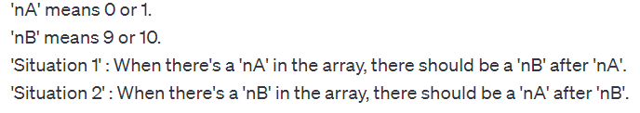
Quantification
Explainable model for time-series via ChatGPT
Problem
GPT has bad quantification ability
Features given by GPT are hard to redefine.
Solution:
Standardize data (0-10)
Quantify by human
Rename features
Prompt: Find situation 1 & 2 step by step

Slide 9
Prompt for classification
Explainable model for time-series via ChatGPT
Use sharp drop and sharp increase (more features decrease accuracy)
Class2(shake hand): Have both sharp drop and sharp increase
Class3(move to left): Have only sharp increase
Class4(move to left): Have only sharp drop

Slide 10
Result
Explainable model for time-series via ChatGPT
57.17%
Class2(shake hand): True: 60%; False: 44%, average: 52%
Class3(move to left): True: 84%; False: 40%: average: 62%
Class4(move to right): True: 60%; False: 55%: average: 57.5 %

Slide 11
Future works
Explainable model for time-series via ChatGPT
Use ChatGPT or GPT-4 instead of GPT-3.5-turbo (86.67% for class2 true)
Use 0-9 standardize instead
Try to classify class 2 & 3, class 2 & 4, class 3 & 4

