Slide 1


SMART INDIA HACKATHON 2026
Problem Statement ID– Problem Statement Title-Theme-
PS Category- Hardware Team ID- 130117
Team Name (Registered on portal):
SIH26007
Safe and Efficient Operation of Mine Vehicles in Fog and Low-Visibility Conditions in Open Cast Iron Ore Mines.
Smart Automation
The Sentinel Crew

Slide 2



IDEA TITLE
THE
SENTINAL
CREW
Proposed Solution:
HAUL SENTINEL uses ultrasonic sensors and ESP32 to detect obstacles and assess risk in low visibility.
It automatically reduces vehicle speed and stops the vehicle when danger is critical.
The system also provides instant alerts to the driver and control room.
How to address the Problem:
It helps prevent collisions when fog, dust, or rain limits the driver's visibility.
Automatic speed control reduces reaction time and keeps the vehicle at a safer speed.
This provides additional protection for drivers and mining operations.
Innovation and Uniqueness of the Problem:
Unlike systems that only provide warnings, HAUL SENTINEL takes preventive action by controlling vehicle speed.
It combines obstacle detection, risk assessment, speed control, and alerts in one system.
The solution is designed specifically for challenging mining and low-visibility conditions. 🚛🛡️

Slide 3
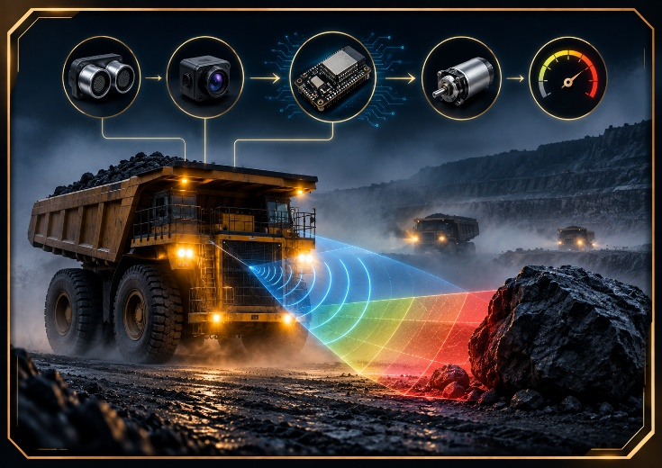
TECHNICAL APPROACH
Your Team Name
Technologies Used:
Programming: C/C++ using Arduino IDE.
Hardware: ESP32, ultrasonic sensors, motor driver, DC motors, buzzer and LEDs.
Communication: Wi-Fi/Bluetooth for monitoring and alerts.
Sensors provide real-time data, which the ESP32 processes for speed control.
Methodology & Process for Implementation:
Sensors → ESP32 → Distance & Risk Analysis → Speed Control → Alert → Monitoring
Sensors continuously detect obstacles and measure distance.
ESP32 analysis the risk and automatically adjusts vehicle speed.
A working prototype and flowchart demonstrate the complete process in real time. 🚛⚙️

Slide 4
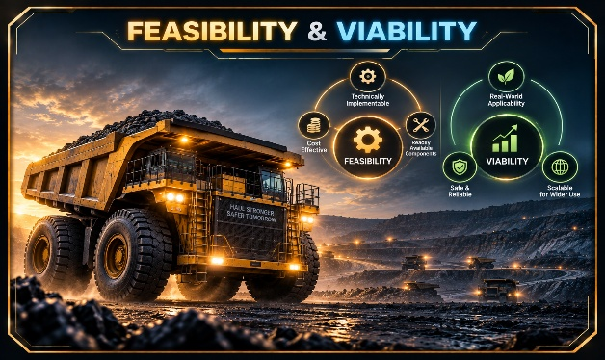
FEASIBILITY AND VIABILITY
Your Team Name
Feasibility of the Idea:
The solution uses low-cost, easily available components like ESP32 and ultrasonic sensors.
It is easy to build, test, and scale for mining vehicles.
The prototype can demonstrate real-time obstacle detection and automatic speed control.
Potential Challenges & Risks:
Fog, dust, rain and uneven terrain may affect sensor performance.
Sensor readings may sometimes be inaccurate or detect false obstacles.
Real mining vehicles require stronger industrial-grade hardware and safety testing.
Strategies to Overcome Challenges:
Use multiple sensors and combine their readings for better accuracy.
Apply filtering and safety thresholds to reduce false detections.
For the Prototype the ultrasonic sensors have been used but in the real world problem the radars will be
placed and they will act accordingly.
Perform extensive testing and upgrade to rugged industrial sensors for real-world deployment. 🛡️🚛

Slide 5

IMPACT AND BENEFITS
Your Team Name
Potential Impact on Target Audience:
. Improves safety of drivers and mining workers in low-visibility conditions.
. Helps mining companies reduce accidents and vehicle damage.
. Enables better real-time monitoring and safer operations.
. Supports mining companies in creating a safer and more efficient workplace.
Benefits of the Solution:
Social: Protects lives and improves worker safety. 👷
Economic: Reduces accident-related losses, vehicle damage and downtime.
Environmental: Helps reduce unnecessary fuel consumption through intelligent speed control. 🌱

Slide 6

RESEARCH AND REFERENCES
NIOSH – Proximity Warning Systems:
Research on radar, sonar, GPS and other technologies for preventing collisions in surface mines. Field-tested on large mining trucks.
https://www.cdc.gov/niosh/docs/mining/works/coversheet202.html?utm_source=chatgpt.com
CSIR-CIMFR, India – Foggy Mine Driving: Researchers developed intelligent driving systems specifically for open-cast mines during foggy weather, directly supporting our problem statement.
https://www.tandfonline.com/doi/full/10.1080/00224065.2024.2345255?utm_source=chatgpt.com
Click Here 👇 To Watch Prototype Videos
1.
Technical Approach
2.
Prototype Demonstration

