Slide 1

FOOTBALL DATA ANALYTICS
Kush Bindal - 017441359
Shobhita Agrawal - 017552795
Darpankumar Jiyani - 017536623
Dhruv Patel - 017507100

Slide 2
Abstract
In today's fast-paced world of sports, making strategic moves using data analytics has become a game changer. Teams now understand the critical role of analytics in achieving competitive advantage. This project dives deep into football data analytics and explores strategies on and off the pitch. All the insights that can be found that are known or unknown to the football community can be highly impactful. Using extensive datasets from major leagues such as the UEFA Champions League, our analysis breaks down player performance in different game scenarios. By looking at players' dynamics along with environmental factors and opponent tactics, we reveal hidden insights that improve decision-making. Using advanced statistical techniques, we aim to insightful intelligence, revolutionizing player selection and tactical strategies. Ultimately, our goal is to show how soccer data analysis can succeed in the ever-evolving world of sports.

Slide 3
Introduction
Football data analytics revolutionizes the sport by dissecting vast datasets, uncovering player performance trends, and decoding match dynamics. Leveraging advanced statistical methods and machine learning, this project aims to reveal hidden patterns, offering actionable insights for teams, coaches, and enthusiasts. Through historical data analysis and tactical scrutiny, we seek to enhance understanding of player dynamics and strategic play. Ultimately, our goal is to transform raw data into strategic intelligence, empowering stakeholders to make informed decisions and gain a competitive advantage in the ever-evolving world of football.

Slide 4
Dataset
Clean, structured and automatically updated football data from Transfermarkt, including
60,000+ games from many seasons on all major competitions
400+ clubs from those competitions
30,000+ players from those clubs
400,000+ player market valuations historical records
1,200,000+ player appearance records from all games
The dataset is composed of multiple CSV files with information on competitions, games, clubs, players and appearances that is automatically updated once a week. Each file contains the attributes of the entity and the IDs that can be used to join them together.

Slide 5
Power BI Overview
Developed by Microsoft, Power BI is a leading business analytics tool.
Enables users to visualize and share insights from diverse datasets.
Power BI has been instrumental in our football analytics project, facilitating the transformation of raw data into actionable insights. With its seamless integration with our data storage solution, Azure SQL Database, Power BI enabled the creation of dynamic dashboards revealing player performance, team dynamics, and match outcomes. Its intuitive interface and robust analytical capabilities have democratized access to football analytics, empowering stakeholders to interactively explore and interpret data-driven insights, ultimately enhancing our understanding and optimization of football performance.

Slide 6
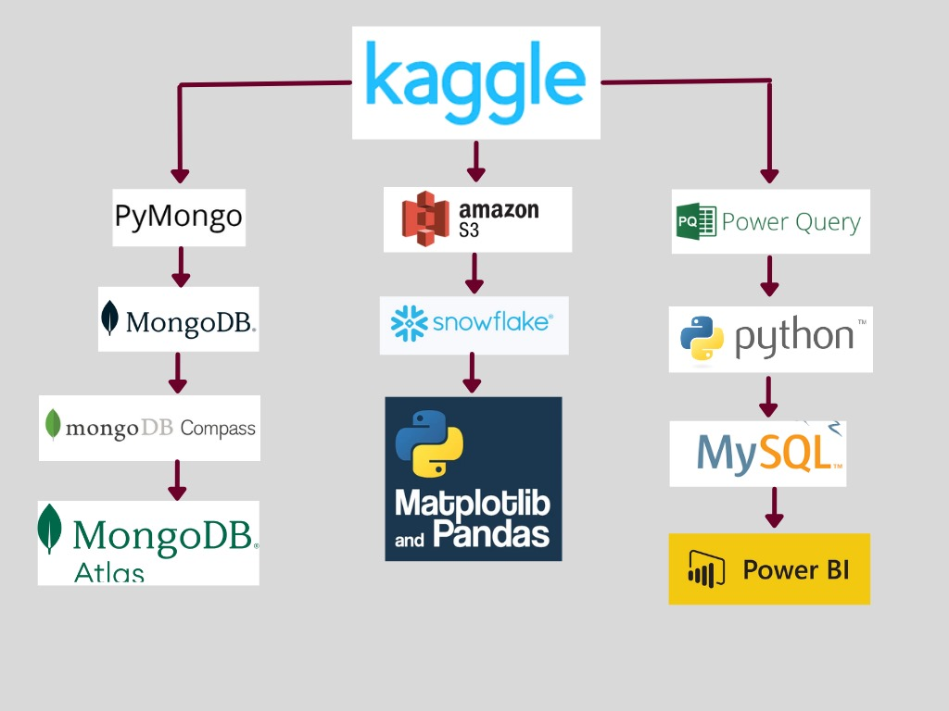
Flow Diagram

Slide 7
Project Flow
Cloud tools: AWS S3 (Simple Storage Service) & Snowflake
AWS S3 is a cloud storage service for storing and accessing data globally.
Snowflake is a scalable data warehousing platform optimized for modern analytics and business intelligence.
Data Transformation: Power Query editor
Power Query editor is a data transformation tool in Power BI used for shaping and cleaning data before analysis.
Data Analysis: Python, MySQL, Snowflake Worksheet
Python is a versatile programming language commonly used for data manipulation, analysis, and machine learning tasks.
MySQL is a popular relational database management system known for its ease of use and scalability.
Snowflake Worksheet is an interface for executing SQL queries and managing data within the Snowflake data warehousing platform.
Data Visualization: Power BI & MongoDB Atlas
Power BI is a powerful business intelligence tool for visualizing and analyzing data from various sources.
MongoDB Atlas is a fully managed cloud-based database service for MongoDB, offering scalability and flexibility for modern applications.

Slide 8
AWS S3 Data Lake
Amazon S3 is a basic and adaptable data lake storage option. Large volumes of unstructured data, such as text, photos, and videos, are supported. At its foundation, S3's scalability, durability, and accessibility make it essential for building adaptable data lakes that satisfy changing analytics and storage requirements.
S3 Bucket Creation: To start an S3 bucket, use the AWS Management Console to gain access to the service. Important steps include deciding on the storage region, giving the system a globally unique name, and setting up features like versioning and access control. The resulting bucket serves as the data's central repository, enabling additional processing and organization.
Folder Upload in S3: After setting up an S3 bucket, creating folders makes data organization simple. Effective data administration is facilitated by folders, and creating a folder is made easier with the "Create folder" option. Adding the project's CSV file to these folders prepares the data for further processing and analysis, making the S3 data lake logically organized and accessible.
S3 Bucket Policy: In AWS S3, a bucket policy is a set of rules created by the bucket owner to control access permissions to objects that are stored. It is expressed in JSON. These S3 bucket-attached policies are essential for managing data access and security. They add to strong security by making it possible to define precisely who has access to the data and what they can do.

Slide 9
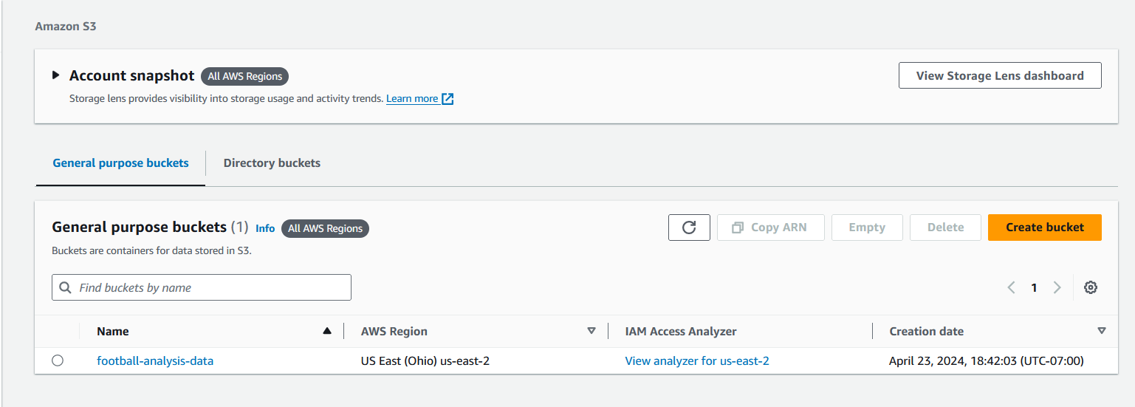
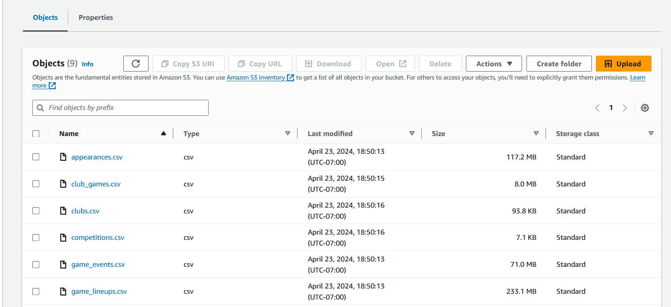
Step Image for AWS S3
AWS S3 bucket, a cloud computing technology has been created which is being used as Data Lake for the project.
One folder has been created inside the S3 bucket that can store relational data sources (CSV files) which are the data files from Kaggle

Slide 10
Data Modeling
Normalization: By systematically removing redundant information and improving overall database performance, a third normal form (3NF) was attained. The strategic approach entailed the elimination of superfluous data.
Indexes: By adding indexes on important columns (such as competition_id, and club_code in clubs), database access patterns and query performance were improved. This optimization sped up the process of retrieving data.
Primary and Foreign Keys: By adhering to the relationships between primary and foreign keys and providing clear specifications, referential integrity was maintained. This guaranteed accurate recording of table relationships and avoided database inconsistencies.
Unique Constraints: By imposing distinct constraints on each player_id club_id in the players and clubs table respectively, unique constraints are used to strengthen data integrity. This prevented accidental duplication of important identifiers.
Data Types: By choosing the right data type for each column, you can maximize storage and query efficiency. By taking such care, the database was able to handle data in a way that was consistent with its purpose and nature, which maximized resource utilization.

Slide 11
SnowFlake as Data Warehouse
Overview of Snowflake Data Warehousing: Snowflake is cutting-edge cloud-based data warehousing software that is intended to revolutionize the way that companies handle and examine their data. It offers a fully-managed, scalable solution for real-time data processing, storing, and querying and is positioned as a Data Cloud platform. Because of its distinct architecture, which divides processing and storage resources, it is possible to make dynamic adjustments in response to changing needs for maximum efficiency and least amount of money.
Optimizing the “Compute WH” Data Warehouse: Performance and scalability are given top priority in the small-scale setup of the "Compute WH" data warehouse. Scaling policies dynamically resize clusters in response to workload demands, ensuring flexibility. This method optimizes query execution times while taking into account the different processing demands of distinct queries. Notably, the system's automatic load balancing capabilities enhance overall performance by efficiently managing varying workloads.
Multi-Cluster Architecture for Better Performance: This data warehouse architecture, which fits into a cost-effective and adaptable usage model, improves performance. This virtual data warehouse offers both on-premise and cloud-based implementation options, allowing it to be customized to meet specific business needs. Because pay-as-you-go pricing matches costs to actual resource usage, it guarantees cost-effectiveness. The “Compute WH” data warehouse is a flexible option for businesses looking for the best query performance in analytical projects because it combines cost-effectiveness, load balancing, and scalability.

Slide 12
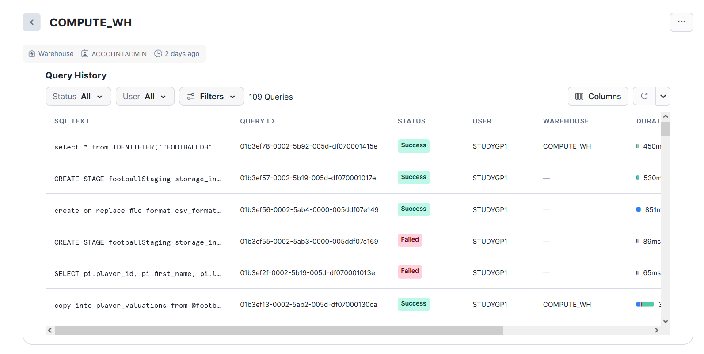
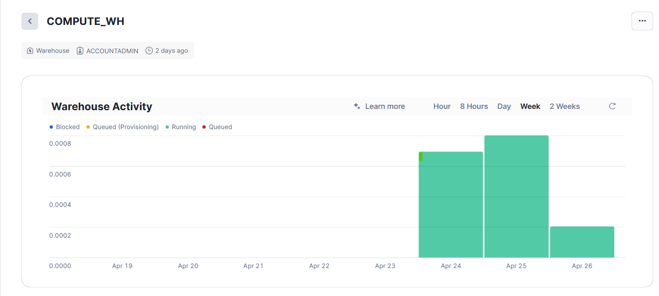
SnowFlake Data Warehouse
In the SNOWFLAKE, a data warehouse has been created named‘COMPUTE_WH’ having size: small.

Slide 13
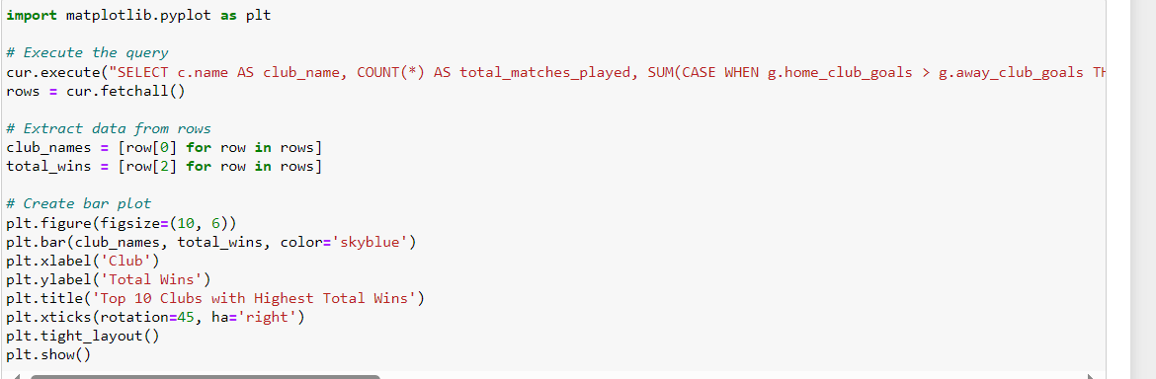
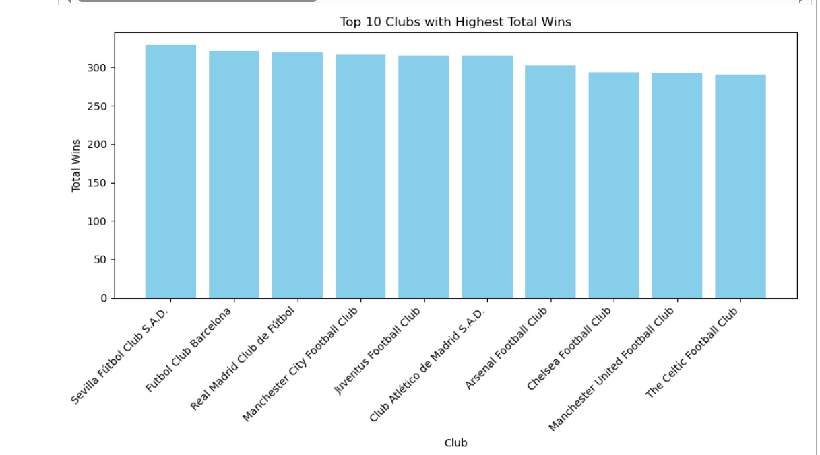
Python with Pandas and Matplotlib
Python, complemented by Pandas and Matplotlib, forms a formidable analytical toolkit renowned for its efficiency and versatility. Pandas simplifies data manipulation and analysis tasks with its intuitive data structures and powerful functionalities, allowing analysts to effortlessly clean, transform, and explore datasets. Matplotlib, on the other hand, offers a flexible framework for creating an array of high-quality visualizations, enabling analysts to communicate insights effectively.

Slide 14
Technical Difficulties Faced
Addressing data quality issues, including missing values and inconsistent formatting, through data cleaning and preprocessing techniques like imputation, standardization, and outlier detection.
Integrating football data from diverse sources, such as match statistics databases and tracking systems, by employing data integration tools like ETL processes and data normalization methods.
Overcoming challenges in setting up the AWS environment, including adjusting default data types, configuring VPC endpoints, specifying file paths during data loading, and ensuring correct IAM role assignments for ETL jobs.

Slide 15
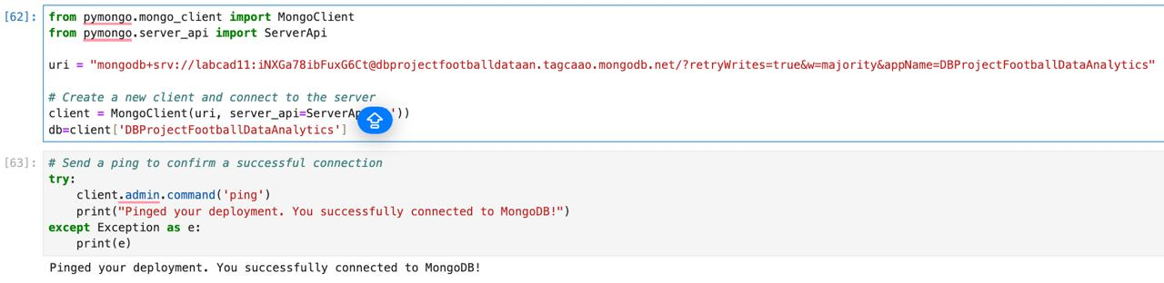
DB Connectivity/API calls via PyMongo Connection
A connection was established between Jupyter Notebook and MongoDB using Pymongo for running the queries in Python & importing all the data in MongoDB.

Slide 16
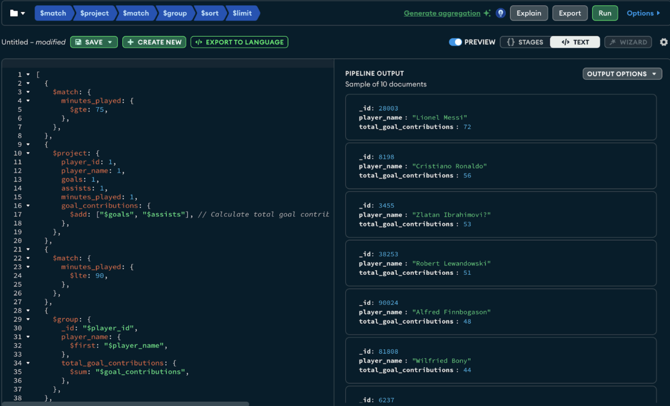
Used Aggregation pipelines in MongoDB Compass to build & make queries on the imported data
A brief query is given as follows:
Identified players who performed best in the final minutes of a match, we analyzed players' goal contributions (goals and assists) specifically in the last 15 minutes of a match.
This query filters appearances where the player played at least 75 minutes, calculates their total goal contributions (goals + assists), and then filters appearances where the player played less than or equal to 90 minutes (indicating they played in the final 15 minutes).
It then groups the players, sums their total goal contributions, sorts them by total goal contributions in descending order, and finally limits the result to the top 10 players.

Slide 17
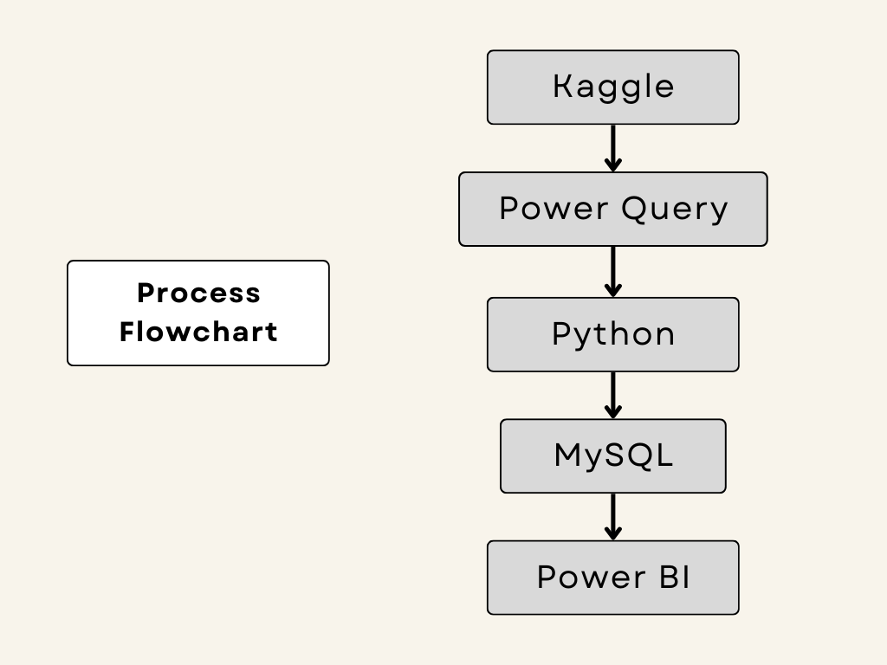
Process Flow using SQL

Slide 18

Data Collection and Preparation
Data Source:
A football dataset including team details, player statistics, and match details was obtained from Kaggle.
Data Cleaning:
Power Query & Python
To address problems like missing values, inconsistent formatting, and duplicates, the raw dataset was cleaned and transformed using Power Query in Excel.
Feature engineering, addressing outliers, and getting the dataset ready for analysis are just a few of the sophisticated data preprocessing activities that Python is used for.
Managing Null Values and Outliers: imputation techniques for missing data and statistical approaches for identifying and addressing outliers are some of the tactics that have been implemented to manage null values and outliers.

Slide 19
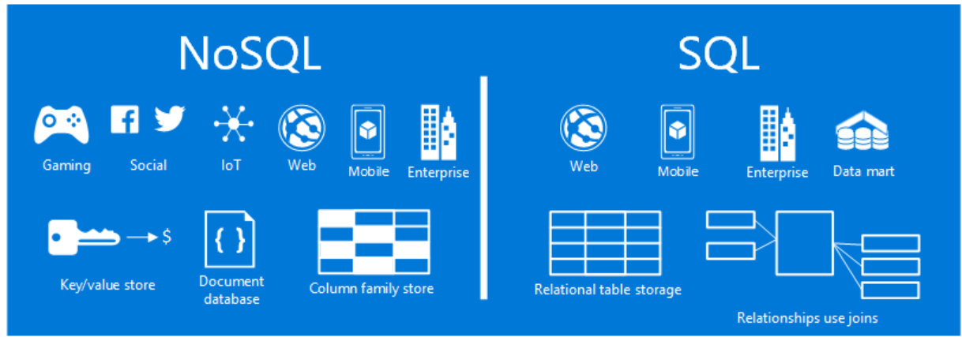
Why SQL? (Instead of NoSQL)
SQL databases are preferred for this project due to the structured nature of football data, which benefits from relational data modeling and complex querying capabilities.
NoSQL databases may be suitable for unstructured data or real-time applications but are less optimal for structured analytics workflows requiring complex joins and aggregations.

Slide 20
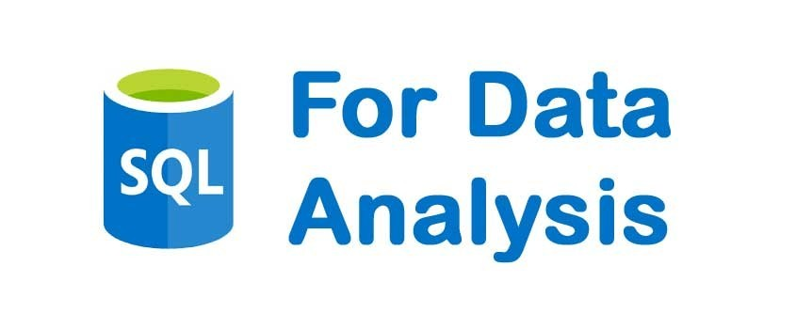
Data Analysis and SQL Integration
Uploading to a SQL Database:
The cleaned dataset was uploaded into a SQL database for additional analysis and insight extraction following data cleaning and preprocessing.
SQL Query for Analysis:
Several tables were joined, aggregations were made, and filtering was done in order to obtain insightful information from the football dataset.
Integration with Power BI:
To visualise and explore the analysed football data, a connection was made between the SQL database and Power BI.

Slide 21
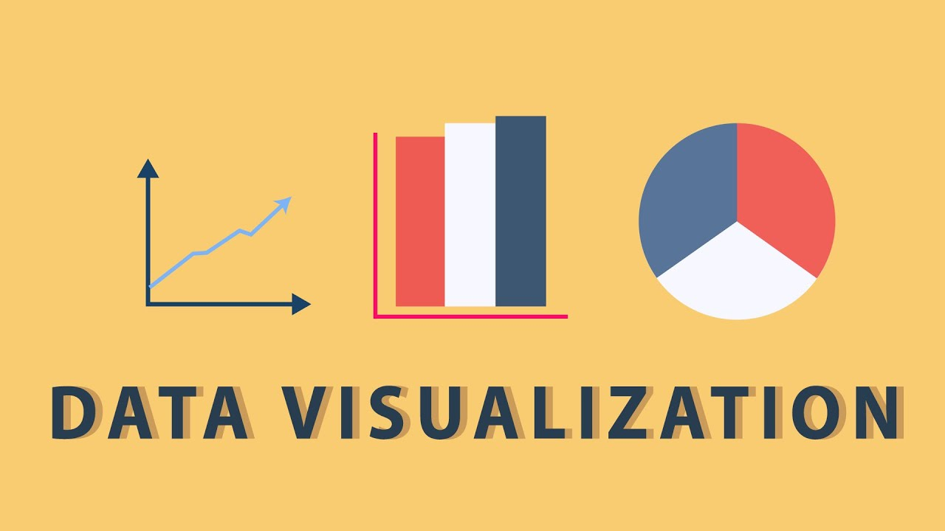
Integration with Power BI
Linking SQL Database to Power BI:
Made use of Power BI to create a smooth link with the SQL database that held the football dataset under analysis.
Football Analytics Visualization:
In order to show important data like player performance, team statistics, match insights, and trends over time, Power BI dynamic and interactive dashboards were created.
Interactive Reports:
Using user-friendly filters and visualizations, drill-down interactive reports enable users to examine in-depth football analytics.

Slide 22
Insights and Visualization
Football Analytics Key Findings:
Included are important takeaways from the football dataset analysis, such as player trends, team performance patterns, match-influencing variables, and comparison evaluations.
Dashboard Highlights:
Showcased several Power BI dashboards and visualizations that showed goal distributions, player statistics, team standings, and other significant indicators.
Effective Visualizations:
To help with decision-making, intricate football analytics were communicated in an understandable and visually appealing way by using charts, graphs, and maps.

Slide 23
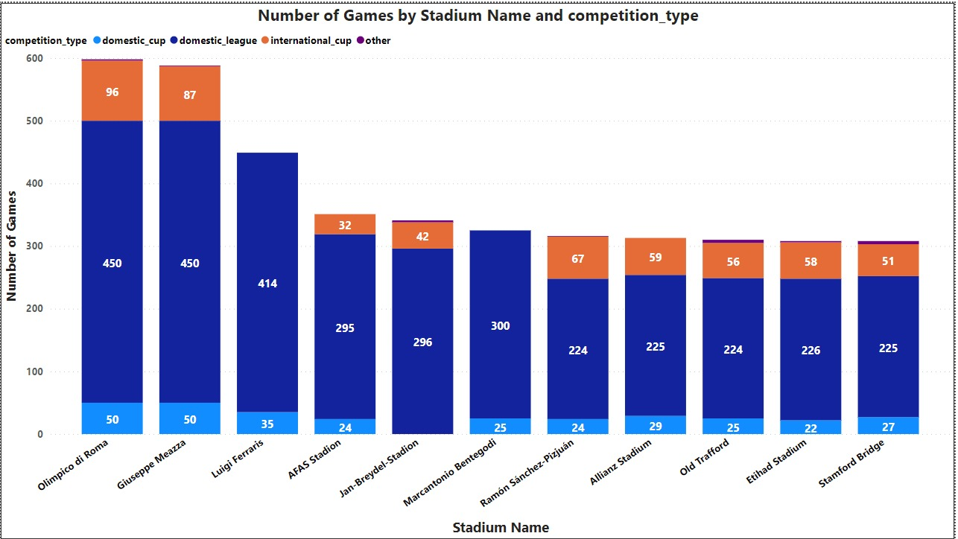
Visualization: 1

Slide 24
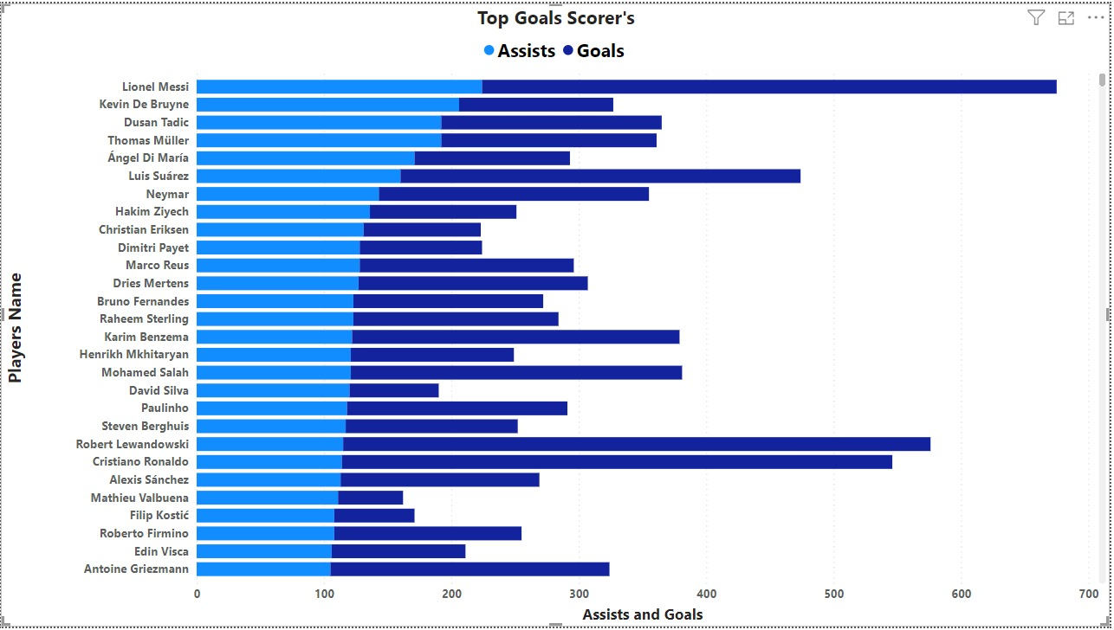
Visualization: 2

Slide 25
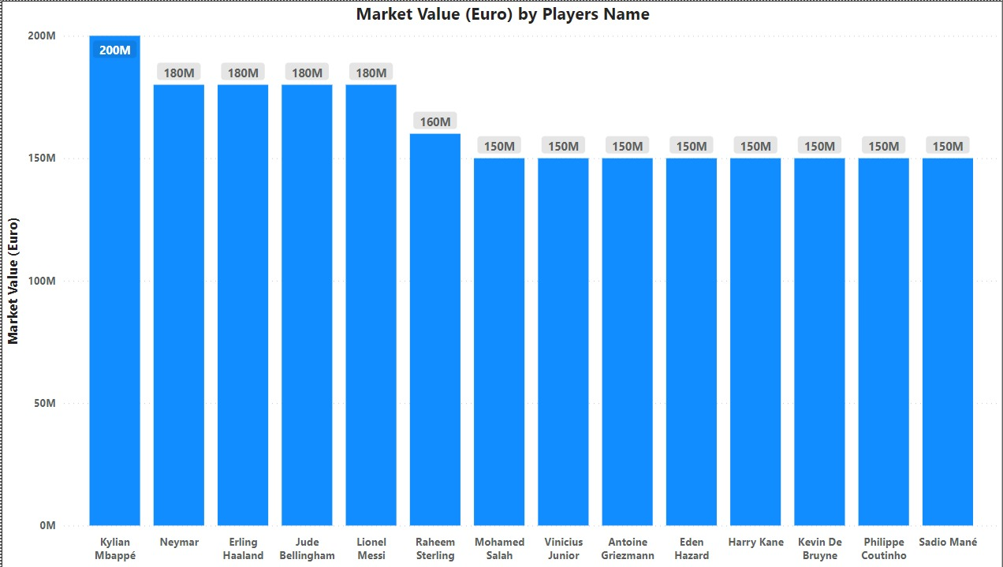
Visualization: 3

Slide 26
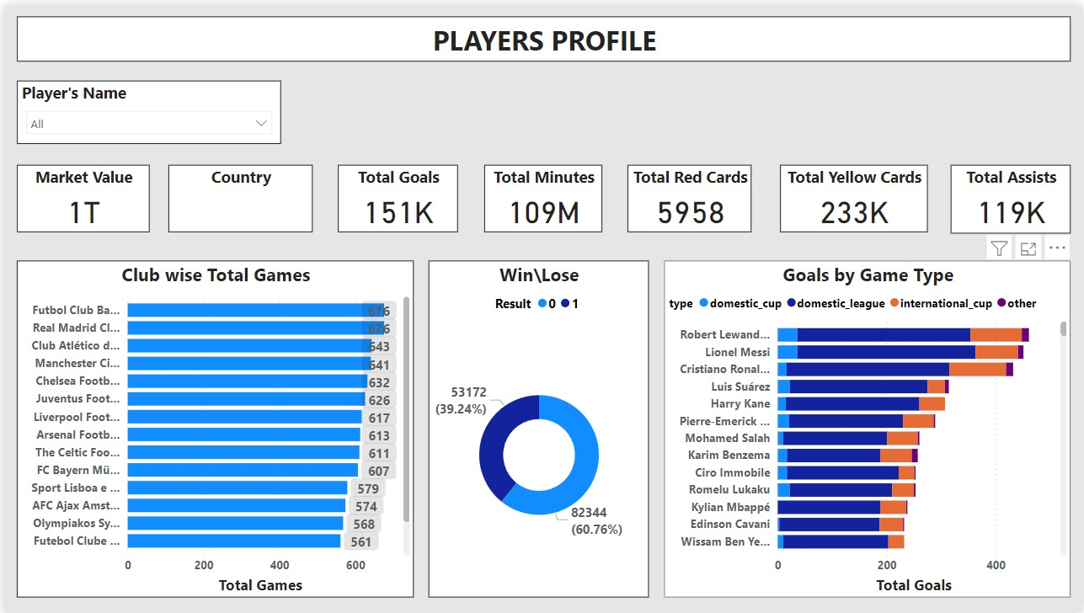
Players Profile Dashboard

Slide 27
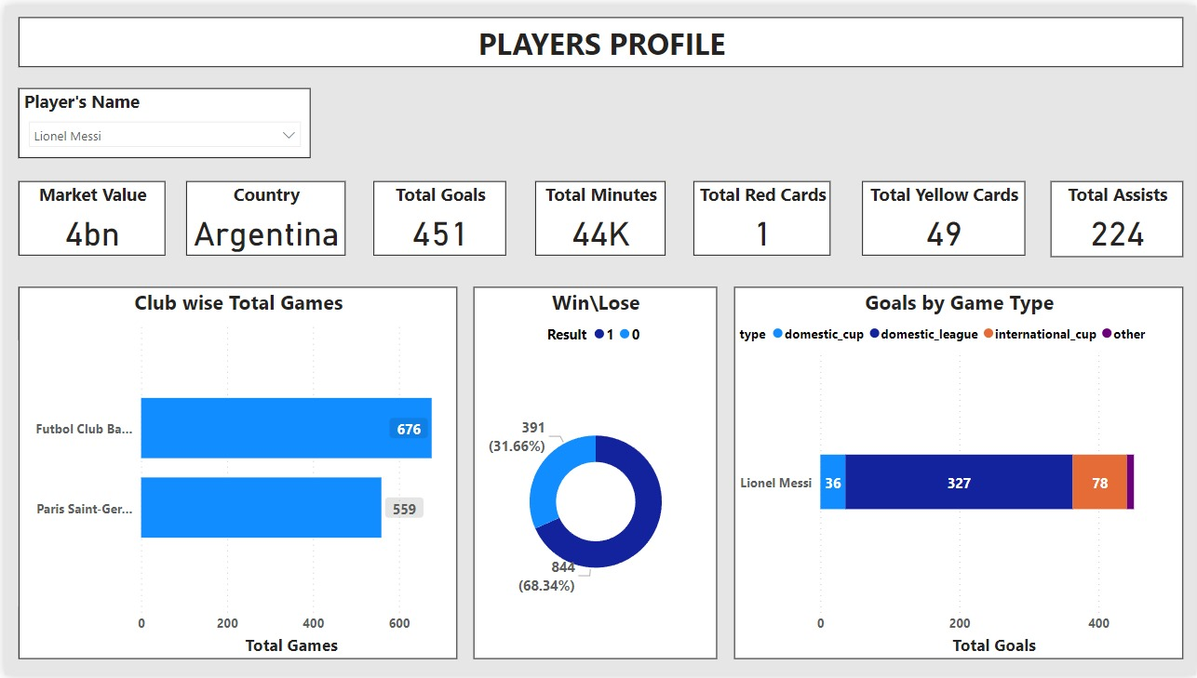
Messi’s Profile Dashboard

Slide 28
Conclusion and Impact
Project Outcomes and Achievements: A summary of the project's accomplishments was provided, highlighting the importance of football analytics in providing teams, coaches, and other stakeholders with strategic insights.
Football analytics' effects on decision-making procedures, player scouting, performance optimization, and fan involvement were examined in terms of their business and sporting implications.
Future Directions: Included some possible future directions, like adding more sophisticated machine learning models, growing the number of data sources, and improving visualization methods.
Last Thought: Concluded with thoughts on the accomplishments of the project, the lessons discovered, and the changing use of data analytics in contemporary football management.

Slide 29
Key Learnings
MySQL and MongoDB were employed for data storage, showcasing the versatility of SQL and NoSQL databases in handling structured and unstructured football data.
Utilizing Power BI and Power Query facilitated advanced data visualization and transformation, enhancing the presentation and interpretation of football analytics results for stakeholders.
Gain proficiency in MongoDB document-oriented approach and Snowflake’s cloud-based data warehouse offer different capabilities for managing football data effectively.
Understand how to optimize data processing and analysis workflows for performance and scalability.
Develop a deep understanding of football analytics concepts, including player performance metrics, team strategis, and competition analysis.

Slide 30
THANK YOU!!
ANY QUESTIONS??

