Slide 1


Grounding Surgical Action Triplets with Instrument Instance Segmentation
A dataset and target-aware fusion approach
by Oluwatosin Alabi, Meng Wei, Charlie Budd, Tom Vercauteren, and Miaojing Shi
Extended presentation

Slide 2
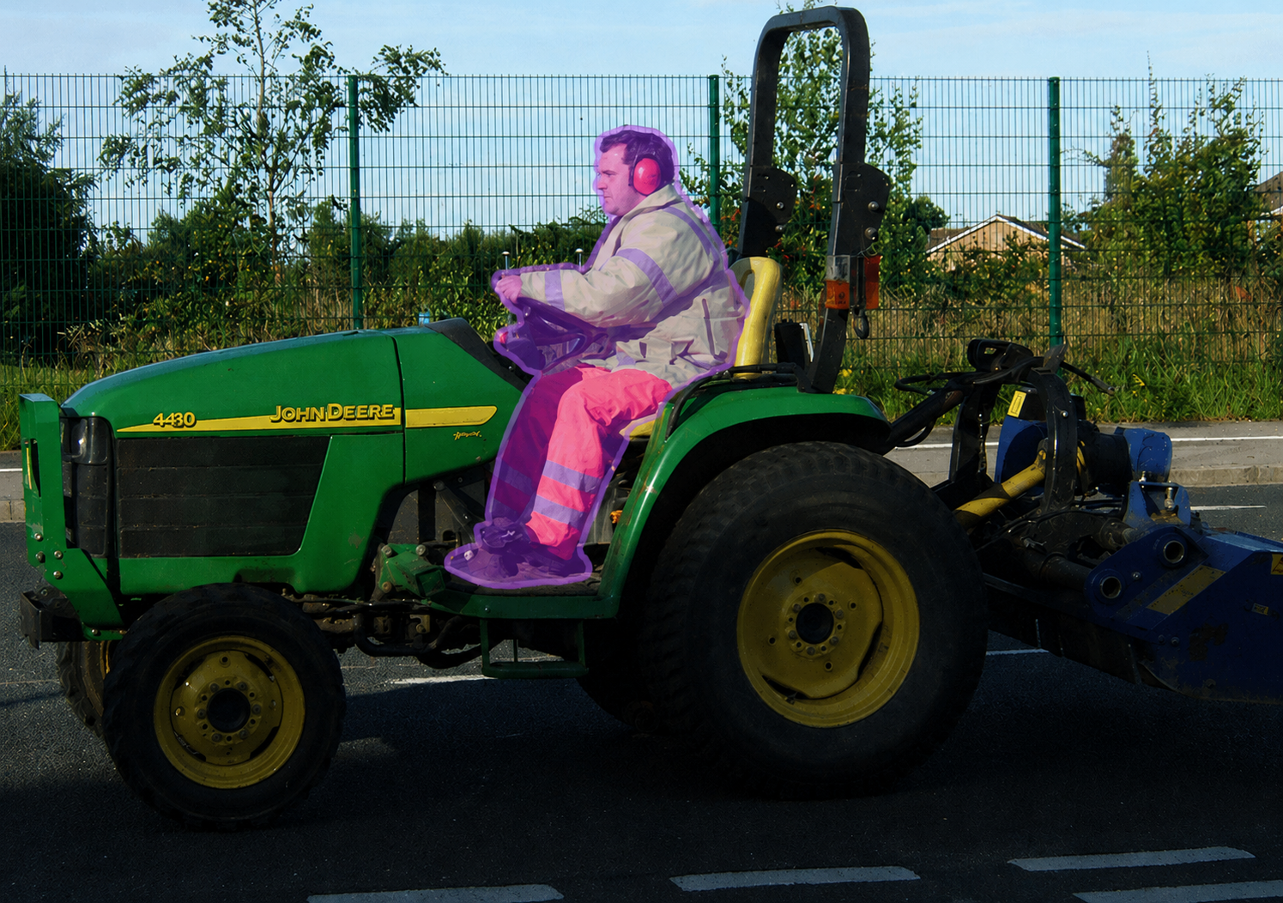
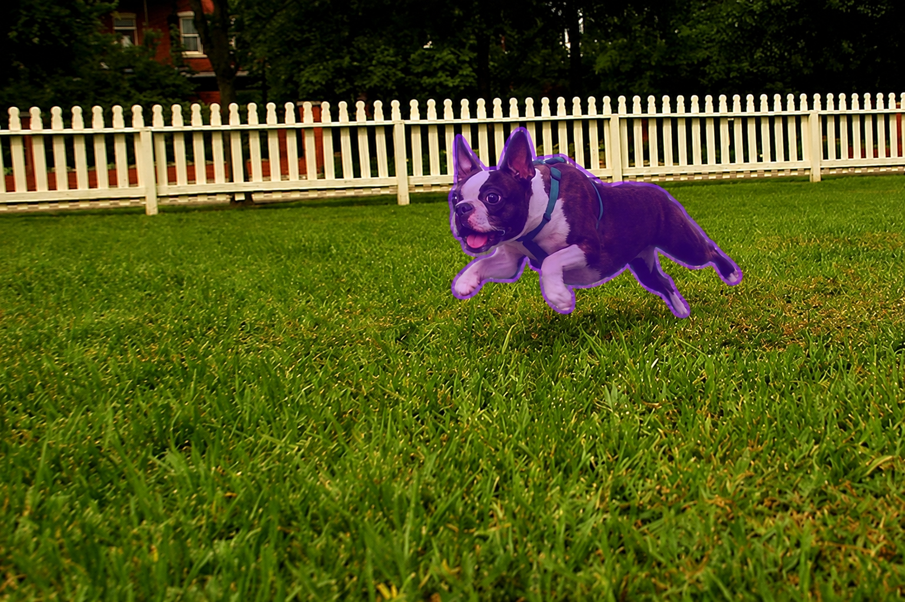
What is visual grounding?
A man with reflective safety clothes and ear protection drives a John Deere tractor on a road
Energetic dog in a vibrant garden
  Grounding - Ability to link abstract concepts like words, phrases, labels to physical regions or pixels in an Image

Slide 3
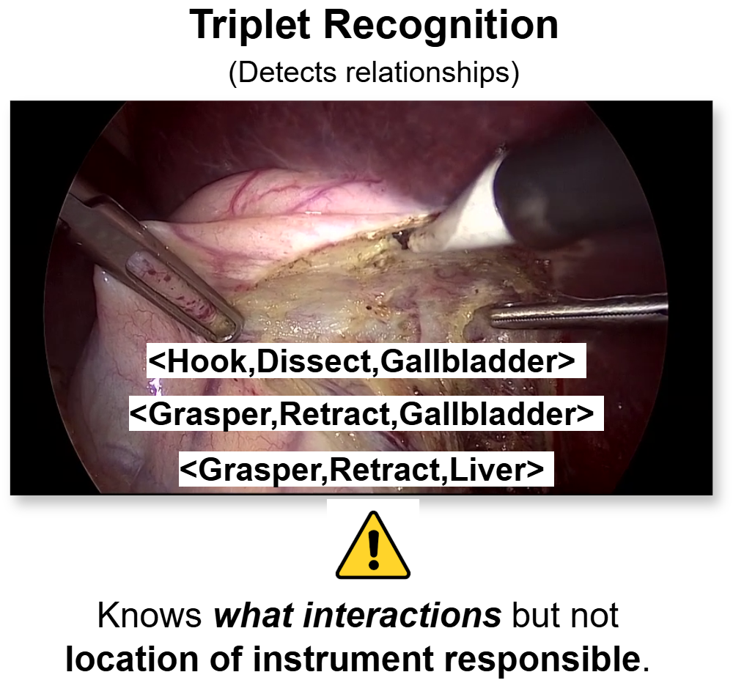
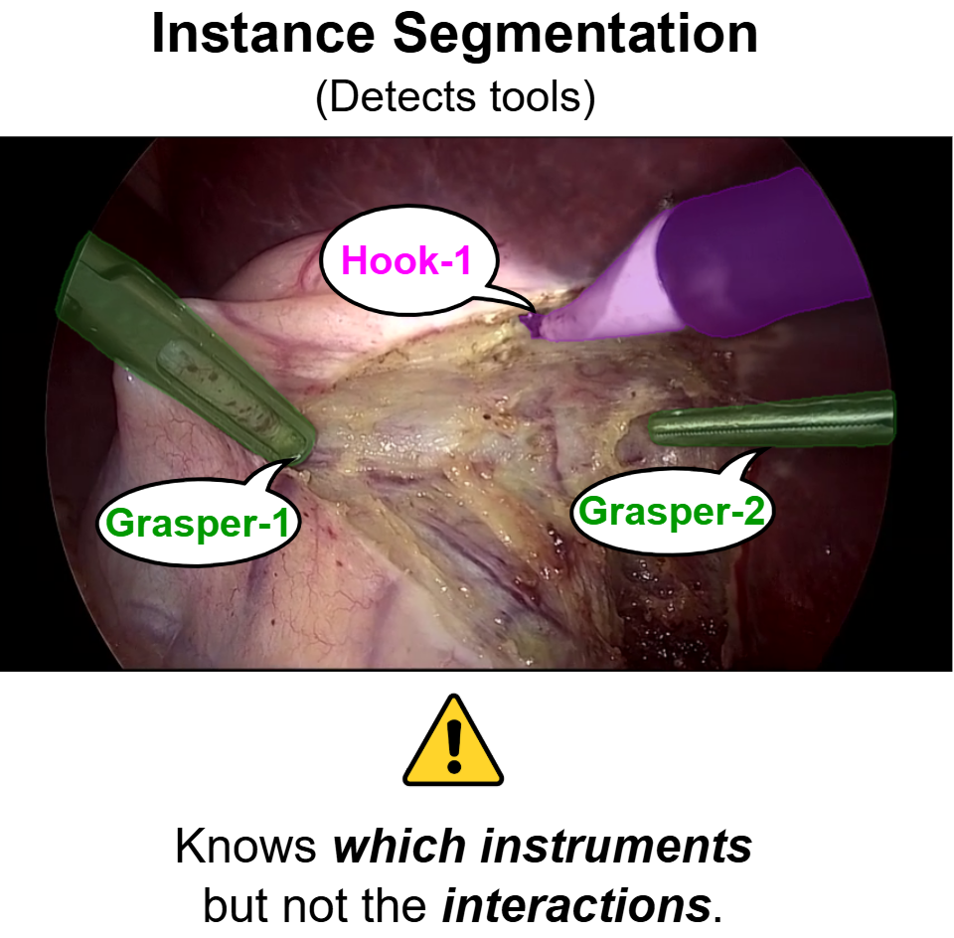
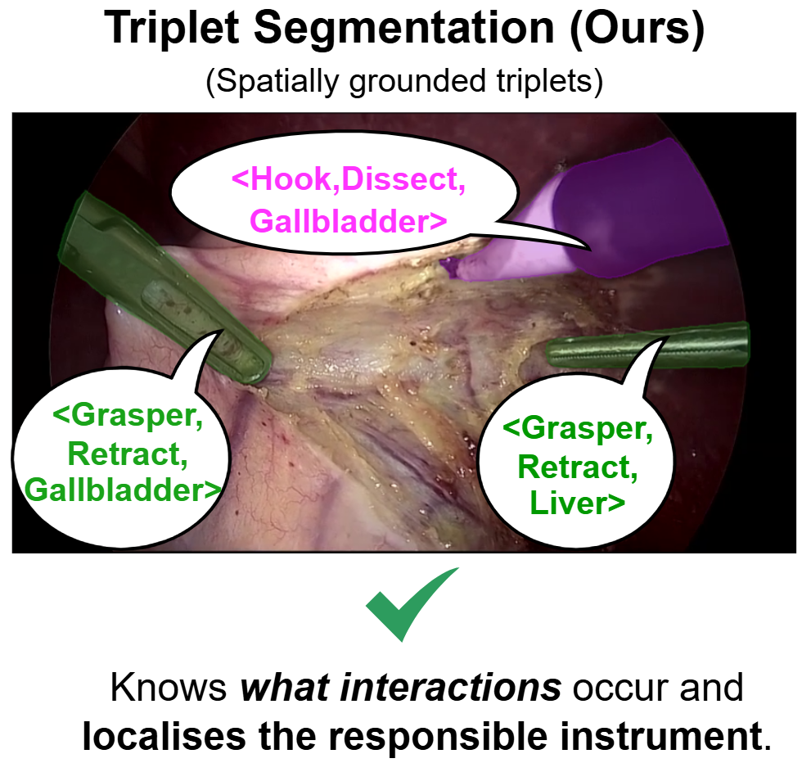
PROBLEM → TASK: Grounding triplets

Slide 4
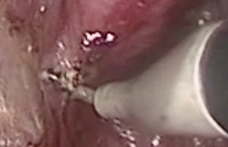
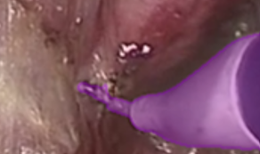
TASK : We define triplet segmentation
+
+
+
Model
Hook-1
Class and Instrument Instance
Dissect
Verb
Gallbladder
Target
Input Image
Mask
Grounded triplets
Prediction Target
  Predict every instrument instance mask and output a single triplet class (<I,V,T>) per instance mask .
Evaluation
  Recognition mAP: frame-level triplet presence.[1]
  Detection mAP: triplet linked to a bounding box. [2]
  Segmentation mAP: triplet linked to an instance mask.
Nwoye, C. I et al. CholecTriplet2021: A benchmark challenge for surgical action triplet recognition MEDIA 2023
Nwoye, C. I et al. CholecTriplet2022: Show me a tool and tell me the triplet—An endoscopic vision challenge for surgical action triplet detection. MEDIA 2023

Slide 5
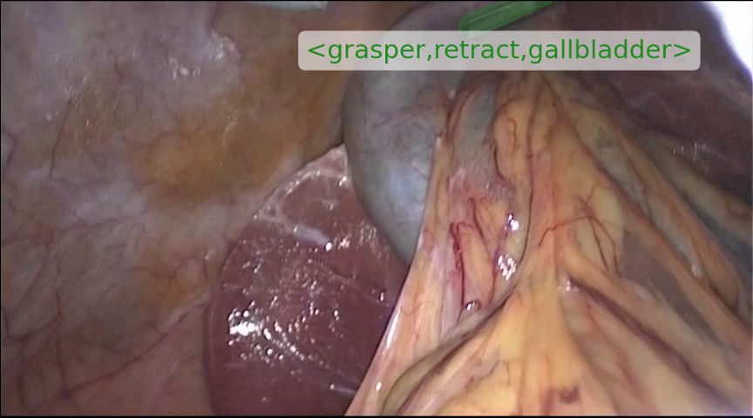
DATASET: CholecTriplet-Seg
CholecT50[1]
Frame triplets
CholecInstanceSeg[2]
instrument masks
Manual alignment
and quality control
CholecTriplet-Seg
grounded triplets
+
+
→
30,955
49,866
50
93
annotated frames
grounded triplets
cholecystectomy videos
observed valid triplets
6
10
15
instruments
verbs
targets
Nwoye, C. I et al. Rendezvous: Attention mechanisms for the recognition of surgical action triplets in endoscopic videos. MEDIA 2022.
Alabi, O., et al. Cholecinstanceseg: A tool instance segmentation dataset for laparoscopic surgery. Scientific Data, 2025.

Slide 6
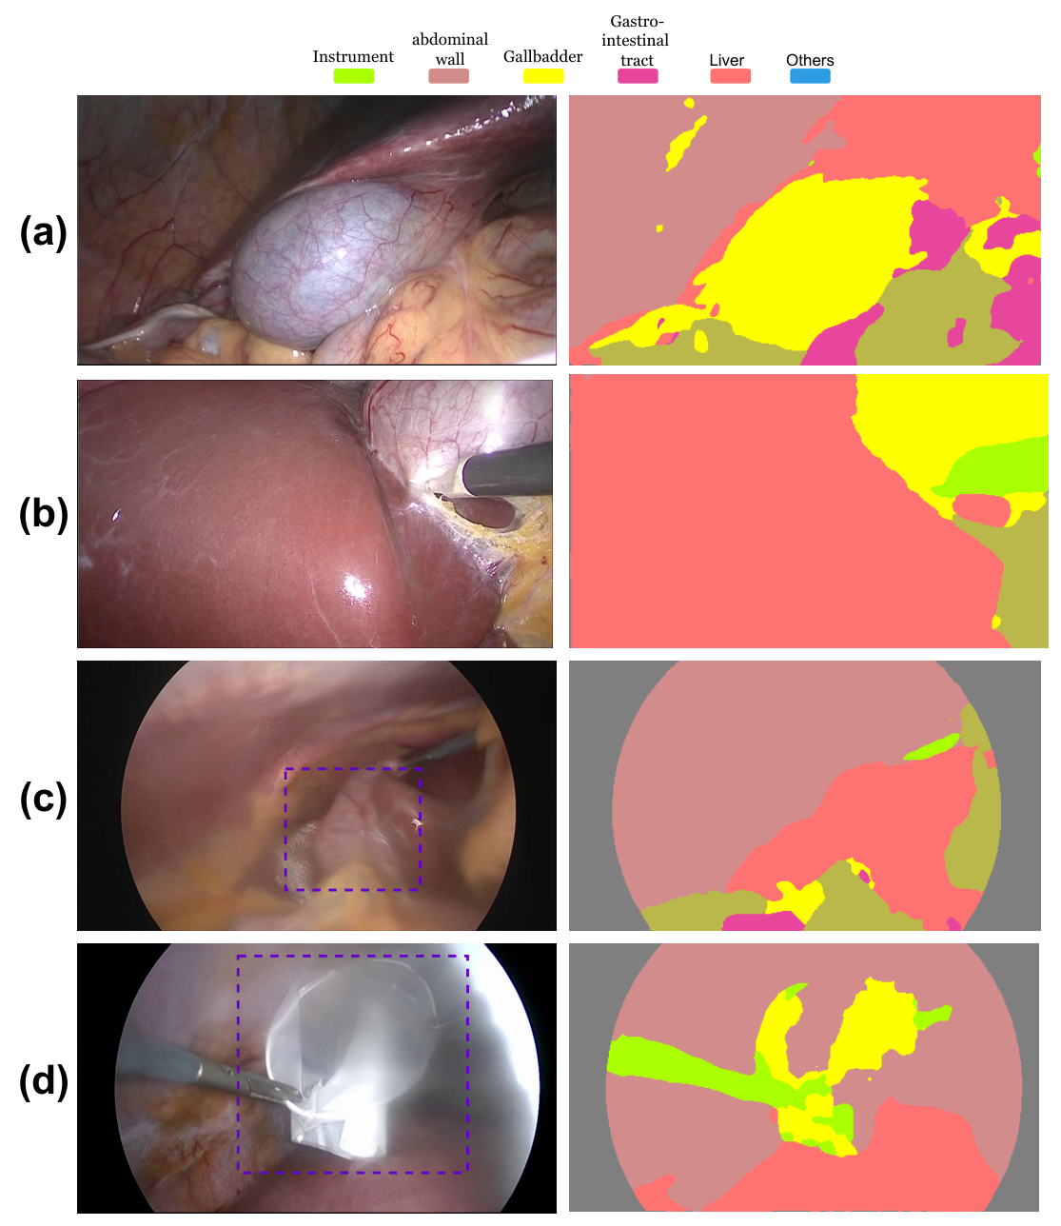
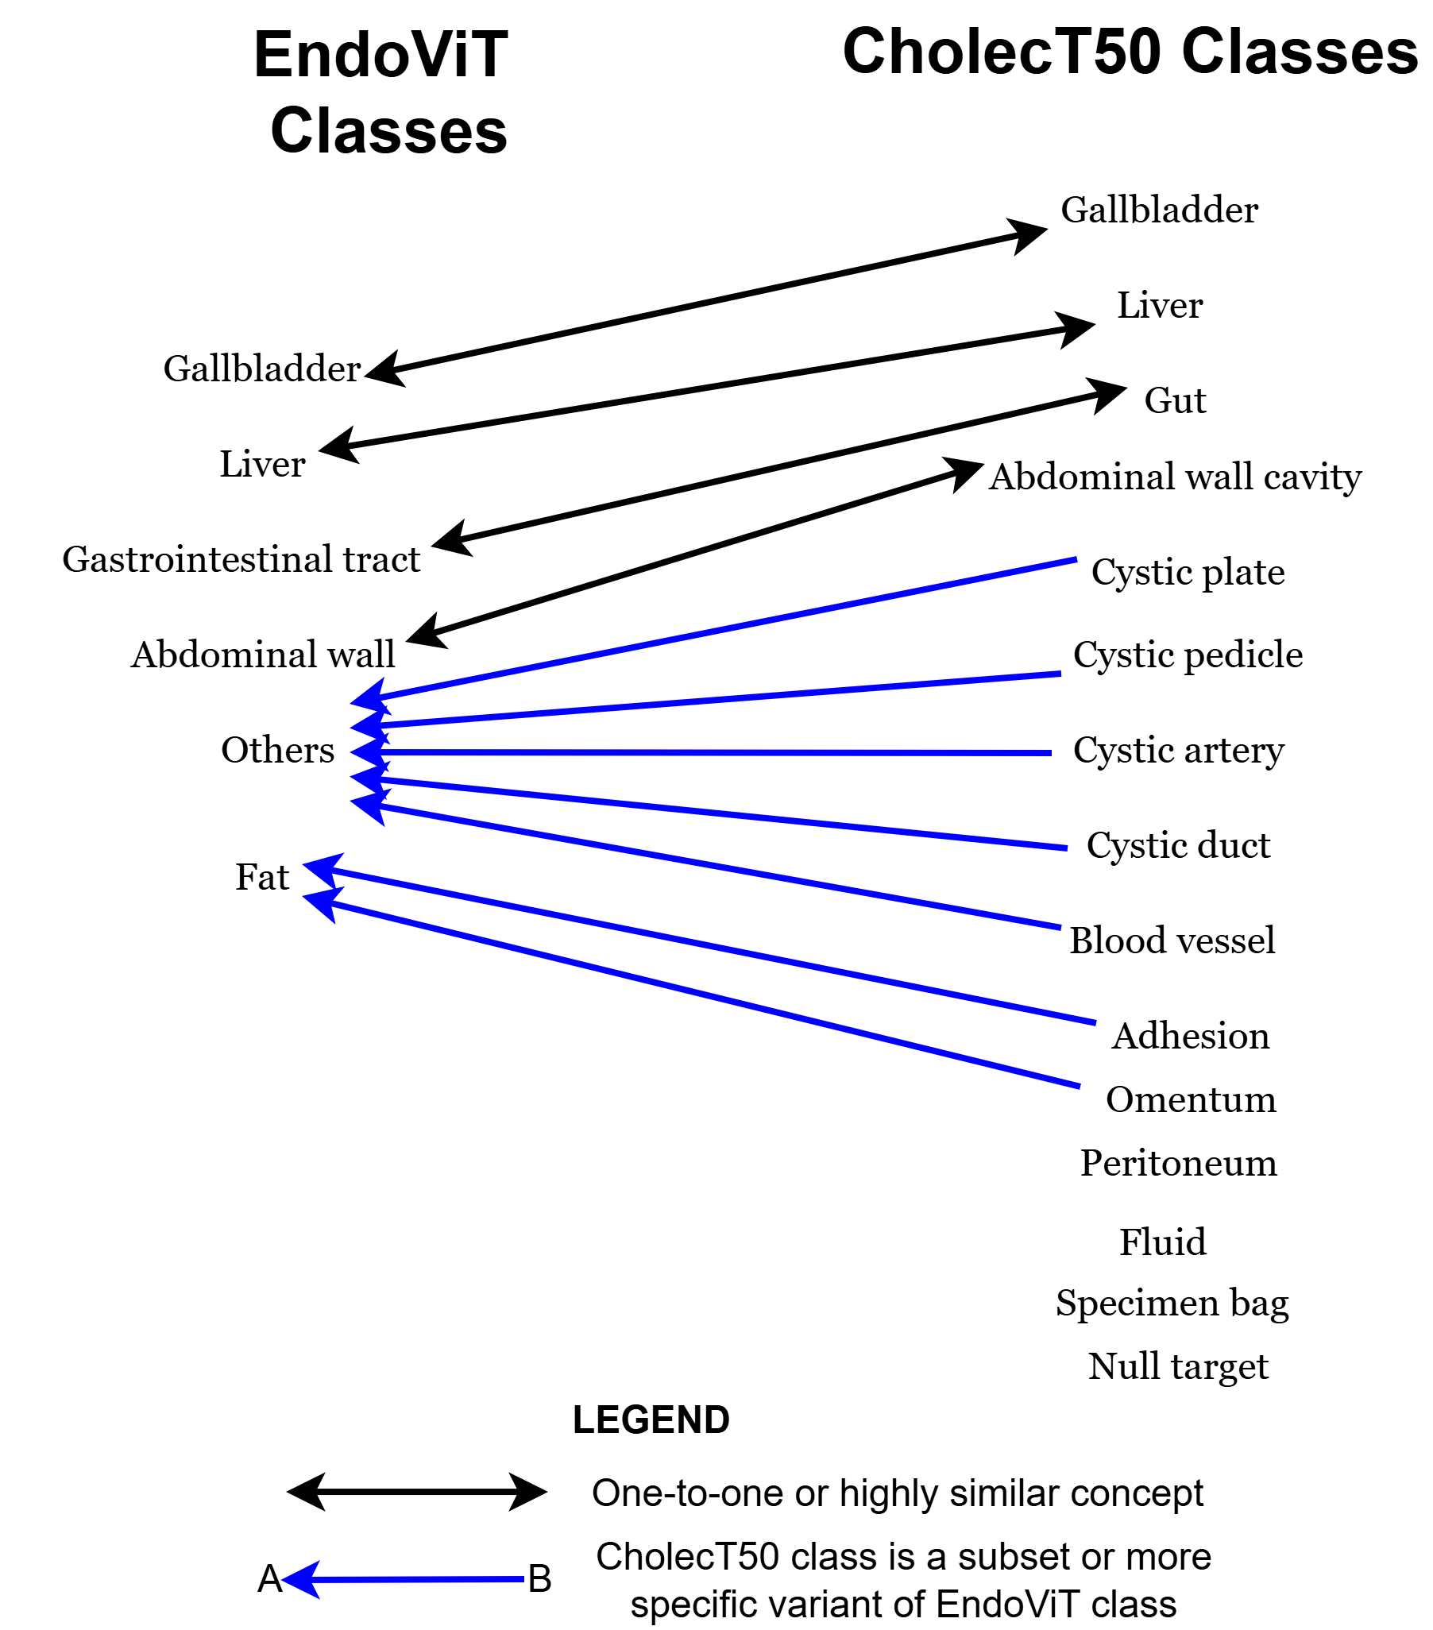
BOTTLENECK: The hard part is the target
Batić et al. Endovit: pretraining vision transformers on a large collection of endoscopic images. IJCARS 2024.

Slide 7
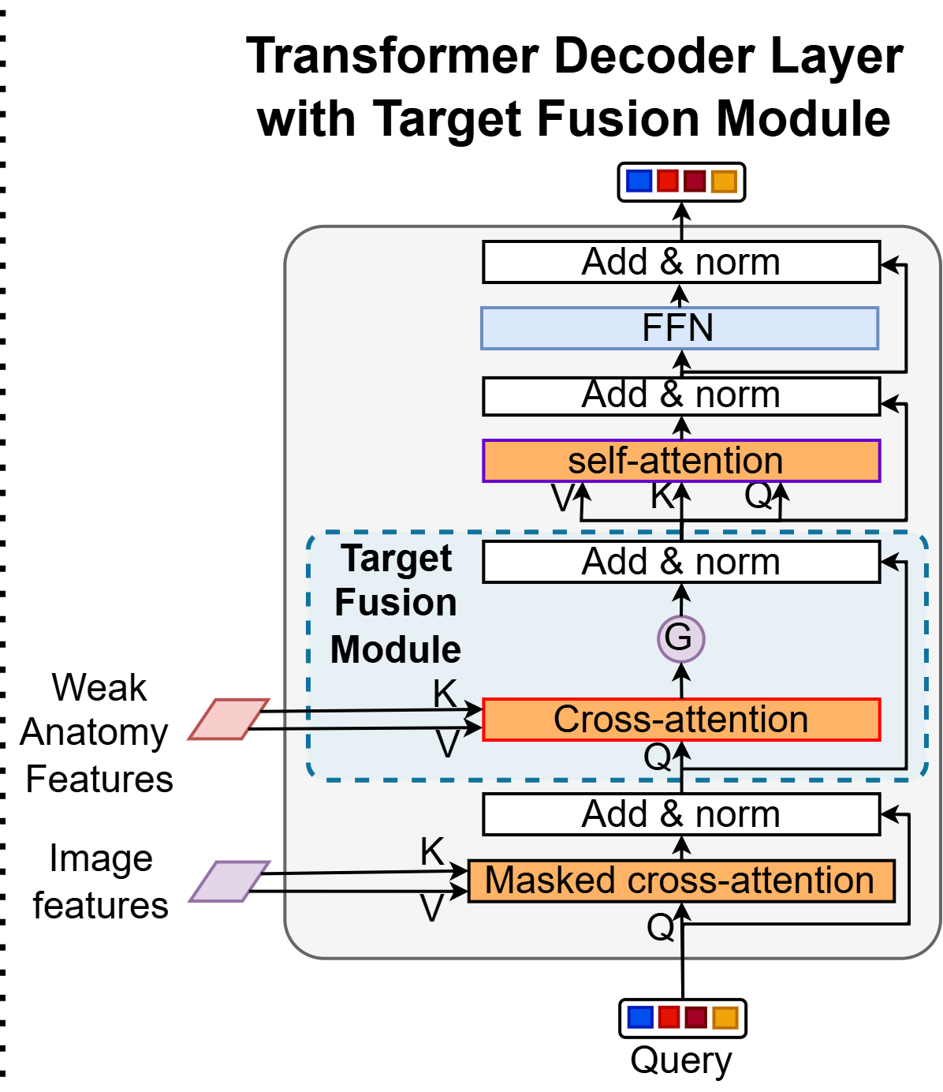
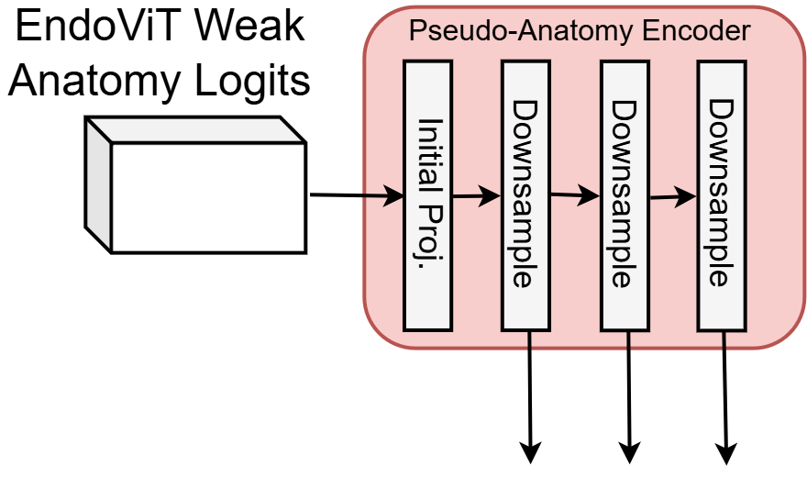
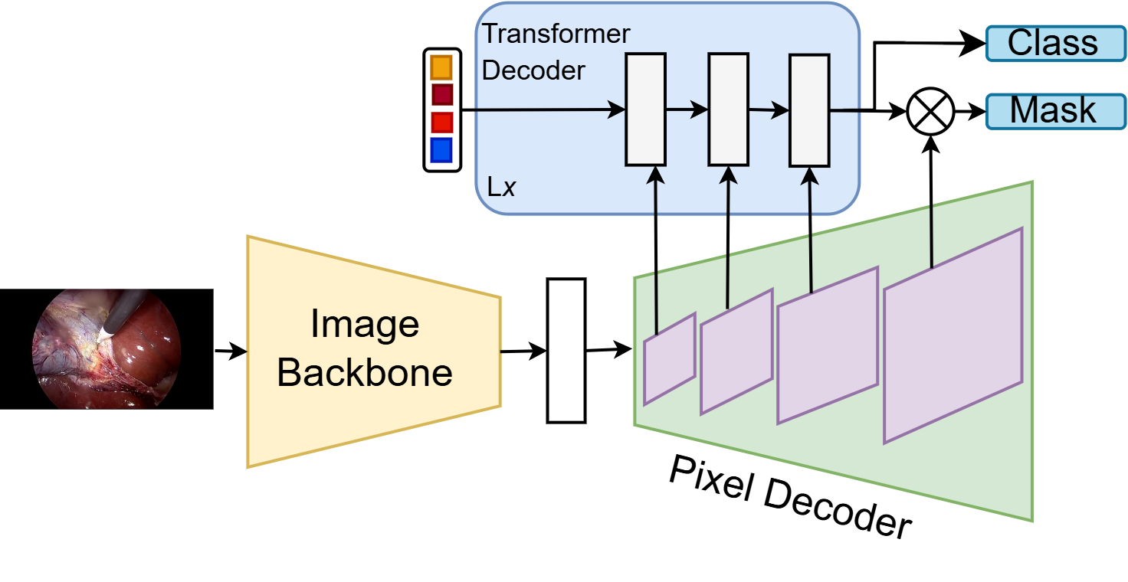
METHOD: TargetFusionNet, use anatomy logits as a weak cue
    Dual-encoder Mask2Former with weak anatomical priors
    Novel gated cross-attention enabling query-specific trust in anatomy predictions

Slide 8
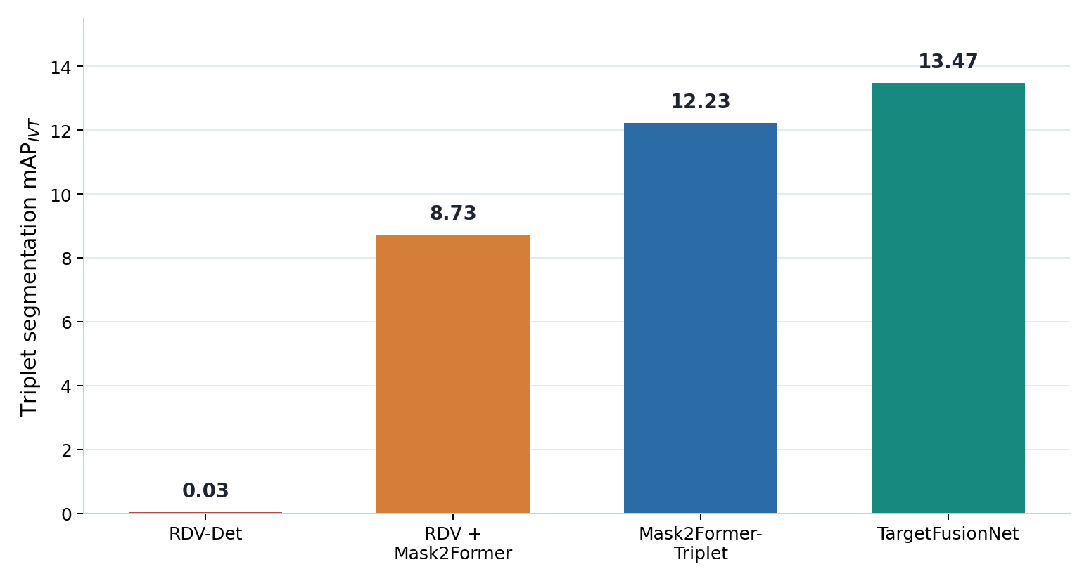
RESULTS : What moves the needle?
    CAM-based weak grounding is not enough
    Strong instrument masks create the largest jump
    TargetFusionNet improves the strongest baseline
      Segmentation mAP = 13.47
      TargetFusionNet significantly outperforms our best baseline (Mask2Former-Triplet).

Slide 9
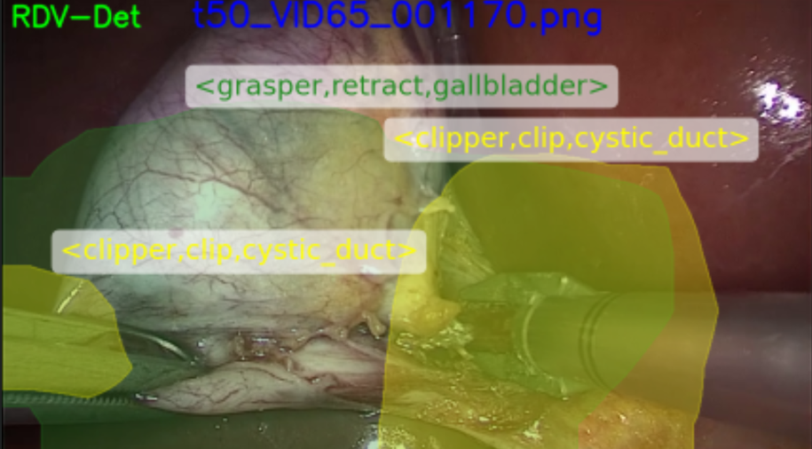
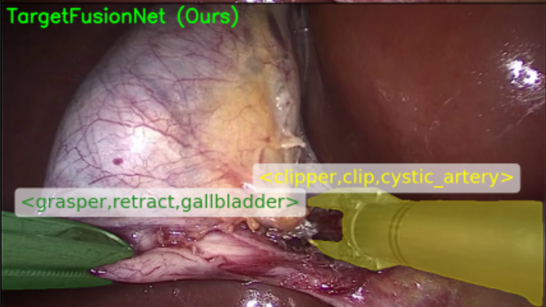
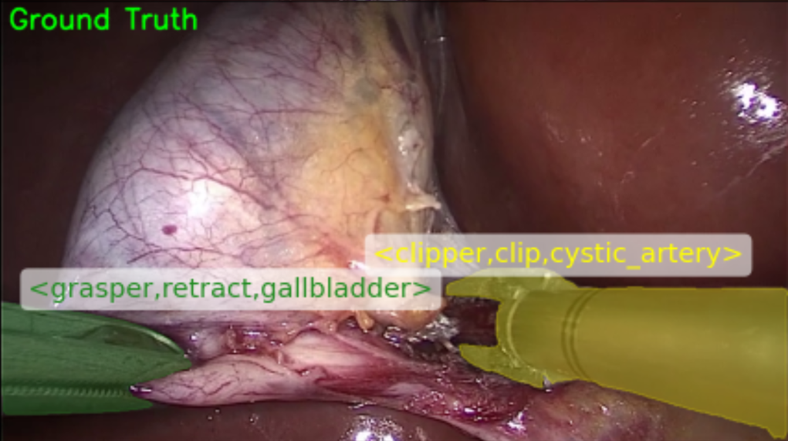
QUALITATIVE : CAM localization with multiple instruments

Slide 10
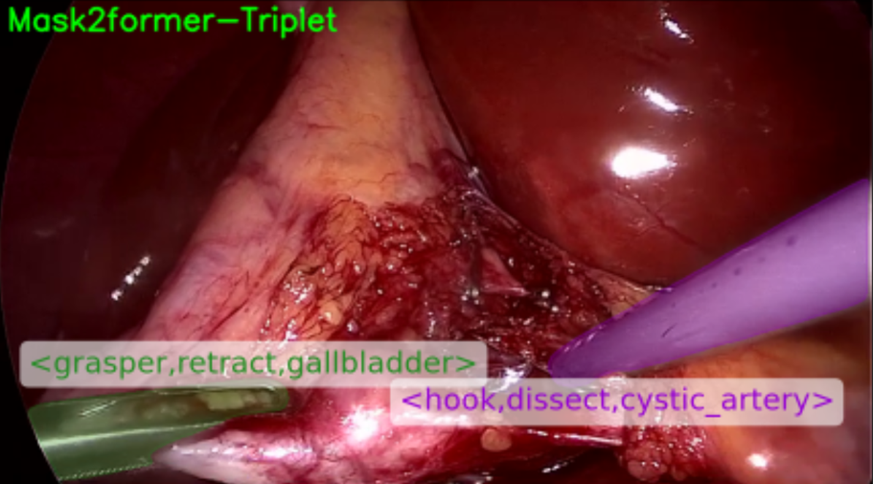
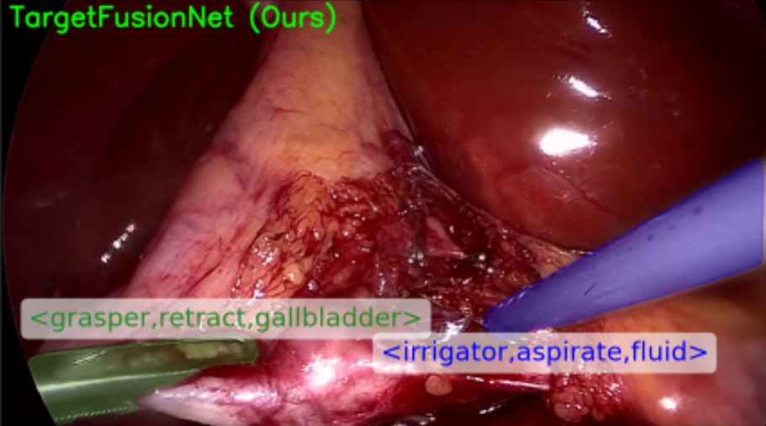
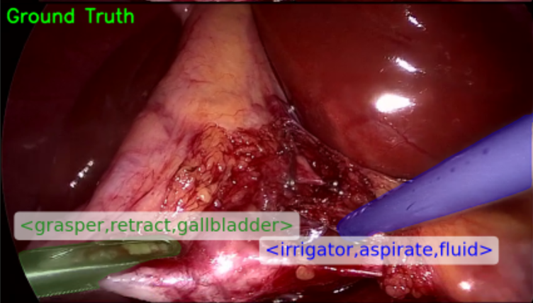
EXAMPLES : TargetFusionNet improvement
    TargetFusionNet improves association in complex scenes, while remaining errors motivate future work.

Slide 11
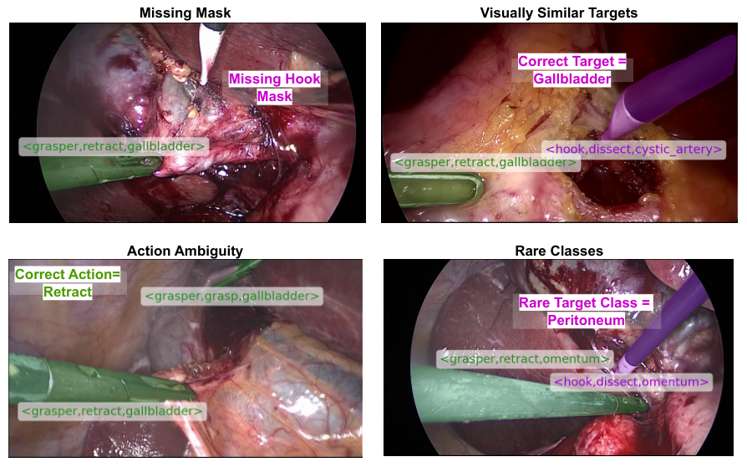
LIMITATIONS : What still fails

Slide 12
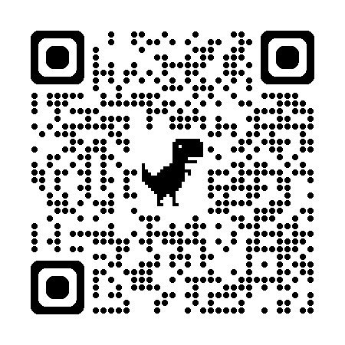
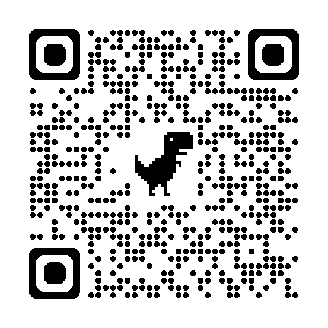
CONCLUSION : take-home message
Triplet segmentation grounds action triplets to instrument instances.
CholecTriplet-Seg provides the first large-scale benchmark for this task.
TargetFusionNet shows that weak anatomy priors improve grounded triplet prediction.
The next frontier is temporal, anatomy-aware reasoning under long-tailed supervision.
Dataset
GitHub

