Slide 1

Grounding Surgical Action Triplets with Instrument Instance Segmentation
Oluwatosin Alabi
02/09/2025

Slide 2

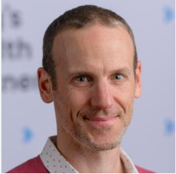

Introduction
My name is Oluwatosin (Tosin) Alabi
I am a PhD student in the EPSRC CDT in Smart Medical Imaging at King’s College London
I am super supervised by
Prof Tom Vercauteren and
Prof Miaojing Shi.
My research focuses on surgical computer vision, particularly understanding surgical actions through triplet prediction and grounding.
I worked with Hwee Kuan during a summer internship in 2021.

Slide 3
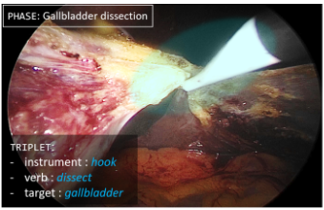
Surgical Action Triplets (Intro…)
Instrument: The surgical tool(e.g. grasper, hook)
Verb: The action performed (e.g., grasp, dissect)
Target: Tissue/structure acted upon(e.g gallbladder)
Action triplets are written as
<instrument, verb, target>
<Hook, Dissect, Gallbladder>
Notes:
Surgical action triplets are a compact but expressive representation of surgical activity specifically Tool-Tissue Interaction
Cholecystectomy is a very popular MIS and CholecT50 and triplets is a popular task.

Slide 4
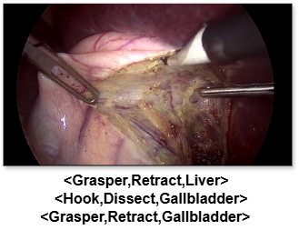
Why Surgical action triplets
It allows for a structure representation of each step the surgeon takes.
It has potential for lots of downstream applications
  Safety - Detect unsafe tool-tissue interactions
  Improved Workflow modelling - maps surgical steps over time
  Skill assessment - You can apply it to track actions performed by trainees
  Video Summarization – Summarize in terms of triplets per frame.
Notes:
Safety application - Help to detect incorrect actions or unsafe tool tissue interactions
Improved workflow modelling – Phase recognition, or time to completion.

Slide 5
Triplet Recognition: The Original Task
No Localisation -> Ambiguity
Predict all triplets per frame
No instance-level grounding
Instance level grounding adds localisation
Confusion when multiple identical tools appear
Notes:
Originally, it is a frame level task which involves predict all the triplets in the image.
A better representation would be
<grasper,retract,liver> + location information
This gives information for applications that want position of interaction.

Slide 6
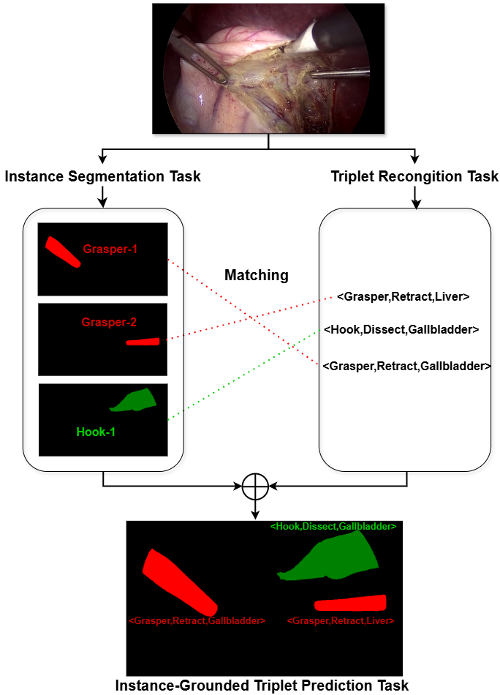
Solving the Grounding Problem.
We need instrument instance masks
Triplets must be linked to tools
CholecT50(public dataset) lacked this
So, we generated these labels and matching

Slide 7
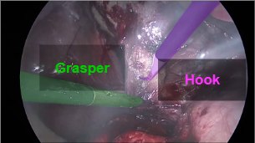
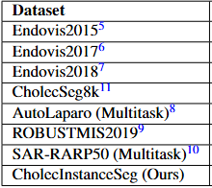
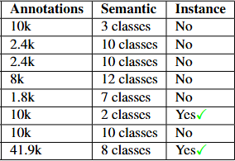
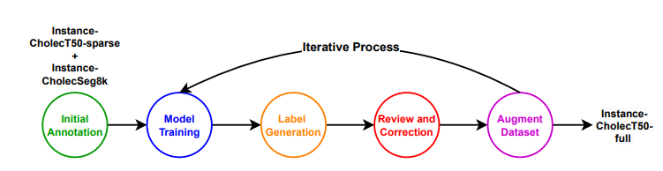
CholecInstanceSeg: A Tool Instance Segmentation
Dataset for Laparoscopic Surgery (Scientific Data)
First large-scale instrument instance segmentation dataset for laparoscopic surgery
Annotated 40k+ frames in 1 month using Semi automatic pipeline with SAM.
Publicly available here

Slide 8
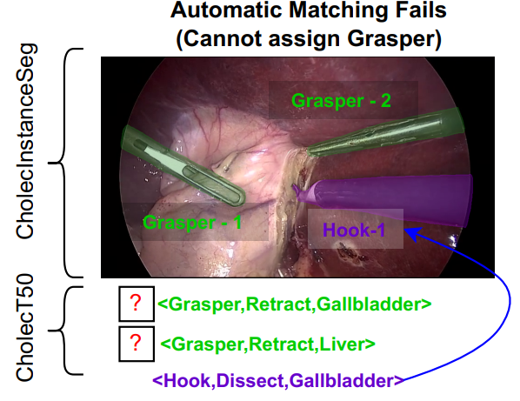
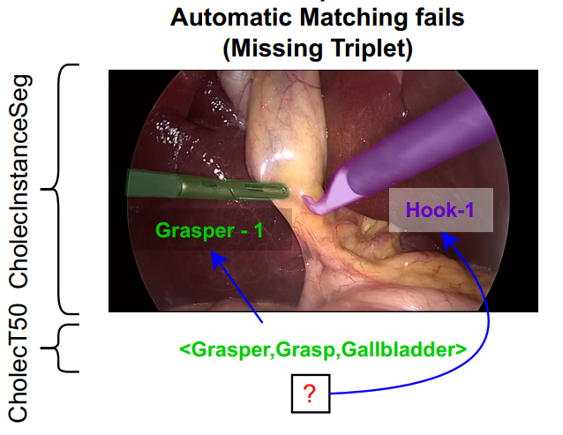
Creating Grounded dataset
Matching error
Auto match triplet with masks
Initial alignment fails in two cases
  Matching error – Frames with multiple identical instruments
  Conflict errors – Where instance segmentation and triplet label disagree.
Manual correction for the two error types
Dataset now has instance-linked triplets
Conflict error
Notes:
We needed to match each triplet label to a mask
Initial alignment by automatically matching instrument class labels in CholecT50 and CholecInstanceSeg.

Slide 9
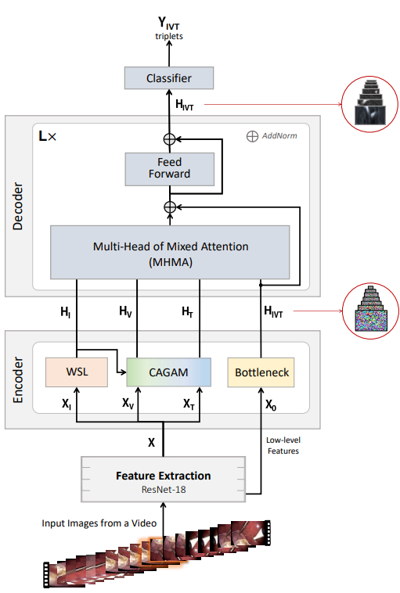
Baseline Models
RDV (MICCAI 2022): Predicts triplets using attention mechanisms and a weak s but no localisation
RDV-Det (MICCAI 2023 challenge): First localisation attempt (weak CAMs from the WSL to perform localization
Both limited by dataset without instance masks
Nwoye et al, Rendezvous: Attention mechanisms for the recognition of surgical action triplets in endoscopic videos. Medical Image Analysis
Notes:
The baseline for surgical action triplet prediction is called the Rendezvous(RDV). It is an attention-based method for predicting all three tasks <instrument, verb, target>. This was made in 2022.
There was an attempt in the MICCAI 2023 challenge to utilize external datasets to localize, but this did not work
The RDV-Det was proposed in this challenge and utilized class activation maps on the predicted instrument classes to perform grounding.

Slide 10
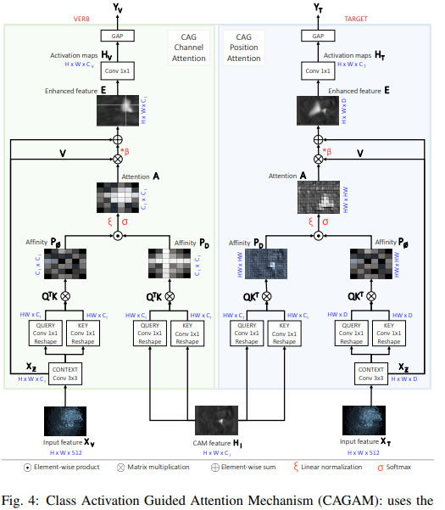
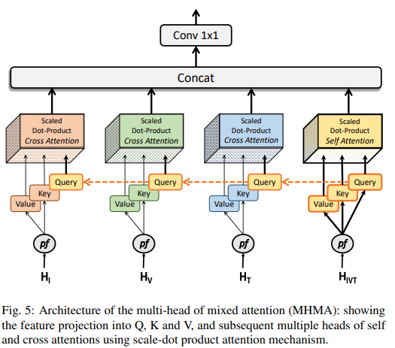
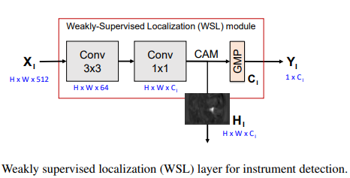
Optional(CAGAM, WSL, Attention)- skip likely
Notes:
Mainly a way to inculcate the instrument information to what they called verb and target features. They attended the features frm the CAM with the verb features and the target features. To generate Yv and YOT. Note it is the activation maps that are taken. There are some submtilities, note QTK and QKt. Their idea of comparing saliency maps. This was the way to do visual attention before the advent of ViT.

Slide 11
New baselines with Grounded Data
Model | Main idea | Matching | Results vs RDV-Det
RDV+ Mask2former | RDV predictions + masks | Heuristic match | Better performance
Mask2Former-Triplet | Predict triplets directly per query | One stage | Even greater Performance
RDV+Mask2Former: Quick heuristic pipeline
Mask2Former-Triplet: End-to-end triplet segmentation
Both outperform RDV-Det, proving value of grounded dataset
Bowen Cheng et al, Masked-attention Mask Transformer for Universal Image Segmentation(Mask2former)
Notes:
We created two common sense baselines using our dataset.
RDV+Mask2former - We utilized the triplets predicted by the RDV and matched them with instances from a mask2former instrument and matched with the instrument class heuristic.
Mask2former-Triplet - Directly predict the triplet classes from the mask2former queries
Results from this common sense dataset already far improves on RDV-Det justifying adding localization information, however, we noticed that the metric on target prediction is very low.
RDV+ Mask2formerThis shows us the effect of adding the instrument prediction
Mask2former-Triplets eliminate the query

Slide 12
Evaluation metrics
The evaluation metric for triplet recognition is the mean average precision (mAP)
It is made up of 6 components.
  mAP_{I} , mAP_{v} , mAP_{t} – These are called individual components, they measures the mean average precision for the instrument, verb, and target class only.
  mAP_{iv}, mAP_{it}, – These are component pair maP that measure how well we are predicting pairs.
  mAP_{ivt} This is the triplet mAP metric. The main metric.
These six metrics exists for
  The triplet recognition – mAP_{X}^{rec} which measures how well labels are predicted
  The triplet detection – mAP_{X}^{det} which measures how well you are predicting triplets and localizing with bounding box
  The triplet segmentation – mAP_{X}^{seg} which measures how well you are predicting triplets and localizing by segmentation
Notes:
We proposed the triplet segmentation metric, because we noticed that there is lots of overlap in bounding boxes when they are near each other, and no overlap in segmentation.
Triplet mAP is the hardest metric—requires everything correct and grounded in the image

Slide 13
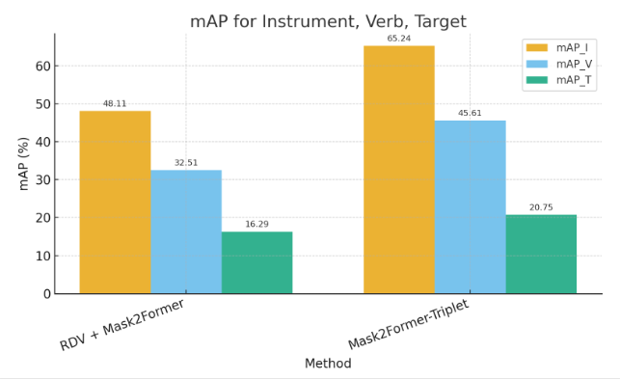
Why Target Prediction Matters
component metric indicate that target prediction is hardest
6 instruments, 10 verbs, 15 targets → hardest task
No annotated targets → weaker predictions
Improving targets is critical for overall performance.
Notes:
Looking at the metrics, we noticed that the instrument prediction and action prediction work very well, but the target prediction does not work as well.
This makes sense in that there are 6 instruments, 10 actions and 15 possible targets (instrument easier than action easier than targets).
However we needed a way to improve target prediction. As if the targets are not predicted well, all triplet scores would go down.
All triplets must be predicted correctly for mAP_{ivt} to have a high value.
While we have instrument localization information we do not have any for the targets.
Annotating targets is also really difficult.

Slide 14
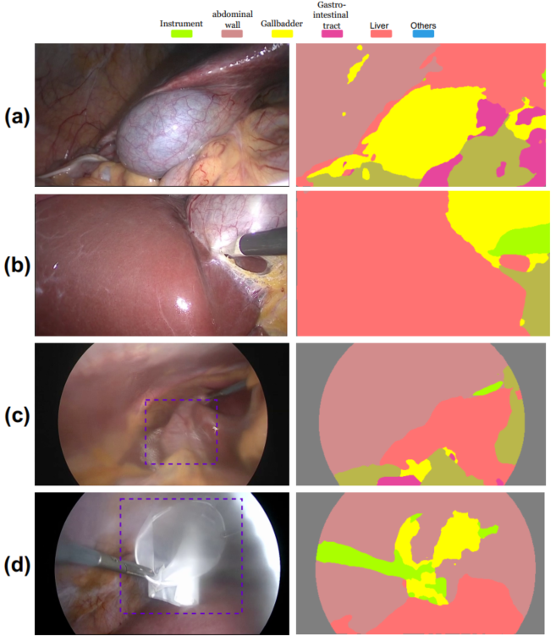
Target Fusion network.
There is another dataset which is annotated for 7 targets (Not our 15 targets)
It was used to train EndoViT which gives good results
Leverage weak target masks (pseudo-ground truth)
Fuse anatomy cues with gated cross-attention.
End-to-end training with triplet segmentation
Weak Anatomy masks from EndoViT. (a), (b) are good, but c and d are poor.

Slide 15
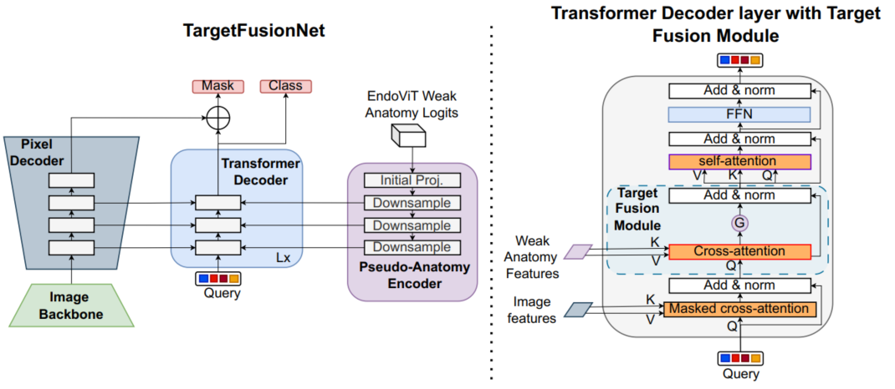
TargetFusionNet Architecture
We extend Mask2former – Pseudo-Anatomy encoder and target Fusion Module with gating.
Use soft anatomy priors to add information about target localization
Notes:
Overview of the TargetFusionNet. It augments the Mask2former with two things. A Pseudo-Anatomy encoder that processes weak anatomy logits from EndoViT into multi-scale feature maps. And a target fusion module that fuses the weak anatomy logits with a gated cross attention module (cross attention with a gate to determine how much of the information from the weak anatomy to use.

Slide 16
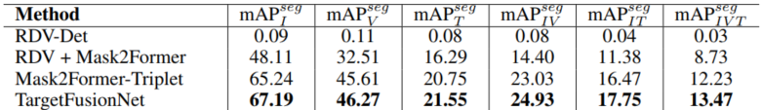
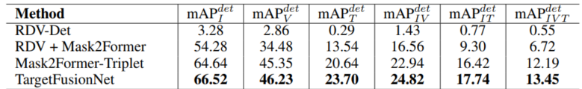
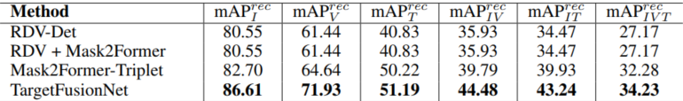
Results Segmentation, Detection and Recognition metrics
Segmentation Results
Detection Results
Recognition Results
Grounded dataset improves all metrics
Mask2Former-Triplet >>>> heuristic baseline (which does not work)
TargetFusionNet further improves target + triplet mAP
Added bonus that grounding also improves the recognition task.
Notes:
While RDV-Det is very poor at localizing (Segmentation and Detection Results). Using a grounded dataset, we are able to improve the results a lot.
Using a one stage mask2former to predict is better than using RDV+Mask2former, and adding weak target information asl helps the predictions. However, the results are still low and there is much to be done.

