Slide 1

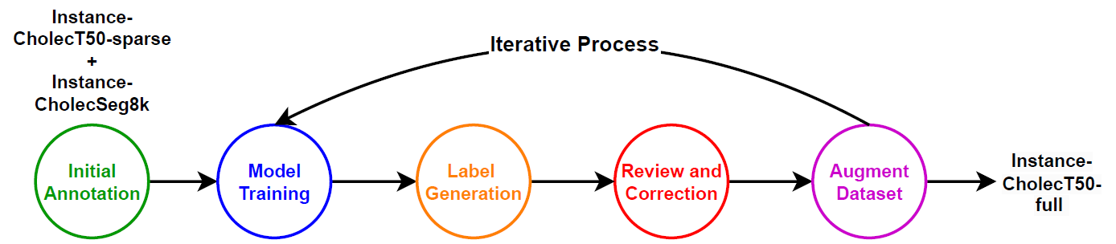
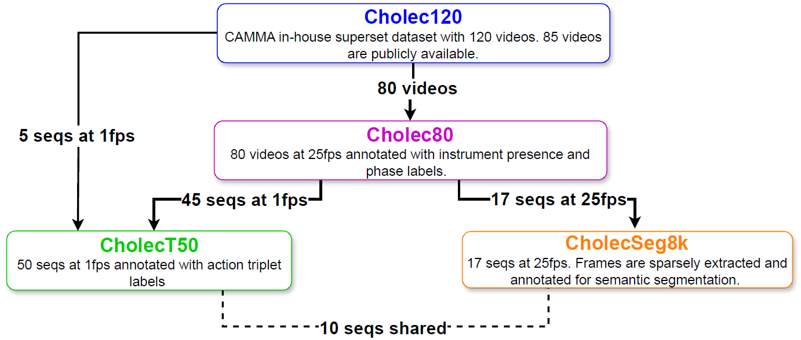
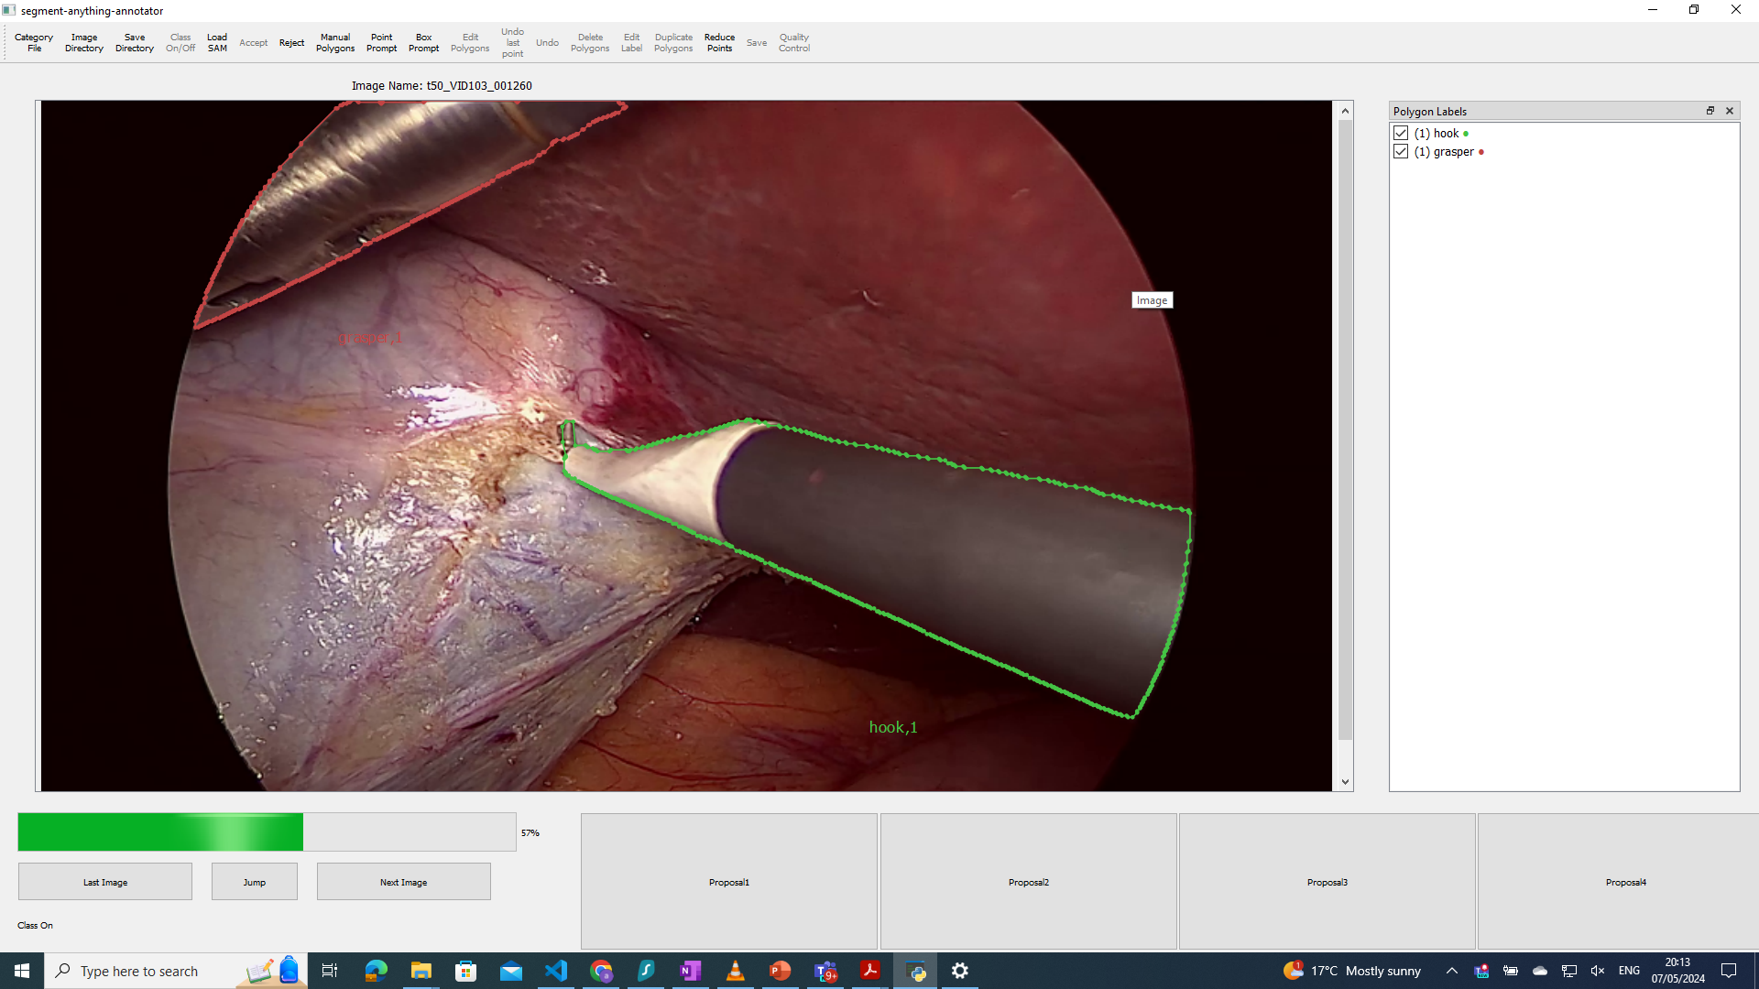
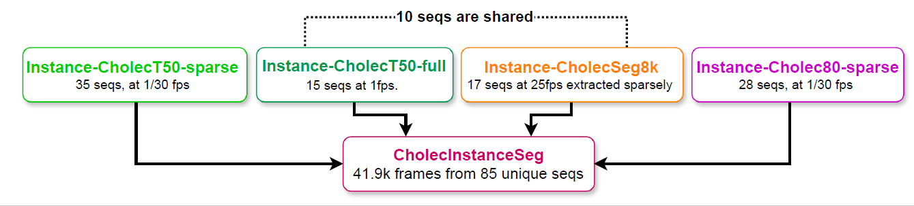
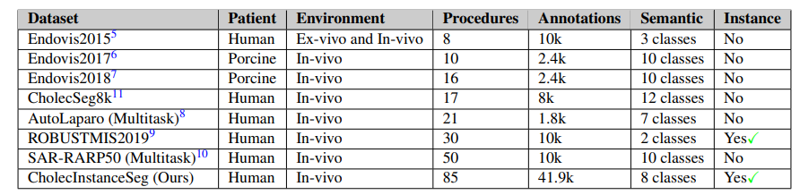
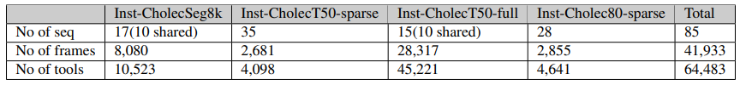
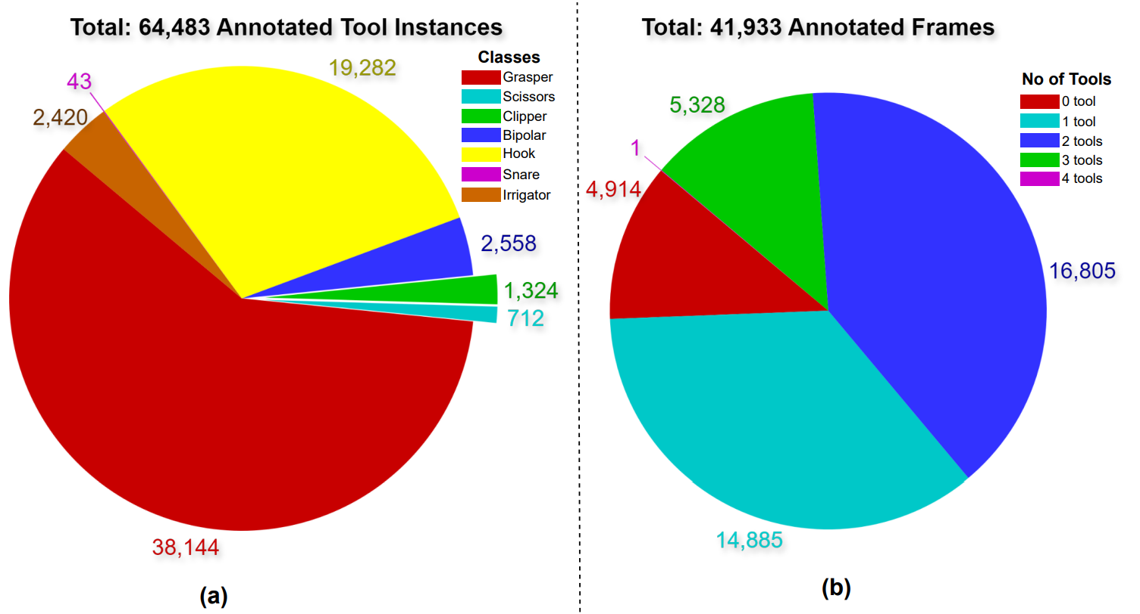
CholecInstanceSeg: A Surgical Tool Instance Segmentation Dataset.
Oluwatosin Alabi¹, Ko Ko Zayar Toe², Zijian Zhou⁴, Charlie Budd¹, Nicholas Raison¹, Miaojing Shi³ and Tom Vercauteren¹
1 Kings College London, Surgical & Interventional Engineering, London, SE1 7EU , United Kingdom
2 Kings College Hospital Denmark Hill, department, London, SE5 9RS, United Kingdom
3 Tongji University, College of Electronic and Information Engineering, Shanghai, 200092, China
4 Department of Informatics, King’s College London
INTRODUCTION
ANNOTATION PIPELINE
We created a large-scale surgical tool instance segmentation dataset to solve the scarcity of publicly available annotated datasets for surgical tool instance segmentation in real world scenarios. Link YouTube
DATA SOURCE: THE CHOLEC SERIES
Initial Annotation.
  Utilizing an annotation Software for interactive segmentation with Segment Anything Model as the backbone.
  Heuristics to also generate Instance-CholecSeg8k dataset.
The CholecInstanceSeg dataset is curated from frames extracted from laparoscopic cholecystectomy videos sourced from three publicly available datasets – Cholec80, CholecT50 and CholecSeg8k dataset
Figure 1: Source Dataset Relationships
CHOLECINSTANCESEG
The CholecInstanceSeg dataset contains 41,933 frames annotated with instance-ids and semantic segmentation information. It is split into four partitions.
Figure 4: LabelMe Annotator with the Segment Anything Model
Model Training.
  Real-Time Models for Object Detection and Instance Segmentation Large (RTMDet-Ins-l).
  MMDetection software package.
Annotation Proposal Generation.
  Leveraging the trained model,
  We generated annotations for a larger portion of the
  unannotated data
Figure 2: CholecInstanceSeg Partitions
DATASET STATISTICS
Annotation Review and Correction.
  Human annotators corrected the proposal generated
Data Augmented and Retraining.
  Human annotators corrected the proposal generated
Quality Control
Checking images with more than 3 tool instances.
  we observed that the most crowded scenes typically included a maximum of three separate tool
Utilizing tool presence labels from Cholec80.
  Tool presence labels from the Cholec80 parent dataset, although noisy and incomplete, were used for cross-referencing
Reducing noise for scenes with tool overlap.
  To reduce labelling noise for scenes that include tools occluding other tools, we checked instances that had overlaps
Figure 3: Tool Distribution

