Slide 1
SURGICAL WORKFLOW • OAUTHC
Teaching AI what is
happening during surgery
P1
Preparation
P2
Calot triangle dissection
P3
Clipping and cutting
Cholecystectomy phase annotation, domain shift and the TeCNO + HMM study
P4
Gallbladder dissection
P5
Gallbladder packaging
P6
Cleaning and coagulation
P7
Specimen extraction
OAUTHC annotation discussion • 17 October 2026

Slide 2
PART 1
Introduction
What phase recognition is, why it can be useful, and where Cholec80 fits.

Slide 3
PURPOSE
What we need to achieve today
UNDERSTAND
AGREE
Why surgical workflow labels matter
How we define difficult boundaries
PRACTISE
CONNECT
How to annotate, review and correct
How 26 OAUTHC videos support an AI experiment
3

Slide 4
THE BASIC IDEA
An operation is also a timeline
Video
P1
P2
P3
P4
P5
P6
P7
0 min
End
A phase answers:
Not simply:
“What is the dominant surgical objective at this time?”
“Which instrument can I see?”
The timeline turns a long video into clinically meaningful sections.
4

Slide 5
CLINICAL MOTIVATION
Why recognise surgical workflow?
FIND
TEACH
MEASURE
SUPPORT
Navigate directly to a phase in a long video
Retrieve comparable examples for training and review
Study phase duration, workflow and delays
Give future AI systems the current surgical context
Phase recognition is foundational context—not yet a clinical decision-maker.
Clinical applications: Hashimoto et al., Ann Surg 2022; Mascagni et al., npj Digit Med 2022.
5

Slide 6
BEYOND ONE OPERATION
A practical clinical scenario
Without phases
Open every video and search manually
A trainee wants to review how difficult Calot dissections were approached across many long operations.
With phases
Retrieve relevant sections for teaching or review
Later
Give safety and decision-support research workflow context
The same principle applies to appendectomy, colorectal surgery and other procedures once their phases are defined.
6

Slide 7
THE BENCHMARK WE ARE COMPARING WITH
What is Cholec80?
Why it matters
80
• it made surgical phase-recognition studies comparable
• many influential models were trained or evaluated on it
• its seven-phase convention gives us a useful reference
• it does not represent every hospital, patient or difficult workflow
laparoscopic cholecystectomy videos
Recorded in Strasbourg, France
and labelled with seven operative phases
Our aim is comparison and transfer—not to treat Cholec80 as the only clinically valid interpretation.
Twinanda et al., IEEE TMI 2017. Cholec80 was collected at University Hospital of Strasbourg.
7

Slide 8
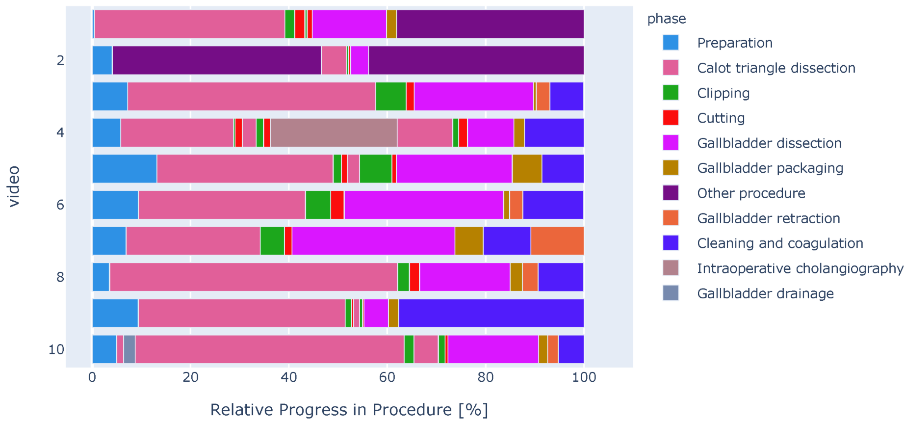
WHY LOCAL DATA MATTER
Public benchmarks are cleaner than real practice
What this figure shows
• phase lengths vary substantially
• phases may repeat or occur out of order
• additional real-world activities appear
• one linear workflow cannot represent every case
Cholec80 is an influential benchmark—not a universal clinical standard.
Figure 1: Ramesh et al., Surgical Phase Recognition: From Public Datasets to Real-World Data, Appl Sci 2022 (CC BY 4.0).
9

Slide 9
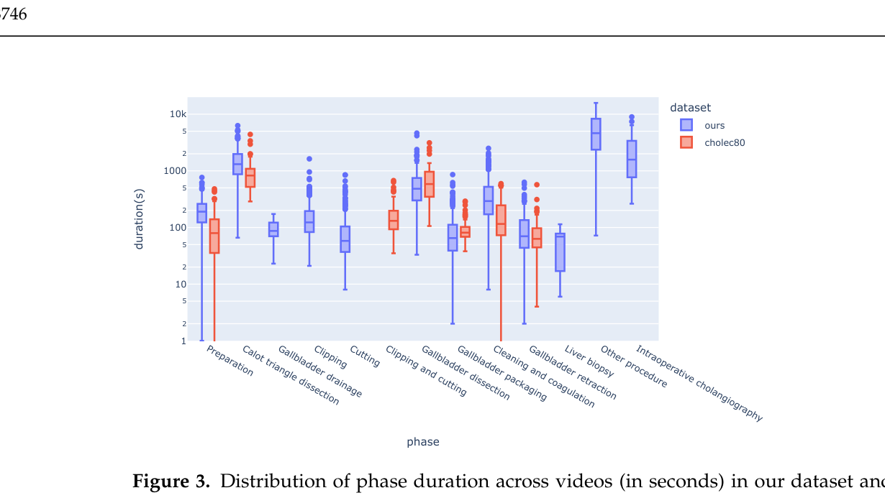
DOMAIN SHIFT
The same phases can have different durations
Real-world dataset
Median operation
54 min
Cholec80 median: 34 min
Different duration distributions change the temporal patterns a model sees.
Figure 3 and reported medians: Ramesh et al., Appl Sci 2022 (CC BY 4.0).
10

Slide 10
PUBLISHED EVIDENCE
Greater case complexity can reduce AI performance
Surgeon agreement
AI accuracy
92% → 81%
92
92
91
90
89
90
90
88
AI accuracy fell as operative complexity increased.
81
81
At the highest complexity, surgeon agreement remained about 90%.
1
2
3
4
5
Complexity level
Redrawn from Figure 3A: Golany et al., Surg Endosc 2022, DOI 10.1007/s00464-022-09405-5 (CC BY 4.0).
11

Slide 11
THE RESEARCH PROBLEM
Domain shift: the deployment data are not the training data
PATIENTS
Inflammation, adhesions, anatomy and disease severity
PRACTICE
Technique, instruments, workflow and interruptions
IMAGING
Camera, resolution, smoke, lighting and recording
LABELS
The same phase name may use a different boundary rule
A model can fail because the video looks different—or because “correct” is defined differently.
12

Slide 12
PART 2
Decisions for annotation
Agree what the phases mean before asking people—or AI—to reproduce them.

Slide 13
CLINICAL OBSERVATION
What the first two OAUTHC annotations revealed
Cholec80-style visual cue
OAUTHC task-based rule
Hook appearance/use is often close to the P1 → P2 transition.
Hook use for adhesiolysis and exposure remains Preparation until focused Calot dissection begins.
P2 may begin earlier
Longer P1 in difficult cases
Dr Olugbami: extensive pericholecystic adhesions require adhesiolysis before access to Calot’s area.
14

Slide 14
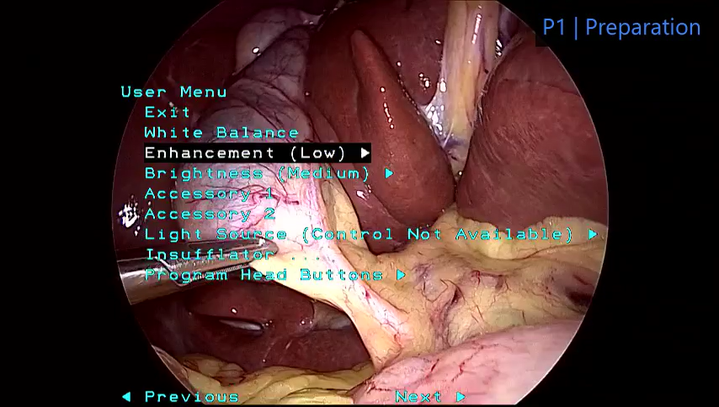
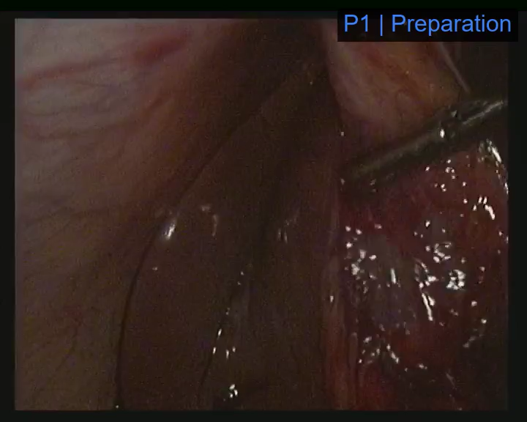
VIDEO DISCUSSION
Compare the boundary in two real examples
CHOLEC80-STYLE VISUAL CUE
OAUTHC TASK-BASED RULE
LOCAL-01-B01: Preparation → Calot triangle dissection
Watch when the hook appears and begins to be used.
Watch for the sustained change in operative objective.
V04-B01: Preparation → Calot triangle dissection
15

Slide 15
DECISION FOR ANNOTATION
Draft rule: Preparation → Calot triangle dissection
Instrument appearance alone does not determine the phase. P2 begins when focused dissection of the hepatocystic triangle becomes the sustained operative objective.
REMAIN IN P1
BEGIN P2
• adhesiolysis
• general exposure
• clearing fat/inflammatory tissue
• hook use outside focused Calot dissection
• sustained work in the hepatocystic triangle
• purposeful exposure of cystic structures
• clear change from general exposure to Calot-specific work
Two videos suggest the pattern. The wider 26-video collection will show whether it recurs.
16

Slide 16
DR OLUGBAMI'S CONCERN
Long inactive periods: preserve first, analyse separately
The concern is valid
Why not delete it now?
Draft seven-phase rule
Searching for clips or resolving an issue outside the field is different from a brief pause.
• changes timestamps and durations
• hides a real deployment condition
• may inflate model performance
• removes information about workflow delay
• context clear → continue current phase
• unclassifiable/out of body → Undefined
• do not guess an invisible cause
• flag important long delay in a note
We can add an auxiliary idle analysis later without changing the seven primary phases.
Published complex-LC work has used separate idle and out-of-body states; this is a valid but different annotation task.
Idle/out-of-body precedent: Golany et al., Surg Endosc 2022, DOI 10.1007/s00464-022-09405-5.
17

Slide 17
PART 3
The annotation work
Use the improved Phase Annotator to label, review and correct each complete timeline.

Slide 18
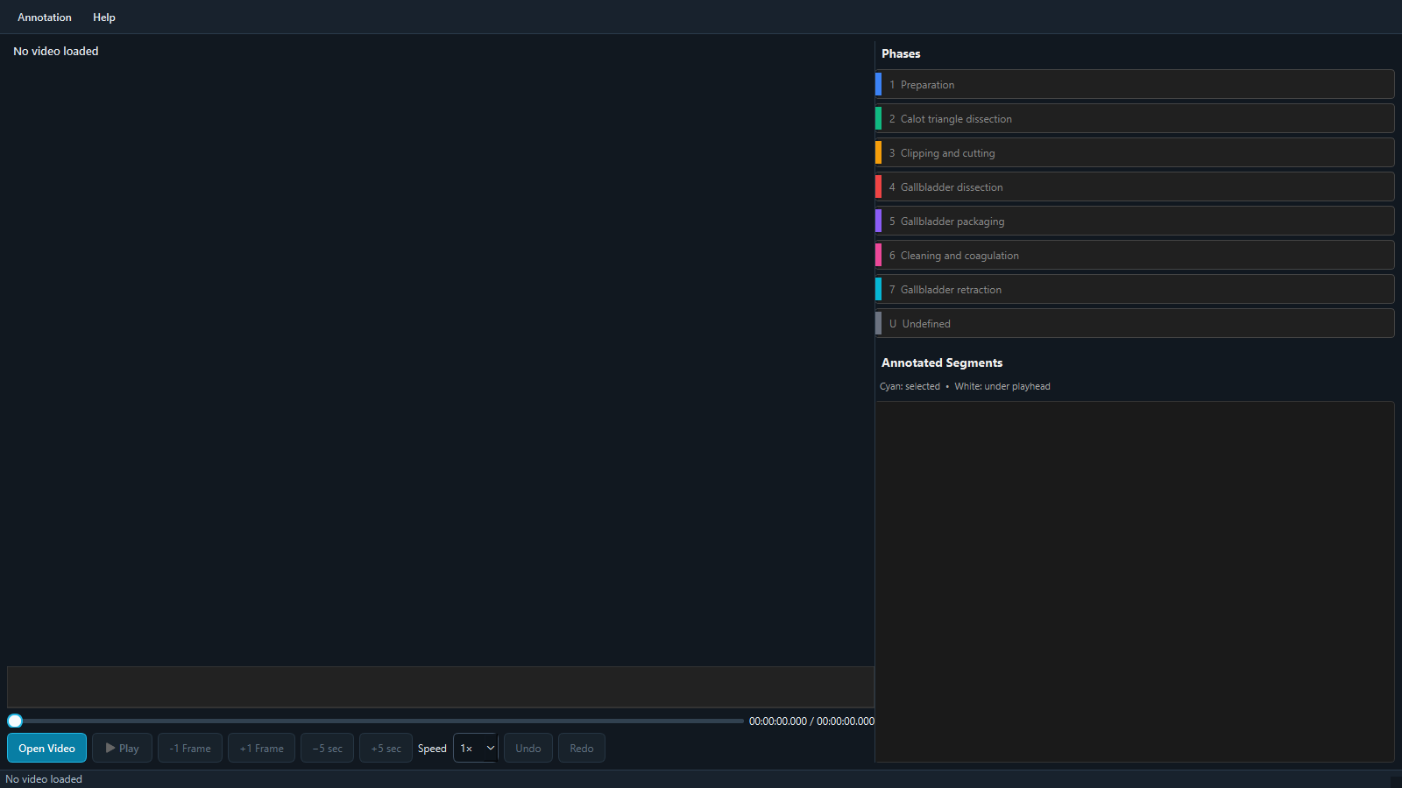
IMPROVED SINCE THE PILOT
The Phase Annotator
Video + timeline
Playback + corrections
Segments to review
Phase choices
The updated application and training materials will be resent after this meeting. The full user guide remains the reference.
19

Slide 19
LIVE DEMONSTRATION
How Phase Annotator supports the work
1
Select Cholecystectomy
2
Open the de-identified video
3
Label with hotkeys or phase buttons
4
Correct boundaries and notes
5
Review the complete timeline
6
Mark Completed and return JSON
LIVE: create one boundary → move it → add a note → undo → reopen the saved annotation
20

Slide 20
ROLES
Annotation is a team workflow
STUDENTS
DR OLUGBAMI
TOSIN
• first annotate the same five cases
• then split assigned full timelines
• follow the draft rules
• note uncertainty
• annotate and correct cases
• review the shared five cases
• teach difficult transitions
• review disagreements
• prepare de-identified videos
• support the software
• check each returned batch
• measure agreement and run the AI study
Clinical review is part of annotation—not an afterthought.
21

Slide 21
STAGED ROLLOUT
How the 26 videos will be annotated
FIRST: 5 SHARED
NEXT: 10
THEN: 10 + 6
Both annotators label the same five videos
After reviewing the shared five, divide the next ten
Send the remaining videos in two manageable batches
We measure inter-rater variability: where two informed people agree or differ.
Return this batch promptly so Tosin can check the files while annotation continues.
The two annotators split the work rather than each repeating all 26.
Goal: annotate all 26 available cholecystectomy videos. The first experiment may use 15 or 20 to keep the initial analysis simple.
22

Slide 22
PART 4
From annotation to an AI study
Test whether a model learned elsewhere understands OAUTHC operations—and whether explicit workflow knowledge helps.

Slide 23
FROM LABELS TO EVIDENCE
The first AI experiment
Cholec80
TeCNO
OAUTHC
Compare
Public training benchmark
Learns visual + temporal patterns
Clinically annotated local videos
Where and why does it fail?
The question is transfer: does a model trained elsewhere understand our operations?
24

Slide 24
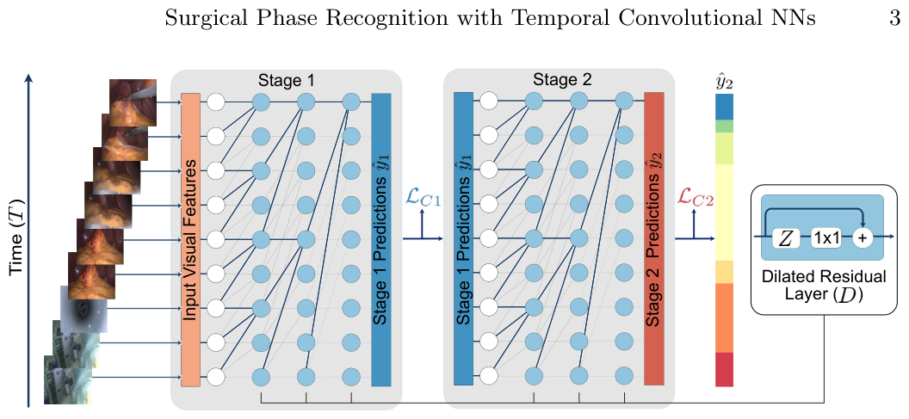
MODEL OVERVIEW
TeCNO already reasons across time
In plain language
• extract visual information from frames
• look across preceding frames
• refine phase predictions in stages
• produce a phase for each sampled time
This is why the HMM may—or may not—add value.
Figure 1: Czempiel et al., TeCNO, MICCAI 2020, arXiv:2003.10751.
25

Slide 25
EXPLICIT WORKFLOW PROBABILITIES
What does the HMM add?
Common path
P1
P2
P3
P4
P5
P6
P7
Same TeCNO probabilities
HMM chooses the most plausible sequence
Important: transitions are probabilities, not rules. Unusual OAUTHC workflows must remain possible.
26

Slide 26
TECNO VERSUS TECNO + HMM
The controlled comparison
TeCNO's most likely
phase at each time
We measure
One set of TeCNO
class probabilities
• accuracy and macro-F1
• each phase
• boundary timing
• fragmentation
• harm to unusual workflows
HMM Viterbi
decoding
The HMM is useful only if the evidence says so.
27

Slide 27
DISCUSSION
Decisions and next actions
1
Confirm the P1 → P2 task-based rule
2
Agree how to label long inactive periods
3
Agree when Undefined should be used
4
Confirm the shared-five agreement exercise
5
Confirm the 10, 10 and 6 return batches
The quality of the AI study begins with the quality and clarity of the clinical annotation.
28

Slide 28
SOURCES
Key references
1.
Czempiel T et al. TeCNO: Surgical Phase Recognition with Multi-Stage Temporal Convolutional Networks. MICCAI 2020. arXiv:2003.10751.
2.
Ramesh S et al. Surgical Phase Recognition: From Public Datasets to Real-World Data. Applied Sciences. 2022;12:8746. DOI: 10.3390/app12178746.
3.
Golany T et al. Artificial intelligence for phase recognition in complex laparoscopic cholecystectomy. Surgical Endoscopy. 2022;36:9215–9223. DOI: 10.1007/s00464-022-09405-5.
4.
Twinanda AP et al. EndoNet: A Deep Architecture for Recognition Tasks on Laparoscopic Videos. IEEE TMI. 2017;36:86–97.
5.
Hashimoto DA et al. Machine Learning for Surgical Phase Recognition. Annals of Surgery. 2022;275:846–855.
6.
Mascagni P et al. Computer vision in surgery: from potential to clinical value. npj Digital Medicine. 2022;5:163.
Borrowed figures are cited on their slides. The complexity chart was redrawn from published values for legibility.
29

