Slide 1
Conditioned Diffusers

Slide 2
Introduction
Conditional diffusers are a class of generative models that use the concept of diffusion (the process of gradually adding noise and then denoising it repeatedly) to generate high-quality images.
The fundamental idea behind conditional diffusers is to employ additional information, like a text description or a class label, to condition the diffusion process in order to produce more varied and controllable images.
This approach has been shown to be effective in a variety of image generation tasks, from generating realistic faces to creating novel artwork.

Slide 3
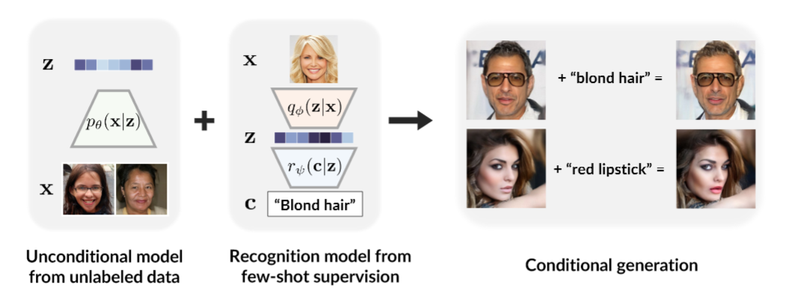
https://d2c-model.github.io/

Slide 4
Motivation!
Using conditioned diffusion models for image generation allows for more fine-grained control over the generated images. By conditioning the model on additional variables, such as a class label or a set of attributes, the model can be guided to generate images that are more specific to the desired conditions. Thus, we experiment with hugging face — Diffusers library for conditioned generation of images

Slide 5
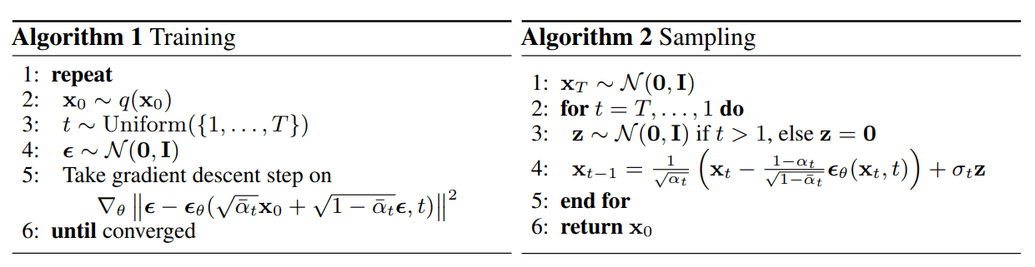

Background – Understanding Diffusion

Slide 6
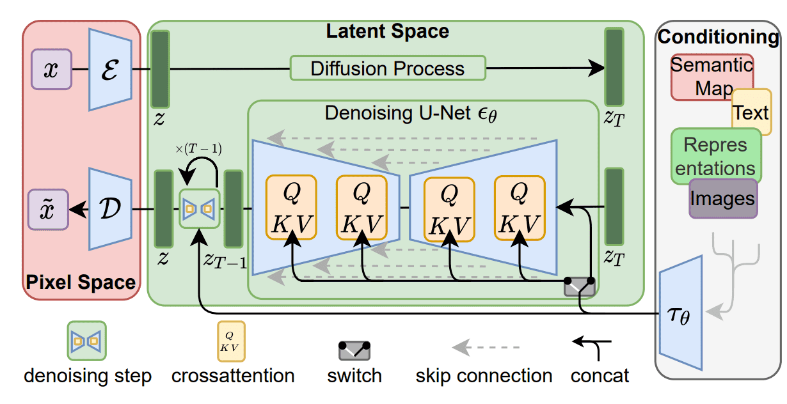
Background – Stable (Latent) Diffusion
Stable Diffusion model is a mathematical framework for image synthesis from text inputs that leverages the principles of Latent Diffusion models while operating in a lower dimensional space, making it computationally efficient
https://arxiv.org/abs/2112.10752

Slide 7
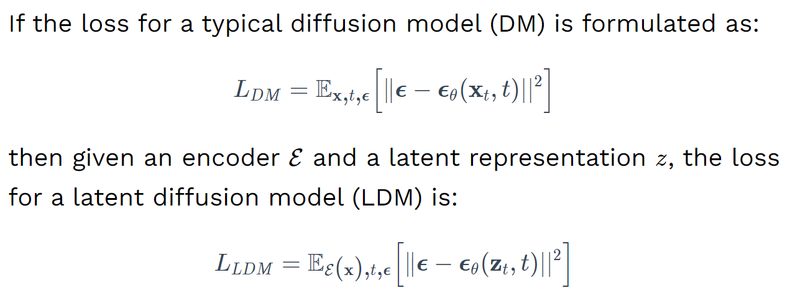
Background – Stable (Latent) Diffusion

Slide 8
Background – Stable (Latent) Diffusion
Three main components:
Text encoder
A VAE
A U-Net

Slide 9
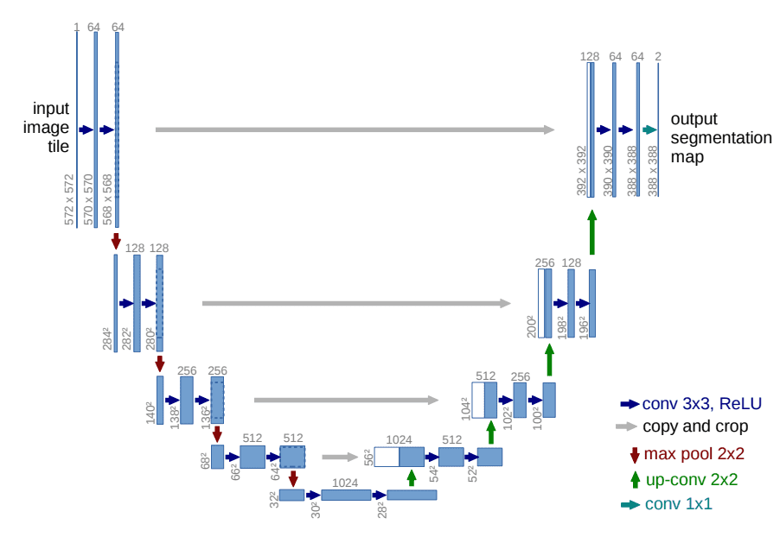
Background - U-Net Model
“A U-Net is a symmetric architecture with input and output of the same spatial size that uses skip connections between encoder and decoder blocks of corresponding feature dimension”
https://huggingface.co/blog/annotated-diffusion

Slide 10
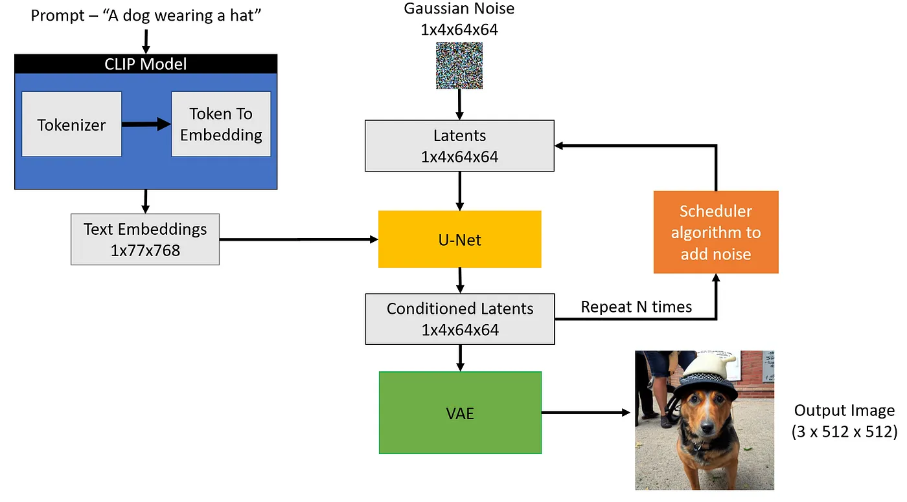
Background – The Diffusion Process
“the main (perhaps only) disadvantage of diffusion models is that they require multiple forward passes to generate an image (which is not the case for generative models like GANs)”

Slide 11
Experiments
Explore & Implement two variations –
Negative Prompt (Conditioned Diffusion)
Image-to-Image Pipeline

Slide 12
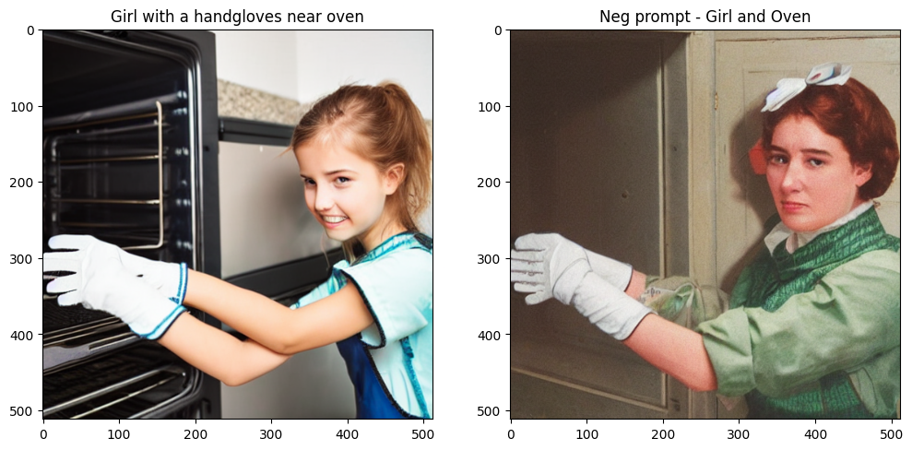
Results – Negative Prompting

Slide 13
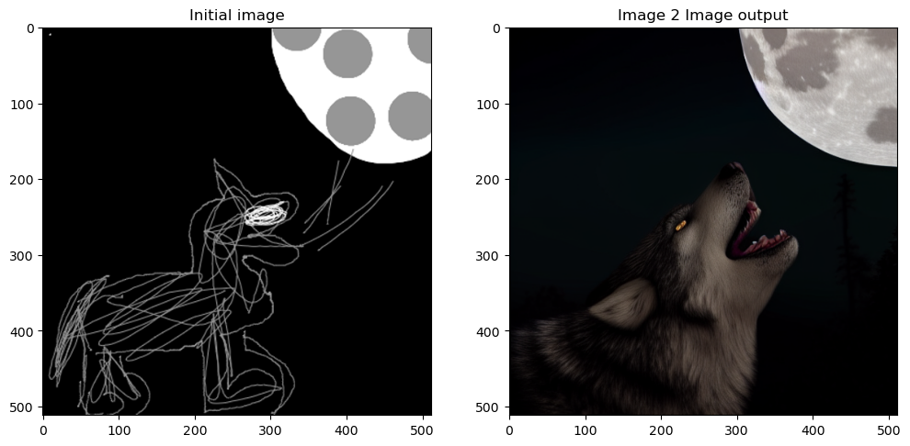
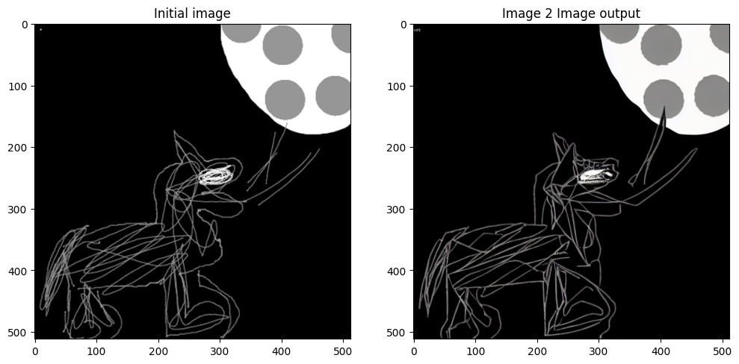
Results – Image-to-Image Pipeline
Strength = 0.8
Strength = 0.4

Slide 14
References
High-Resolution Image Synthesis with Latent Diffusion Models
https://huggingface.co/blog/stable_diffusion
https://bipinkrishnan.github.io/posts/getting-started-in-the-world-of-stable-diffusion/

