Slide 1
DS 303 Project Presentation
Stroke prediction using clinical features

Slide 2
Problem Statement
Predicting whether a person will suffer from a stroke depending on 11 clinical factors using the various classification algorithms taught, and comparing the results obtained.

Slide 3
Introduction
Heart stroke is the second leading cause of death worldwide, accounting for about 11% of all deaths, according to the World Health Organization (WHO).
Based on input parameters such as gender, age, various diseases, and smoking status, we use machine learning to predict whether a patient is likely to have a stroke.
Each row of data in the table contains pertinent details about the patient.
Algorithms used: Decision Tree, SVM, Logistic Regression, KNN and Dimension Reduction using PCA

Slide 4
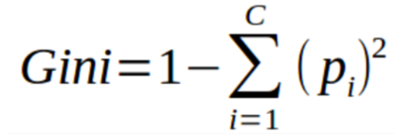
Algorithms used and Mathematics
Decision Tree:
Decision Tree algorithm belongs to the family of supervised learning algorithms.
Gini index is a cost function used to evaluate splits in the dataset. It is calculated by subtracting the sum of the squared probabilities of each class from one.

Slide 5
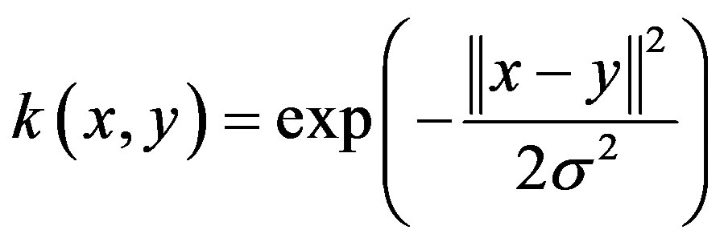
Algorithms used and Mathematics
SVM:
A support vector machine (SVM) is a supervised machine learning model that uses classification algorithms for two-group classification problems. After giving an SVM model sets of labeled training data for each category, they’re able to categorize new text.
Using C, gamma, and kernel we can twig with the svm model outcome to get the best results

Slide 6


Algorithms used and Mathematics
Logistic Regression:
In the Logistic Regression model, the probabilities describing the possible outcomes of a single trial are modeled using a logistic function.
The standard logistic function is given as:
Thus, for the logistic regression model:

Slide 7
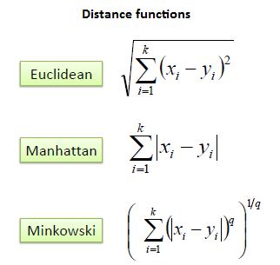
Algorithms used and Mathematics
KNN:
K nearest neighbors is a simple algorithm that stores all available cases and classifies new cases based on a similarity measure.
Using the number of nearest neighbors, weight and the type of metric we can adjust the model to get best accuracy.

Slide 8
Implementation
Step 1: Preliminary Analysis
After importing the data file we conduct preliminary analysis of variables - data type, unique, null values- followed by removal of null value data
Following this, exploratory data analysis is performed. Histograms are plotted to analyze the distribution of data over variables. Heatmap shows us the codependency of variables - which is low with a maximum of 0.33 for bmi and age, while for stroke it is maximum 0.23 with age.

Slide 9
Implementation
QQ plots show how the variables are distributed in comparison to normal distribution for the continuous variables like age, avg glucose and bmi.
Box plots comparing the target values of stroke and non-stroke vs. age and average glucose level, show how likely it is to get stroke.
Step 2: Data Preprocessing
In data preprocessing, removal of an unnecessary variable ‘id’, one-hot encoding of categorical variables, and scaling of continuous variable is done.
Following this, shuffling of data for removal of any pre-existing order and splitting of data in training, test and validation sets is done.

Slide 10
Implementation
Step 3: Applying various algorithms
Decision tree is implemented using gini criterion and max depth of 3 as the parameters, giving an accuracy of 96% upon hyperparameter tuning.
On applying random forest ensemble we get an accuracy of 95%.

Slide 11
Implementation
Logistic regression model is able to achieve 95% classification accuracy on the test set (15% split) consisting of 737 examples.
ROC and PR Curves

Slide 12
Implementation
Support Vector Machine (SVM-C) Model using C = 1.0, kernel = RBF, and gamma = scale we get an accuracy of 96% upon cross-validation.
KNN model using 13 nearest neighbors, Euclidean metric and uniform weight give us 96% accuracy upon cross-validation.

Slide 13
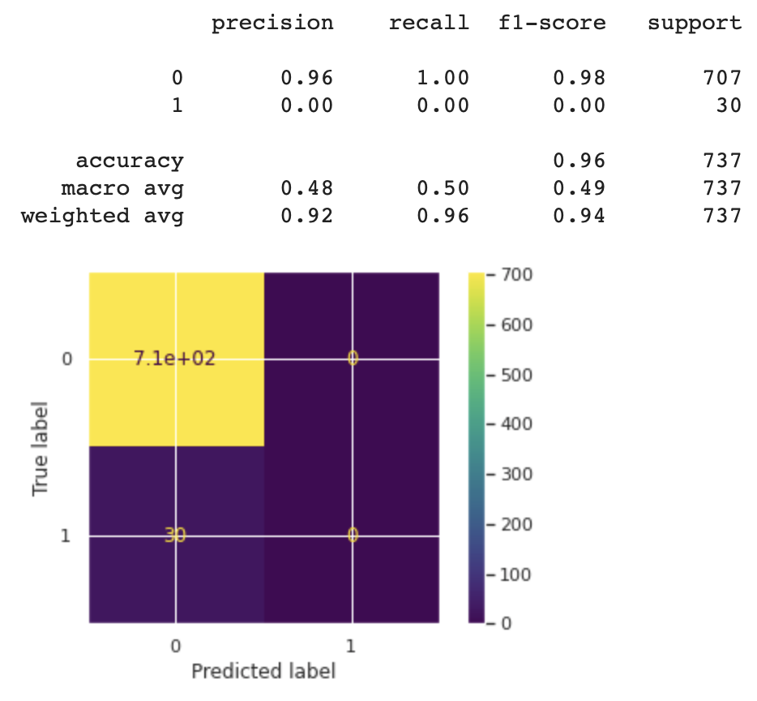
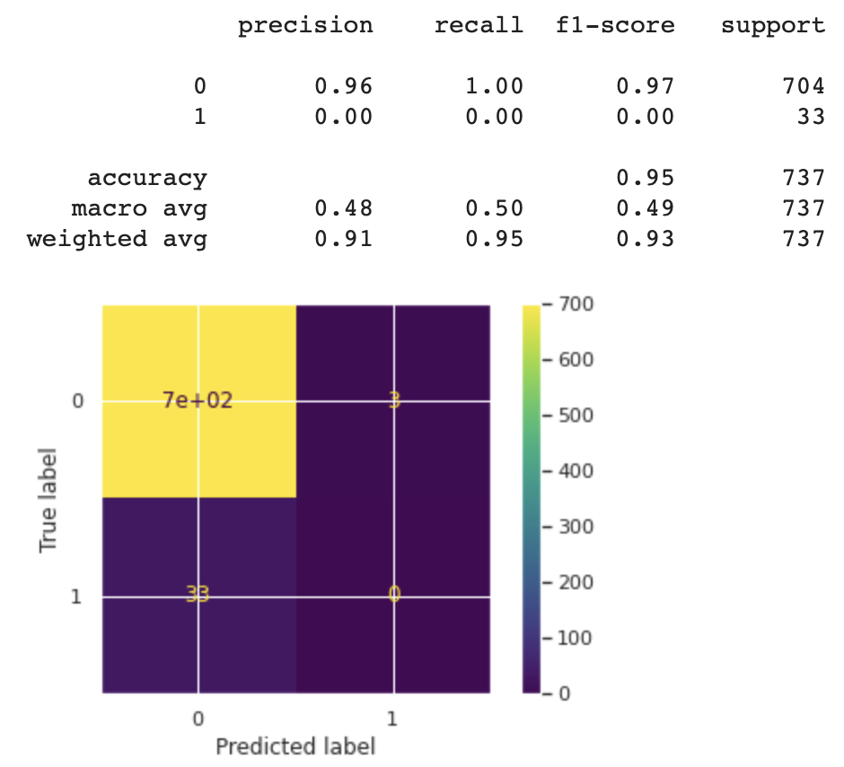
Results
Decision Tree Random Forest

Slide 14
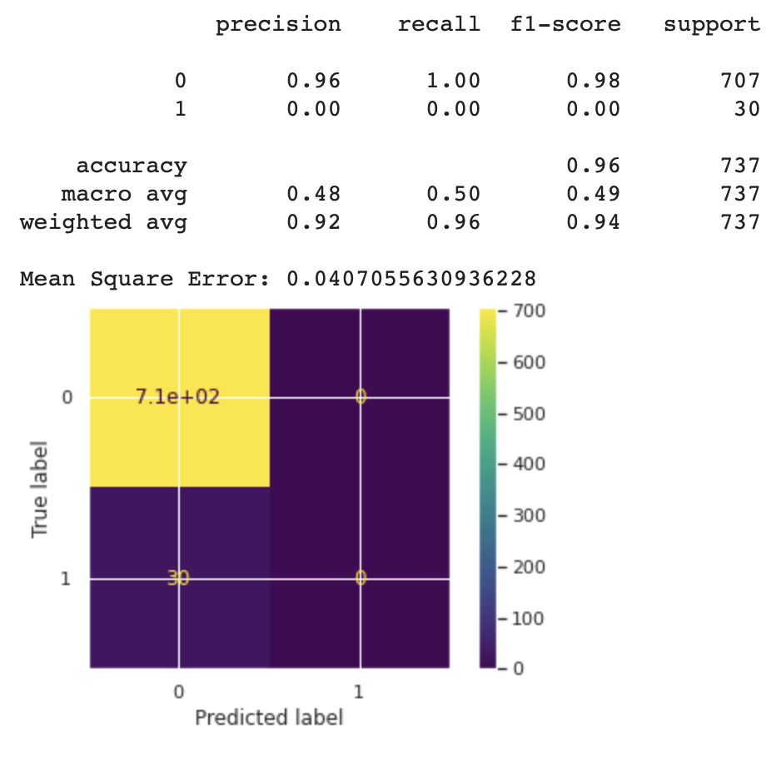
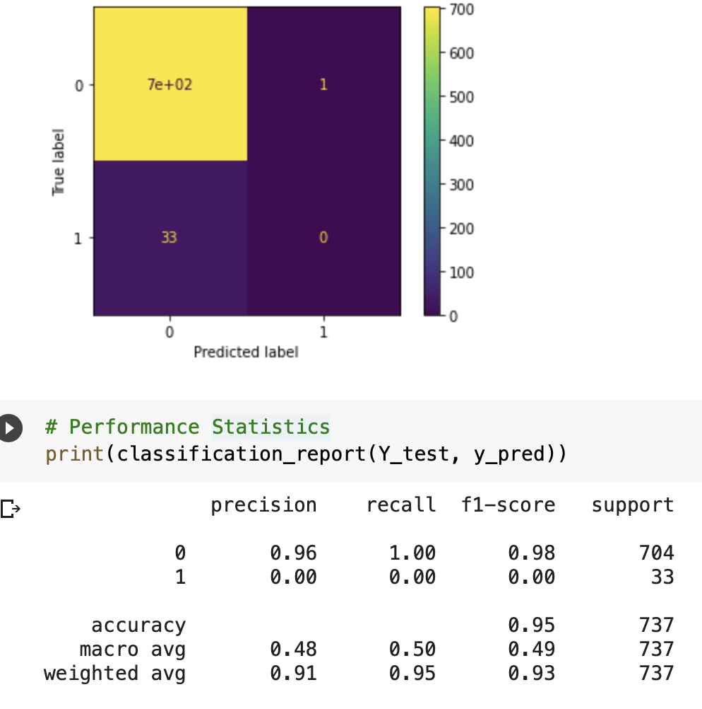
Results
SVM Logistic Regression

Slide 15
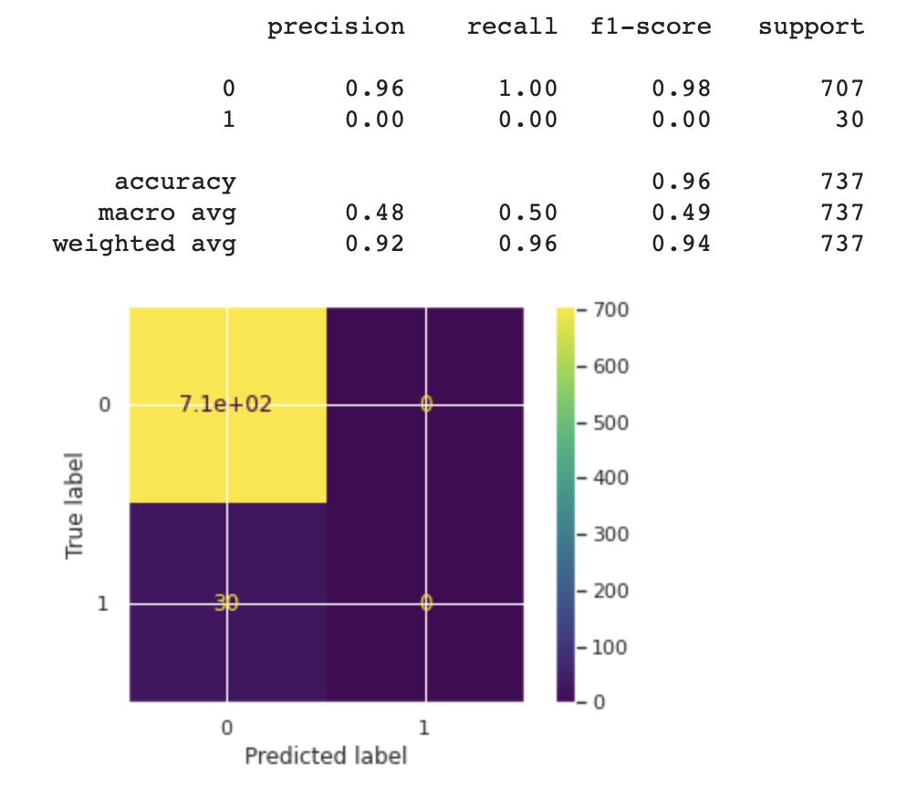
Results
KNN

Slide 16
Analysing our results
From the above four classification models, we observe that the accuracy of decision tree, svm and knn is more than that of logistic regression. This can be attributed to the factor of hyperparameter tuning that was done for all except logistic regression, and how different problems respond differently to various models.
Thus, we have shown how cross validation on a validation set using either RandomSearchCV or GridSearchCV can help us optimize the parameters for the machine learning model. Also, that according to the problem and data at hand, an appropriate model should be built.

Slide 17
Analysing our results
The accuracy of Decision Tree is more than that of Random Forest, leading to following observation: The performance of the ensemble is not better than that of a single decision tree classifier as aggregated/ensemble models are not universally better than their "single" counterparts, they are better if and only if the single models suffer of instability. In our case, decision tree performed quite accurately. In cases of less training data like ours, decision tree is preferable.

Slide 18
Analysing our results
On applying dimension reduction to our 22 component feature set into two principal components using PCA, the mean squared error using SVM is slightly increased with no drastic change. From this we can infer that though it successfully manages to create components in the directions explaining highest variance, there is not much need of applying it in our case where the data can be handled by the models quite well without it.

Slide 19
Thank You

