Slide 1
WELCOME
Have a seat

Slide 2
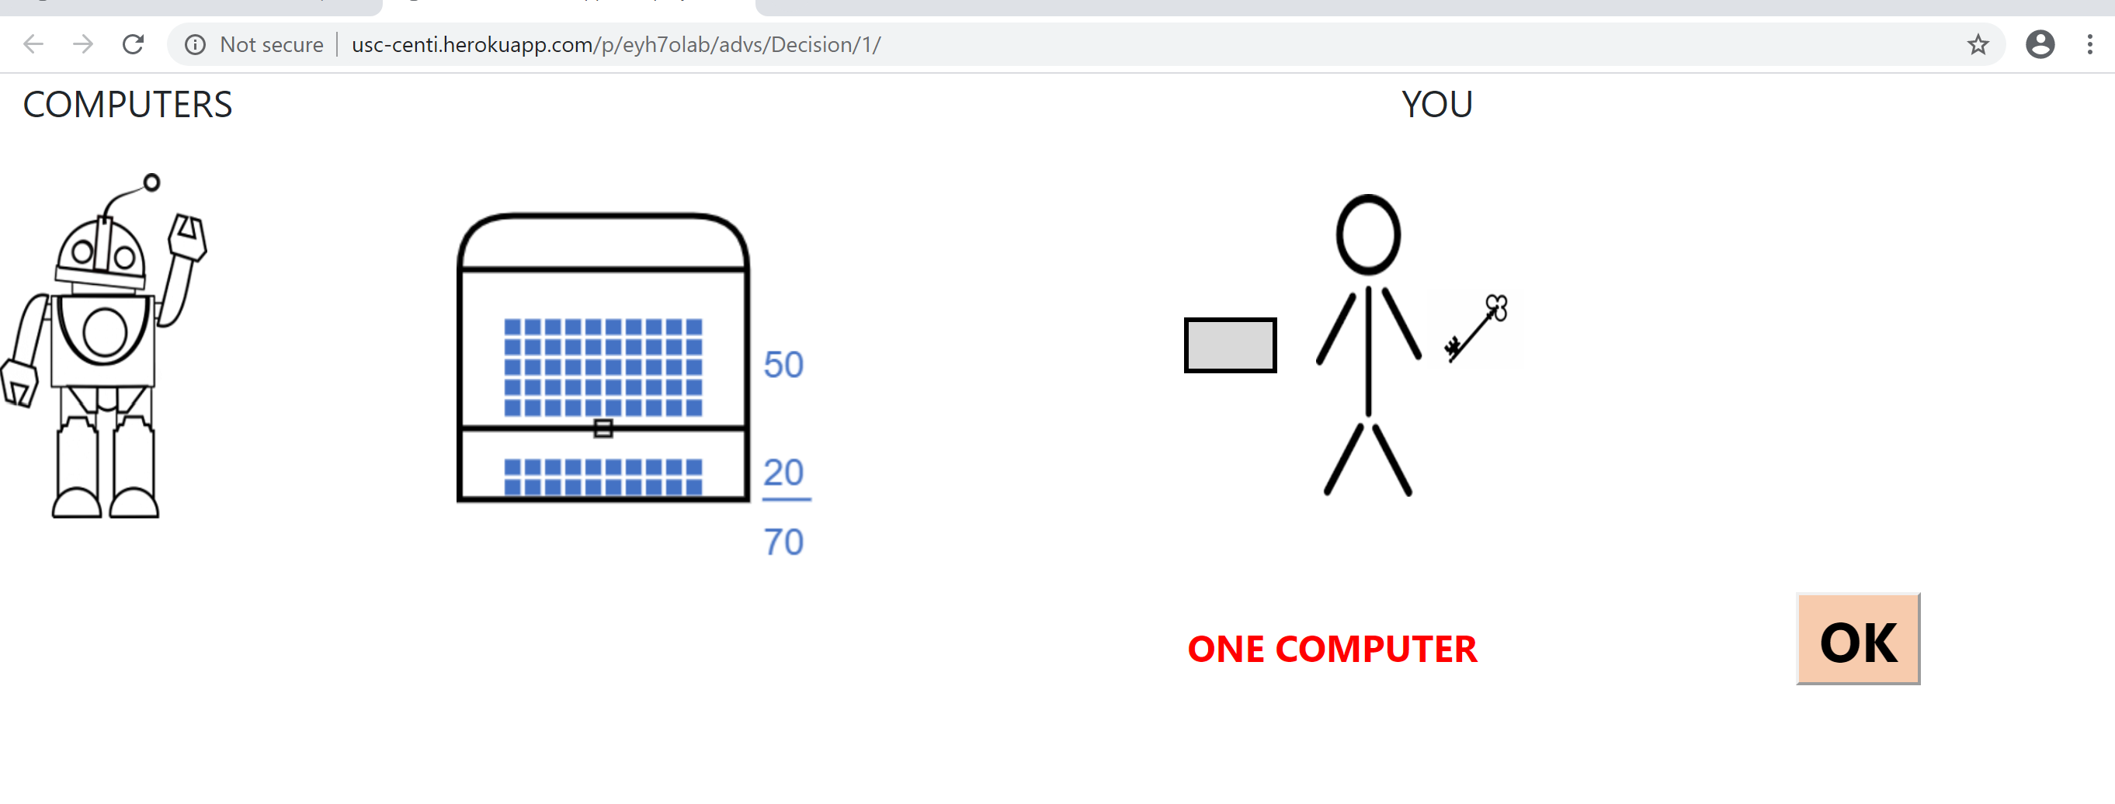
SLIDE 1

Slide 3
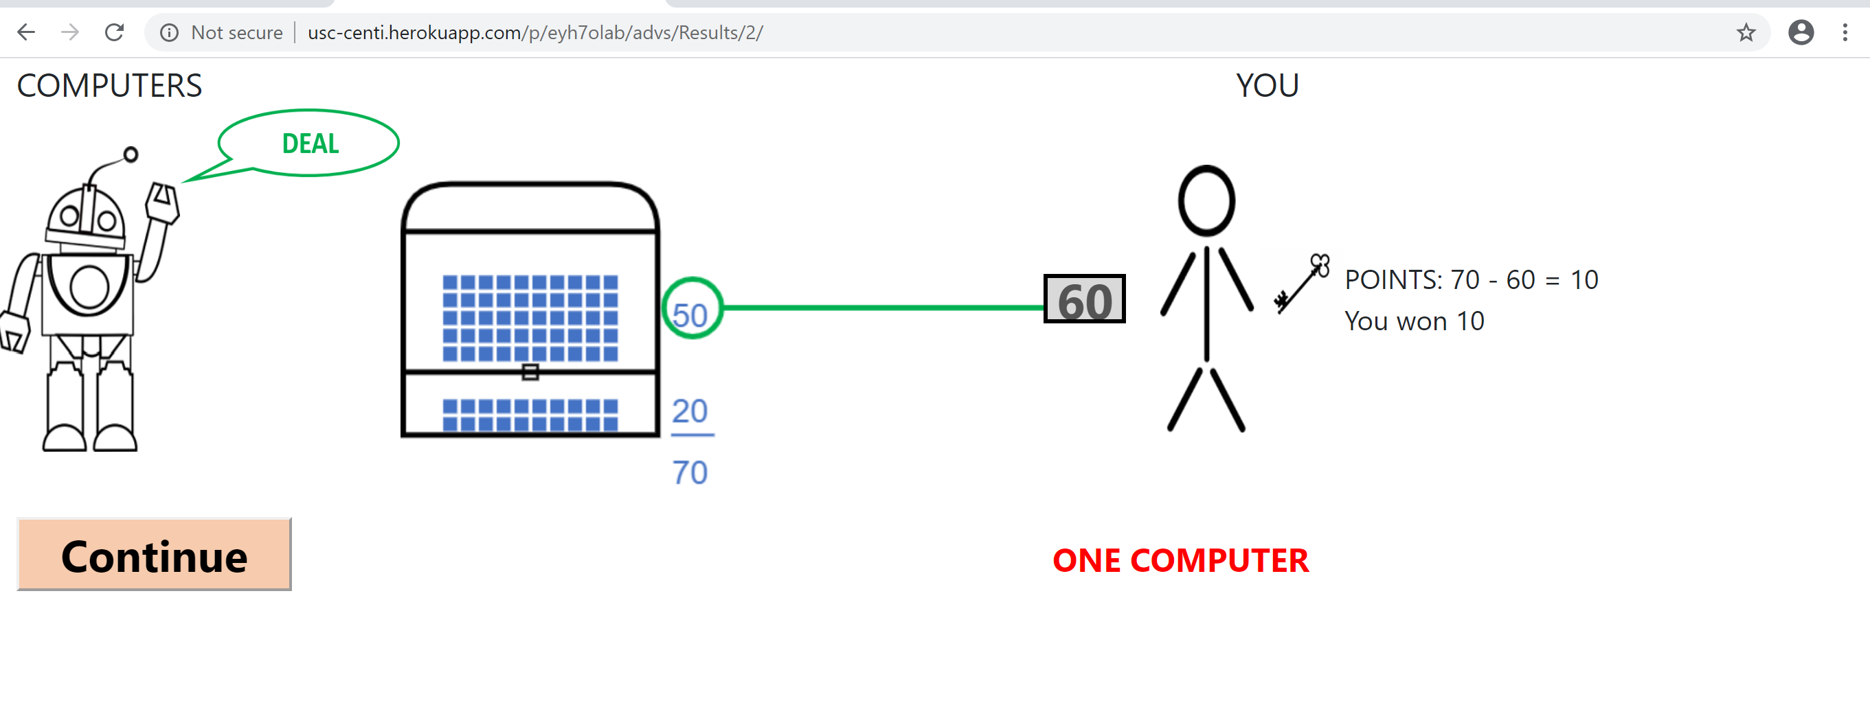
SLIDE 2

Slide 4
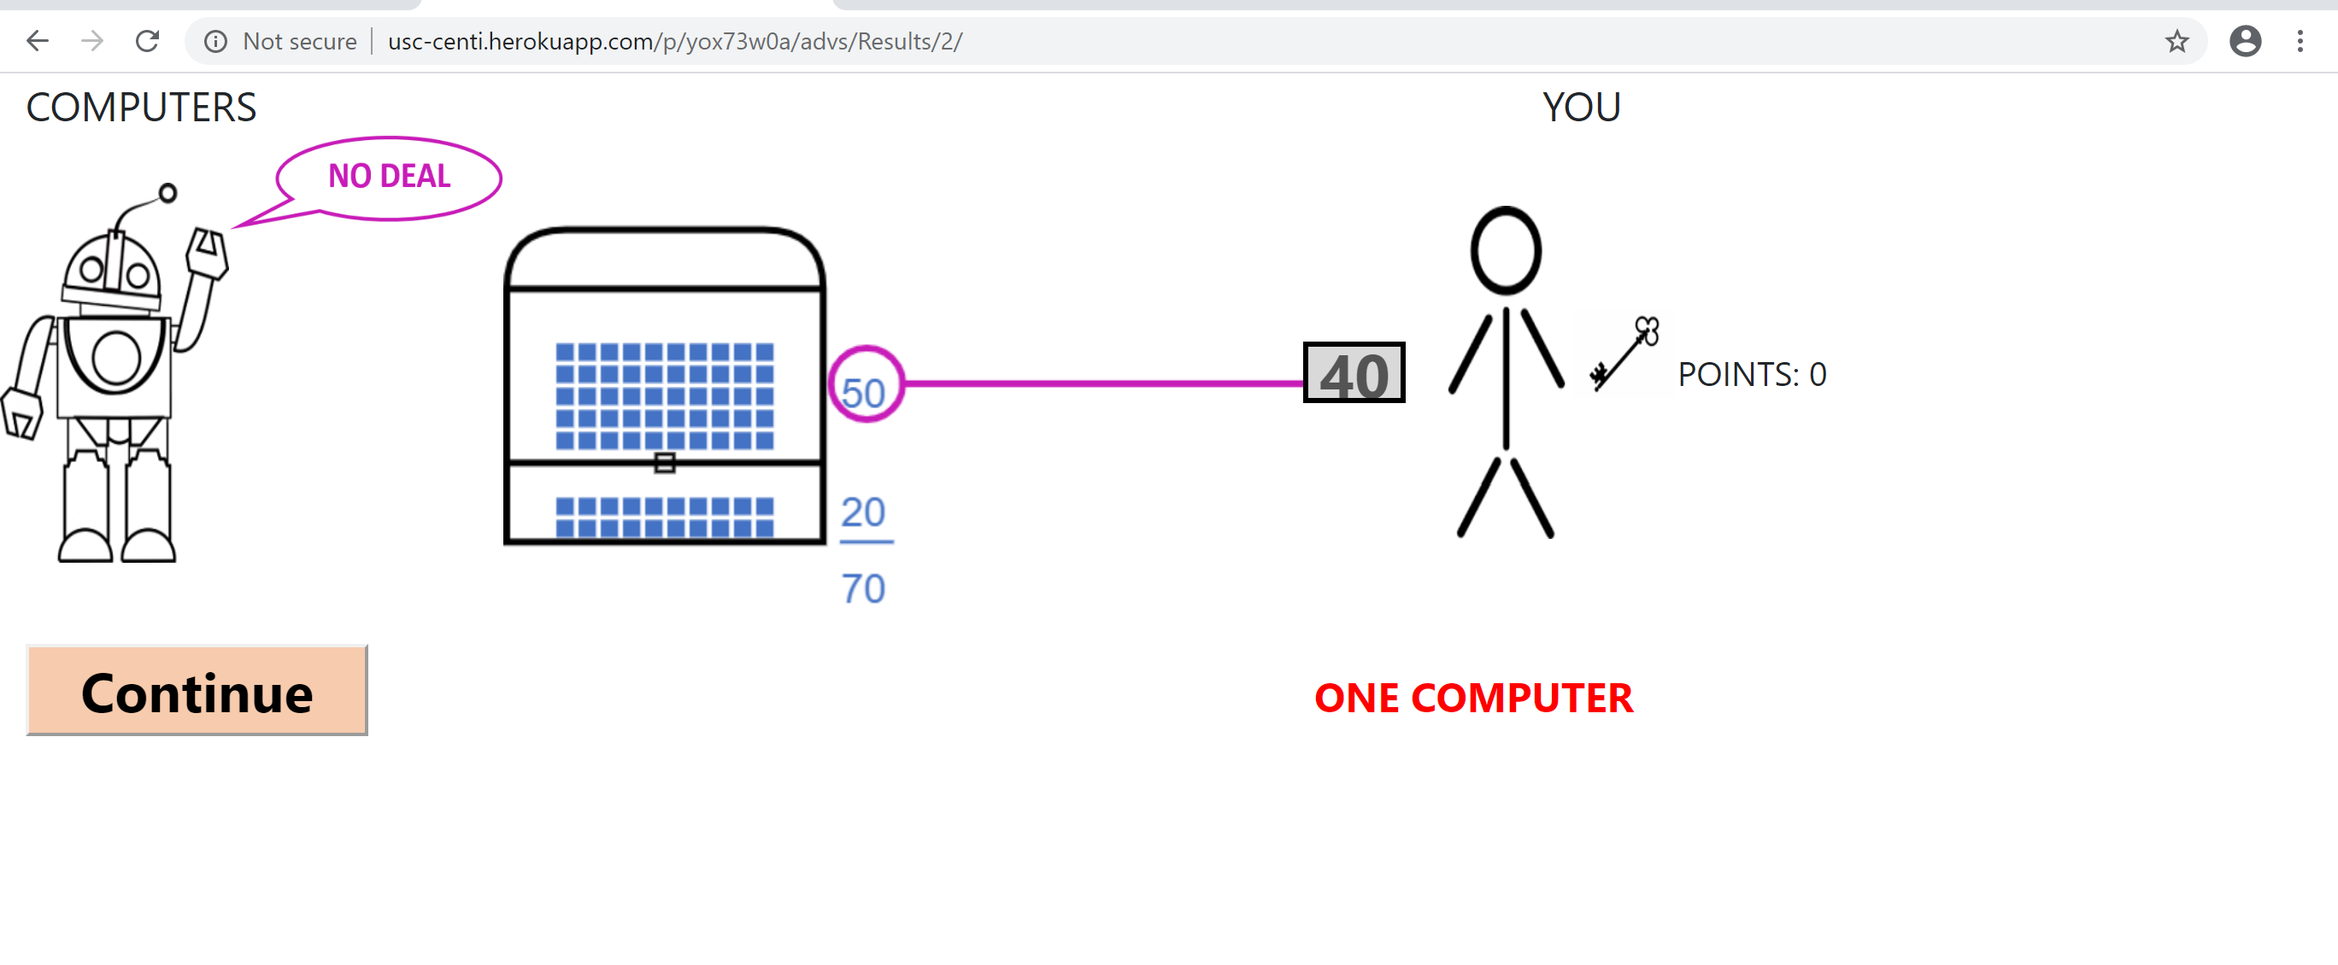
SLIDE 3

Slide 5
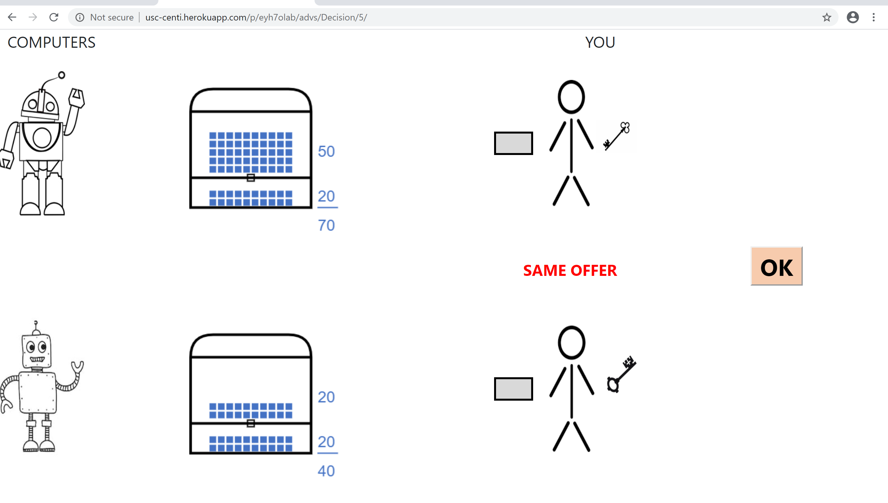
SLIDE 4

Slide 6
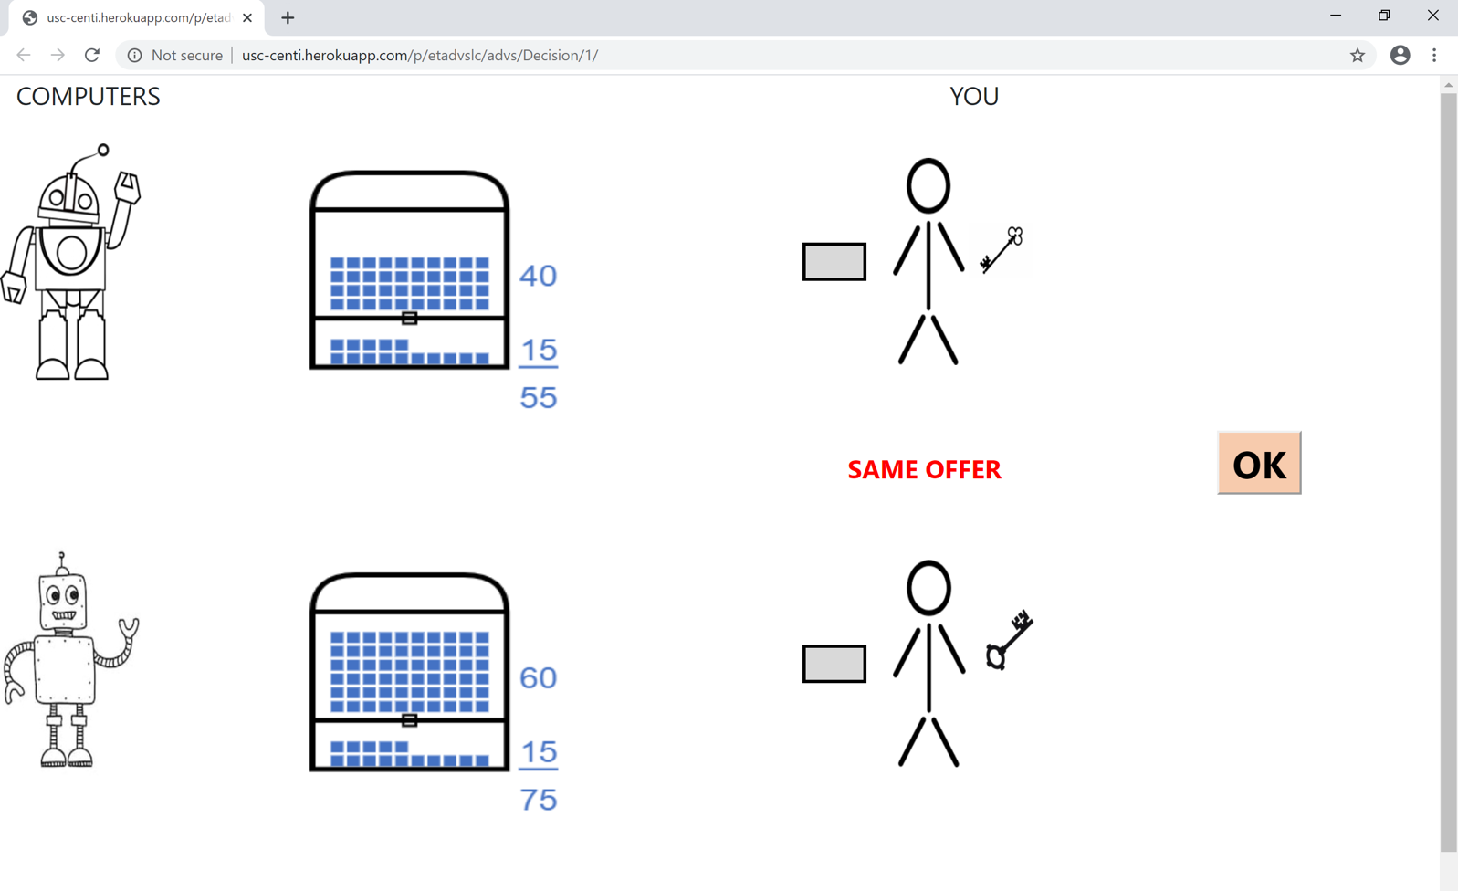
SCREENSHOT FOR QUIZ

Slide 8
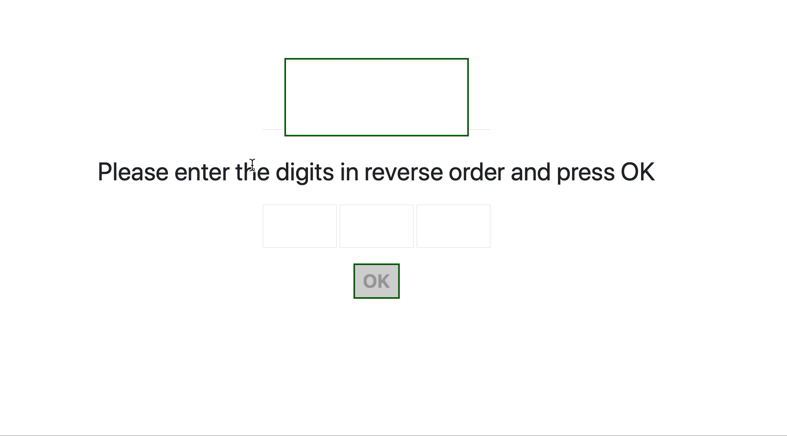

Slide 9


