Slide 1
WELCOME

Slide 2
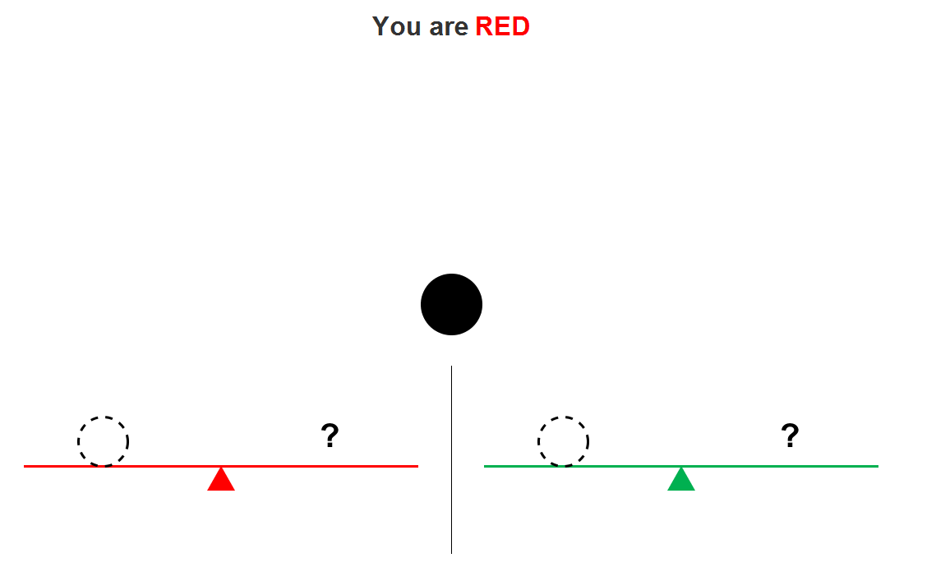

Slide 3
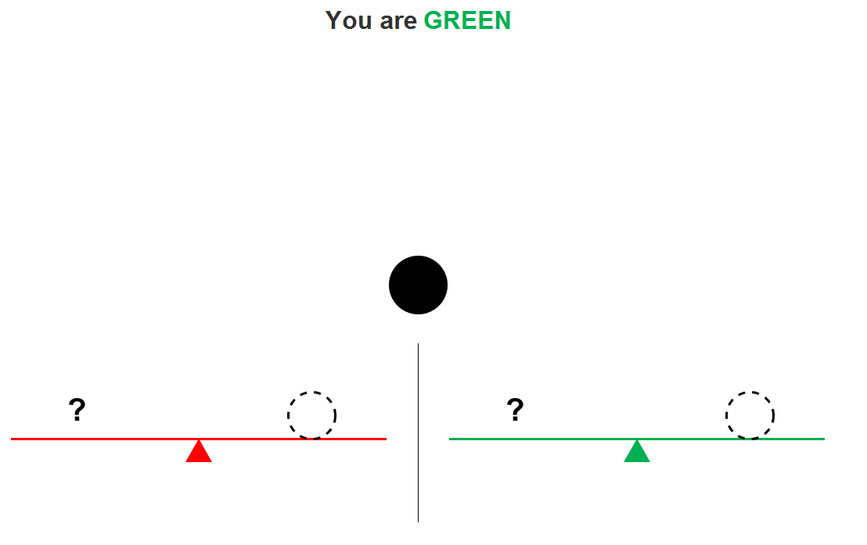

Slide 5
Points
RED
GREEN
5
3
3
5
1
1
1
1

Slide 6
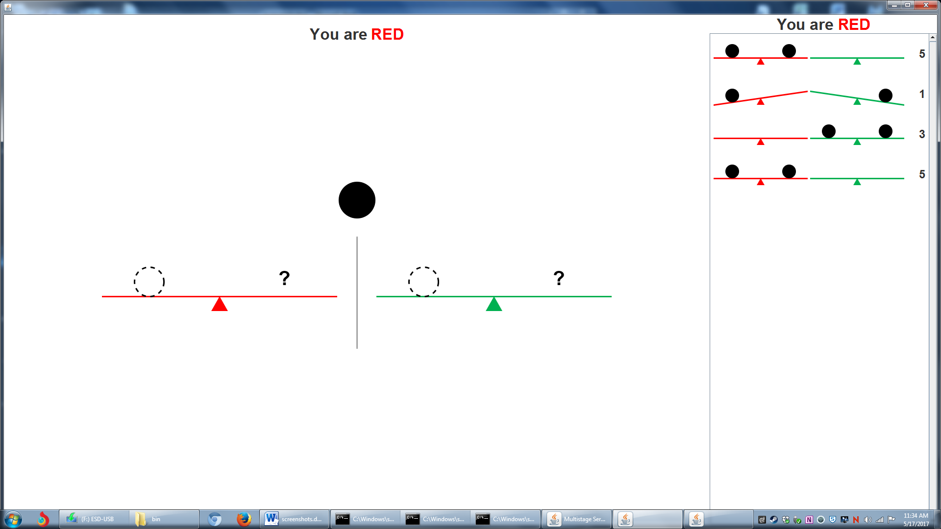

Slide 7
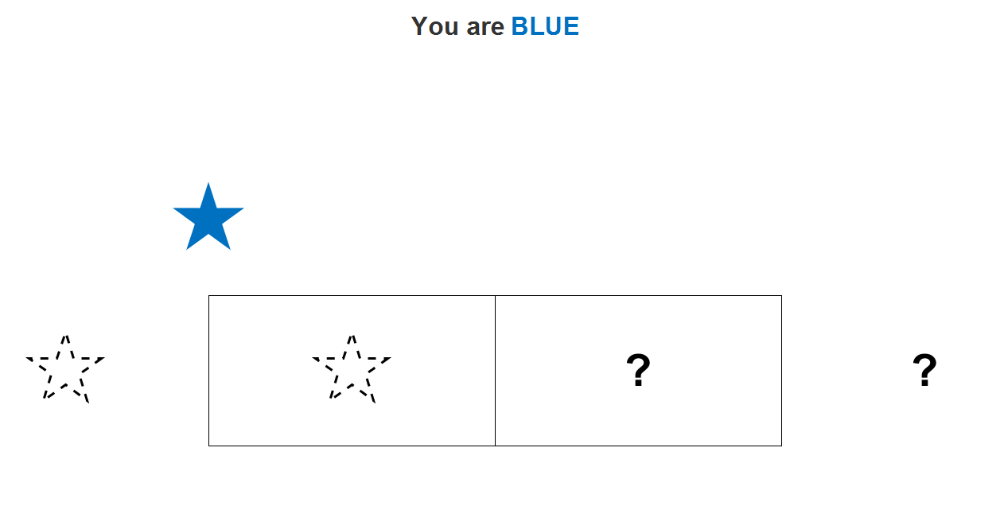

Slide 8
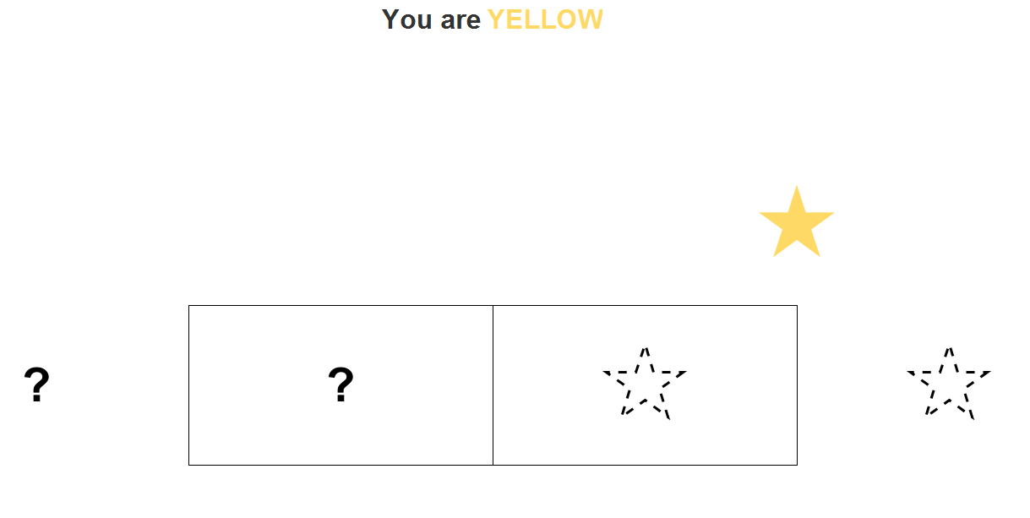

Slide 10
Points
BLUE
YELLOW
2
1
2
2
3
3
1
2

Slide 11
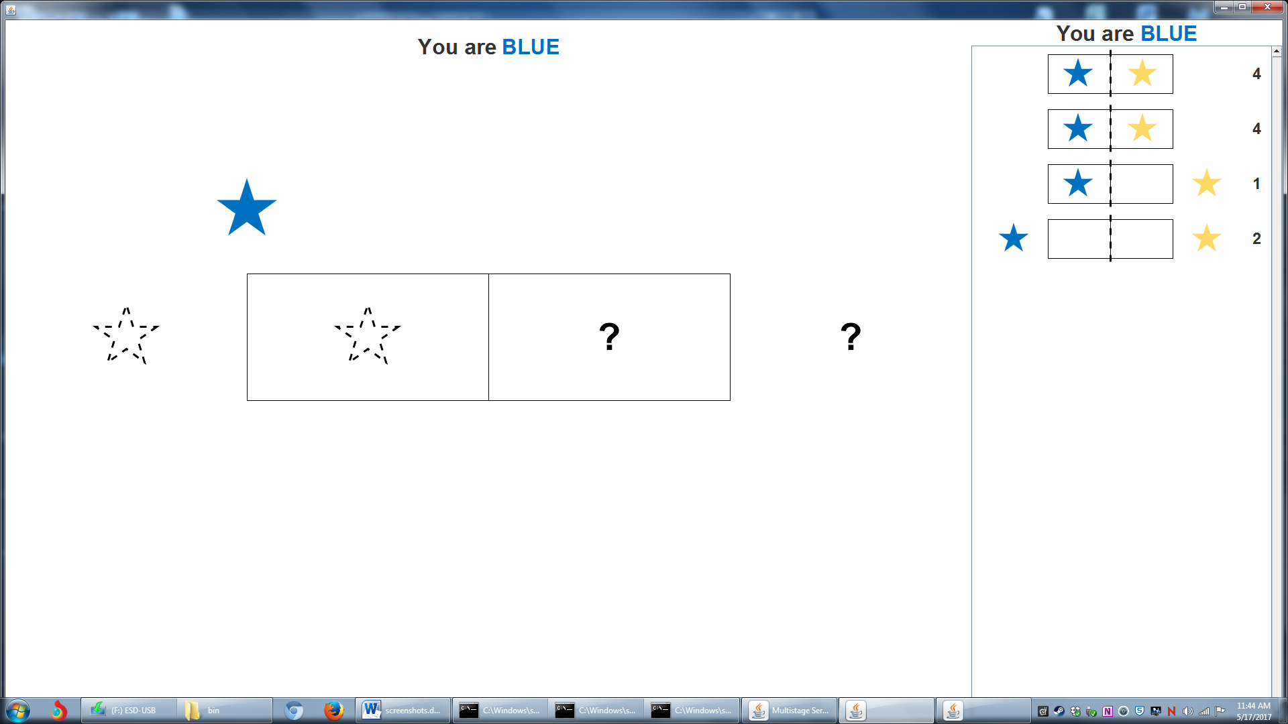
3
3

