Slide 1
Problem:
Angie Bradley is a professional hair stylist at Moxie Salon. Angie spends a lot of her time managing her hair appointments. She still keeps track of her bookings in an organizer (pen and paper) and communicates with her clients solely through texts and phone calls. She receives texts and phone calls from clients every day, and at all hours. She personally sends individual texts to her clients to remind them about their appointments that they routinely forget. Thich is extremely time consuming and annoying. There are currently many appointment apps in the app store, but Angie finds them too complicated and just wants it to be “easy” for her and her clients.

Slide 2
Login Screen
Angie’s App
Name
Phone
Client Side
Email
Password
Remember me
Login as Admin
Verify correct login info
Login
Create new client ID. Have user verify password.
Create Account

Slide 3

Angie’s App
Choose Services
Schedule Appointment
Cancel Appointment
Cancel an appointment if more than 12 hours from appointment time.
Change Appointment
Make a change to appointment if more than 12 hours from appointment time.

Slide 4

Choose Services
Client selects desired services. Some options are able to be combined into one appointment.
Some services will be exclusive (unable to book simultaneously with another service). Others can be combined.
Men’s Haircut
30 min, Price:
Women’s Haircut
45 min, Price:
Face Wax
15 min, Price:
Bang Trim
Shows price and approximate time duration of services
10 min, Price:
Root Retouch: 1 Color
2 hours, Price:
Partial Weave
2 hours, Price:
Full Weave: Long
3 hours, Price:
Full Weave: Short
2 hours, Price:
Balayage Color
3 to 4 hours, Price:
Ombre Color
3 to 4 hours, Price:
Select

Slide 5
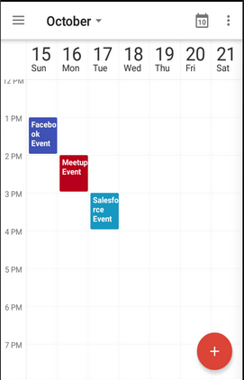
Administrator’s Google Calendar
Date / Time
Admin will select dates/times that are available for booking.
Client selects desired date and time of service. Times with appointments already booked will be unavailable to exclusive services.
Selecting a valid date/time will fill spot on calendar and prompt admin for approval.
Event can also be added to client’s Google Calendar.
Appointment booked!
Awaiting approval…

Slide 6
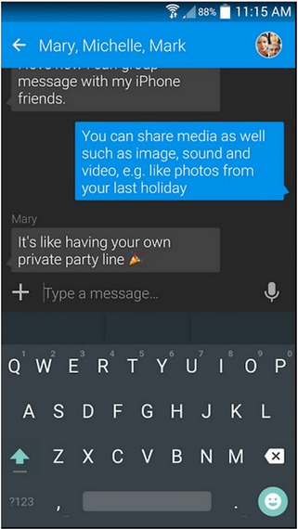
Auto-Text Confirmation
Angie’s App
If not approved. Auto message will be sent notifying that the appointment could not be confirmed with new date/time suggestion.
An auto SMS text will be sent to the client when the appointment is approved by the administrator.
Your appointment on 10/16/18 at 4:00 PM has been booked and confirmed! A reminder text will be sent 24 before the appointment.

Slide 7
Auto-Text Confirmation
Angie’s App
If not approved, the auto-text will provide a link that re-opens the app and prompts the client to accept or deny the new suggested time.
I’m sorry, your appointment on 10/16/18 could not be approved. Another date/time has been suggested: Tap here

Slide 8
If client accepts, the appointment is booked and approval text is automatically sent to client.
Date / Time
Displays admin’s suggested date/time for appointment. The client is prompted to accept or decline the new time.
Generate AutoText
Suggested
If client declines, the client may select another date/time for the desired appointment and must be approved by the administrator.
Suggested time: 10/18/18, 1:00PM
Accept
Decline
Back to date/time

Slide 9
24 Hours Before Appointment
Angie’s App
Client receives courtesy reminder text automatically 24 hours before the appointment.
Client goes to appointment
REMINDER! You have an appointment with Angie tomorrow at 4:00 PM!
Thank you for reminding me!

Slide 10
Admin
To Google Calendar View
My Calendar
To Approval List
Approve Appointments
To list of clients, details
My Clients
To Settings
Settings

Slide 11
Appointment set. Auto text sent to client.
Approvals
Client Name, Service 10/24/18 @ 1:00 pm
Client Name, Service 10/24/18 @ 1:00 pm
Client Name, Service 10/24/18 @ 3:00 pm
Client Name, Service 10/24/18 @ 11:00 am
Client Name, Service 10/24/18 @ 4:00 pm
Client Name, Service 10/24/18 @ 1:00 pm
To Calendar to select suggested alternate date/time.

Slide 12
Admin Settings Options
Set work schedule, set time slot length, Sync with Google Calendar, Set visible calendars
Settings
Update available services, prices, timeframes, overlapping
Calendar
Services
Settings for Auto-Text messages, Time sent (24 hr, 12 hr, 2 hr etc.), Edit message sent
Reminders
Notifications
Set notifications for admin, Approvals needed, Failed SMS
General
Show client info on call screen, Timezone, Language

