Slide 1
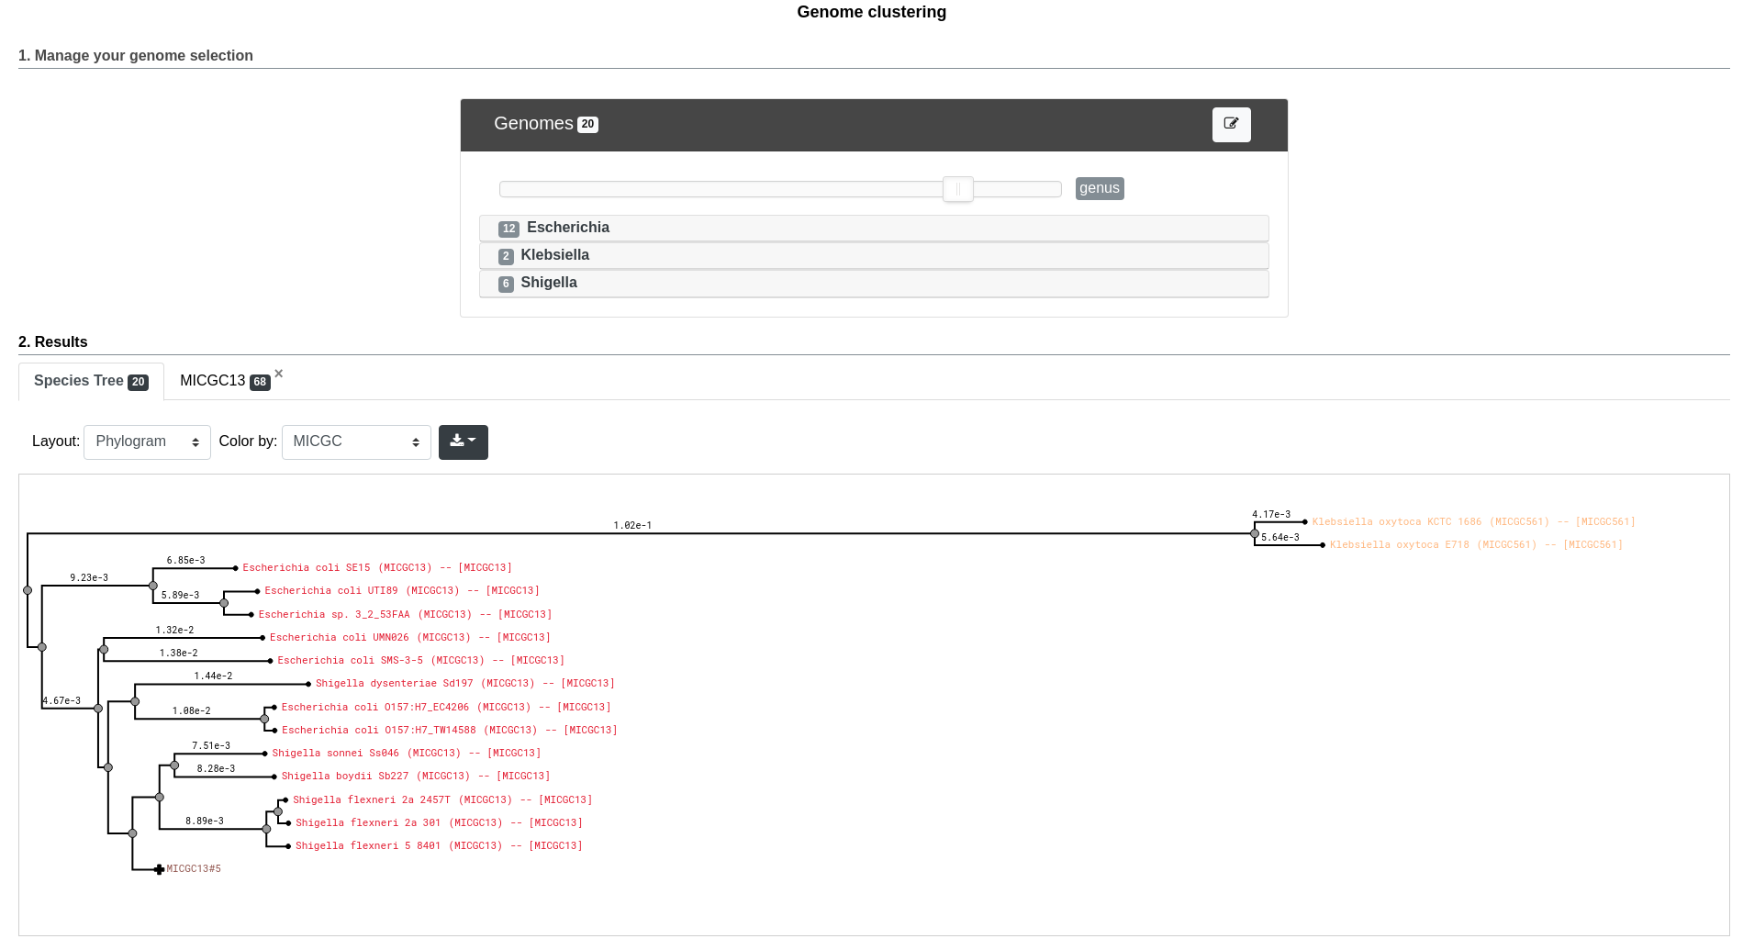
Detailled information about the cluster
Layout options
Export button
Cluster to which the organism belong

