Slide 1

Analysis on the effects of COVID-19 on tweets
ASA DataFest @ UofT 2020
Team Pi-Rates

Slide 2
Introduction
COVID-19 surfaced towards the end of 2019 resulting in a global pandemic.
Currently over 7 million cases with over 400k deaths.
Rise in online activity due to systemic lockdown.
Expect the average sentiment of tweets to decrease as daily cases increased.
Data: COVID-19 related subset of all tweets.

Slide 3
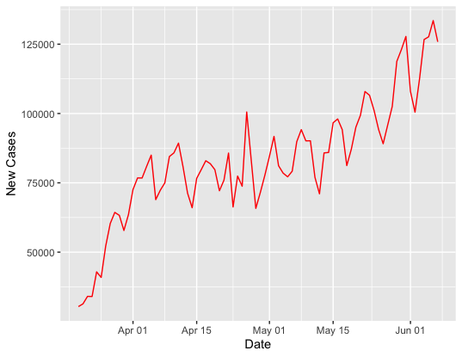
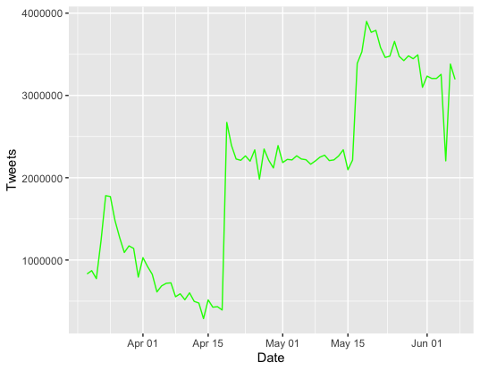
Daily Cases vs. Daily Tweets
Time Period: March 20, 2020 – June 7, 2020
Model used to collect COVID-19 related tweets.
COVID-19 related tweets seemingly held stable as daily cases increased.
April 18: Additional Keywords added to model.
May 16: Server optimization.

Slide 4
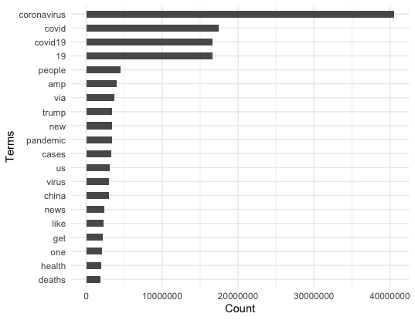
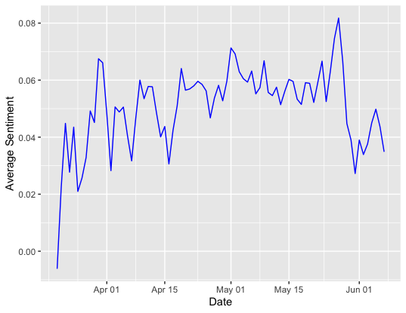
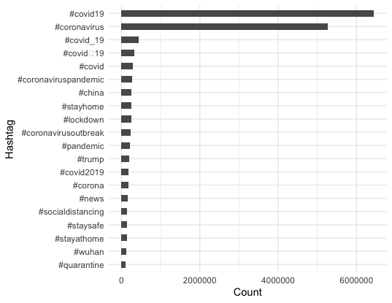
Average Sentiment
Sentiment score between -1 and 1.
Captures the emotion of a “tweeter”.
Average sentiment did NOT decrease with rise in daily cases.
Negative at the very start.
Most frequent term: coronavirus
Most frequent hashtag: #covid19
> 0: Positive
< 0: Negative

Slide 5
References
[1] Rabindra Lamsal. "Coronavirus (COVID-19) Tweets Dataset". IEEE Dataport, 2020. [Online]. Available: http://dx.doi.org/10.21227/781w-ef42. Accessed: Jun. 05, 2020.
[2] Banda, Juan M., Tekumalla, Ramya, Wang, Guanyu, Yu, Jingyuan, Liu, Tuo, Ding, Yuning, … Chowell, Gerardo. (2020). "A large-scale COVID-19 Twitter chatter dataset for open scientific research - an international collaboration (Version 13.0) [Data set]". Zenodo. http://doi.org/10.5281/zenodo.3884334. Accessed Jun. 13, 2020.
[3] “Download today’s data on the geographic distribution of COVID-19 cases worldwide.” European Centre for Disease Prevention and Control, https://www.ecdc.europa.eu/en/publications-data/download-todays-data-geographic-distribution-covid-19-cases-worldwide. Accessed Jun. 13, 2020.
[4] Ritchie, Hannah. “Coronavirus Source Data.” Our World in Data, ourworldindata.org/coronavirus-source-data. Accessed Jun. 14, 2020.
[5] “Coronavirus disease (COVID-19) pandemic.” World Health Organization, https://www.who.int/emergencies/diseases/novel-coronavirus-2019. Accessed Jun. 14, 2020

Slide 6
Thank you and Stay Safe!

