Slide 1
MOBILE PRODUCT DESIGN
Bean Bud
A personal cafe notebook for Dhaka and Bangkok, and the small group of friends who keep one each.
Direction: Bud
Light and dark
Six screens
Notes:
Bean Bud is a personal cafe notebook — not a review site. Twenty cafes, two cities, four friends who each keep their own book.

Slide 2
The brief
IN THE CAFE
LATER, AT HOME
A visit logged in under a minute, one-handed, sitting at the table.
Deciding where to work tomorrow, or where to take someone.
Five star rows, a drink, a price. Everything else optional and folded away.
Comparison is the real work: the same cafe rated differently by you and a friend, or a coffee that got more expensive.
Mobile-first
Light and dark
Stars 1–5
Prices carry their own currency
No embedded map, link out only
Notes:
Two modes of use pull in opposite directions: logging is fast and one-handed in a noisy room; browsing is slow and comparative, later, at home.

Slide 3
Three directions
Same tokens in all three. What changed was structure — which is where the escape from the warm-cafe cliché had to come from.
1a
1b
1c
Ledger
Bud
Counter
Rows, not cards. Sage leads; terracotta is reserved for change alone. Densest, best for scanning twenty.
Score as a filled disc, everything pill-shaped, one cafe per thumb-height block. Chosen.
Dark-first, cream only as the card. Its compare rail and inverted feed carried into the build.
Notes:
All three sat on the same tokens. What differed was structure, not palette — that was the answer to not wanting the default cafe look.

Slide 4
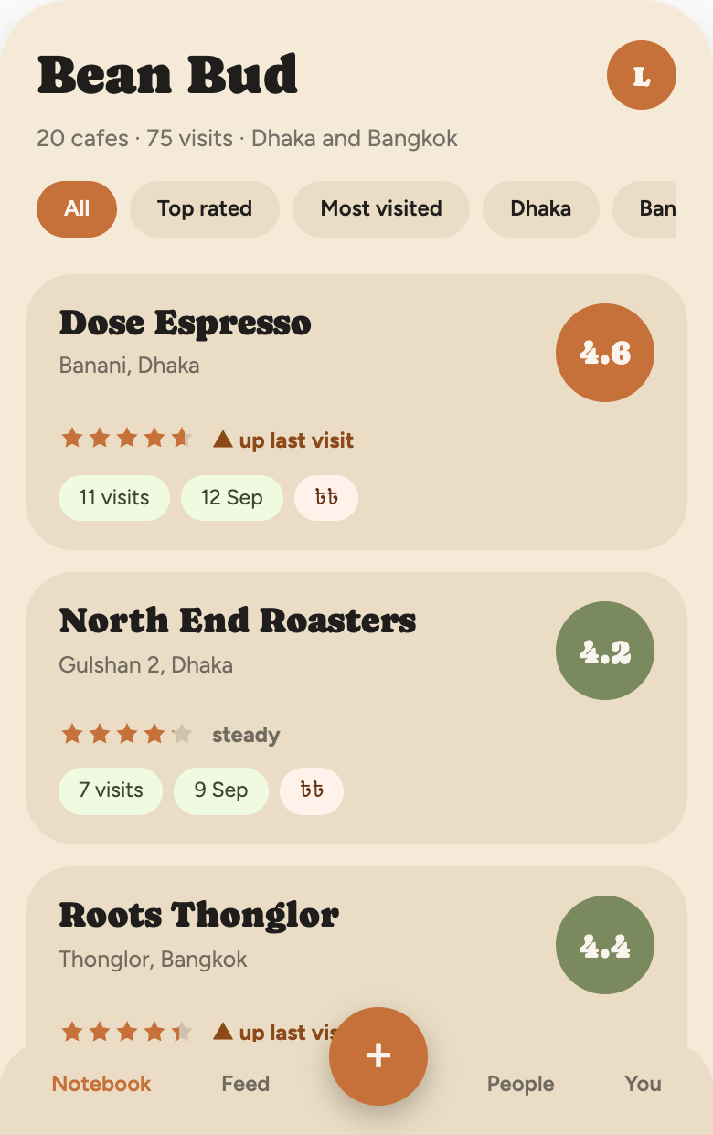
CHOSEN
Bud, with Counter's feed
The cream ground is the system's mandate, so the design leans in rather than apologising. The case for it is the hand, not the mood board.
48px
Minimum tap target, everywhere. The rating stars are 25px glyphs in 44px buttons.
1
Cafe per thumb-height block, so the list reads at arm's length in bad light.
2
Accents only. Terracotta acts; sage measures. Nothing else carries meaning.
Notes:
Bud for the shell, Counter for the feed. The argument for warmth is the hand, not the mood board: biggest targets, readable at arm's length.

Slide 5
Notebook
Everything the brief asks for sits on the closed card, so twenty cafes can be judged without opening one.
Name, area, city
Overall stars and score
Visit count and last date
Price band in its own currency
Up or down since last visit
Disc colour tracks the score
Empty, one entry and twenty all use the same card. The empty state is a single sentence and one button.
Notes:
Name, neighbourhood, city, overall stars, visit count, last visit, price band, and whether the latest visit scored up or down — all on the card, no expansion needed.

Slide 6
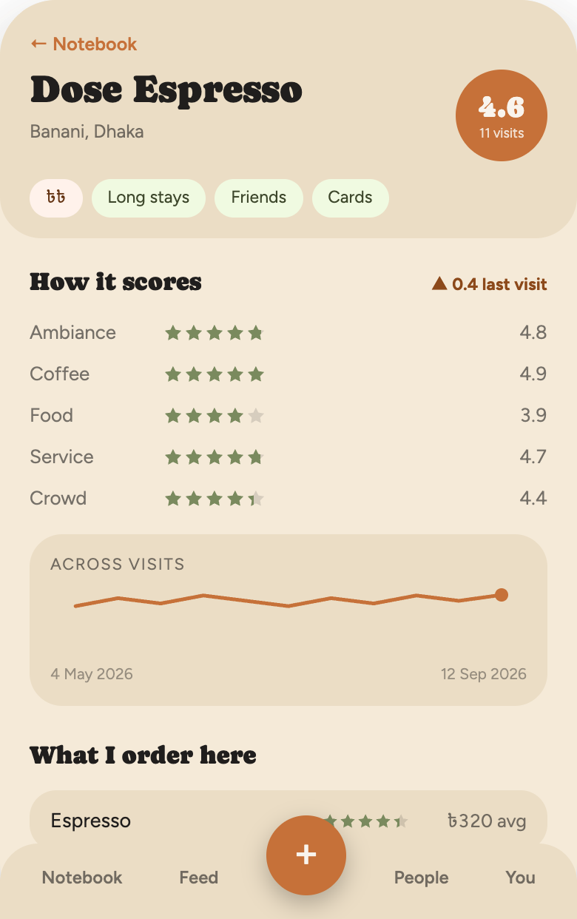
Cafe detail
One screen, five stacked answers.
Five criteria averaged across every visit, in sage.
A trend line over the whole history, with the latest visit dotted.
Every coffee ordered, with average price and its own rating.
Hours, parking, address and a link out — no embedded map.
A dated visit log, each entry opening on its own.
↑৳60 since Jun — price drift flagged in place
Notes:
The expanded view answers the comparison questions: how each criterion averages, whether it is trending, what you order and what it costs now.

Slide 7
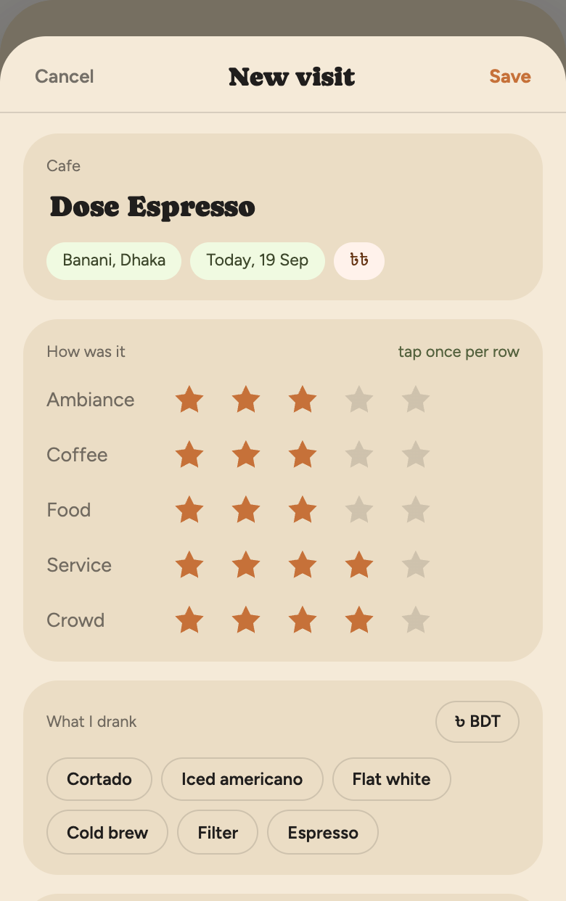
Logging a visit
Under a minute means the required path is short enough to finish before the coffee arrives.
1 Type two letters; autocomplete fills area, city, currency and band.
2 Five rows of stars at 25px — one tap each, tap again to clear.
3 Drink, price and currency; a note if there is anything to say.
Everything else — hours, parking, good-for tags, amenities — sits behind a single optional row.
Notes:
The whole form is name, five taps, a drink and a price. Hours, parking, tags and amenities live behind one optional row.

Slide 8
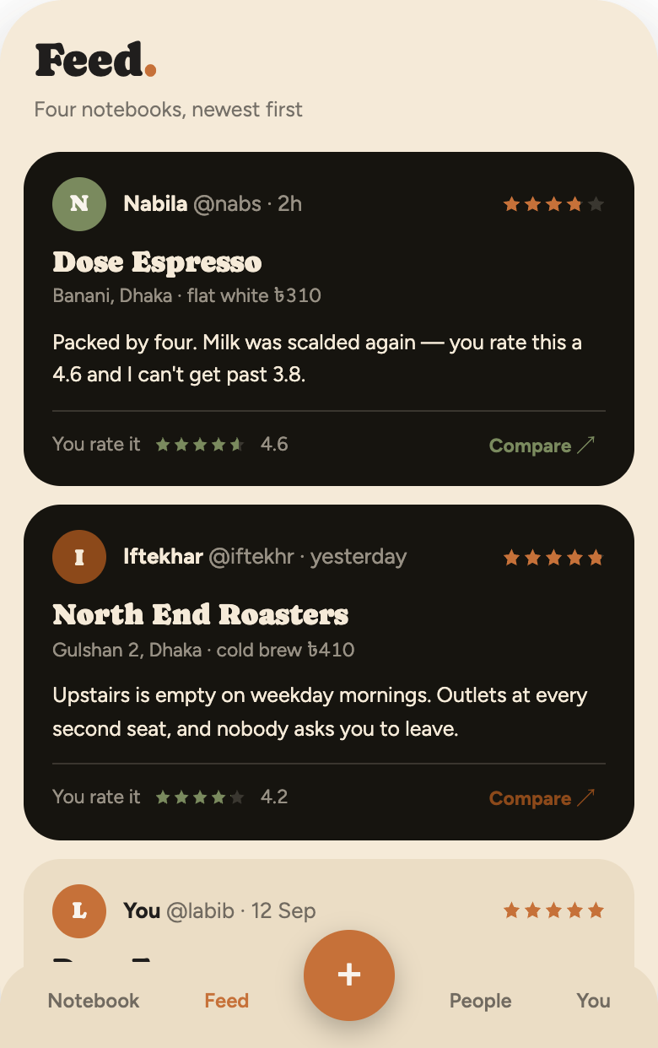
FROM DIRECTION 1C
Feed
Four notebooks in one stream: who, which cafe, stars, what they drank and paid, a line or two of their note.
Nabila rates it
3.8
You rate it
4.6
The disagreement is the content. Every foreign card carries your own score underneath it.
Notes:
The feed inverts: other people's posts sit on the opposite ground from yours, and your own rating of the same cafe is folded into their card.

Slide 9
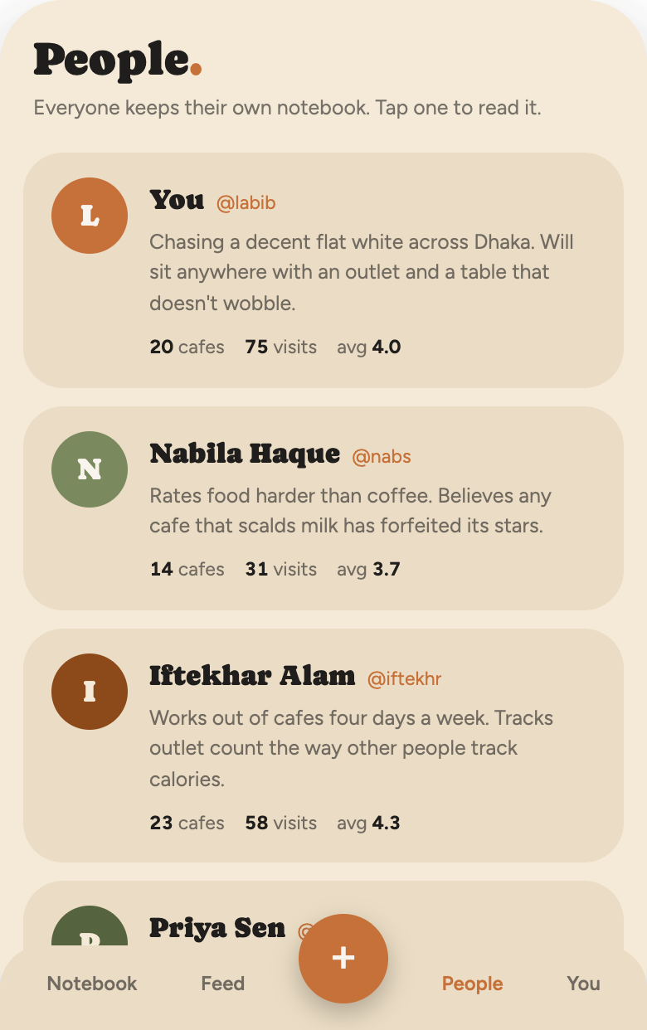
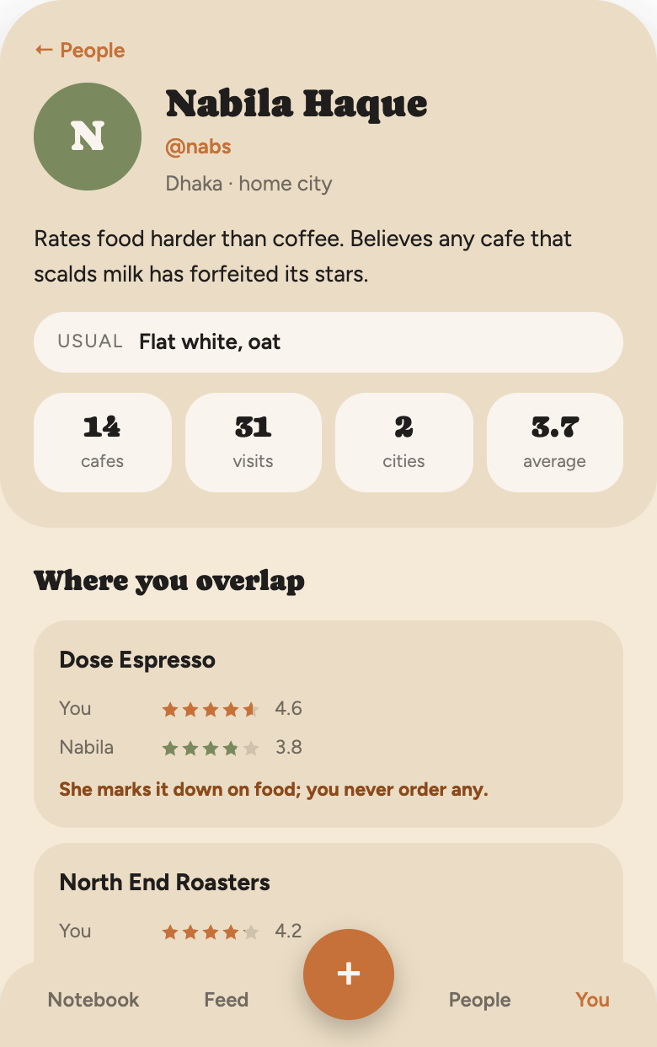
People and profiles
A profile is a notebook with a face on it.
Avatar, name, username, home city
Usual order and a one-line intro
Cafes, visits, cities, average
Where you overlap — your stars against theirs
Notes:
Directory first, then the person: avatar, handle, home city, usual order, one-line intro, counts, where you overlap, and their notebook.

Slide 10
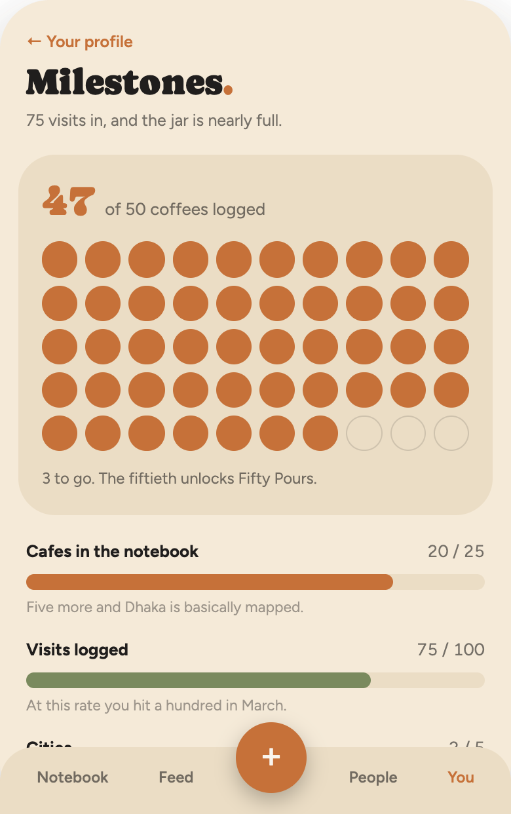
Milestones
Counting what is already being logged, rather than inventing a game on top of it.
47/50
6/9
Coffees, drawn as a jar of beans
Badges earned; locked ones stay dashed
5 wks
↑৳60
Longest run of a visit a week
Cold brew drift nobody else noticed
Notes:
The one piece the brief didn't ask for. A fifty-bean jar, four progress bars, earned and locked badges, and four odd facts drawn from the data.

Slide 11
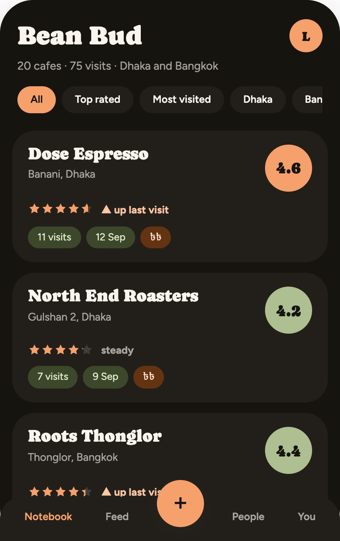
Light and dark
Two tuned themes, not one inverted. Both were designed against the same twenty-cafe notebook.
Accent #c67139 lightens to #f6a06b
Sage #7a8a5e lightens to #aebf92
Ground #f5ead8 becomes #16140f
Feed inversion flips with the theme
Notes:
Dark is not a filter over light. The accent lightens a ramp step, and the feed inversion flips — foreign cards go cream on the dark ground.

Slide 12
The system, in short
TYPE
RADII
STARS
SURFACES
Caprasimo 400 for display, 17–34px. Figtree 400/600/700 for everything else, 10.5–15px. Tabular numerals on every score and price.
38 shell, 26 card, 24 panel, 20 row, 18 inset, 999 for every button, chip, tag and avatar. Nothing square.
One masked element, repeat-x, filled by a hard-stop gradient at value ÷ 5. Fractions render exactly; input is whole stars only.
Cards carry no border and no shadow — only the surface step. Two shadows exist, both on the shell and the floating button.
Spacing 4 · 6 · 9 · 13 · 16 · 20 · 26
Card padding 16 / 18
96px reserved above the tab bar
Noto Sans Bengali and Thai for ৳ and ฿
Notes:
The spec document carries every value. These are the ones a developer asks for first.

Slide 13
Open questions
01
Should the compare rail sit on every notebook card, not only in the feed and profiles?
02
After saving, does the app return to the cafe just logged, or to the notebook?
03
Do milestones deserve a tab of their own, or stay tucked inside your profile?
Notes:
Three decisions worth making before build. The compare rail is the biggest one — it would change every card in the notebook.

