Slide 1
FYDP-I • Textile & RMG Quality Intelligence
Defect-to-Delivery
A Closed-Loop Vision & Machine-Learning System For Fabric Defect Detection And Production Lead-Time Prediction
Group: 262-034
Department Of Computer Science And Engineering
United International University (UIU), Dhaka, Bangladesh
Defect-to-Delivery | FYDP-I • Group: 262-034
1 / 30

Slide 2


Supervisor, Course Teacher & Team
★
Supervisor
Mr. Md. Tarek Hasan
Assistant Professor, Dept. Of CSE, UIU
✎
Course Teacher
Dr. Mohammad Nurul Huda
Professor, Dept. Of CSE, UIU
1
Abdullah Al Fahim Zahin
0112310314
Problem, Motivation & Objectives
2
Nafiz Imtiaz Labib
Literature0112310422
Review & Gap Analysis
3
MST Riya Akter Satu
0112310147
Requirement Analysis & Dataset Audit
4
Mohammed Amin
0112310412
System Design & Diagrams
5
Fahim Ferdous Niloy
0112310307
Standards, Constraints, Budget & Project Plan
6
Md. Mostafizur Rahman Murad
0112310426
Complex Engineering Problem, Task Allocation & Conclusion
Defect-to-Delivery | FYDP-I • Group: 262-034
2 / 30

Slide 3
Agenda
1. Problem & Motivation
2. Objectives & Methodology
3. Literature Review & Gap Analysis
4. Requirement Analysis & Dataset Audit
5. System Design & Diagrams
6. Standards, Constraints, Budget & Plan
7. Conclusion & Future Work
Defect-to-Delivery | FYDP-I • Group: 262-034
3 / 30

Slide 4
Problem Definition
▪ Fabric Inspection In Most Bangladeshi RMG Factories Is Manual — Slow, Inconsistent, And Dependent On Inspector Experience And Fatigue.
▪ Production Planning Runs On Fixed Lead-Time Tables That Never Look At Real-Time Fabric Quality.
▪ Vision (Inspection) And Planning (Scheduling) Live In Two Disconnected Systems — Nobody Turns “How Many Defects” Into “How Many Hours.”
▪ This Gap Threatens Delivery Reliability And Cost Control In Bangladesh’s Largest Export Sector.
No System Links Defect Severity To Production Lead Time — Yet
Defect-to-Delivery | FYDP-I • Group: 262-034
4 / 30

Slide 5
Motivation
▪ A Tired Inspector Logs Defects By Eye At Shift-End, While The Planner Beside Them Quotes Delivery Dates From A Table Printed Last Year — Real Quality Signal Disappears Between The Inspection Board And The Planning Desk.
▪ A Closed Defect → Hours Loop Generalizes Beyond Textiles: Predictive Maintenance, Waste Estimation, Any Line Where Visible Quality Affects Completion Time.
▪ Pilot Work: ~2,550 Factory Images Reviewed Against The Literature; Hashing Found 17 Duplicate Images And 12 Cross-Labeled Files Quarantined After Visual Verification.
▪ A Prior Split Reached 98% Accuracy — Honestly Re-Tested At 93.7–94.0% (See Pilot Result); The 98% Is An Upper Bound, Not A Result.
Defect-to-Delivery | FYDP-I • Group: 262-034
5 / 30

Slide 6
Objectives
1
Build An Audited 6-Class Fabric Image Dataset With Hash Inventory, Quarantine Ledger, And Group-Aware Split Manifest.
2
Train A YOLOv11-Seg Detector For Defect Type + Pixel-True Area, Tracked With mAP.
3
Train A Random Forest Lead-Time Predictor From Speed, Quantity And Defect Density Score (Ds), Tracked With MAE / RMSE / R².
4
Fuse Both Into One Real-Time Closed-Loop Framework With A Planner Dashboard.
5
Prove Every Number On Disjoint Data — The Same Swatch Family Never Appears On Both Sides.
Defect-to-Delivery | FYDP-I • Group: 262-034
6 / 30

Slide 7
Methodology
1
Detect
YOLO-Family Detectors (YOLOv11-Seg Target); OpenCV Thresholding / Contours For Area Measurement.
2
Segment
Instance Masks For Accurate Stain / Pulled-Thread Area Vs Over-Estimating Boxes; Mask IoU Ablation.
3
Catch Unknowns
Few-Shot Anomaly Detection (PatchCore / DINOv2 Family) Trained Only On Good Fabric.
4
Predict
Random Forest Regression On Speed, Quantity, Ds Ablated Against XGBoost And MLP.
5
Smooth
Rolling-Average Ds Over The Last 10 Frames To Filter False Positives.
6
Deploy
Python, Ultralytics YOLO, OpenCV, Scikit-Learn On Jetson-Class Edge With TensorRT.
Defect-to-Delivery | FYDP-I • Group: 262-034
7 / 30

Slide 8
Related Work — Fabric Defect Datasets
Source | Scale / Description | Notes
Isl-Knit (Heliyon 2024, BUTEX) | 3,375 Knit-Fault Images, 7 Classes, Bangladeshi Dyeing Factories | YOLOv5 + 4-Point Raspberry-Pi Prototype
FabricSpotDefect (IUB 2024) | 1,014 Images, 3,288 Spot Annotations | COCO + YOLOv8
ZJU-Leaper | 98,777 Woven-Fabric Images | Large-Scale Supervised Benchmark
Tianchi | 20 Defect Types | Industry Benchmark
MVTec AD / VisA | Anomaly-Detection Standard Sets | Used For Our Few-Shot Branch
Our Pilot Corpus | 2,578 Images, 6 Classes, Per-File Hashes | Audited, Group-Aware Split
Defect-to-Delivery | FYDP-I • Group: 262-034
8 / 30

Slide 9
Related Work — Detection, Anomaly & Planning
Detection
YOLOv1–v11 Fabric Review (2025) Finds YOLOv11 Strongest On Small / Occluded Defects; Fab-ASLKS (+5% mAP50 On Tianchi); Fab-ME (+3.3%, 59.4% Over 20 Classes); FabricMamba For Edge.
Anomaly
PatchCore (99.6% MVTec AUROC), Reverse Distillation (Low Latency), AnomalyDINO / PatchEAD Reach 89–96% With A Handful Of Good Samples And No Defect Labels.
Edge
EfficientDet + Jetson TX2 At 22.7 FPS (2.5× Cloud); YOLOv11 On Orin Nano; YOLOv11 +70% Avg. On NEU-DET Vs Prior Models.
Planning
No Published Vision–Ds Lead-Time Fusion Exists — This Is Our Gap. Closest Work: CIIS 2024 Wastage Prediction (633 Points, ANN/SVR/MLP/RFR/ARIMA); 2025 BD Digital-QC Trials; 2026 Narayanganj Traffic-Light QC Study (94 Lines).
Defect-to-Delivery | FYDP-I • Group: 262-034
9 / 30

Slide 10
Literature Analysis (Selected)
No. | Paper | Method | Dataset | Year
1 | Kumar Fabric Survey | Supervised / Classical | Collected | 2008
2 | Isl-Knit + 4-Point (BUTEX) | Supervised (YOLOv5) | Own (3,375) | 2024
3 | FabricSpotDefect (IUB) | Supervised | Own (1,014) | 2024
4 | YOLOv1–v11 Fabric Review | Supervised | Collected | 2025
5 | PatchCore | Unsupervised | MVTec / VisA | 2022
6 | AnomalyDINO | Few-Shot | MVTec | 2025
7 | PatchEAD | Few / Zero-Shot | 7 Industrial | 2025
8 | Fabric Wastage Prediction (CIIS) | Supervised | Own (633) | 2024
9 | Traffic-Light QC Narayanganj | Applied | 94 Lines | 2026
10 | Redmon (YOLO) / Breiman (RF) | Supervised | VOC-COCO / General | 2016 / 2001
11 | Literature Survey Summary | — | 20 works surveyed | 2026
Defect-to-Delivery | FYDP-I • Group: 262-034
10 / 30

Slide 11
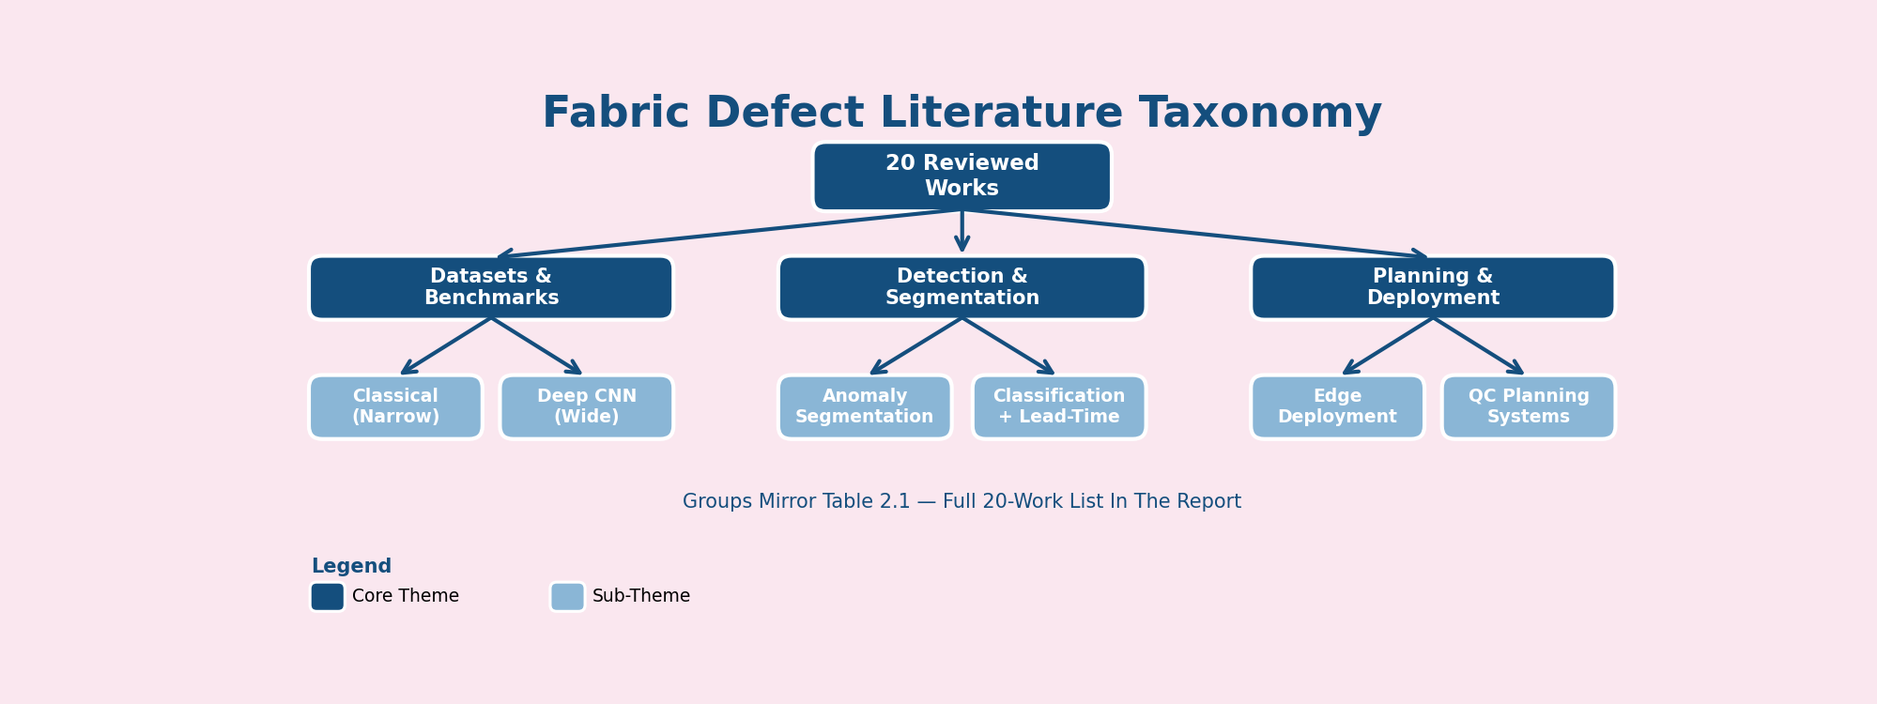
Literature Taxonomy (20 Works)
Defect-to-Delivery | FYDP-I • Group: 262-034
11 / 30

Slide 12
Gap Analysis & Summary
◆
Detectors
Cover Known Defect Types Well, But Stop At Detection — No Link To Production.
◆
Anomaly Models
Handle Unseen Defects, But Are Evaluated On Public Sets, Not Bangladeshi Factory Data.
◆
Edge Tooling
Real-Time Feasibility Is Proven, But Not Paired With A Planning Model.
◆
BD Datasets
Give Local Ground Truth, But No Work Fuses Vision Output With Lead-Time Hours.
The Vision-To-Hours Coupling Remains Unclaimed — That Is Our Contribution.
Defect-to-Delivery | FYDP-I • Group: 262-034
12 / 30

Slide 13
Benchmark Comparison
Capability | Ours | Kotha | Isl-Knit | FabricSpot | v1-base | Note
Roll-disjoint Split | ✓ | — | ✓ | — | — | Audit 2081/468
4-Point Grading | ✓ | — | — | — | — | ASTM D5430
Edge Deployment | ✓ | — | — | — | — | Jetson demo
Honest Repro | ✓ | — | — | — | — | 0.937→0.940
Lead-time Pred. | ✓ | — | ✓ | — | — | Fusion
Dashboard/WPF | — | ✓ | — | — | — | Mockup
Limitation Slide | ✓ | — | — | — | — | Explicit
Defect-to-Delivery | FYDP-I • Group: 262-034
13 / 30

Slide 14
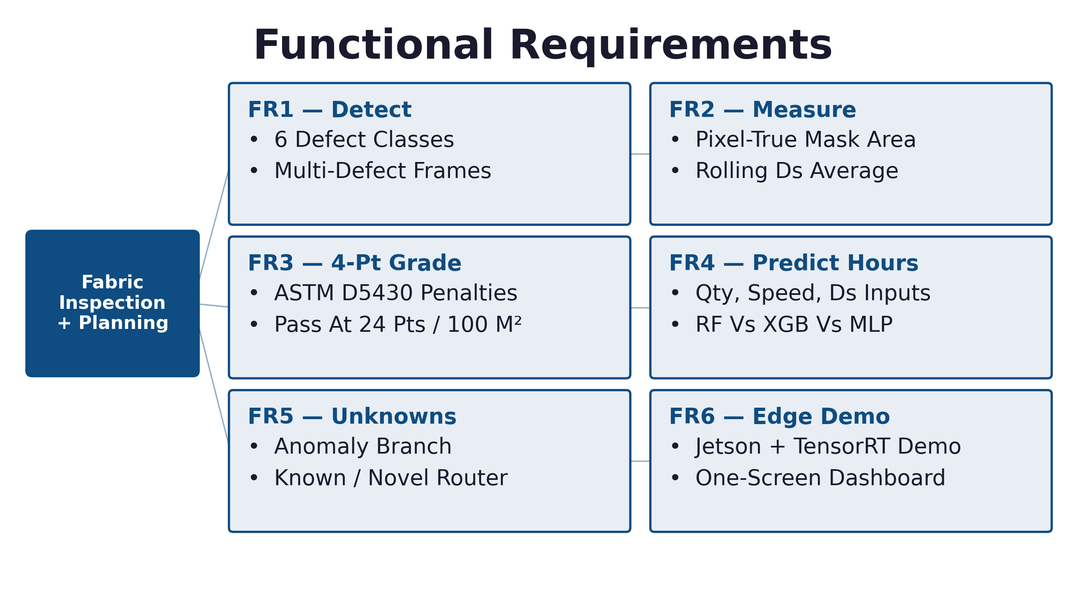
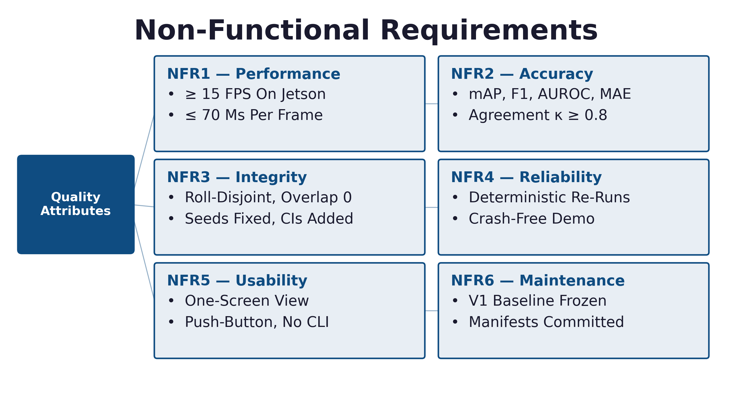
Requirement Analysis
Functional Requirements (FR1–FR6)
Non-Functional Requirements (NFR1–NFR6)
▪ Six Pipeline Function Groups From Image Input To Dashboard Display, Plus Six Quality Attributes With Measurable Targets (≥15 FPS, mAP Tracking, Zero-Overlap Splits).
Defect-to-Delivery | FYDP-I • Group: 262-034
14 / 30

Slide 15
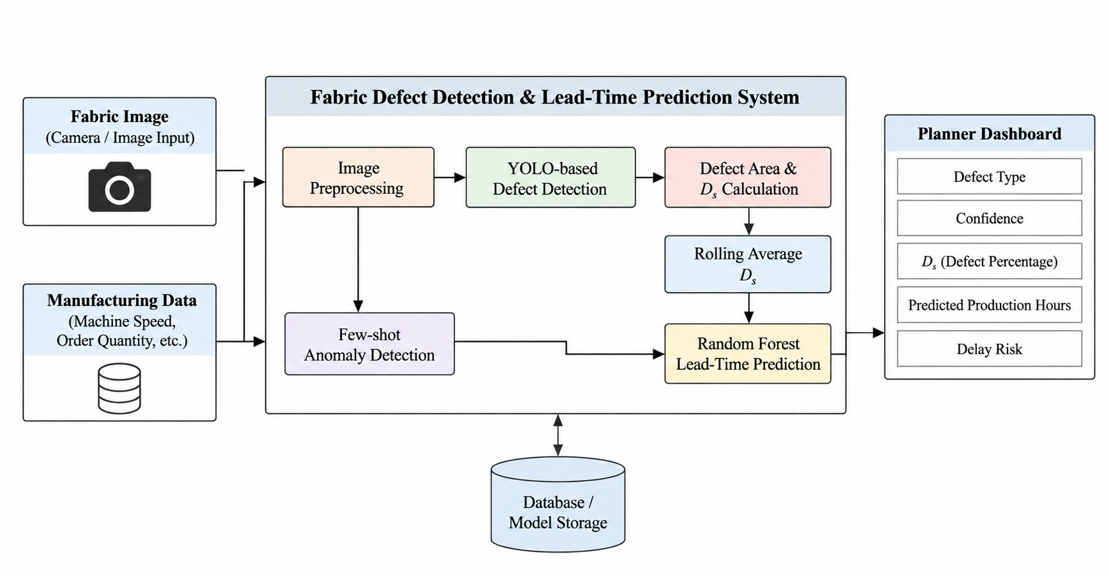
System Design Overview

Slide 16
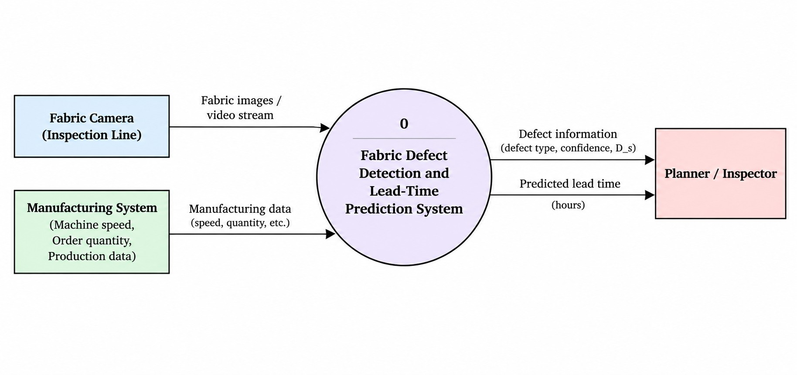
Context Diagram

Slide 17
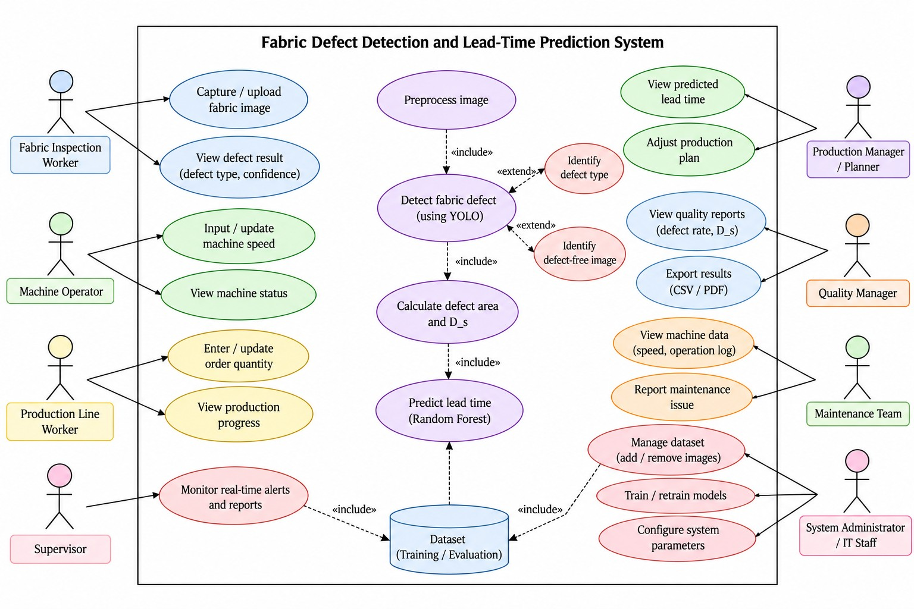
Use Case Diagram

Slide 18
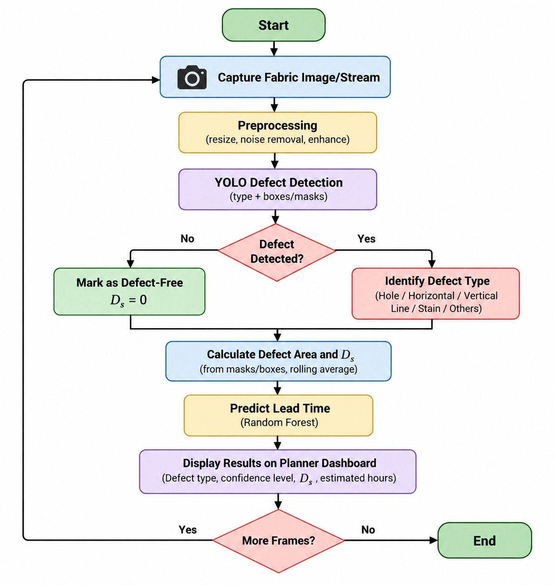
System Workflow

Slide 19
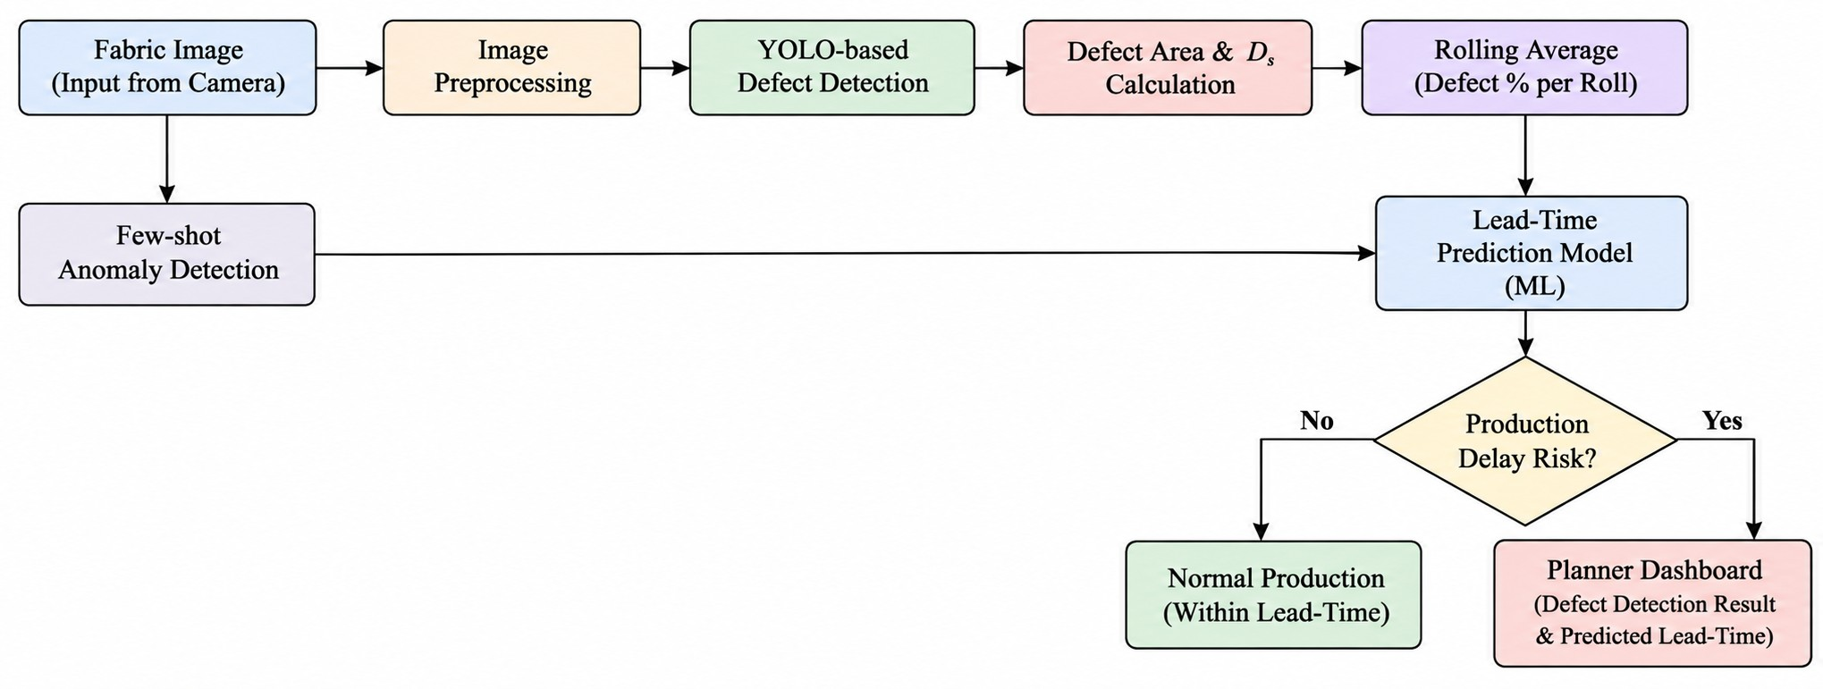
Proposed System Diagram

Slide 20
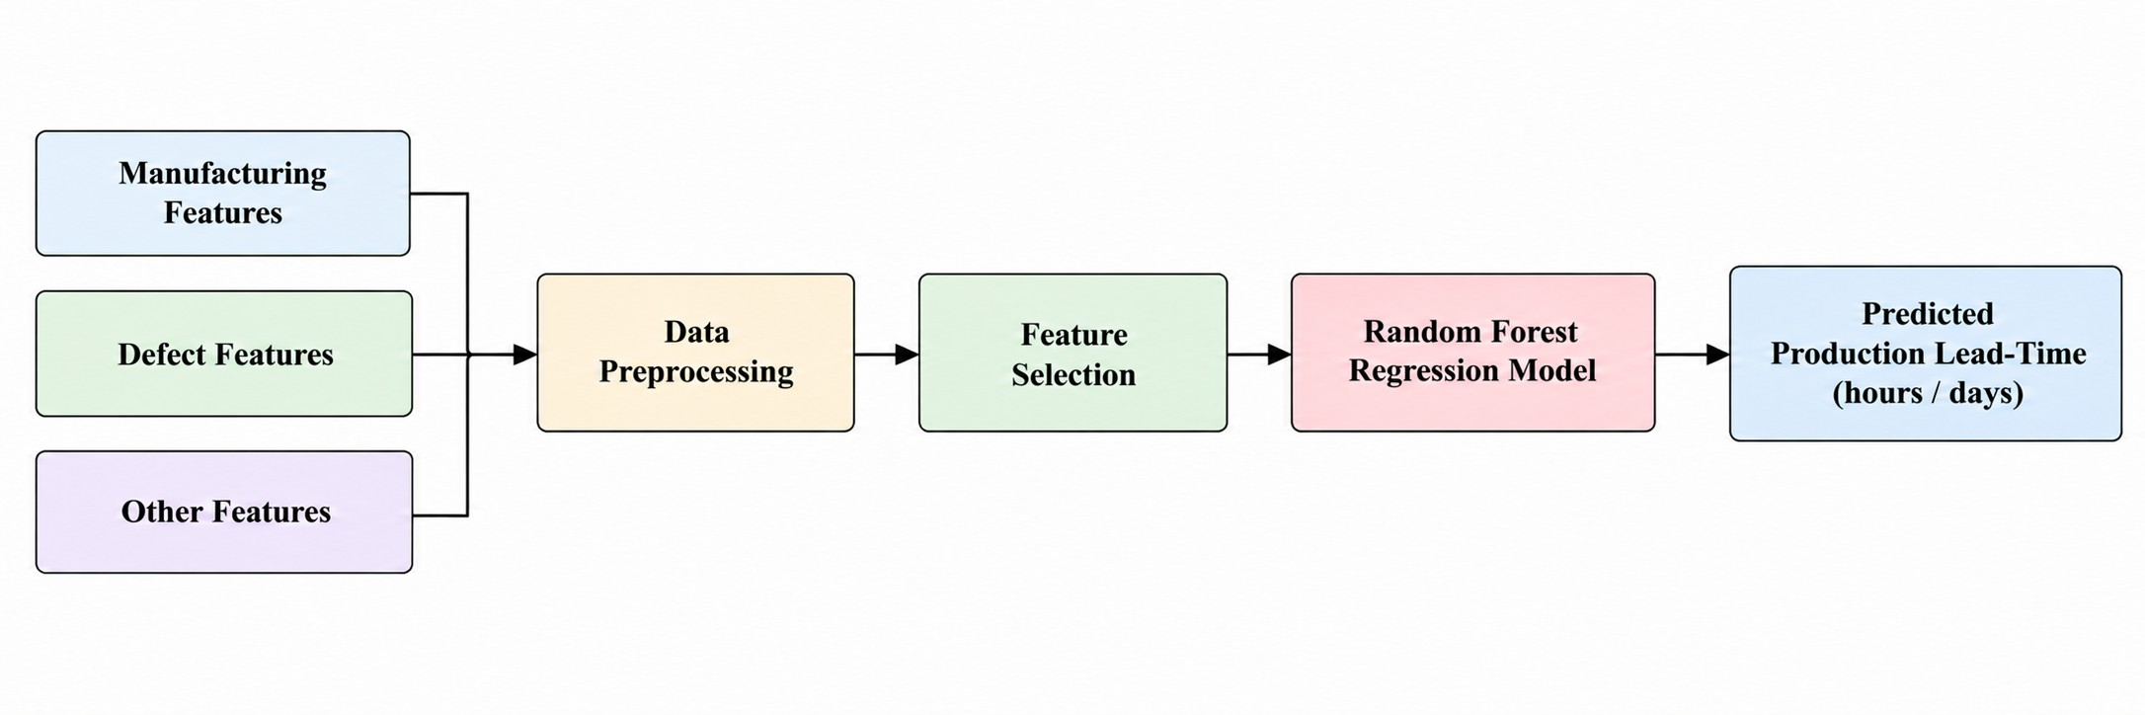
Machine Learning Pipeline

Slide 21
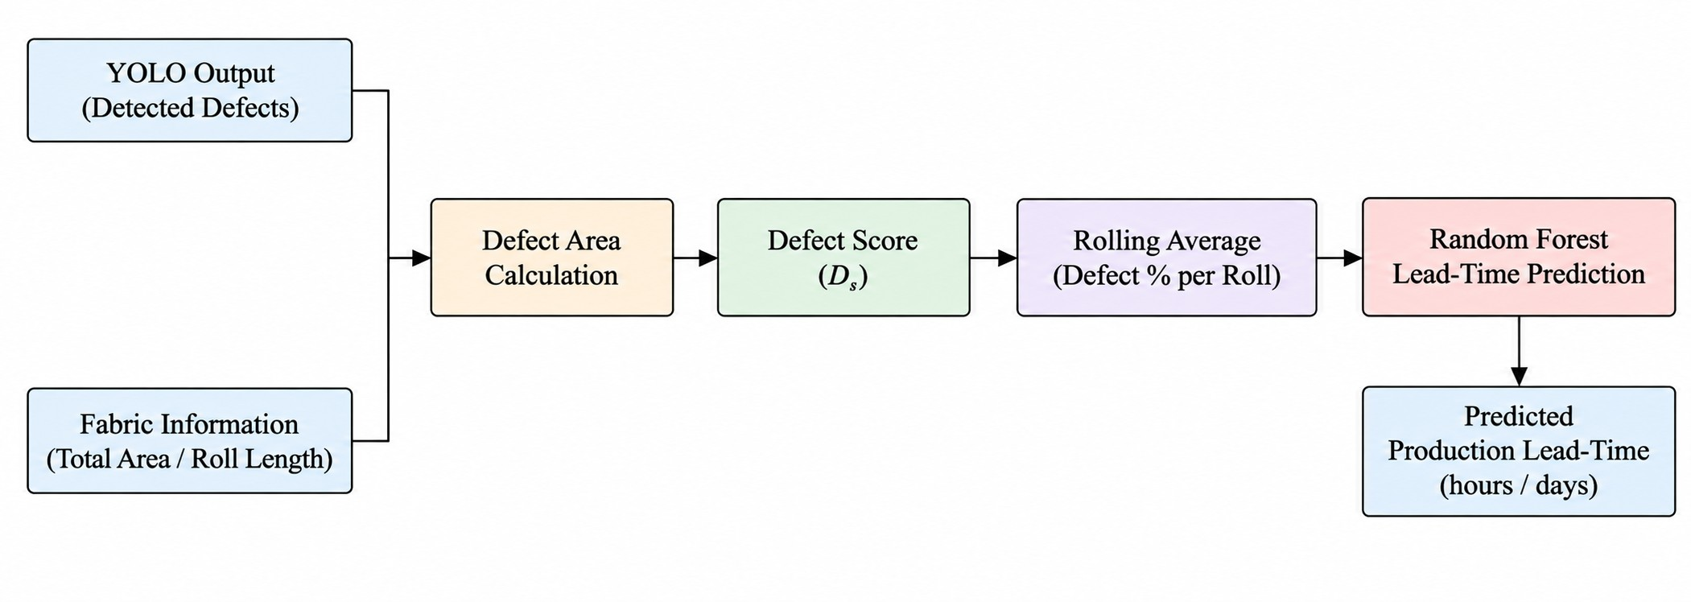
Metadata Bridge

Slide 22
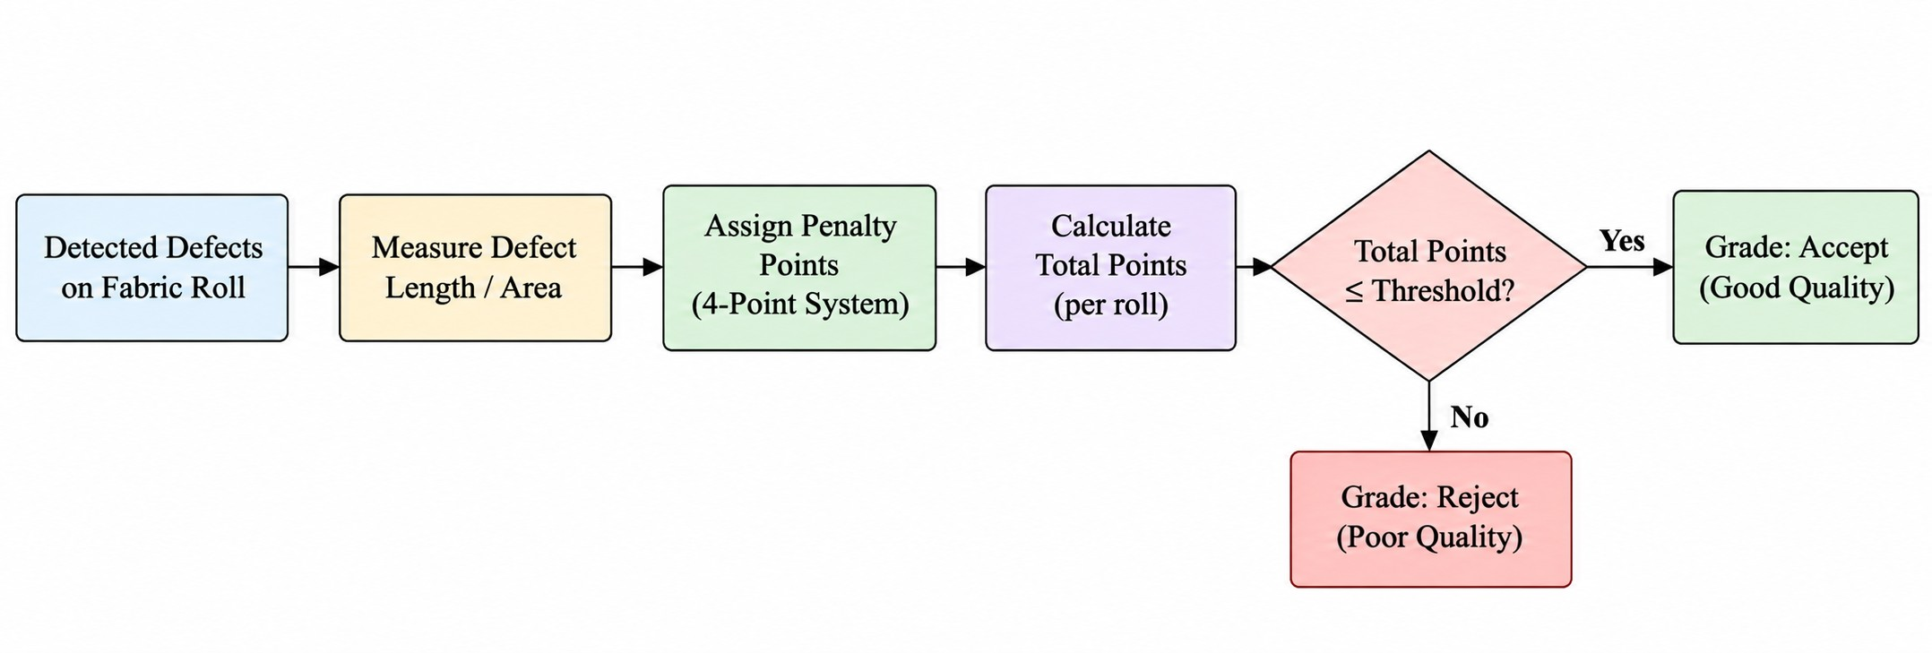
4-Point Grading Module

Slide 23
Dataset: Classes & Audited Composition
Class | Description | Images
Hole | Missing / Damaged Region | 281
Horizontal | Horizontal Defect Pattern | 136
Vertical | Vertical Defect Pattern | 101
Lines | Thin Irregularity Incl. Pulled Threads | 157
Stain | Contamination / Discoloration | 398
Defect-Free | Normal Fabric | 1,505
2,578 Scanned
– 17 Exact Duplicates (Hash)
– 12 Quarantined (Cross-Labeled)
= 2,549 Usable Images
6 Classes, Per-File Cryptographic Hashes, Visual Verification Before Use.
Defect-to-Delivery | FYDP-I • Group: 262-034
15 / 30

Slide 24
Data Audit: Quarantine Ledger & Split
Q
Quarantine Ledger (Table 3.3)
9× Hole/Line_2018-10-11* + 3× Lines/Line_2018-10-10* — Identical Swatches Cross-Labeled Hole Vs Lines, Several Defect-Free.
Verdict: Suspect_Cross_Label / Suspect_Batch — Excluded From Both Train And Test.
Control Pair Verified Clean And Retained (Hole/20180531* Vs Lines/20180531*).
S
Group-Aware Split (Table 3.4)
Seed 42, Test-Fraction 0.2.
Swatch Families And Dated Shoots Never Split Across Sides.
Train: 2,081 Images.
Test: 468 Images.
Overlap Between Train And Test: 0.
Defect-to-Delivery | FYDP-I • Group: 262-034
16 / 30

Slide 25
Pilot Result
▪ naive=0.937 (n=510), honest=0.940 (n=468), accuracy_drop=-0.003.
▪ The 98% prior claim is unreproducible under clean conditions.
▪ Per-class honest F1: defect_free 0.98, stain 0.94, hole 0.88,
▪ horizontal 0.79 (recall 0.68), Vertical 0.70, lines too small to quote.
▪ Conclusion: audit supported; claim void; Track 2 MAY START.
Defect-to-Delivery | FYDP-I • Group: 262-034
17 / 30

Slide 26
System Diagram (Fig. 3.1)
Camera /
Image Stream
Industrial
Preprocessing:
Denoise, Deblur,
Low-Light Norm
YOLO Defect
Detector:
Type + Boxes
And Masks
Metadata
Bridge:
Ds + Rolling
Average
Lead Time
Predictor:
Random Forest
Planner
Dashboard
Closed-Loop Feedback
Camera → Preprocessing → YOLO Detector → Metadata Bridge (Ds) → Random-Forest Lead-Time Predictor → Planner Dashboard.
Defect-to-Delivery | FYDP-I • Group: 262-034
18 / 30

Slide 27
Workflow Flowchart (Fig. 3.2)
Start
▪ Each Frame Is Loaded, Preprocessed, And Passed Through YOLO Detection.
▪ A Defect Triggers Area + Ds Computation; A Clean Frame Sets Ds = 0.
▪ Ds Feeds A Rolling Average Before The Random Forest Predicts Hours.
▪ Result Is Displayed, And The Loop Repeats Until Frames Run Out.
Capture Fabric Image / Stream
Preprocessing
(Resize, Noise Removal, Enhance)
YOLO Defect Detection
(Type + Boxes / Masks)
Defect Detected?
Identify Defect Type
(Hole / Horizontal / Vertical / Lines / Stain)
Mark Defect-Free, Ds = 0
Defect-to-Delivery | FYDP-I • Group: 262-034
19 / 30

Slide 28
Data Flow & Metadata Bridge (Fig. 3.3 / 3.4)
Level-0 DFD
Fabric Camera
0 Detect + Score + Predict
Result + Ds + Hours
Planner / Inspector
Manufacturing Data
Ds Metadata Bridge (Rolling 10-Frame Average)
YOLO Output:
Class, Conf., Box
Per-Defect
Area
Sum Defect
Area
Ds =
Defect / Frame
Rolling Avg.
Last 10 Frames
Predictor
Input
Frame Area
H × W
Defect-to-Delivery | FYDP-I • Group: 262-034
20 / 30

Slide 29
Lead-Time ML Pipeline (Fig. 3.5)
Machine Speed
20–100 m/min
Random Forest
100 Trees
Lead Time
Hours
MAE / RMSE / R²
Vs Static + No-Ds
Order Quantity
100–10,000
Defect Density Ds
0.0–0.5
Lead = (Qty / Speed) × 0.1 × (1 + 2 × Ds)
Example: Ds = 0.2 Inflates Predicted Time By 40%. Features: Speed 20–100 m/min, Quantity 100–10,000, Ds 0–0.5, 100-Tree Random Forest, Evaluated Vs Static-Mean And No-Ds Baselines.
Defect-to-Delivery | FYDP-I • Group: 262-034
21 / 30

Slide 30
Four-Point Inspection Grading (Fig. 3.6)
Calibrate Pixels To Inches (Fixed Geometry)
Measure Fault Length
Length?
Under 3 In
1 Point
3 To 6 In
2 Points
6 To 9 In
3 Points
Over 9 In Or
Hole Over 1 In
4 Points
Roll Grade From Total + Length + Weight
Defect-to-Delivery | FYDP-I • Group: 262-034
22 / 30

Slide 31
Standards & Compliance
1
Software
Reusable Packages, Central Configuration, Version Control With Reviewable Manifests, Seeded Deterministic Training, COCO / YOLO Interchange Formats.
2
Hardware
Fixed-Geometry Calibration For Grading, Jetson-Class Edge Device With TensorRT, Factory-Safe Power Envelope.
3
Communication
REST File Handoff To The MES And Dashboard Over HTTP; No Proprietary Protocols.
Defect-to-Delivery | FYDP-I • Group: 262-034
23 / 30

Slide 32
Design Constraints
Constraint | How We Handle It
Economic | Zero Software Cost; ROI Via Reduced DHU / Chargeback In 2–3 Years At Expected Trial Performance.
Environmental | Small Training Footprint, Low Edge Power Draw, Fewer Faulty Shipments.
Ethical | Cameras Face Fabric, Not Workers; Wrong Labels Are Corrected, Not Ignored; Planning Data Stays Labeled Until Factory Records Take Over.
Health & Safety | Enclosed System Helps Reduce Inspector Eye Strain.
Social | Bangla-Language Labels; Inspectors Trained Toward Supervisor Roles.
Political | No Approvals Required.
Manufacturability & Cost | Computers, Cameras, And Jetson Hardware Are All Moderate-Cost And Readily Available.
Sustainability | Open Formats, Maintainable Scripts, An Expandable Dataset.
Defect-to-Delivery | FYDP-I • Group: 262-034
24 / 30

Slide 33
Estimated Project Budget (Table 4.1)
SL | Purpose | Amount (BDT)
1 | Fabric Swatch Collection & Manual Verification | 1,500
2 | Industrial Inspection Camera (USB 1080p) | 3,500
3 | Fixed-Geometry Mounting Frame / Fixture | 1,000
4 | Calibration Materials (Ruler, Grid Chart) | 600
5 | Dept. GPU Lab + Free Cloud Compute | 0
6 | Additional GPU Compute Beyond Free Quota | 3,000
7 | Cloud Storage For Dataset & Hash Manifests (1 Yr) | 2,400
8 | Existing Laptops / PCs | 0
9 | ML Libraries (YOLO, OpenCV, Scikit-Learn) | 0
10 | Dev Tools & Version Control | 0
11 | Internet Connectivity & Dataset Transfer | 1,500
12 | Jetson Orin Nano / Edge Deployment Kit | 25,000
13 | Documentation, Printing, Binding, Presentation | 2,500
Estimation Total
42,000 BDT
Defect-to-Delivery | FYDP-I • Group: 262-034
25 / 30

Slide 34
Project Plan (Fig. 5.1)
Sprint | Focus | Weeks | Owner
S1 | Data Preparation And Requirements | 1–2 | Riya, Labib
S2 | Setup And Preprocessing | 3–4 | Zahin, Riya
S3 | Defect Detection | 5–6 | Zahin
S4 | Anomaly Detection And Metadata | 7–8 | Amin, Niloy
S5 | Lead-Time Prediction | 9–10 | Zahin
S6 | Dashboard Development | 11–12 | Niloy
S7 | Deployment, Testing And Documentation | 13–14 | Labib, Murad, Riya
S8 | Final Integration And Presentation | 15–16 | All
Audit / Split (Done) → Reproduction → Segmentation → Anomaly → Planning → Edge → Write-Up, Over 32 Weeks.
Defect-to-Delivery | FYDP-I • Group: 262-034
26 / 30

Slide 35
Complex Engineering Problem
P1 Depth of knowledge | P2 Conflicting requirements | P3 Depth of analysis | P4 Familiarity of issues | P5 Applicable codes | P6 Stakeholder involvement | P7 Inter- dependence
✅ | ✅ | ✅ | ❌ | ❌ | ✅ | ✅
P1 - Knowledge
P2 - Trade-off
Computer vision, image processing, deep learning, anomaly detection, machine learning, production planning, YOLO-based defect detection, few-shot anomaly detection and edge deployment.
Balances defect-detection accuracy, real-time processing speed, edge-resource limits and reliable lead-time prediction from available manufacturing data.
P3 - Analysis
P6/P7 - Involvement & Interdependence
Requires analysis of dataset quality, duplicate and quarantined samples, group-aware splitting, detection metrics (mAP) and prediction metrics (MAE, RMSE, R²).
Supports inspectors, planners and developers. Preprocessing affects detection, detection affects Ds, and Ds affects lead-time prediction.
FGAP | FYDP-I
Report: Table 5.2 and Section 5.4.1

Slide 36
Complex Engineering Activities
A1 Range of resources | A2 Level of interaction | A3 Innovation | A4 Consequences for society and environment | A5 Familiarity
✅ | ✅ | ✅ | ✅ | ✅
A1 - Resources
A2 - Interaction
Uses datasets, Python libraries, Ultralytics YOLO, OpenCV, scikit-learn, cloud GPU resources, industrial cameras and Jetson-class edge hardware.
Image input, preprocessing, YOLO detection, metadata bridge, defect scoring, prediction and dashboard output closely interact throughout the system.
A3 - Innovation
A4/A5 - Consequences & Familiarity
Connects fabric defect detection with production lead-time prediction through the Defect Density Score (Ds) and a few-shot anomaly branch.
Improves quality inspection, production planning and resource use. Integrates both established tools and advanced techniques in one system.
FGAP | FYDP-I
Report: Table 5.3 and Section 5.4.2

Slide 37
Risks & Mitigations
⚠
Key Risks
Free T4 GPU quota: already exhausted once; fallback to Kaggle (30h/week) or local M1 overnight run.
Factory data access: if unavailable, fallback to calibrated queuing simulation with documented parameters; paired Ds‑vs‑defect analysis is the contribution.
Quarantine ambiguity: 152‑file lines batch may hide a second quarantine; visual review still open.
✓
Mitigations
Checkpoint sync every 10 min during training so quota loss costs minutes, not hours.
Paired dataset (defect counts + our Ds) is itself a contribution if factory declines.
Visual review of lines batch in progress; interim: report as ‘suspicious’ in datasheet.
Defect-to-Delivery | FYDP-I • Group: 262-034
27 / 30

Slide 38
Task Allocation
Member | Primary Responsibility
Abdullah Al Fahim Zahin | Baseline Reproduction, YOLO Model Training And Evaluation, Lead-Time Prediction
Nafiz Imtiaz Labib | Dataset Collection And Auditing, Dataset Split And Preparation, Edge Deployment And Validation
MST Riya Akter Satu | Requirement Analysis, Image Preprocessing, Documentation And Report Writing
Mohammed Amin | Few-Shot Anomaly Detection Using PatchCore / DINOv2
Fahim Ferdous Niloy | Metadata Bridge, Defect Density Score (Ds) Calculation, Rolling Average, Planner Dashboard Development
Md. Mostafizur Rahman Murad | Testing And Evaluation
Defect-to-Delivery | FYDP-I • Group: 262-034
28 / 30

Slide 39
Conclusion & Future Work
✓
Summary
Reviewed 20 Works, Fixed Requirements, Chose The Detect → Segment → Anomaly → Predict Methodology.
Audited The Dataset: Hashed Every Image, Removed 17 Duplicates, Quarantined 12 Files, Confirmed 2,081 Train / 468 Test With Zero Overlap.
That Audit Supports Every Number That Follows.
→
Future Work
Relabel Quarantine Using A pHash Sweep.
Gather Roll-ID-Disciplined V2 Factory Data.
Build A Bangla Dashboard For Planners.
Benchmark Against Isl-Knit And FabricSpotDefect.
Submit Results To A Conference.
Limitations: Pilot Localization Is Estimated, Not Measured; Planning Labels Are Synthetic; 1,994 Files Lack Group IDs; Minority Classes Are Thin; Industrial Validation Is Pending.
Defect-to-Delivery | FYDP-I • Group: 262-034
29 / 30

Slide 40
Thank You
Any Question?
Defect-to-Delivery — Fabric Defect Detection & Lead-Time Prediction | FYDP-I
Defect-to-Delivery | FYDP-I • Group: 262-034
30 / 30

