Slide 1
FYDP-I • Textile & RMG Quality Intelligence
Defect-to-Delivery
A Closed-Loop Vision & Machine-Learning System For Fabric Defect Detection And Production Lead-Time Prediction
Group: 262-034
Department Of Computer Science And Engineering
United International University (UIU), Dhaka, Bangladesh
RIYA • ZAHIN • LABIB • AMIN • MURAD • NILOY
Defect-to-Delivery | FYDP-I • Group: 262-034
1 / 27

Slide 2
Supervisor, Course Teacher & Team
★
Supervisor
Mr. Md. Tarek Hasan
Assistant Professor, Dept. Of CSE, UIU
✎
Course Teacher
Dr. Mohammad Nurul Huda
Professor, Dept. Of CSE, UIU
1
Abdullah Al Fahim Zahin
0112310314
Problem, Motivation & Objectives
2
Nafiz Imtiaz Labib
0112310422
Literature Review & Gap Analysis
3
MST Riya Akter Satu
0112310147
Requirement Analysis & Dataset Audit
4
Mohammed Amin
0112310412
System Design & Diagrams
5
Fahim Ferdous Niloy
0112310307
Standards, Constraints, Budget & Project Plan
6
Md. Mostafizur Rahman Murad
0112310426
Complex Engineering Problem, Task Allocation & Conclusion
Defect-to-Delivery | FYDP-I • Group: 262-034
2 / 27

Slide 3
Agenda
1. Problem & Motivation
2. Objectives & Methodology
3. Literature Review & Gap Analysis
4. Requirement Analysis
5. Dataset Audit
6. System Design & Diagrams
7. Standards & Constraints
8. Budget & Project Plan
9. Conclusion & Future Work
Defect-to-Delivery | FYDP-I • Group: 262-034
3 / 27

Slide 4
Problem Definition
▪ Fabric Inspection In Most Bangladeshi RMG Factories Is Manual — Slow, Inconsistent, And Dependent On Inspector Experience And Fatigue.
▪ Production Planning Runs On Fixed Lead-Time Tables That Never Look At Real-Time Fabric Quality.
▪ Vision (Inspection) And Planning (Scheduling) Live In Two Disconnected Systems — Nobody Turns “How Many Defects” Into “How Many Hours.”
▪ This Gap Threatens Delivery Reliability And Cost Control In Bangladesh’s Largest Export Sector.
No System Links Defect Severity To Production Lead Time — Yet
Defect-to-Delivery | FYDP-I • Group: 262-034
4 / 27

Slide 5
Motivation
▪ A Tired Inspector Logs Defects By Eye At Shift-End, While The Planner Beside Them Quotes Delivery Dates From A Table Printed Last Year — Real Quality Signal Disappears Between The Inspection Board And The Planning Desk.
▪ A Closed Defect → Hours Loop Generalizes Beyond Textiles: Predictive Maintenance, Waste Estimation, Any Line Where Visible Quality Affects Completion Time.
▪ Pilot Work: ~2,550 Factory Images Reviewed Against The Literature; Hashing Found 17 Duplicate Images And 12 Cross-Labeled Files Quarantined After Visual Verification.
▪ A Prior Split Reached 98% Accuracy — We Treat That As An Upper Bound To Be Re-Tested Honestly, Not A Final Result.
Defect-to-Delivery | FYDP-I • Group: 262-034
5 / 27

Slide 6
Objectives
1
Build An Audited 6-Class Fabric Image Dataset With Hash Inventory, Quarantine Ledger, And Group-Aware Split Manifest.
2
Train A YOLOv11-Seg Detector For Defect Type + Pixel-True Area, Tracked With mAP.
3
Train A Random Forest Lead-Time Predictor From Speed, Quantity And Defect Density Score (Ds), Tracked With MAE / RMSE / R².
4
Fuse Both Into One Real-Time Closed-Loop Framework With A Planner Dashboard.
5
Prove Every Number On Disjoint Data — The Same Swatch Family Never Appears On Both Sides.
Defect-to-Delivery | FYDP-I • Group: 262-034
6 / 27

Slide 7
Methodology
1
Detect
YOLO-Family Detectors (YOLOv11-Seg Target); OpenCV Thresholding / Contours For Area Measurement.
2
Segment
Instance Masks For Accurate Stain / Pulled-Thread Area Vs Over-Estimating Boxes; Mask IoU Ablation.
3
Catch Unknowns
Few-Shot Anomaly Detection (PatchCore / DINOv2 Family) Trained Only On Good Fabric.
4
Predict
Random Forest Regression On Speed, Quantity, Ds Ablated Against XGBoost And MLP.
5
Smooth
Rolling-Average Ds Over The Last 10 Frames To Filter False Positives.
6
Deploy
Python, Ultralytics YOLO, OpenCV, Scikit-Learn On Jetson-Class Edge With TensorRT.
Defect-to-Delivery | FYDP-I • Group: 262-034
7 / 27

Slide 8
Related Work — Fabric Defect Datasets
Source | Scale / Description | Notes
Isl-Knit (Heliyon 2024, BUTEX) | 3,375 Knit-Fault Images, 7 Classes, Bangladeshi Dyeing Factories | YOLOv5 + 4-Point Raspberry-Pi Prototype
FabricSpotDefect (IUB 2024) | 1,014 Images, 3,288 Spot Annotations | COCO + YOLOv8
ZJU-Leaper | 98,777 Woven-Fabric Images | Large-Scale Supervised Benchmark
Tianchi | 20 Defect Types | Industry Benchmark
MVTec AD / VisA | Anomaly-Detection Standard Sets | Used For Our Few-Shot Branch
Our Pilot Corpus | 2,578 Images, 6 Classes, Per-File Hashes | Audited, Group-Aware Split
Defect-to-Delivery | FYDP-I • Group: 262-034
8 / 27

Slide 9
Related Work — Detection, Anomaly & Planning
Detection
YOLOv1–v11 Fabric Review (2025) Finds YOLOv11 Strongest On Small / Occluded Defects; Fab-ASLKS (+5% mAP50 On Tianchi); Fab-ME (+3.3%, 59.4% Over 20 Classes); FabricMamba For Edge.
Anomaly
PatchCore (99.6% MVTec AUROC), Reverse Distillation (Low Latency), AnomalyDINO / PatchEAD Reach 89–96% With A Handful Of Good Samples And No Defect Labels.
Edge
EfficientDet + Jetson TX2 At 22.7 FPS (2.5× Cloud); YOLOv11 On Orin Nano; YOLOv11 +70% Avg. On NEU-DET Vs Prior Models.
Planning
No Published Vision–Ds Lead-Time Fusion Exists — This Is Our Gap. Closest Work: CIIS 2024 Wastage Prediction (633 Points, ANN/SVR/MLP/RFR/ARIMA); 2025 BD Digital-QC Trials; 2026 Narayanganj Traffic-Light QC Study (94 Lines).
Defect-to-Delivery | FYDP-I • Group: 262-034
9 / 27

Slide 10
Literature Analysis (Selected)
No. | Paper | Method | Dataset | Year
1 | Kumar Fabric Survey | Supervised / Classical | Collected | 2008
2 | Isl-Knit + 4-Point (BUTEX) | Supervised (YOLOv5) | Own (3,375) | 2024
3 | FabricSpotDefect (IUB) | Supervised | Own (1,014) | 2024
4 | YOLOv1–v11 Fabric Review | Supervised | Collected | 2025
8 | PatchCore | Unsupervised | MVTec / VisA | 2022
11 | AnomalyDINO | Few-Shot | MVTec | 2025
12 | PatchEAD | Few / Zero-Shot | 7 Industrial | 2025
15 | Fabric Wastage Prediction (CIIS) | Supervised | Own (633) | 2024
17 | Traffic-Light QC Narayanganj | Applied | 94 Lines | 2026
19 / 20 | Redmon (YOLO) / Breiman (RF) | Supervised | VOC-COCO / General | 2016 / 2001
Defect-to-Delivery | FYDP-I • Group: 262-034
10 / 27

Slide 11
Gap Analysis & Summary
◆
Detectors
Cover Known Defect Types Well, But Stop At Detection — No Link To Production.
◆
Anomaly Models
Handle Unseen Defects, But Are Evaluated On Public Sets, Not Bangladeshi Factory Data.
◆
Edge Tooling
Real-Time Feasibility Is Proven, But Not Paired With A Planning Model.
◆
BD Datasets
Give Local Ground Truth, But No Work Fuses Vision Output With Lead-Time Hours.
The Vision-To-Hours Coupling Remains Unclaimed — That Is Our Contribution.
Defect-to-Delivery | FYDP-I • Group: 262-034
11 / 27

Slide 12
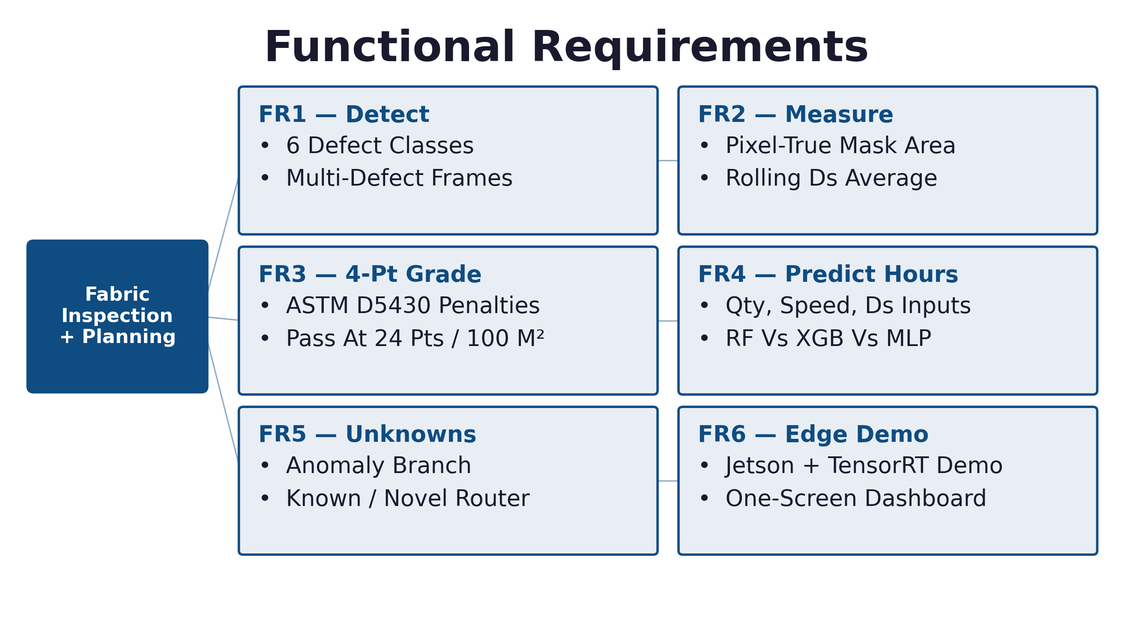
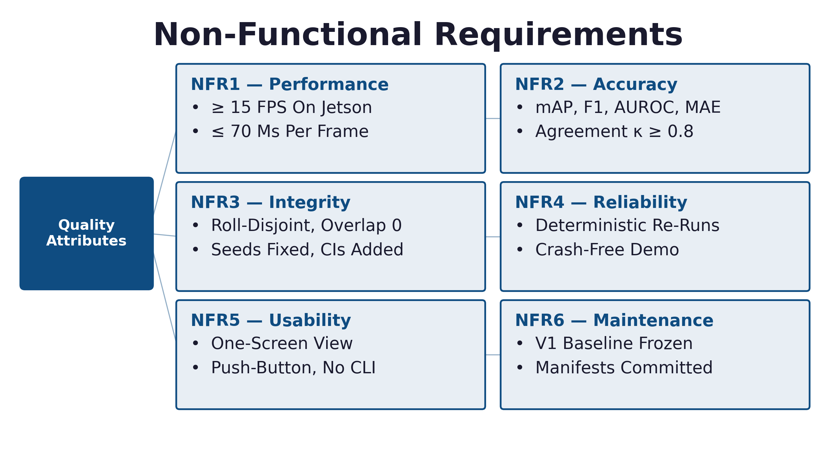
Requirement Analysis
Functional Requirements (FR1–FR6)
Non-Functional Requirements (NFR1–NFR6)
▪ Six Pipeline Function Groups From Image Input To Dashboard Display, Plus Six Quality Attributes With Measurable Targets (≥15 FPS, mAP Tracking, Zero-Overlap Splits).
Defect-to-Delivery | FYDP-I • Group: 262-034
12 / 27

Slide 13
Dataset: Classes & Audited Composition
Class | Description | Images
Hole | Missing / Damaged Region | 281
Horizontal | Horizontal Defect Pattern | 136
Vertical | Vertical Defect Pattern | 101
Lines | Thin Irregularity Incl. Pulled Threads | 157
Stain | Contamination / Discoloration | 398
Defect-Free | Normal Fabric | 1,505
2,578 Scanned
– 17 Exact Duplicates (Hash)
– 12 Quarantined (Cross-Labeled)
= 2,549 Usable Images
6 Classes, Per-File Cryptographic Hashes, Visual Verification Before Use.
Defect-to-Delivery | FYDP-I • Group: 262-034
13 / 27

Slide 14
Data Audit: Quarantine Ledger & Split
Q
Quarantine Ledger (Table 3.3)
9× Hole/Line_2018-10-11* + 3× Lines/Line_2018-10-10* — Identical Swatches Cross-Labeled Hole Vs Lines, Several Defect-Free.
Verdict: Suspect_Cross_Label / Suspect_Batch — Excluded From Both Train And Test.
Control Pair Verified Clean And Retained (Hole/20180531* Vs Lines/20180531*).
S
Group-Aware Split (Table 3.4)
Seed 42, Test-Fraction 0.2.
Swatch Families And Dated Shoots Never Split Across Sides.
Train: 2,081 Images.
Test: 468 Images.
Overlap Between Train And Test: 0.
Defect-to-Delivery | FYDP-I • Group: 262-034
14 / 27

Slide 15
System Diagram (Fig. 3.1)
Camera /
Image Stream
Industrial
Preprocessing:
Denoise, Deblur,
Low-Light Norm
YOLO Defect
Detector:
Type + Boxes
And Masks
Metadata
Bridge:
Ds + Rolling
Average
Lead Time
Predictor:
Random Forest
Planner
Dashboard
Closed-Loop Feedback
Camera → Preprocessing → YOLO Detector → Metadata Bridge (Ds) → Random-Forest Lead-Time Predictor → Planner Dashboard.
Defect-to-Delivery | FYDP-I • Group: 262-034
15 / 27

Slide 16
Workflow Flowchart (Fig. 3.2)
Start
▪ Each Frame Is Loaded, Preprocessed, And Passed Through YOLO Detection.
▪ A Defect Triggers Area + Ds Computation; A Clean Frame Sets Ds = 0.
▪ Ds Feeds A Rolling Average Before The Random Forest Predicts Hours.
▪ Result Is Displayed, And The Loop Repeats Until Frames Run Out.
Capture Fabric Image / Stream
Preprocessing
(Resize, Noise Removal, Enhance)
YOLO Defect Detection
(Type + Boxes / Masks)
Defect Detected?
Identify Defect Type
(Hole / Horizontal / Vertical / Lines / Stain)
Mark Defect-Free, Ds = 0
Defect-to-Delivery | FYDP-I • Group: 262-034
16 / 27

Slide 17
Data Flow & Metadata Bridge (Fig. 3.3 / 3.4)
Level-0 DFD
Fabric Camera
0 Detect + Score + Predict
Result + Ds + Hours
Planner / Inspector
Manufacturing Data
Ds Metadata Bridge (Rolling 10-Frame Average)
YOLO Output:
Class, Conf., Box
Per-Defect
Area
Sum Defect
Area
Ds =
Defect / Frame
Rolling Avg.
Last 10 Frames
Predictor
Input
Frame Area
H × W
Defect-to-Delivery | FYDP-I • Group: 262-034
17 / 27

Slide 18
Lead-Time ML Pipeline (Fig. 3.5)
Machine Speed
20–100 m/min
Random Forest
100 Trees
Lead Time
Hours
MAE / RMSE / R²
Vs Static + No-Ds
Order Quantity
100–10,000
Defect Density Ds
0.0–0.5
Lead = (Qty / Speed) × 0.1 × (1 + 2 × Ds)
Example: Ds = 0.2 Inflates Predicted Time By 40%. Features: Speed 20–100 m/min, Quantity 100–10,000, Ds 0–0.5, 100-Tree Random Forest, Evaluated Vs Static-Mean And No-Ds Baselines.
Defect-to-Delivery | FYDP-I • Group: 262-034
18 / 27

Slide 19
Four-Point Inspection Grading (Fig. 3.6)
Calibrate Pixels To Inches (Fixed Geometry)
Measure Fault Length
Length?
Under 3 In
1 Point
3 To 6 In
2 Points
6 To 9 In
3 Points
Over 9 In Or
Hole Over 1 In
4 Points
Roll Grade From Total + Length + Weight
Defect-to-Delivery | FYDP-I • Group: 262-034
19 / 27

Slide 20
Standards & Compliance
1
Software
Reusable Packages, Central Configuration, Version Control With Reviewable Manifests, Seeded Deterministic Training, COCO / YOLO Interchange Formats.
2
Hardware
Fixed-Geometry Calibration For Grading, Jetson-Class Edge Device With TensorRT, Factory-Safe Power Envelope.
3
Communication
REST File Handoff To The MES And Dashboard Over HTTP; No Proprietary Protocols.
Defect-to-Delivery | FYDP-I • Group: 262-034
20 / 27

Slide 21
Design Constraints
Constraint | How We Handle It
Economic | Zero Software Cost; ROI Via Reduced DHU / Chargeback In 2–3 Years At Expected Trial Performance.
Environmental | Small Training Footprint, Low Edge Power Draw, Fewer Faulty Shipments.
Ethical | Cameras Face Fabric, Not Workers; Wrong Labels Are Corrected, Not Ignored; Planning Data Stays Labeled Until Factory Records Take Over.
Health & Safety | Enclosed System Helps Reduce Inspector Eye Strain.
Social | Bangla-Language Labels; Inspectors Trained Toward Supervisor Roles.
Political | No Approvals Required.
Manufacturability & Cost | Computers, Cameras, And Jetson Hardware Are All Moderate-Cost And Readily Available.
Sustainability | Open Formats, Maintainable Scripts, An Expandable Dataset.
Defect-to-Delivery | FYDP-I • Group: 262-034
21 / 27

Slide 22
Estimated Project Budget (Table 4.1)
SL | Purpose | Amount (BDT)
1 | Fabric Swatch Collection & Manual Verification | 1,500
2 | Industrial Inspection Camera (USB 1080p) | 3,500
3 | Fixed-Geometry Mounting Frame / Fixture | 1,000
4 | Calibration Materials (Ruler, Grid Chart) | 600
5 | Dept. GPU Lab + Free Cloud Compute | 0
6 | Additional GPU Compute Beyond Free Quota | 3,000
7 | Cloud Storage For Dataset & Hash Manifests (1 Yr) | 2,400
8 | Existing Laptops / PCs | 0
9 | ML Libraries (YOLO, OpenCV, Scikit-Learn) | 0
10 | Dev Tools & Version Control | 0
11 | Internet Connectivity & Dataset Transfer | 1,500
12 | Documentation, Printing, Binding, Presentation | 2,500
Estimation Total
16,000 BDT
Defect-to-Delivery | FYDP-I • Group: 262-034
22 / 27

Slide 23
Project Plan (Fig. 5.1)
Sprint | Focus | Weeks | Owner
S1 | Data Preparation And Requirements | 1–2 | Riya, Labib
S2 | Setup And Preprocessing | 3–4 | Zahin, Riya
S3 | Defect Detection | 5–6 | Zahin
S4 | Anomaly Detection And Metadata | 7–8 | Amin, Niloy
S5 | Lead-Time Prediction | 9–10 | Zahin
S6 | Dashboard Development | 11–12 | Niloy
S7 | Deployment, Testing And Documentation | 13–14 | Labib, Murad, Riya
S8 | Final Integration And Presentation | 15–16 | All
Audit / Split (Done) → Reproduction → Segmentation → Anomaly → Planning → Edge → Write-Up, Over 32 Weeks.
Defect-to-Delivery | FYDP-I • Group: 262-034
23 / 27

Slide 24
Complex Engineering Problem Mapping (Table 4.2)
Dimension | Our Problem
Depth Of Knowledge | Vision, Detection / Segmentation, Anomaly Detection, Ensemble ML, Manufacturing Systems
Conflicting Requirements | Accuracy Vs. FPS Vs. Edge Power
Data Complexity | ~2 GB Heterogeneous Images + Planning Features + Noisy Labels
Practical Impact | QC Accuracy And Delivery Reliability For Export Orders
Scalability | Few-Shot Branch For New Fabrics; Per-Line Replication
Defect-to-Delivery | FYDP-I • Group: 262-034
24 / 27

Slide 25
Task Allocation
Member | Primary Responsibility
Abdullah Al Fahim Zahin | Baseline Reproduction, YOLO Model Training And Evaluation, Lead-Time Prediction
Nafiz Imtiaz Labib | Dataset Collection And Auditing, Dataset Split And Preparation, Edge Deployment And Validation
MST Riya Akter Satu | Requirement Analysis, Image Preprocessing, Documentation And Report Writing
Mohammed Amin | Few-Shot Anomaly Detection Using PatchCore / DINOv2
Fahim Ferdous Niloy | Metadata Bridge, Defect Density Score (Ds) Calculation, Rolling Average, Planner Dashboard Development
Md. Mostafizur Rahman Murad | Testing And Evaluation
Defect-to-Delivery | FYDP-I • Group: 262-034
25 / 27

Slide 26
Conclusion & Future Work
✓
Summary
Reviewed 20 Works, Fixed Requirements, Chose The Detect → Segment → Anomaly → Predict Methodology.
Audited The Dataset: Hashed Every Image, Removed 17 Duplicates, Quarantined 12 Files, Confirmed 2,081 Train / 468 Test With Zero Overlap.
That Audit Supports Every Number That Follows.
→
Future Work
Relabel Quarantine Using A pHash Sweep.
Gather Roll-ID-Disciplined V2 Factory Data.
Build A Bangla Dashboard For Planners.
Benchmark Against Isl-Knit And FabricSpotDefect.
Submit Results To A Conference.
Limitations: Pilot Localization Is Estimated, Not Measured; Planning Labels Are Synthetic; 1,994 Files Lack Group IDs; Minority Classes Are Thin; Industrial Validation Is Pending.
Defect-to-Delivery | FYDP-I • Group: 262-034
26 / 27

Slide 27
Thank You
Questions & Discussion
Defect-to-Delivery — Fabric Defect Detection & Lead-Time Prediction | FYDP-I
Defect-to-Delivery | FYDP-I • Group: 262-034
27 / 27

